Slide 1
Status of SPES Cyclotron at Laboratori Nazionali of Legnaro -INFN
Mario Maggiore On behalf of LNL Cyclotron team

Slide 2
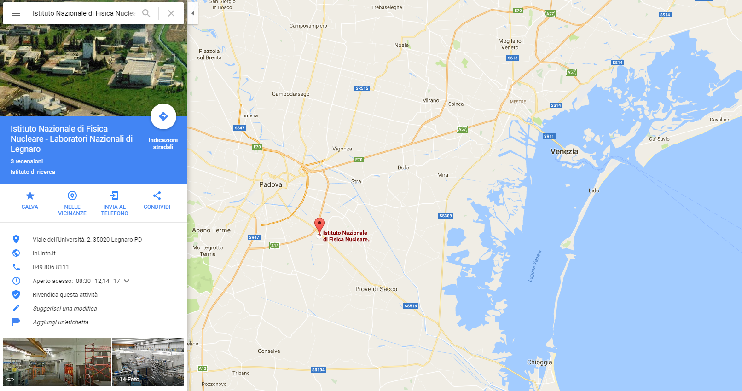
Laboratori Nazionali di Legnaro -INFN

Slide 3
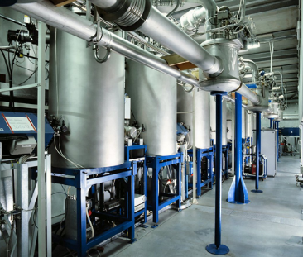
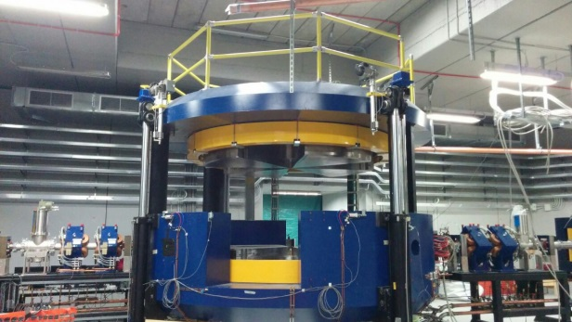
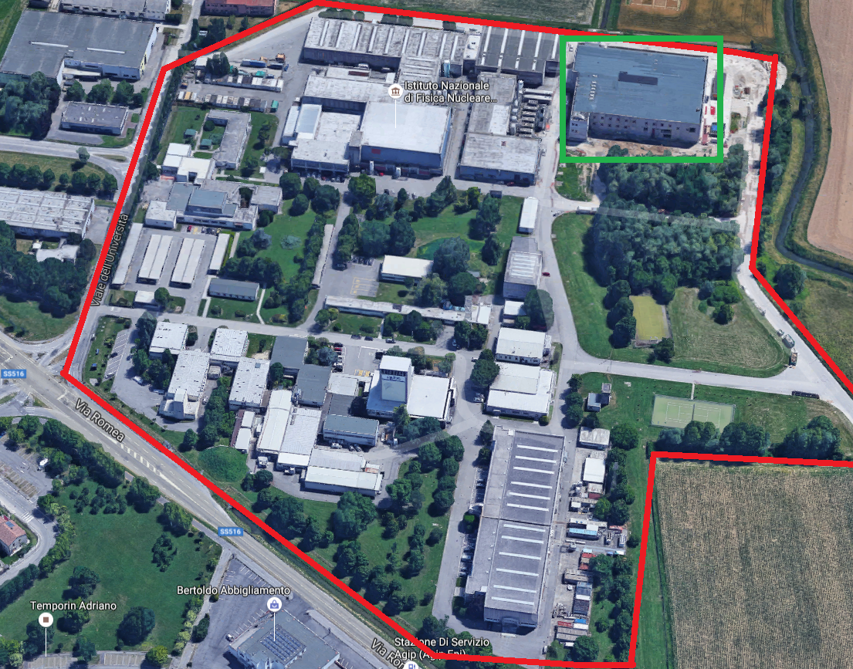
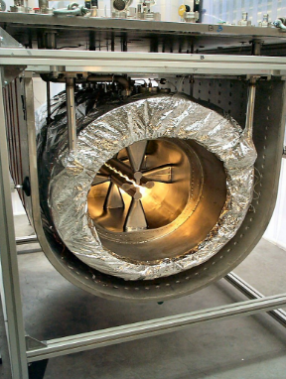
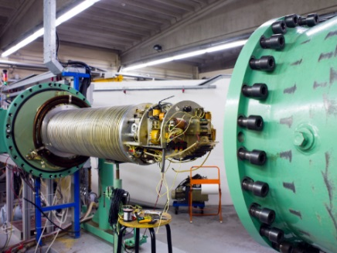
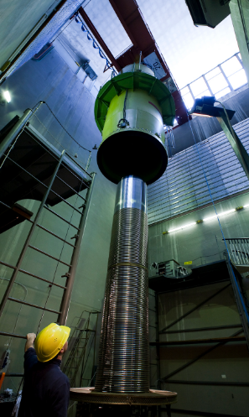
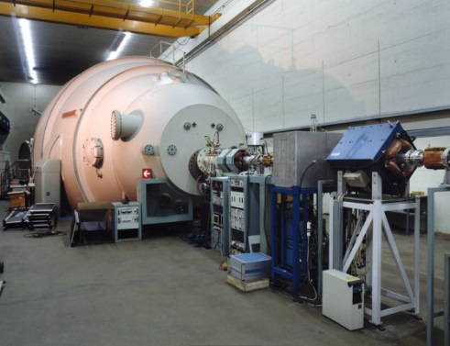
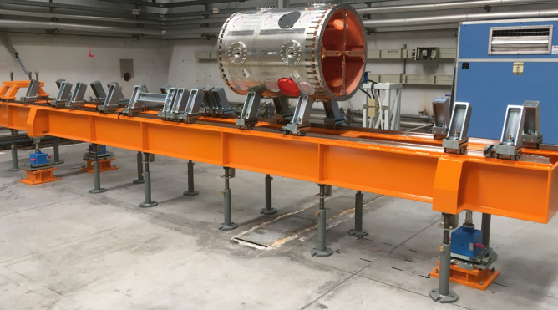
Accelerators at Legnaro Labs
CYCLOTRON
ALPI – SC LINAC
AN- 2 MV
PIAVE –SC RFQ
SPES –RFQ
(under installation)
TANDEM – 15 MV
CN- 7 MV

Slide 4
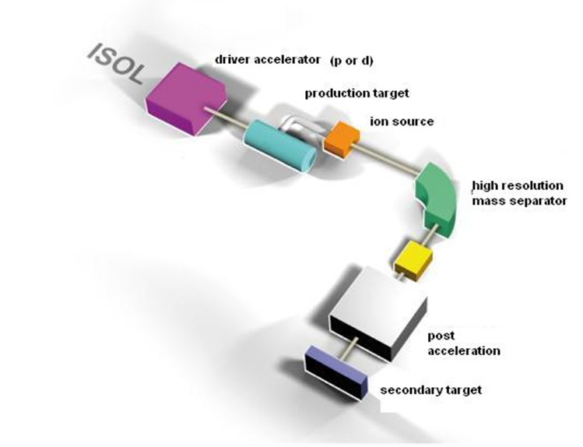
SPES: Selective Production of Exotic Species
Flagship of INFN on Nuclear Physics and Astrophysics Research
~ 58 Meuro budget fully funded (Alpha and Beta phases)
It consists of 4 phases:
Alpha: Cyclotron (proton beam driver) and High Intensity Beam Delivering
Beta: RIBs production and Physics at Low and High Energy (Re-acceleration)
Gamma: R&D on Radioisotope for Medical Application (LARAMED project)
Delta: Neutron sources generation and Applications
Construction phase started in 2010 with Cyclotron and in 2012 with the dedicated building
Completion of SPES Project (Alpha and Beta-low energy) is expected in 2025

Slide 5
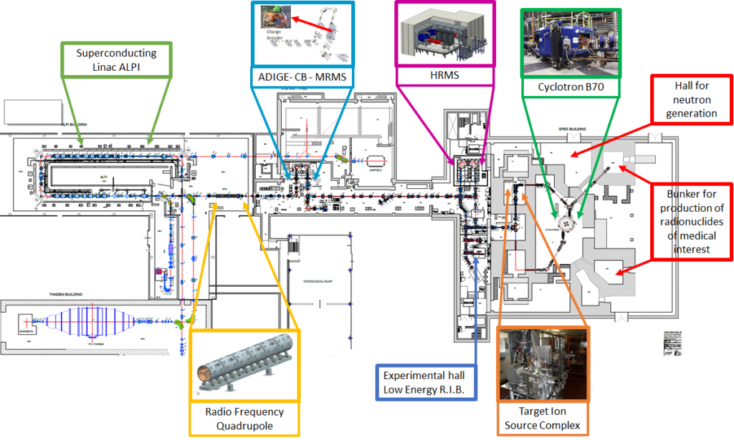
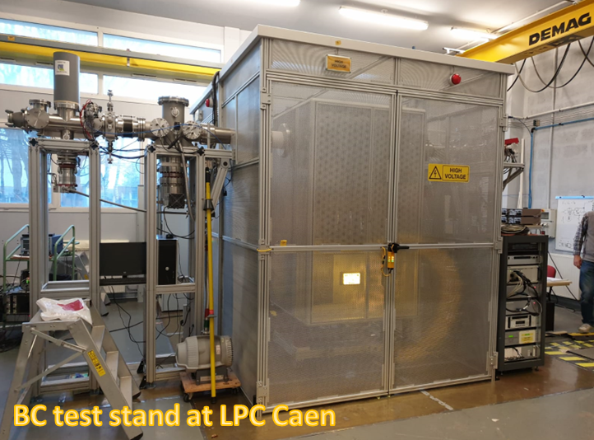
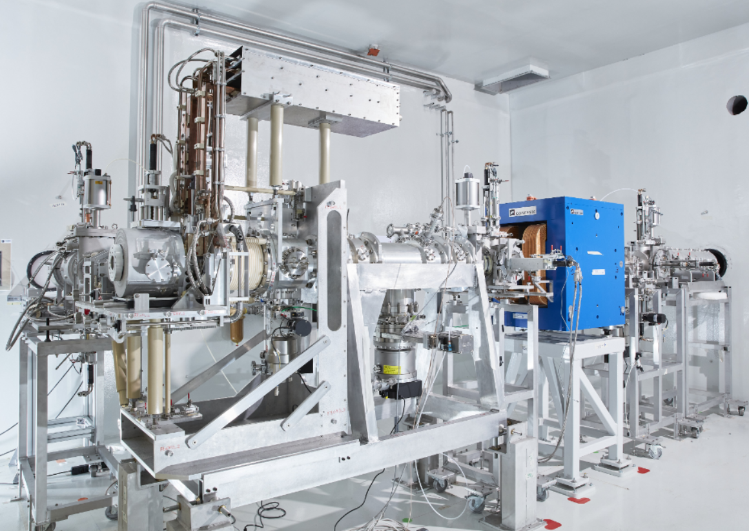
SPES project status (accelerator systems)
Cyclotron and beamline to ISOL target is commissioned and actually the plants are being upgraded
ISOL target installed and ancillary plants are being installed
1+ transport line, first section (ISOL-BC-LE area) under installation
Beam Cooler under beam testing at LPC (Caen, France)
HRMS: tender for magnets supply has been awarded, construction and installation within 3 years.
ADIGE (Charge breeder and MRMS) is under completion. Ion source for stable beams is commissioned.
RFQ (new injector of ALPI) under installation
BEAM COOLER

Slide 6
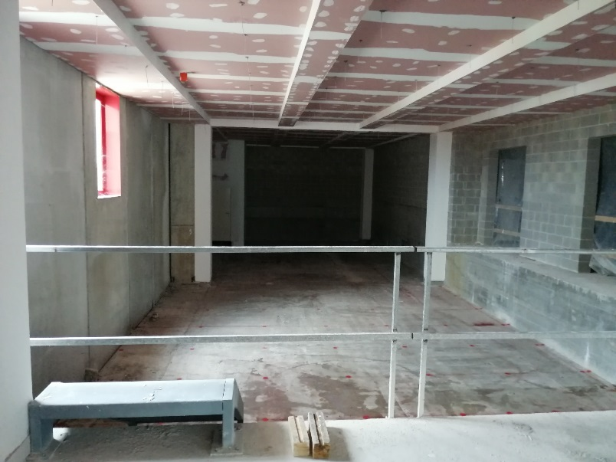
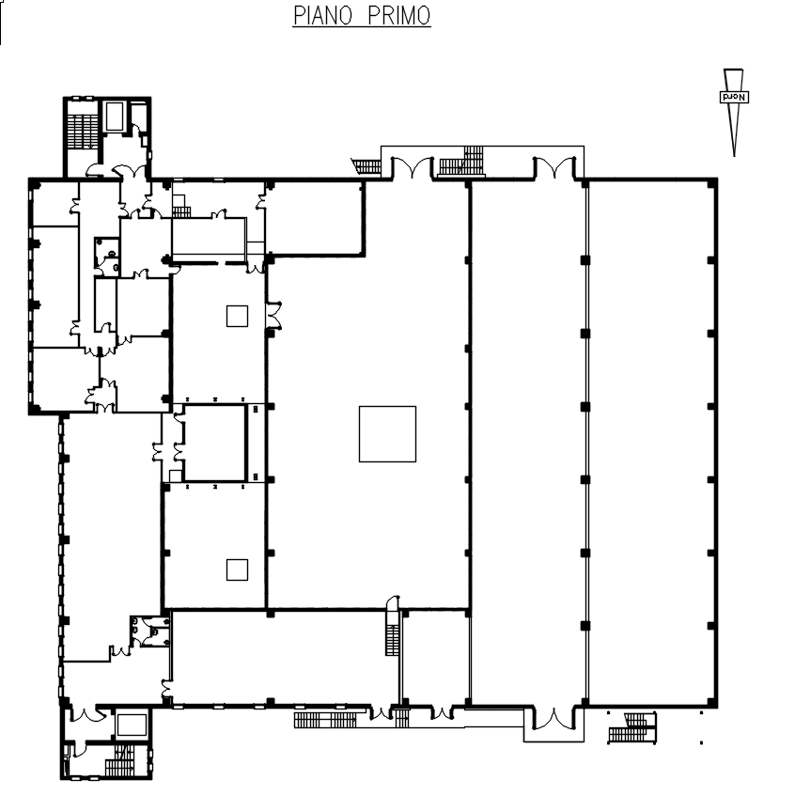
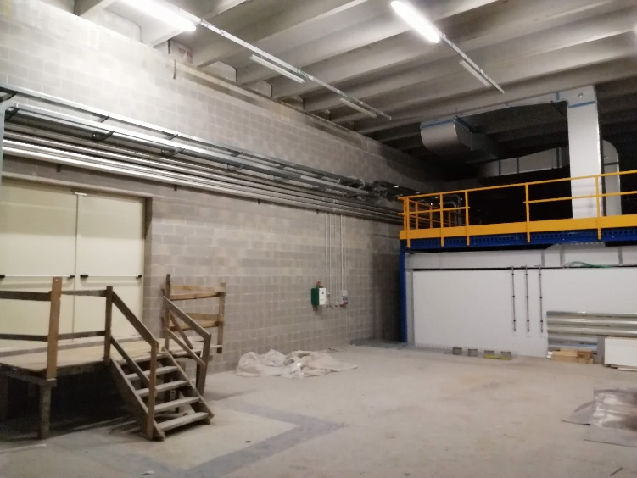
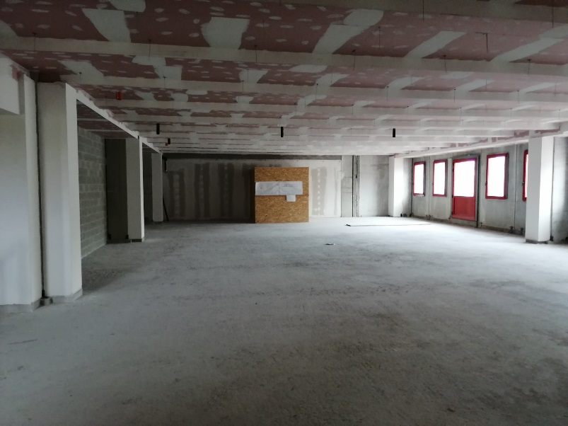
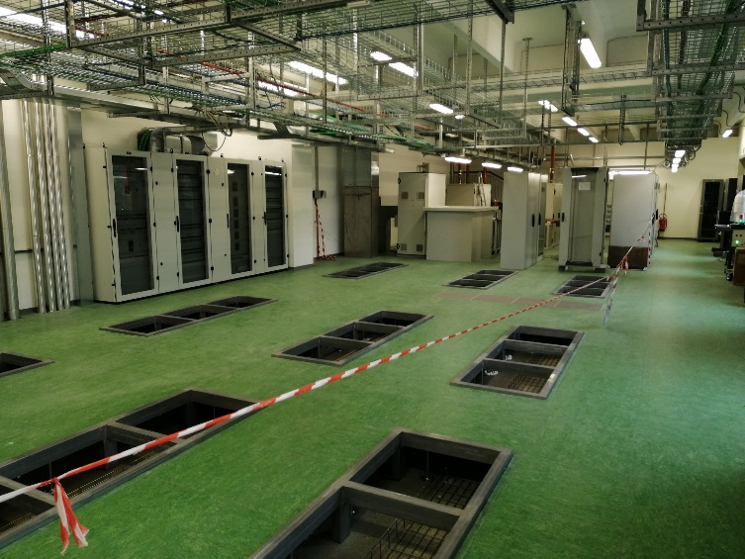
SPES project status (infrastructures)
Sept 2020

Slide 7
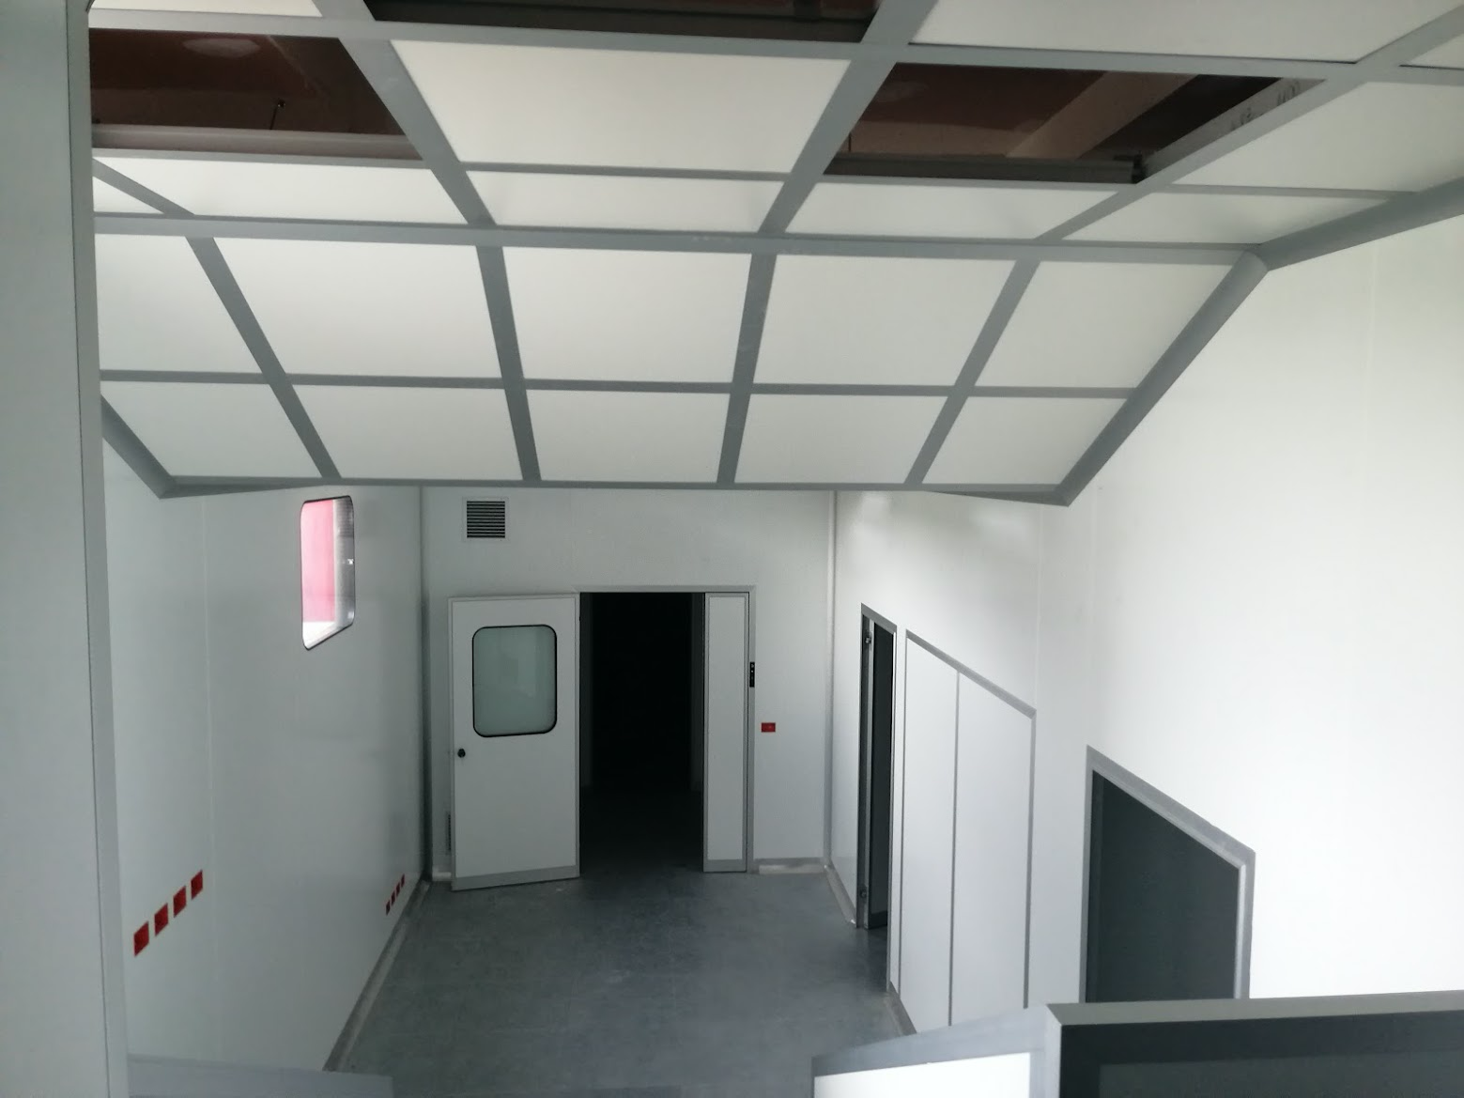
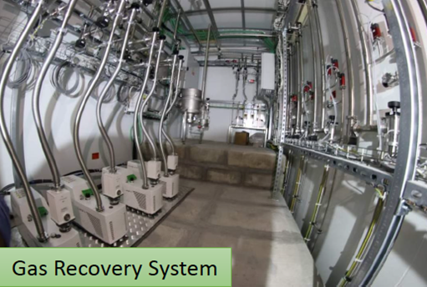
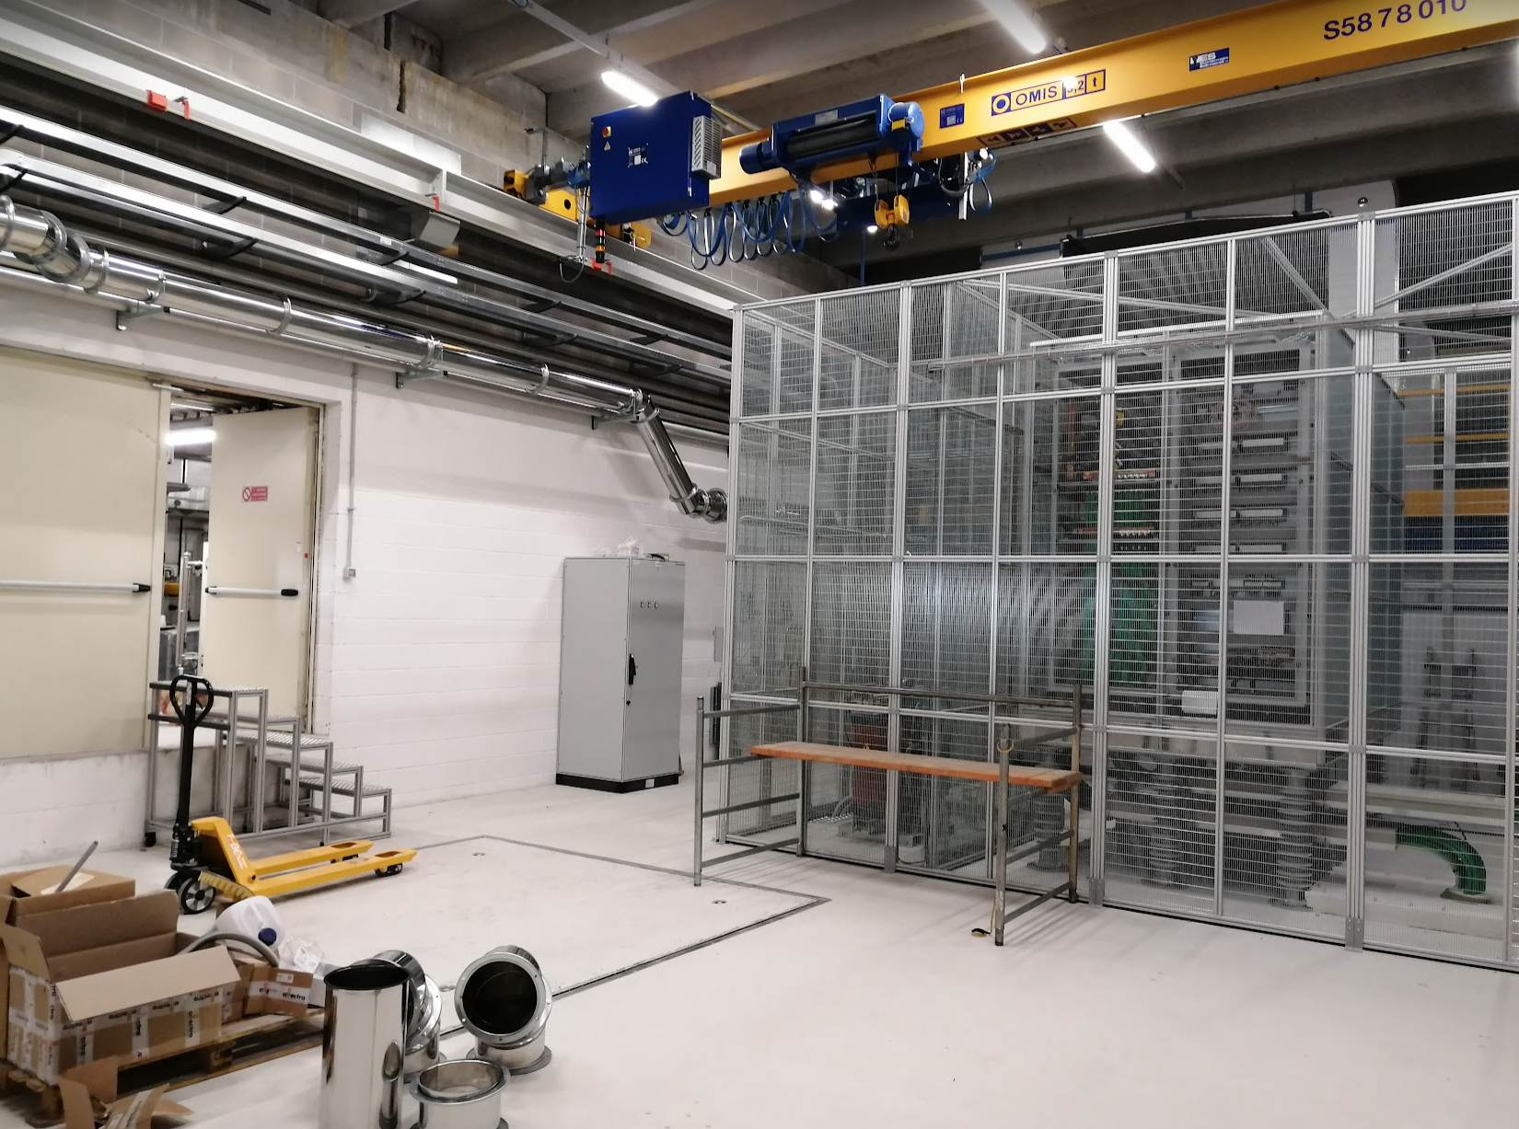
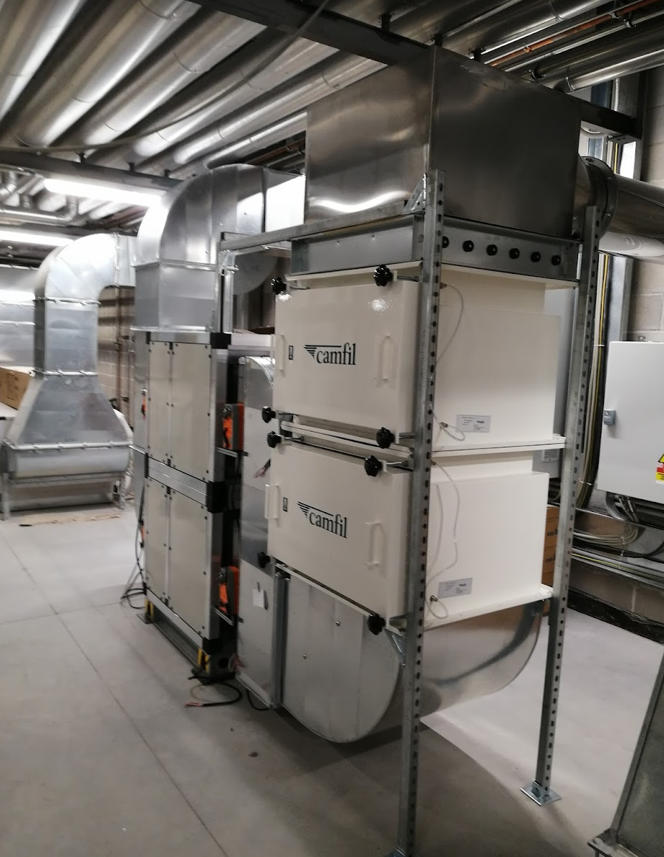
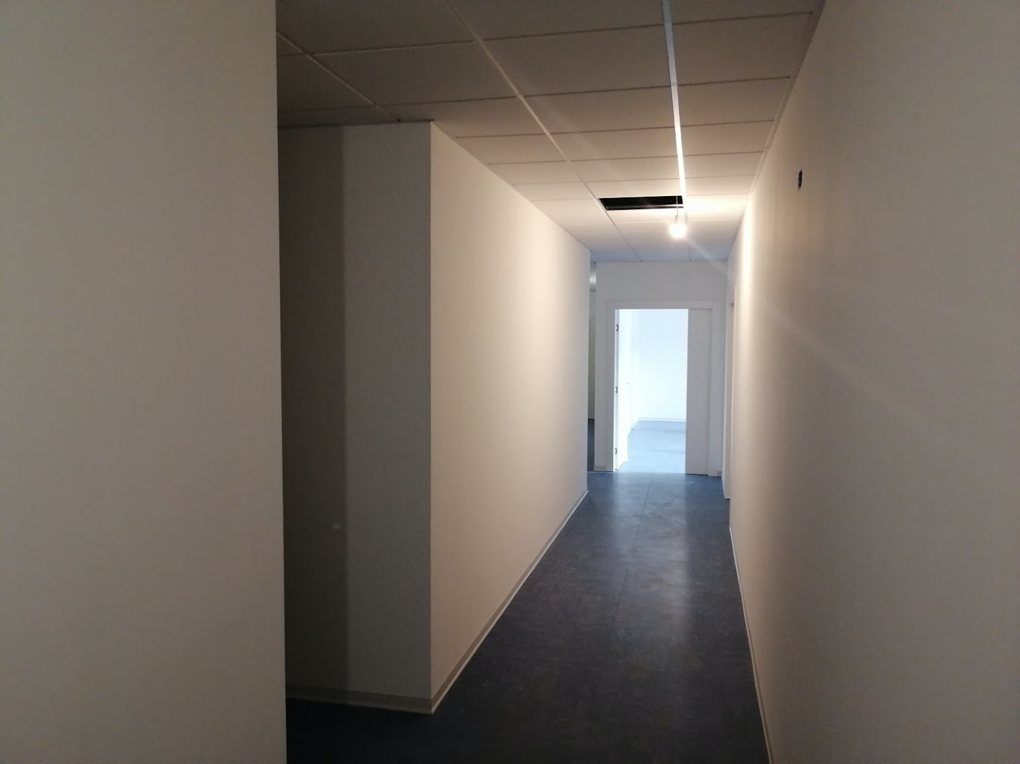
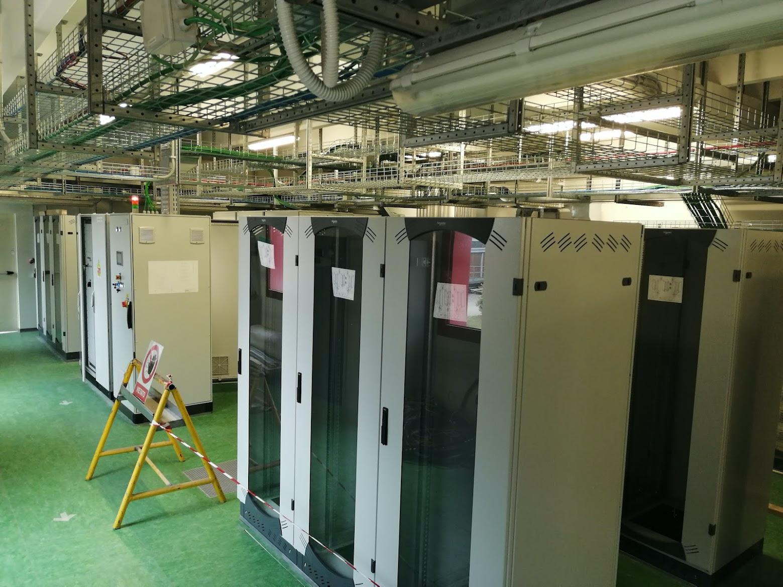
Nov 2022
UCx laboratories
ISOL HV platform
Ventilation system upgrade
ISOL target laboratories
Power supply room

Slide 8
Works Progress in SPES building in 2022
More than 20 companies have been engaged in 2022 to carry on any kind of works:
Structures (civil works and surfaces finishing)
Mechanics and thermomechanics plants
Electrics works, cabling
Accelerators systems and ancillary equipment (HV platform, beamlines,…)

Slide 9
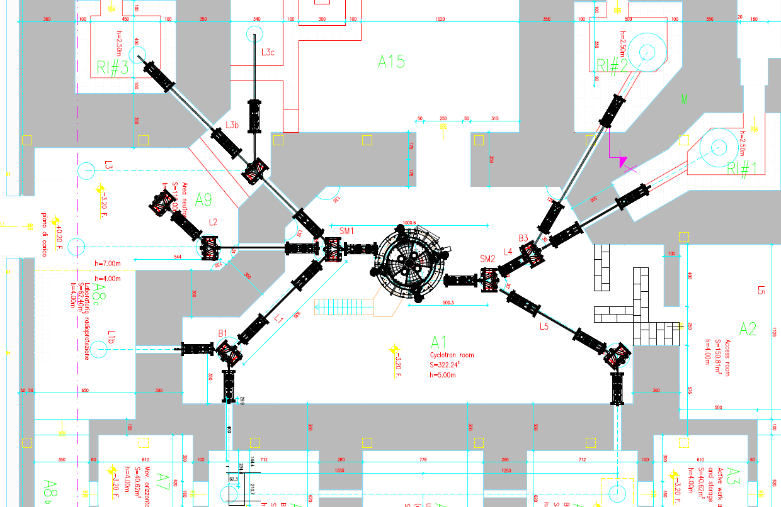
High Intensity Proton Beam Facility for SPES
Production and research on radioisotopes for medical application (LARAMED project)
Up to 9 irradiation target points
2 ISOL target stations (A6, A4)
3 Shielded bunkers (RI #1,#2,#3) for High Intensity irradiation
4 medium and low intensity target areas (A8, A9, A15)
Neutron sources and other applications
(NEPIR)
Production of radioactive beams (ISOL targets)

Slide 10
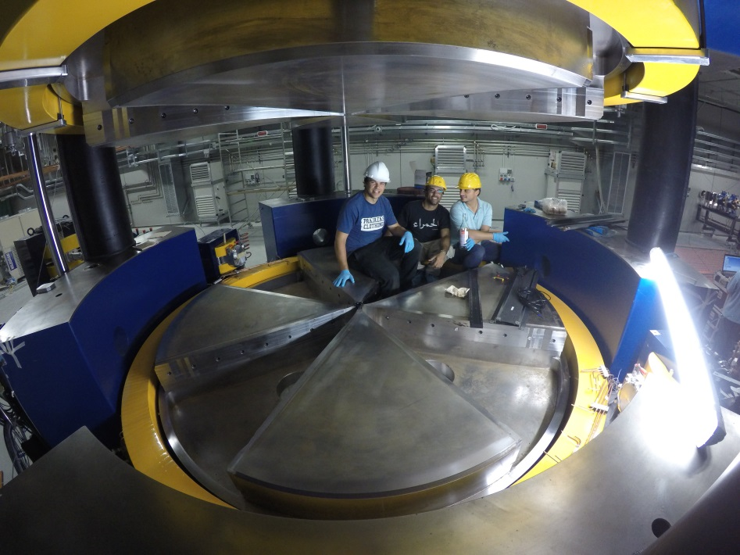
The 70 MeV Cyclotron
Main Parameters
Accelerator type | Cyclotron AVF with 4 sectors, Resistive Magnet
Particle | Protons (H⁻ accelerated)
Energy range | 35-70 MeV
Max Current Intensity | 700 µA (variable within the range 1µA-700µA)
Extraction | Dual stripping extraction
Max Magnetic Field | 1.6 T (Bo = 1 T)
RF System | nr. 2 delta cavities; harmonic mode=4; f _{RF} =56 MHz; 70 kV peak voltage; 50 kW RF power (2 RF amplifiers)
Ion Source | Multi-cusp volume H⁻ source; I_{ext} =8mA; V_{ext}=40 kV; axial injection
Dimensions | Φ=4.5 m, h=2 m, W=190 tons
Vacuum system → 4 cryopumps → 5 x 10⁻⁸ torr (beam OFF)

Slide 11
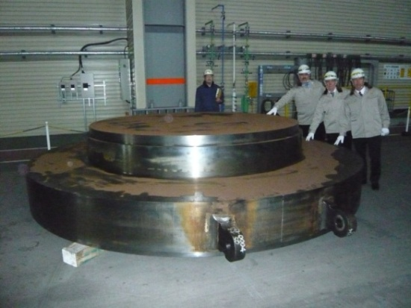
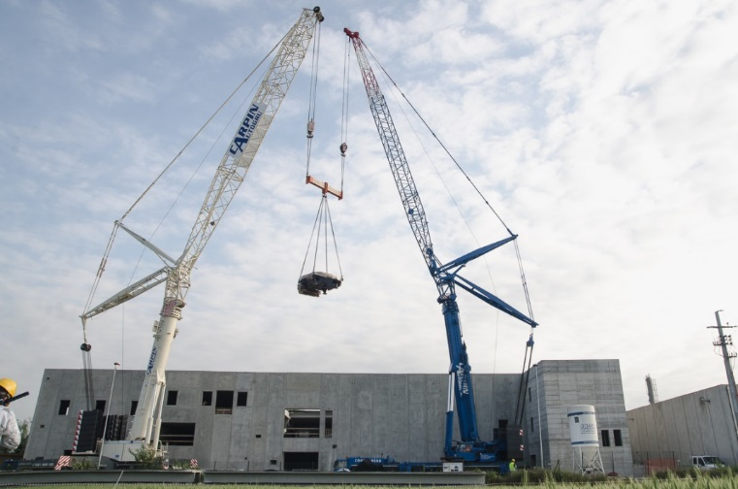
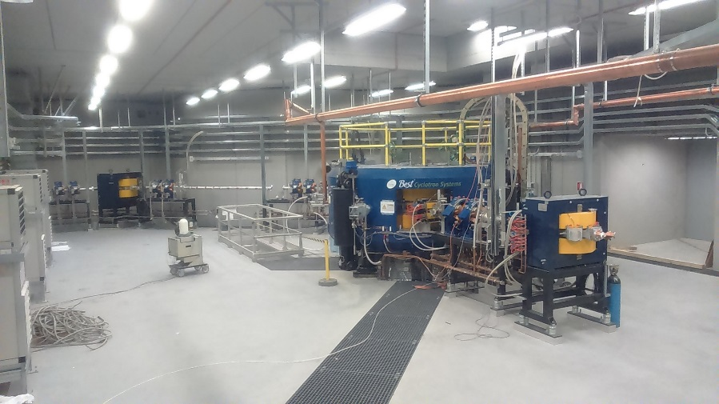
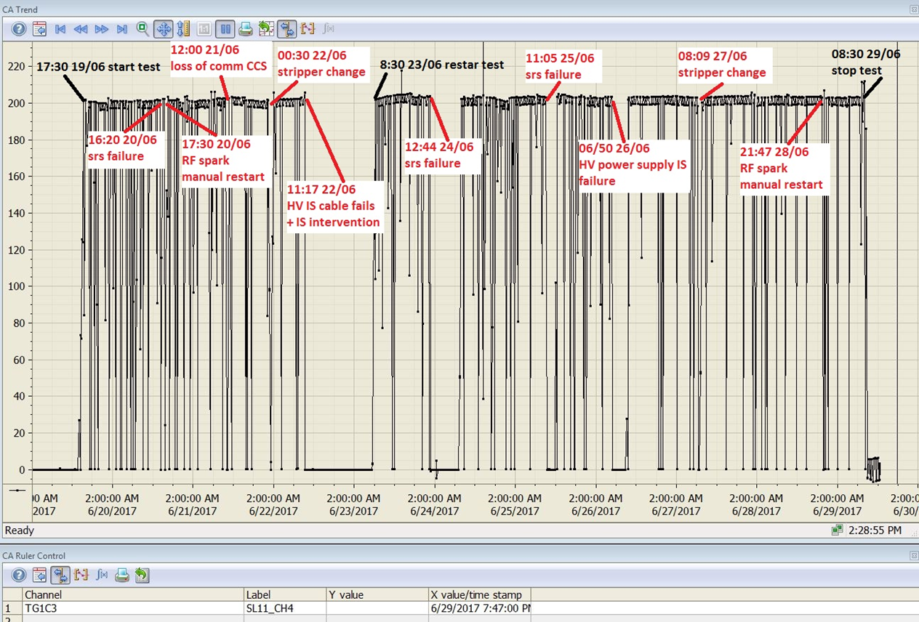
Cyclotron story: it began in 2010 (contract signed with Best Ther.)
2011-2014 Study, Design ,Construction and factory tests
2015
Installation at LNL
2016
First beam and commissioning
2017
Site Acceptance Test and final delivery
2018
INFN operation

Slide 12
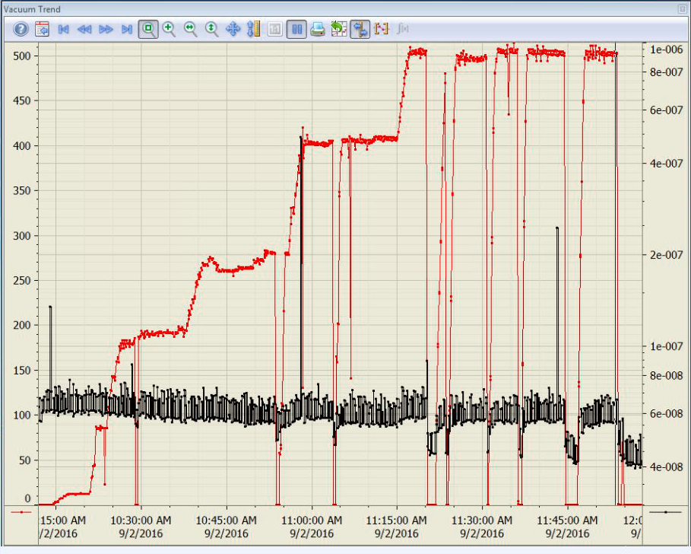
Intensity ramp-up→ beam stability improvements
September 2016
December 2017

Slide 13
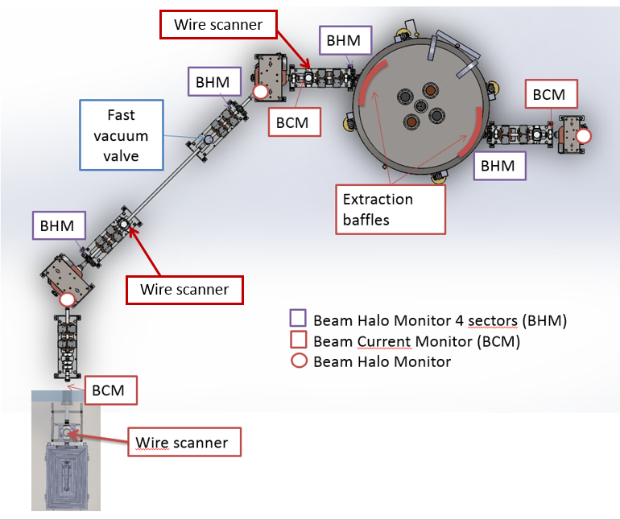
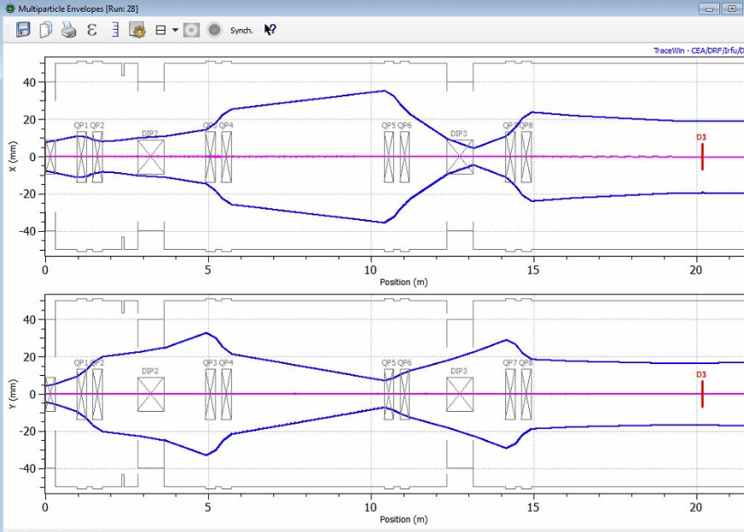
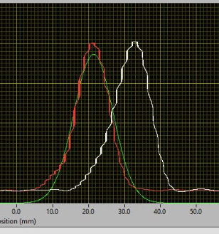
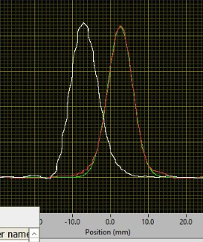
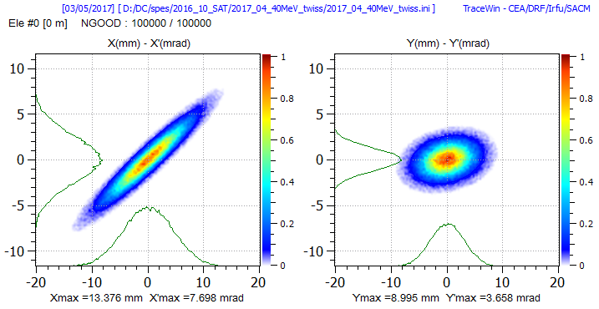
Diagnostics and beam optics check (2018)
TRACEWIN beam optics calculation

Slide 14
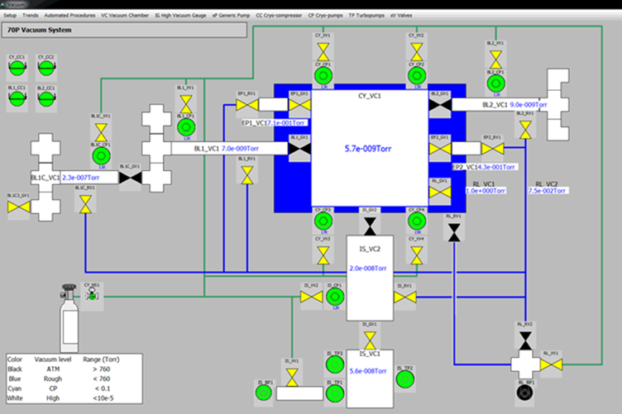
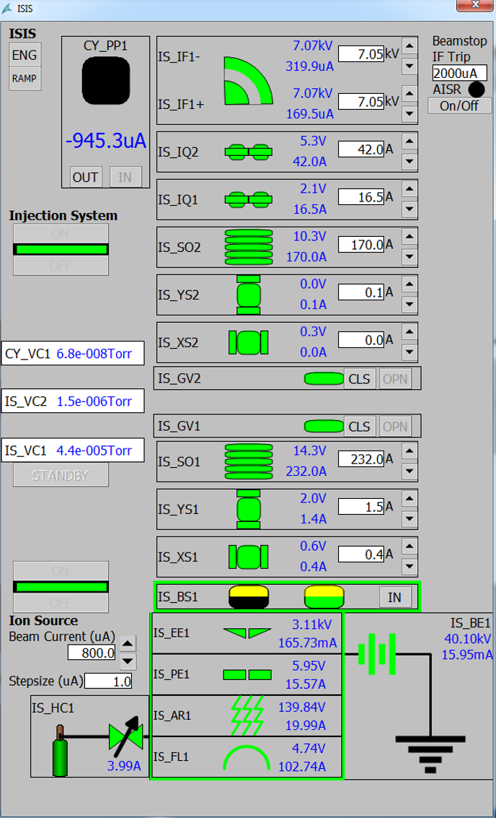
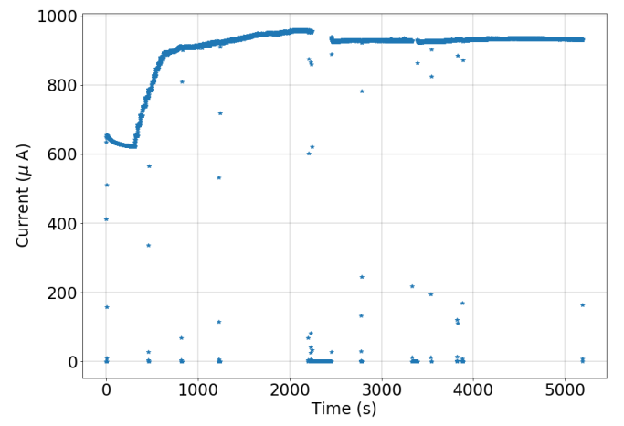
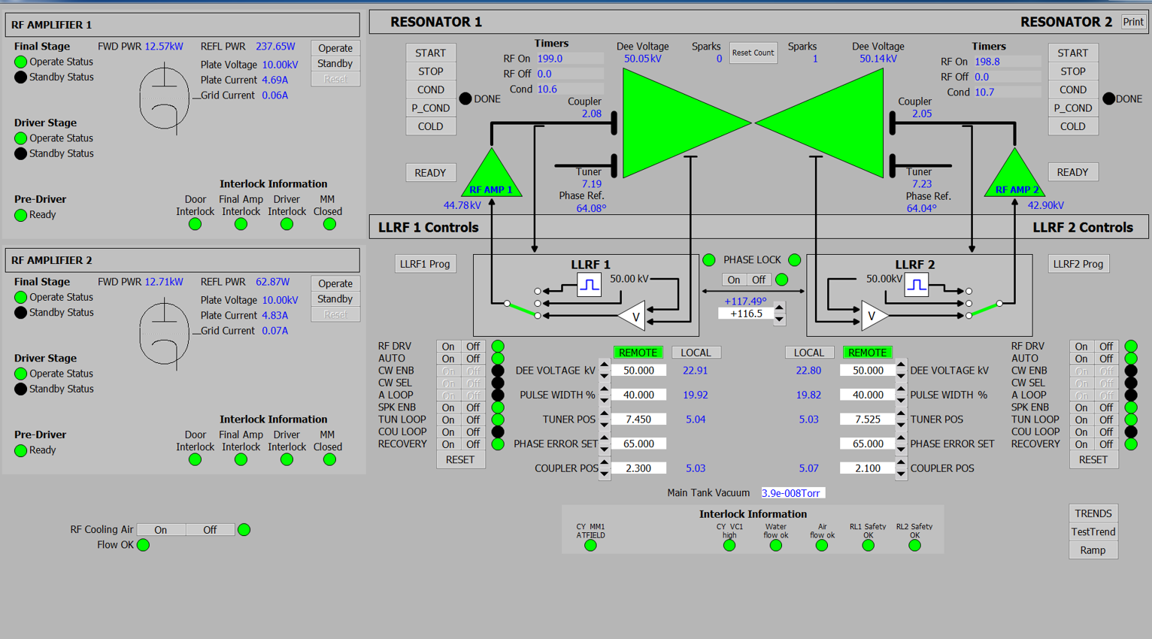
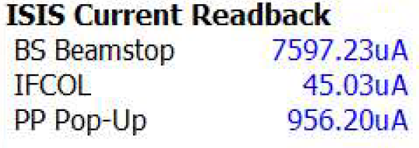
2020- Systems Restarting → 1 MeV operation
950 µA at 1 MeV

Slide 15
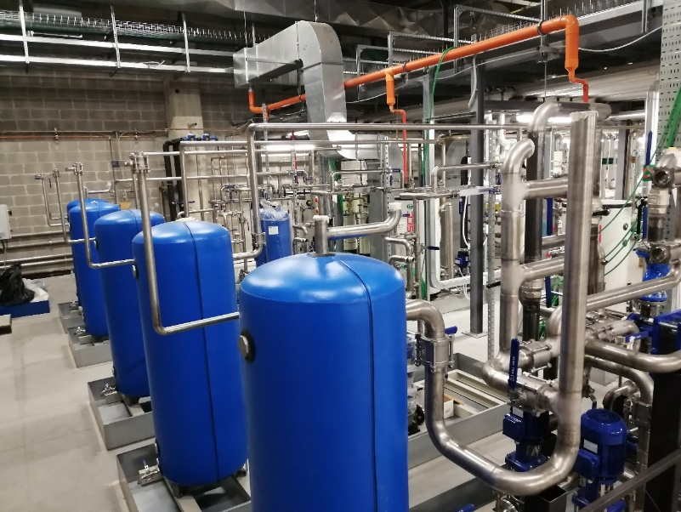
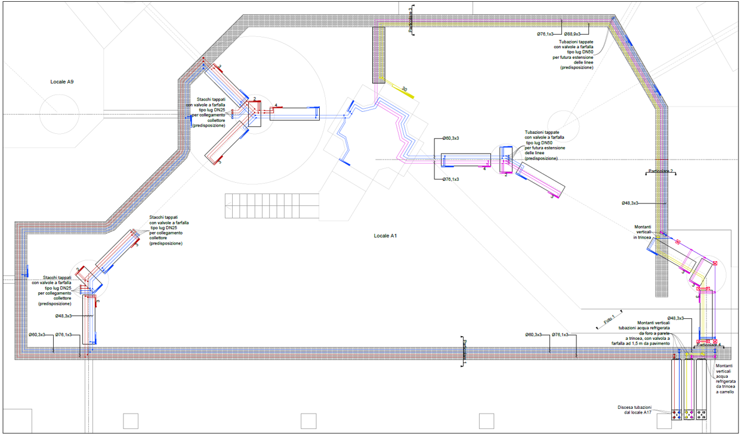
Water Cooling System Upgrade (2021-2023)
The cyclotron was originally supplied with one skid capable to dissipate 300 kW of thermal power for Cyclotron, beamlines, RF system and ancillaries (crio-compressors)
In order to improve the redundancy and the reliability of the overall system, the single skid has been replaced by 5 dedicated water cooling packages and related circuits:
Cyclotron, injection line and ion source
Beamlines on cyc. left side
Beamlines on cyc. right side
RF system (power amplifiers) and criocompressors
Cooling of activated parts (collimators, Faraday cups, probes)
2020
2022
in progress

Slide 16
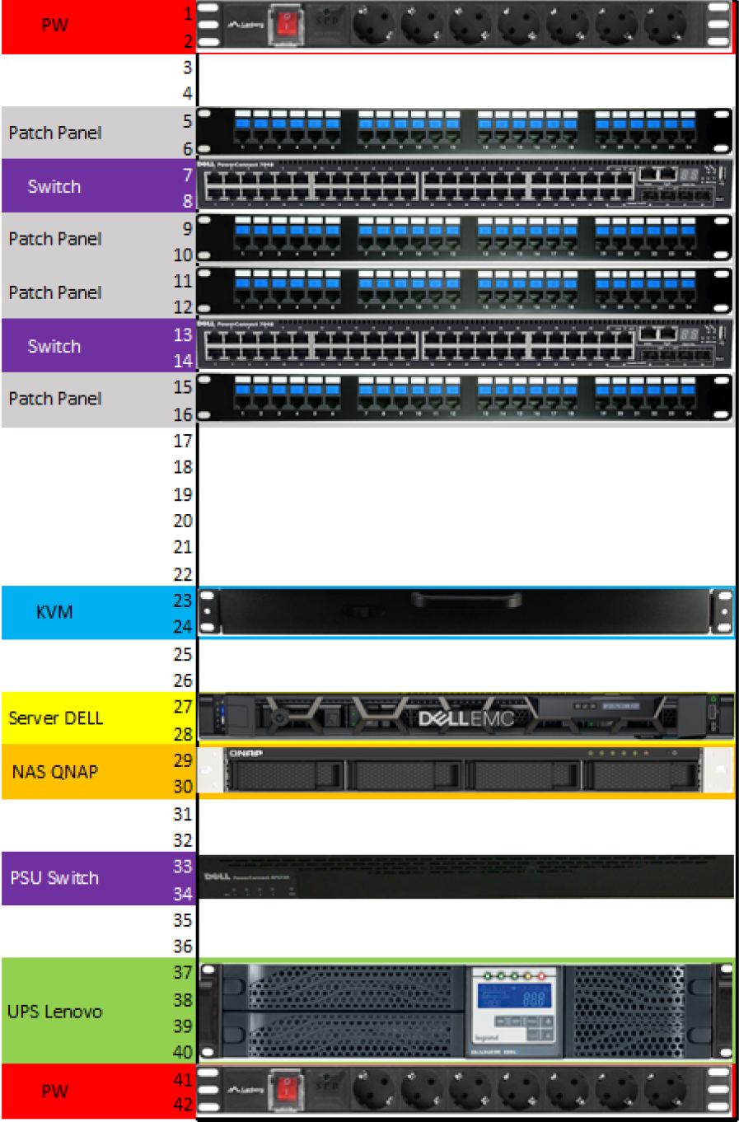
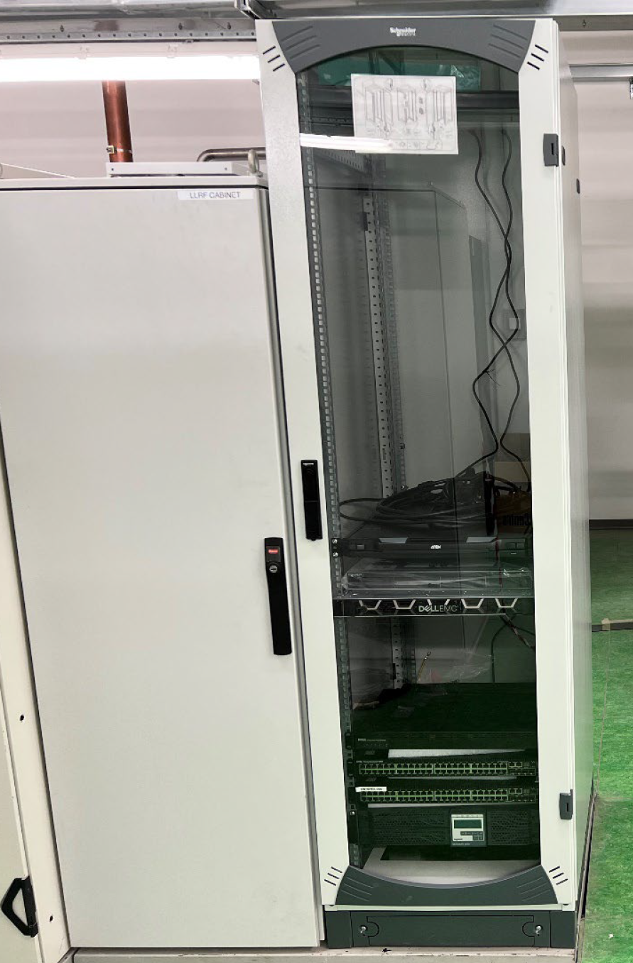
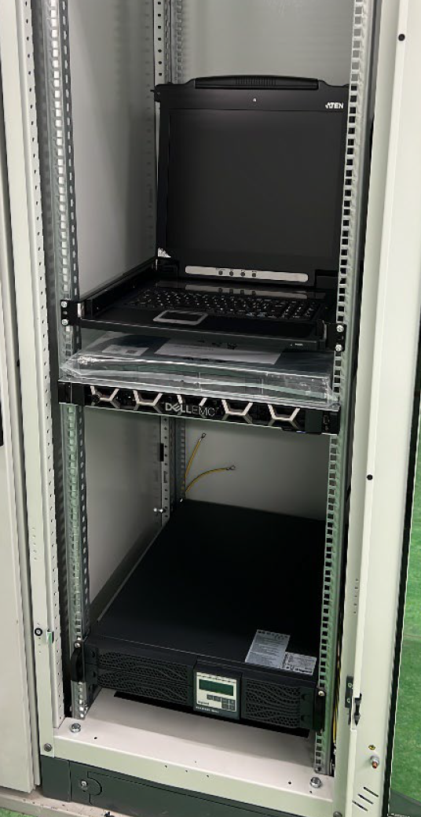
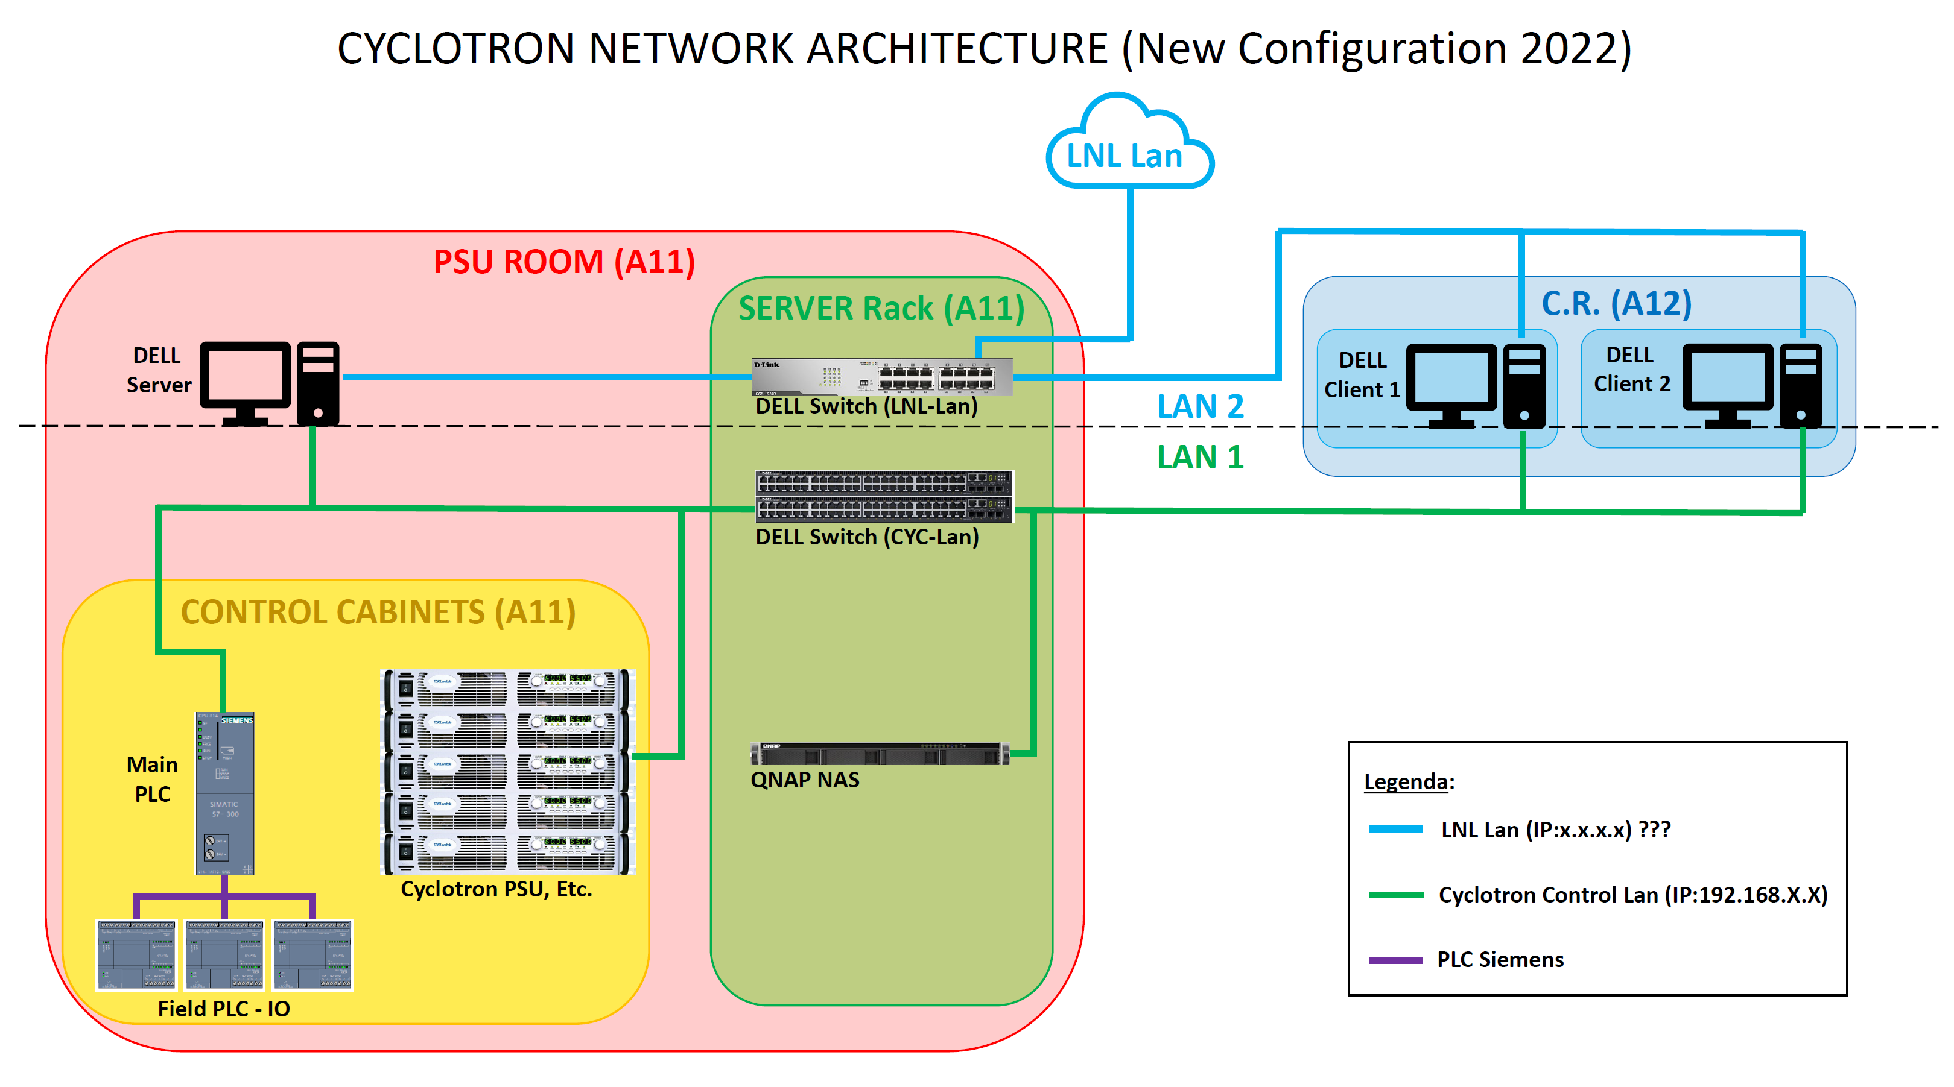
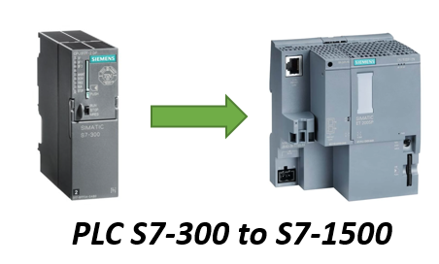
Control System Upgrade (2022-2023)
Replacement and update of cyclotron P70 Server and Clients
Network architecture reorganization (flexible and Ready for future integration and implementation).
Network rewiring and centralization
New Schneider control cabinet (DELL Server, NAS, UPS, Cyclotron Control System Network Patch Panel)
Server and Clients software upgrade (OS and licenses) (Windows Server 2019/2022 - Win10 Pro for Workstation)
Main PLC upgrade and control system migration

Slide 17
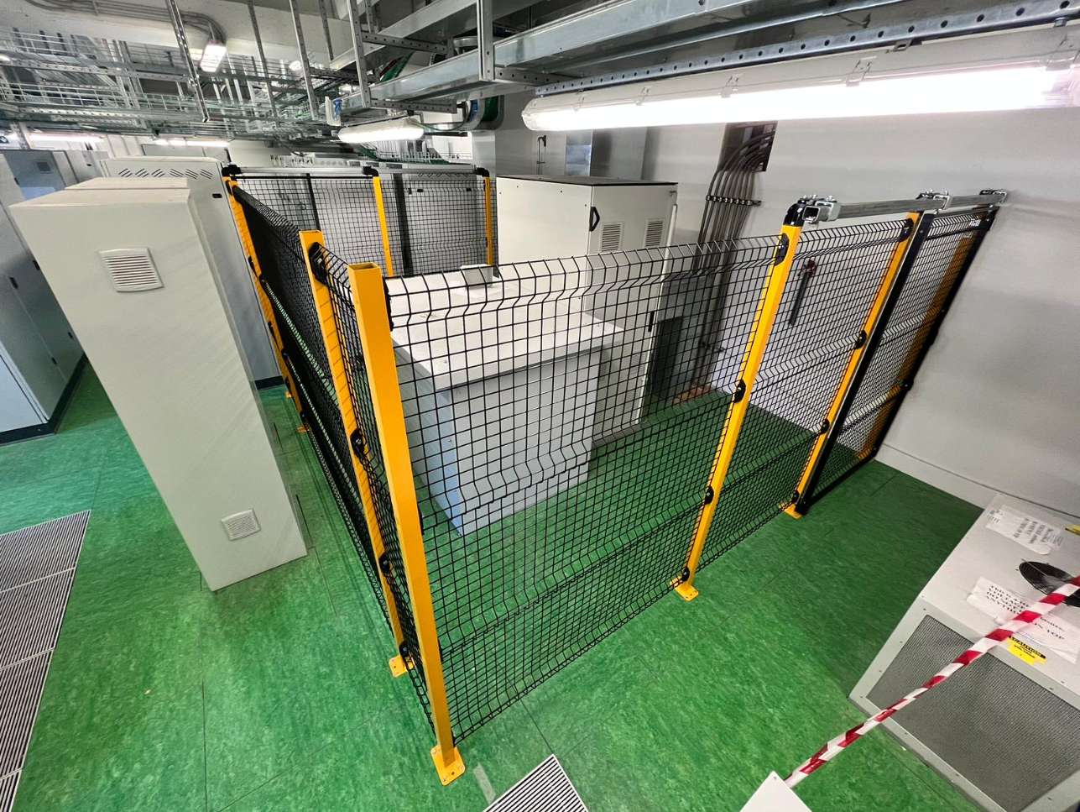
Integration of Cyclotron System with Global Safety System and MPS of SPES (2022-2023)
HV safety to be implemented with new control access system
Cyclotron Safety Devices to be interfaced with Machine Protection System of SPES target (beam trips management)
Very fast interlock (~ 1µsec) to be implemented for beam switching off to avoid any damage of ISOL target
HV ion source cabinet and safety cage

Slide 18
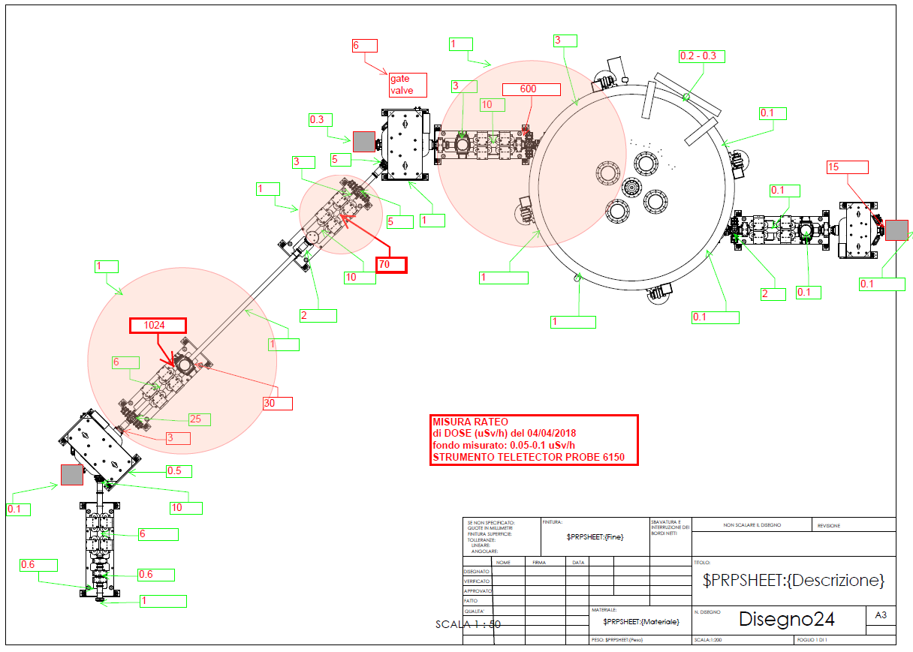
Beam Loss Monitors
Radiation survey on 2018
BLM
To prevent beam losses due to wrong tuning of beam transport lines
BLMs detect secondary particles generated by the lost beam
The BLM will be placed in strategic positions where we expect the beam size increasing (i.e. in the mid of two quads)
Very good partnership with Libera (Instrumentation Tech. ) for testing their devices at LNL
BLM
BLM
BLM

Slide 19
Supply of new beamlines: towards the full configuration

Slide 20
Cyclotron team activity: maintenance
Design and realization of new beamline components (diagnostics box)
Cryopumps and He gas lines and compressors
RF power amplifiers and components
Vacuum gauges calibration
Cyclotron hydraulic system purge and oil replacing
Control System bugs fixing
Cabling for new magnets of beamlines
New local electrical panel dedicated to cyclotron systems
Cryopumps removal activity
Triode spark on 2020

Slide 21
New upgrade of Cyclotron systems
Active system for varying the injected current into the cyclotron: chopper device is under study
The Buncher system is completed. The construction starts in 2023
New high power beam dump for cyclotron tests

Slide 22
Extension plan of high intensity facility
Actual Installation: Cyclotron and ISOL1 beamline
LARAMED beamline (high power beam: 30-70 MeV, 300µA): completed by Feb 2023
ISOL2 beamline (high power beam: 30-70 MeV, 300µA): completed by Feb 2023
LARAMED (low power: 30-70 MeV, 200 nA): tender was awarded in 2022, installation expected in 2024

Slide 23
Summary
The high intensity facility whose core is the cyclotron is operational at LNL:
The commissioning of cyclotron supplied by BEST Theratr. was accomplished out in 2017 and main performances were established (500 µA @70 MeV).
Beam operations were done in 2018 by INFN staff in order to test the capability and full performance of the machine.
After the first shutdown and Covid-19 break (mid 2018- mid 2020), the overall systems resumed with minor troubles and once again beam tests showed very good performance in terms of maximum injected current, reaching the value of 950 µA at 1 MeV, with good stability.
In March 2021, the cyclotron was again turned off to allow the installation of SPES equipment and proceed with the completion of the facility (new safety system, plants upgrading, civil works, compliance with fire brigade directives). Meanwhile the major upgrades of cyclotron systems are still proceeding.
The restart of operations is expected by the end of 2023 with the goal to deliver the first proton beam to ISOL target so that SPES project begins.

Slide 24
Thank you

Slide 25
Backup slides

Slide 26
LARAMED (LAboratory of RAdionuclides for MEDicine) - phase γ
A research laboratory (RILAB) owned jointly by INFN and CNR for:
Nuclear cross section measurements through stack-foils activation technique
A proving ground for high power target test
Low activity production of experimental radioisotopes (^{99m}Tc, ⁶⁴Cu, ⁶⁷Cu, …)
A production facility (RIFAC) operated by INFN and a private partner for production of ⁸²Sr/⁸²Rb and ⁶⁸Ga/⁶⁸Ge
Collaboration with CNR, ARRONAX

Slide 27
NEPIR (NEutron and Proton IRradiation facility) project - phase δ
QMN: Quasi Mono-energetic Neutron source with a controllable energy peak in the 20-70Mev energy range
ANEM: Atmospheric Neutron Emulator to get fast neutrons (E>1 MeV) with a continuous energy distribution similar to that of neutrons found at flight-altitudes and sea-level for SEE testing

