Slide 1
The IsoDAR Experiment and Applications of a High Power Cyclotron
Loyd Waites
on Behalf of the IsoDAR Collaboration
(lwaites@mit.edu)

Slide 2
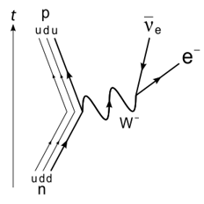
Introduction to Neutrino Physics
Neutrinos outnumber e⁻, p⁺, and n by 10 orders of magnitude
Three “known” neutrinos in Standard Model
Example: 𝝂_{e} produced in beta decay
Oscillate between neutrino flavors

Slide 3
|ν_{μ}>
|ν_{1,2,3}>
|ν_{e}>

Slide 4
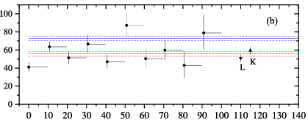
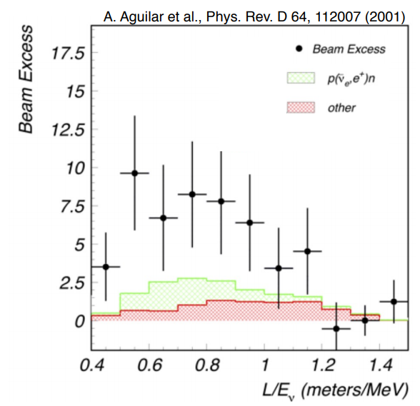
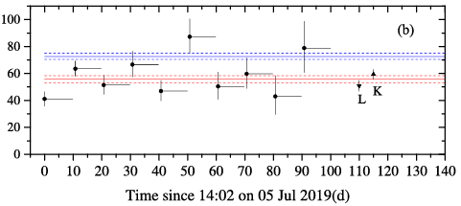
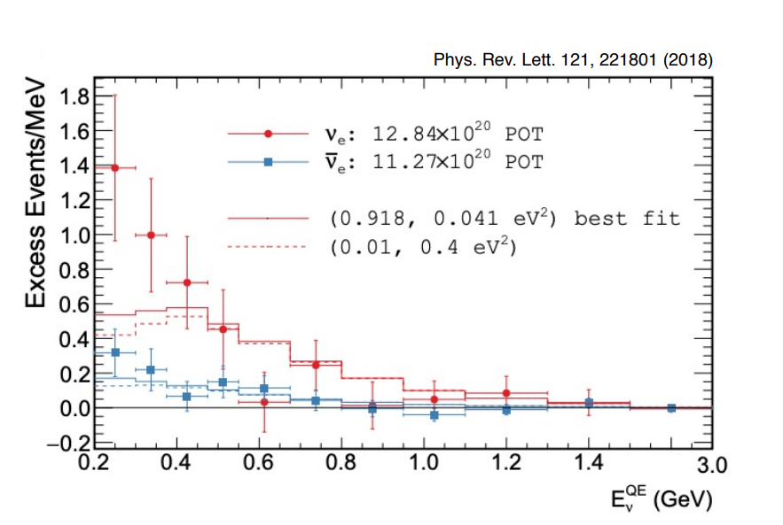
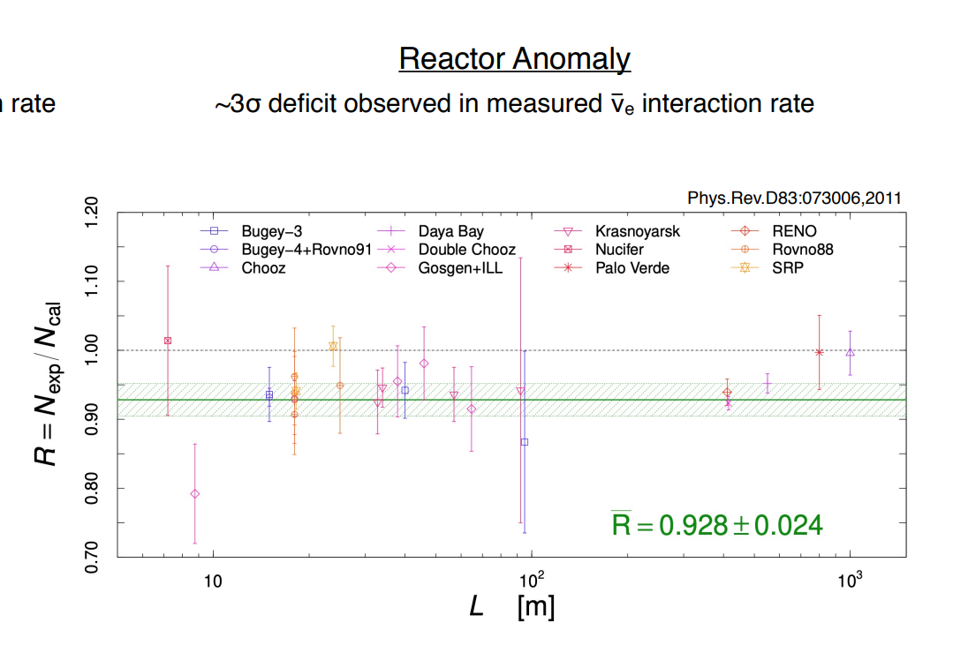
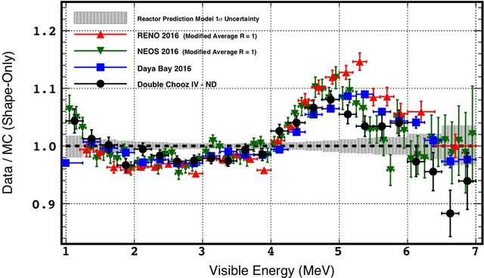
Normalized Production Rate

Slide 5
Normalized Production Rate
Normalized Production Rate
What’s this bump?
What’s this deficit?
What’s this bump?
What’s this deficit?
What’s this bump?

Slide 6
Normalized Production Rate
What’s this bump?
What’s this deficit?
What’s this bump?
What’s this deficit?
What’s this bump?

Slide 9
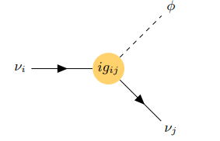

Slide 10
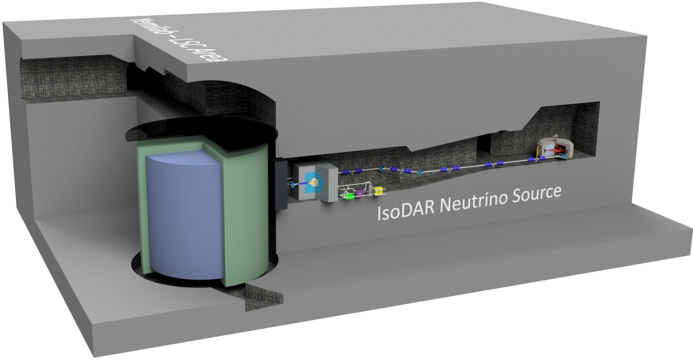
Enter IsoDAR: Unique Accelerator Based Neutrino Source
Isotropic anti-electron neutrino source
Can easily be “Turned Off”
Close proximity to detector

Slide 11
$${\overline{ν}}_{e}$$
$${\overline{ν}}_{e}$$
$${\overline{ν}}_{e}$$
$${\overline{ν}}_{e}$$
$${\overline{ν}}_{e}$$
$${\overline{ν}}_{e}$$

Slide 12
Target
Cyclotron
$${\overline{ν}}_{e}$$
$${\overline{ν}}_{e}$$
Transfer Line
$${\overline{ν}}_{e}$$
$${\overline{ν}}_{e}$$
$${\overline{ν}}_{e}$$
$${\overline{ν}}_{e}$$

Slide 13
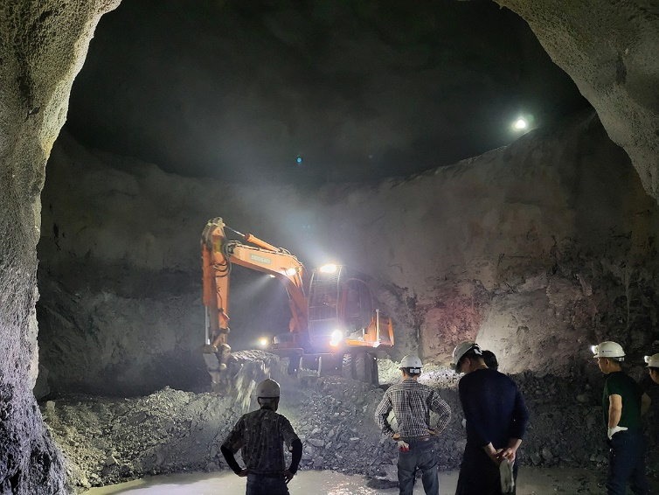
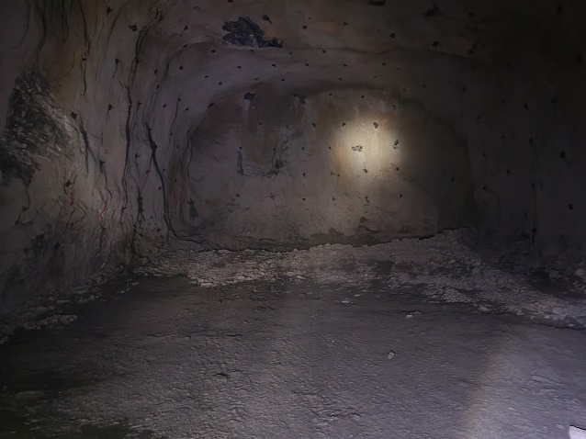
Excavation is now complete!
Cyclotron
Beamline
Target
Excavation is now complete!

Slide 14
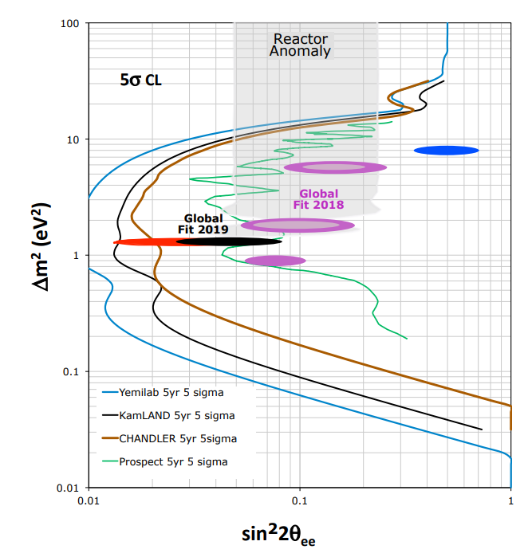
2.0 million IBD events in 5 years at Yemilab
Can exclude massive parameter space to 5 sigma confidence over 5 years
Including the global fits of several anomalies
Global Fit 2019: A. Diaz, C.A. Arguelles, G.H. Collin, J.M. Conrad and M.H. Shaevitz, Phys. Rep. 84 1 2020.

Slide 15
2.0 million IBD events in 5 years at Yemilab
Can exclude massive parameter space to 5 sigma confidence over 5 years
Including the global fits of several anomalies
Global Fit 2019: A. Diaz, C.A. Arguelles, G.H. Collin, J.M. Conrad and M.H. Shaevitz, Phys. Rep. 84 1 2020.

Slide 16
Innovation
Intense neutrino source requires intense proton source
Built underground, at a reasonable cost
10 mA beam current
10X higher than commercial

Slide 17
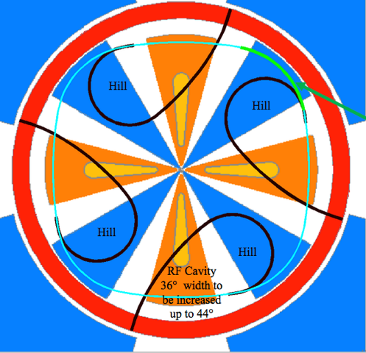
A New Cyclotron Design

Slide 18
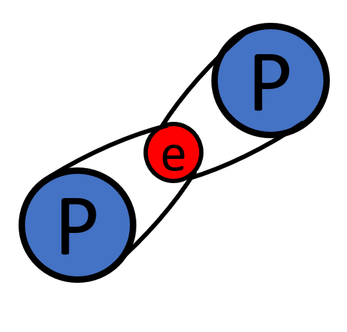
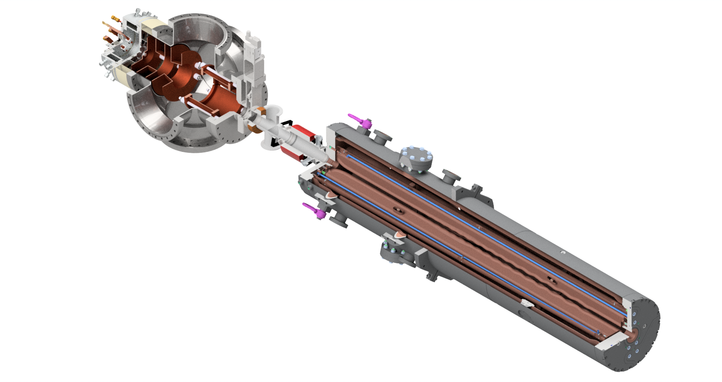
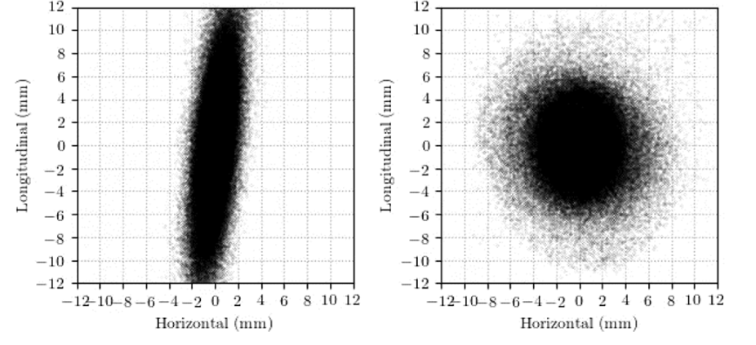
Three Breakthroughs to Higher Currents
Use of H₂⁺
Vortex Motion
RFQ Direct Injection

Slide 19
Use of Machine Learning
Machine learning techniques to Model Accelerator System
Neural Networks
Polynomial Chaos Expansion
Computational Speed Up
Sensitivity studies
Design Optimization

Slide 20
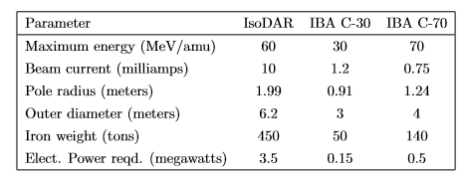
New Technology
Ground-breaking current and power
Capable of applications beyond the scope of particle physics

Slide 21
New Technology
Ground-breaking current and power
Capable of applications beyond the scope of particle physics

Slide 22
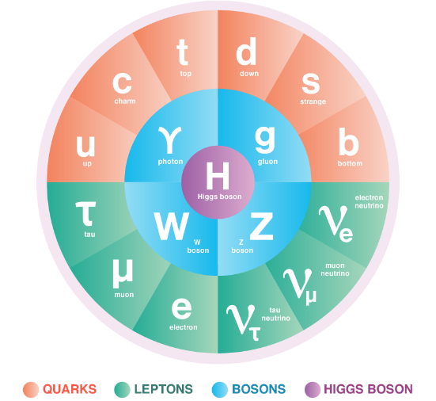
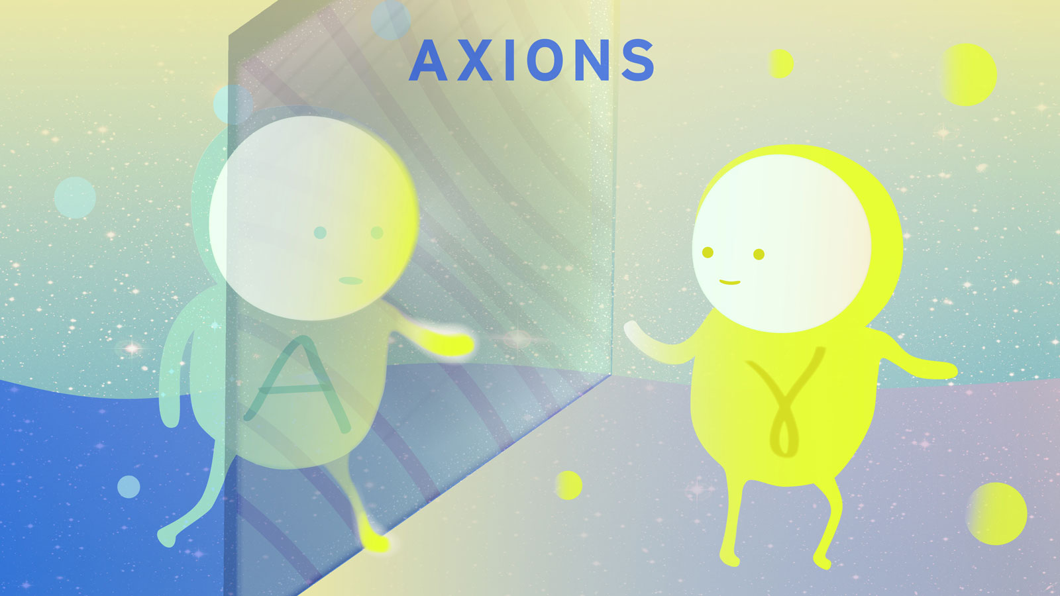
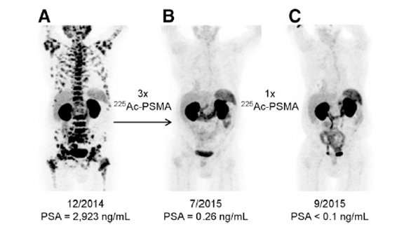
1. Neutrino Physics
3. Machine Learning for Accelerators
2. Accelerator Physics
4. Axions with IsoDAR
5. Medical Isotopes with IsoDAR

Slide 23
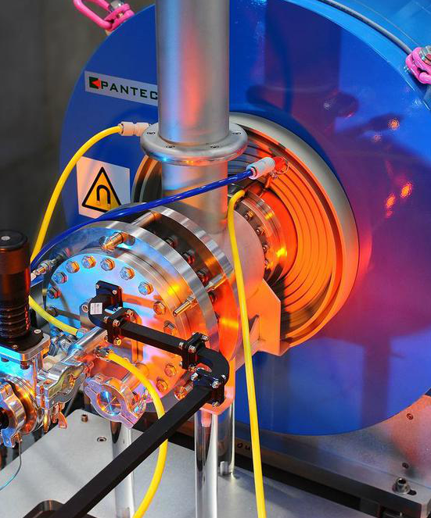
Accelerating New Ions
With minor tuning changes, can accelerate particles with the same charge/mass ratio
He⁺⁺, C⁶⁺ ,
There are commercially available ion sources for this (2.4 mA of alphas and 100 μA of C⁶⁺)
New Reactions

Slide 24
Conclusions
The requirements of an ambitious particle physics experiment have driven the development of new cyclotron technology. This development can grow beyond the scope of neutrino physics, and shift paradigms in the medical isotope community.
IsoDAR not only has the opportunity to change physics, but also has the opportunity to change lives. (lwaites@mit.edu)

Slide 25
Backups

Slide 26
References
IsoDAR CDR: https://arxiv.org/abs/1511.05130
Ion source: https://arxiv.org/abs/2008.12292
RFQ-DIP: https://aip.scitation.org/doi/abs/10.1063/1.4935753
RFQ-DIP: https://arxiv.org/abs/1807.03759
Spiral Inflector: https://arxiv.org/abs/1612.09018
Cyclotron simulations: https://arxiv.org/abs/1003.0326
Cyclotron simulations: https://arxiv.org/abs/2103.09352
Target, ⁸Li yield: https://arxiv.org/abs/1805.00410
Target, shielding: https://arxiv.org/abs/1909.08009
Medical Isotope production: https://ejnmmipharmchem.springeropen.com/articles/10.1186/s41181-020-0090-3

Slide 27
References:
Slide 3: de Kerret, Hervé, et al. "Double Chooz θ13 measurement via total neutron capture detection." Nature Physics 16.5 (2020).
Slide 3: Barinov, V. V., et al. "Results from the Baksan Experiment on Sterile Transitions (BEST)." arXiv preprint arXiv:2109.11482 (2021).
Slide 5: Inoue, K. "Reactor neutrino experiments." Lepton And Photon Interactions At High Energies: Lepton-Photon 2003. 2004. 375-384. https://doi.org/10.1142/9789812702975_0033
Slide 12: https://www.iberdrola.com/innovation/machine-learning-automatic-learning
Slide 16: Pfannkuchen, Nina, et al. "Novel radiolabeled bisphosphonates for PET diagnosis and endoradiotherapy of bone metastases." Pharmaceuticals 10.2 (2017): 45.
Slide 15: Krtochwil JNM 2016 and 2017
Slide 17: https://www.pantechnik.com/ecr-ion-sources/
Slide 26: Kleeven, Wiel. "Some examples of recent progress of beam-dynamics studies for cyclotrons." Proceedings of the 21st International Conference on Cyclotrons and their Applications, Zurich, Switzerland, 2016, WEA01.

Slide 28
Target Management
Use of electron strippers to divide beam
Can be done repeatedly
Enables target testbed / R&D
IsoDAR Cyclotron
Target
Protons
Stripping Foil
H2+
H2+
Dipole Magnet

Slide 29
Application to Medical Isotopes
Higher current
Higher production rate for low cross-section isotopes
Higher production rate of long lived isotopes
Can produce multiple isotopes based on target
⁶⁸Ge/⁶⁸Ga
²²⁵Ac
White paper available:
https://arxiv.org/abs/1807.06627

Slide 30
Vortex Motion

Slide 31
MIST-1 Ion Source
System Overview:
LEBT diagnostics
Electrode LEBT
Radio-Frequency Quadrupole (RFQ)

Slide 32
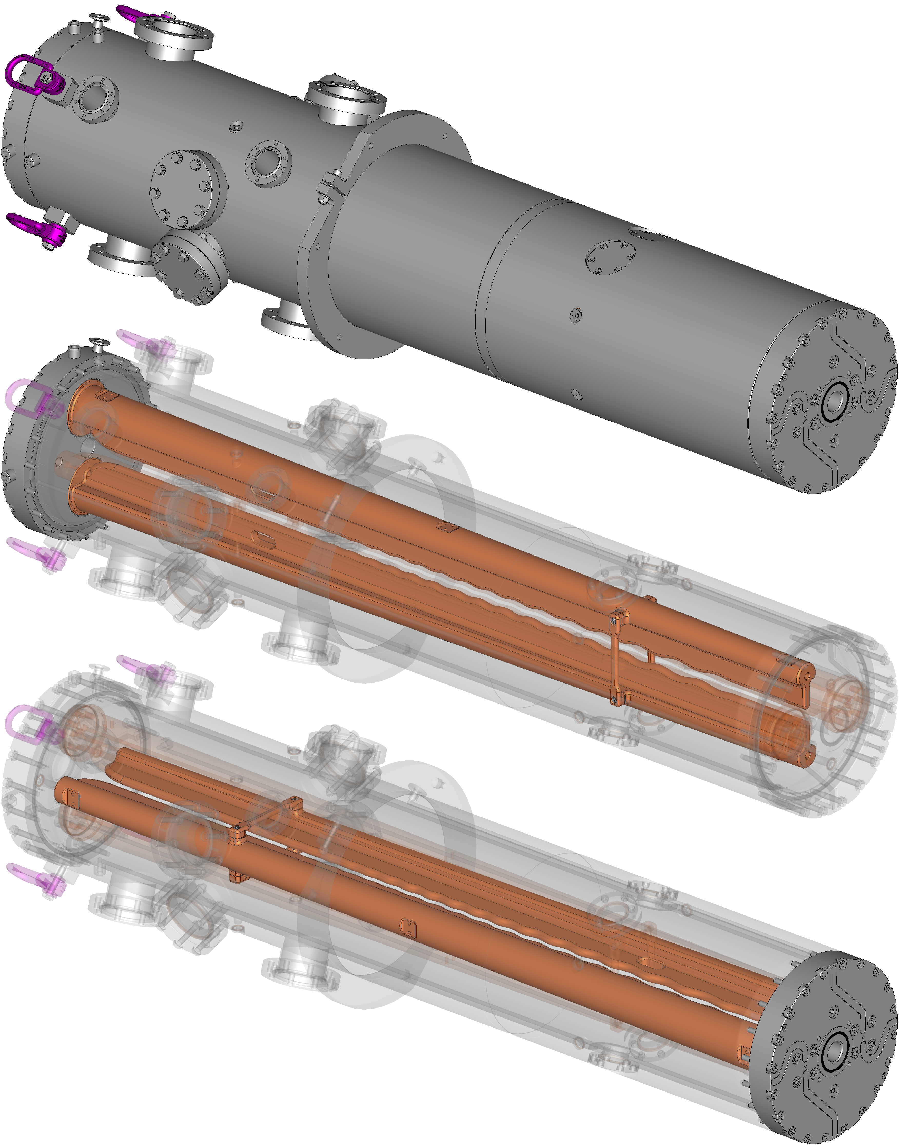
RFQ
Electric Quadrupole (Split Coaxial)
Alternating voltage on vanes at RF
Vanes modulated for longitudinal effects
Effects:
Acceleration
Bunching
Focusing

Slide 33
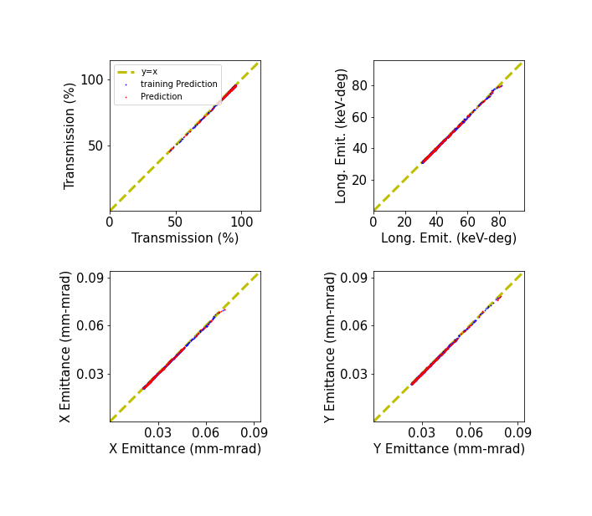
RFQ input parameters
Neural Net able to reproduce RFQGen simulation at sub-percent level in
Training data generated via RFQGen
Input of a series of varying input Twiss parameters
Output of Twiss parameters and transmission

Slide 34
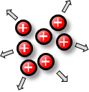
Use of H₂⁺
Problem
Solution
High beam intensity + slow beam velocity
Space charge ⇨ emittance growth
High impact of space charge in the low energy region
H₂⁺: Two units of charge for one in the low energy region
Remove electron by stripping ⇨ two protons
https://arxiv.org/abs/1807.03759

Slide 35
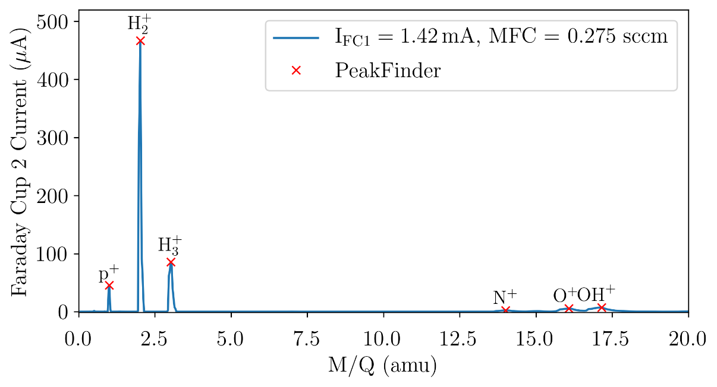
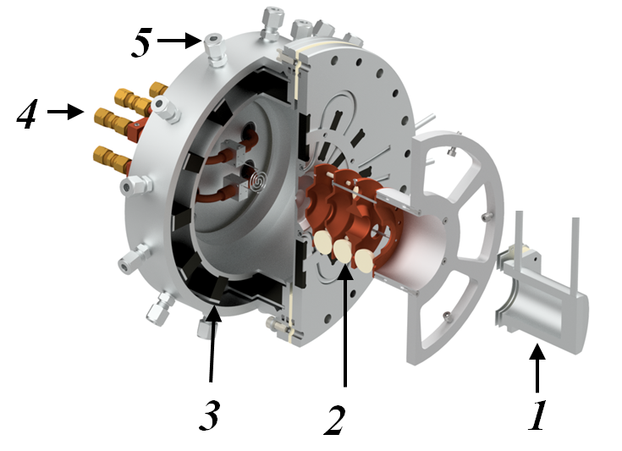
Experimental results
Currently Commissioning at 25% power
80% pure H₂ ⁺
High quality beam emittance: 0.05 π-mm-mrad (RMS, norm.)
Currently working to increase power

