Slide 1
Bench to bedside:
translational nuclear medicine research and clinical theranostics in PUMCH
Pro. Li Huo,
Director of Nuclear medicine department,
Peking Union Medical College Hospital, Beijing, China.
The 23rd International Conference on Cyclotrons and their Applications (CYC2022)
Dec., 5-9, 2022, on-line

Slide 2
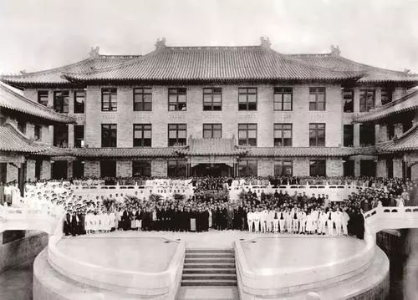
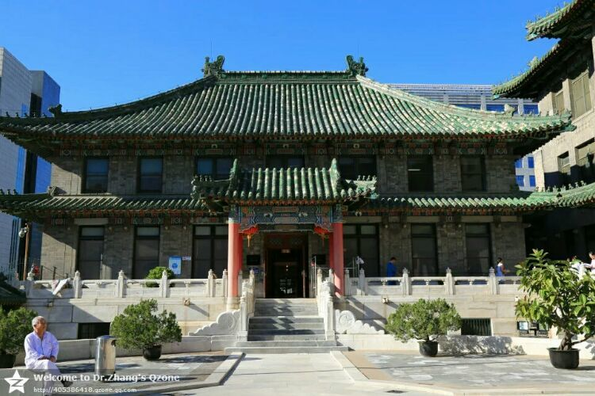
PUMCH
Peking Union Medical College Hospital was founded by the Rockefeller Foundation in 1921.
Over the past 100 years, PUMCH has been leading the advances of modern medical sciences in China, and being ranked 1 in the nation since 2009 to 2022.
PUMCH motto: Precision, Perseverance, Diligence, and devotion

Slide 3
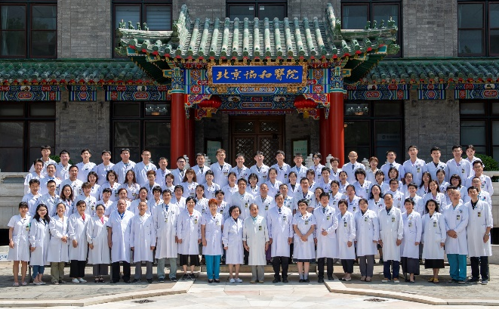
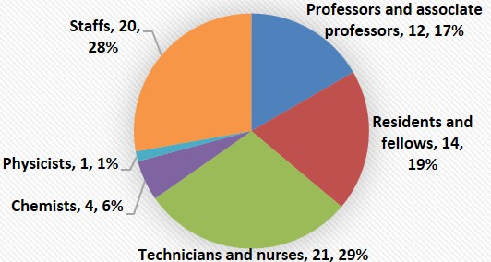
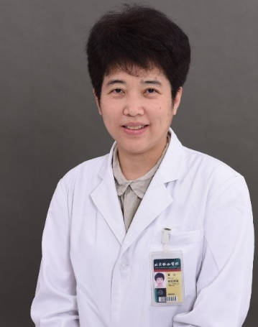
Nuclear Medicine in PUMCH
Nuclear Medicine department was founded in 1958
Equipment for imaging: 2 PET/MR, 5 PET/CT, 8 SPECT/CT and 2 SPECT. Equipment for radiopharmaceutical synthesis and research: 1 Cyclotron, 1 Micro PET, 2 Generator (⁹⁹Mo-^{99m}Tc/⁶⁸Ge-⁶⁸Ga) and 10 hot cell.
1 ward(10beds) for radionuclide therapy
More than 50 research projects
More than 10 isotopes and 90 radiopharmaceuticals are employed to support clinical and research work.
Ranked 1# in in all China’s NM department since 2015 to 2022.
Faculties and staffs of NM (2021)
including secretaries, research staffs, visiting scholars, Ph.D and Post Doc
Clinical work per year in NM department (case)
 | 2019 | 2020 | 2021 | 2022（1-10）
PET scan | 11127 | 9248 | 12871 | 10678
SPECT scan | 23248 | 17250 | 21406 | 17056
Nuclide therapy | 4245 | 2189 | 3722 | 2619
radioimmunoassay | 64681 | 39993 | 60432 | 44452
¹³C breath test | 66228 | 29006 | 53836 | 46226
Director: Pro. Huo Li

Slide 4
Radiopharmaceuticals for clinical and research imaging
 | ¹⁸F （Since 1998） |  | ⁶⁸Ga （Since 2012） | ^{99m}Tc (Since 1980s) | ¹³N/¹¹C （Since 1998） | ¹³¹I (Since 1958)
1 | ¹⁸F-FDG | ¹⁸F-FES | ⁶⁸Ga-DOTA-TATE | ^{99m}Tc-DTPA | ¹³N Ammonia | ¹³¹I
2 | (S)-¹⁸F-FBFP | ¹⁸F-FEL | ⁶⁸Ga-DOTA-RGD | ^{99m}Tc-MAA | ¹¹C Acetate | ¹³¹I-MIBG
3 | L-5-(2-[¹⁸F]fluoro ethoxy)tryptophan | ¹⁸F-FECH | ⁶⁸Ga-DOTA-EB | ^{99m}Tc-MDP | ¹¹C Choline
4 | Al¹⁸F-PSMA-617 | ¹⁸F-FDS | ⁶⁸Ga-NOTA-PRGD2 | ^{99m}Tc-MIBI | ¹¹C Methonine
5 | Al¹⁸F-NOTA-LM3 | ¹⁸F-FDDNP | ⁶⁸Ga-NEB | ^{99m}Tc-OCT | ¹¹C-β-CFT
6 | Al¹⁸F-NOTA-FAPI-04 | ¹⁸F-FCH | ⁶⁸Ga-DOTA-Nerotension | ^{99m}Tc-SC | ¹¹C-PIB
7 | ⁸F-Fluoroacetate | ¹⁸F-Fallypride | ⁶⁸Ga-BMV101 | ^{99m}Tc-PYP | ¹¹C-HFC
8 | ¹⁸F-β-CFT | ¹⁸F-DPA-714 | ⁶⁸Ga-CXCR4 | ^{99m}Tc-ECD
9 | ¹⁸F-XTR004 | ¹⁸F-BPA | ⁶⁸Ga-DOTA-TATE-RGD | ^{99m}Tc-HIDA
10 | ¹⁸F-T807（Fluorine-18 flortaucipir） | ¹⁸F-AV45（Fluorine-18 florbetapir） | ⁶⁸Ga-DOTA-EB-TATE | ^{99m}Tc-DMSA
11 | ¹⁸F-SFB-VEGF | ¹⁸F-AV1（Fluorine-18 florbetaben ） | ⁶⁸Ga-DOTA-BBN-RGD | ^{99m}Tc-HSA
12 | ¹⁸F-P1OP | ¹⁸F-Al-NOTA-TATE | ⁶⁸Ga-DOTA-TMVP1 | ^{99m}Tc-GSA
13 | ¹⁸F-MK6240 | ¹⁸F-Al-NOTA-PRGD2 | ⁶⁸Ga-exendin4 | ^{99m}Tc-RGD
14 | ¹⁸F-MFBG | ¹⁸F-Al-NOTA-EB | ⁶⁸Ga-R01 | ^{99m}Tc-CNDG
15 | ¹⁸F-L-DOPA | ¹⁸F-92 | ⁶⁸Ga-JR11 | ^{99m}Tc-FAPI
16 | ¹⁸F-FP-CIT | ¹⁸F-1799 | ⁶⁸Ga-FAPI | ^{99m}Tc-H-PoFP₂
17 | ¹⁸F-FPA | ¹⁸F-MK6240 | ⁶⁸Ga-PSMA
18 | ¹⁸F-FMISO | ¹⁸F-FP-CIT | ⁶⁸Ga-DOTA-LM3
19 | ¹⁸F-FLT | ¹⁸F-FET | ⁶⁸Ga-RM26
20 | ¹⁸F-FHBG |  | ⁶⁸Ga-FSDD₃I
21 |  |  | ⁶⁸Ga-3BP-227

Slide 5
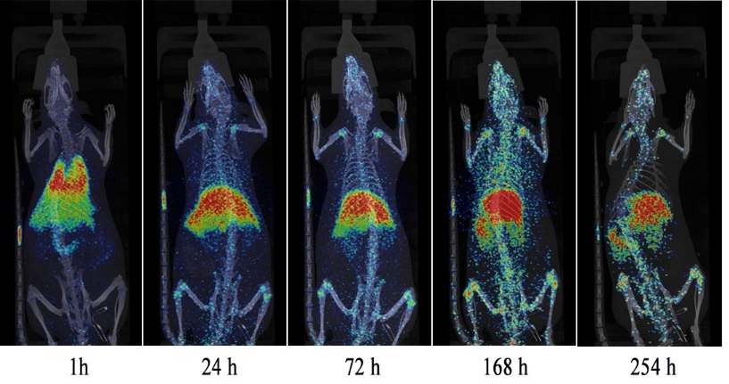
Radiopharmaceuticals for clinical and research therapy
For preclinical research: ¹⁸⁸Re, ⁸⁹Zr, ⁶⁴Cu, and ⁸⁶Y.
For radionuclide therapy:
¹³¹I | ¹⁷⁷Lu （Since 2017） | ⁹⁰Y （Since 2002） | ⁸⁹Sr | ²²³Ra | ³² P
¹³¹I-MIBG | ¹⁷⁷Lu-PSMA | ⁹⁰Y-TATE
¹³¹I | ¹⁷⁷Lu-EB-PSMA
 | ¹⁷⁷Lu-TATE
 | ¹⁷⁷Lu-EB-TATE
⁸⁹Zr-anti-CLDN18.2 VHH
Whole-body microPET/CT imaging of ⁸⁹Zr-oxine EPCs in health rats.
Ding, Jie; et al. 86Y-Labeled Albumin-Binding Fibroblast Activation Protein Inhibitor for Late-Time-Point Cancer Diagnosis. Molecular Pharmaceutics, 2022, 19(9): 3429-3438.
Hu Guilan, et al. Development and comparison of three (89)Zr-labeled anti-CLDN18.2 antibodies to noninvasively evaluate CLDN18.2 expression in gastric cancer: a preclinical study. *Eur J Nucl Med Mol Imaging, 2022, 49(8): 2634-2644.
42. Yimin Liu; et al; Evidence of accumulated endothelial progenitor cells in the lungs of rats with pulmonary arterial hypertension by 89Zr-oxine PET imaging , Molecular Therapy-Methods & Clinical Development, 2020. May 3;17:1108-1117

Slide 6
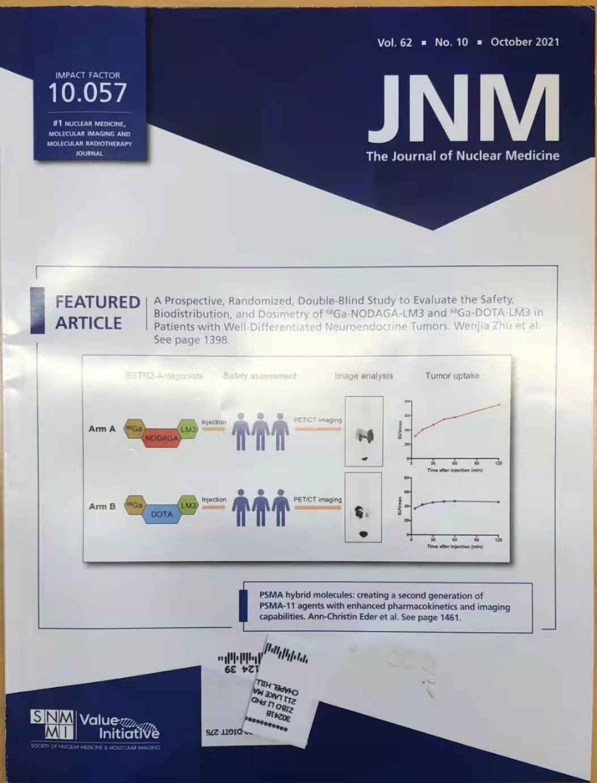
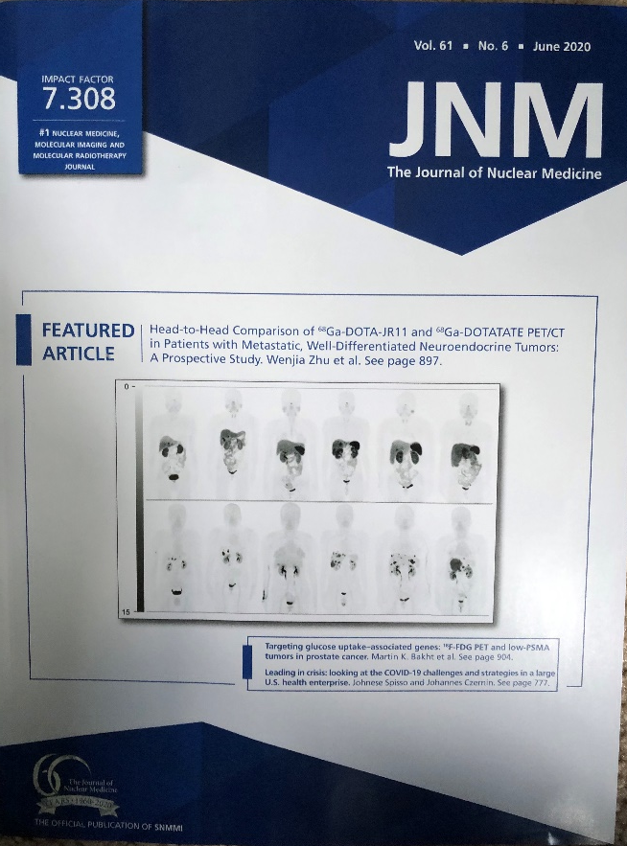
NM translational research stay ahead of the NET theranostic curve
Series translational nuclear medicine research on somatostatin receptor
2020年第6期
Featured article and cover image
2021年第10期
Featured article and cover image

Slide 7
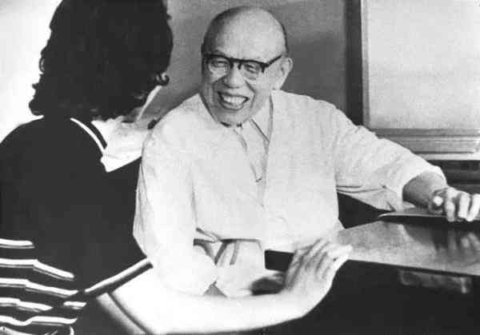
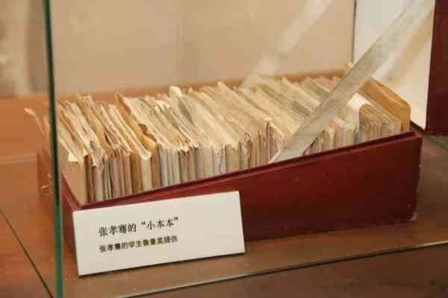
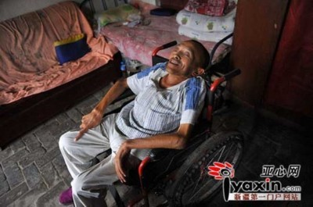
Translational medicine is critical for
complex severe and rare diseases.
PUMCH, national center for complex, severe and rare diseases
Pro. Xiaoqian Zhang , famous professor and internist in China.
He diagnosed the first case of tumor-induced osteomalacia (TIO) in China, a rare paraneoplastic syndrome clinically characterized by bone pain, fractures and muscle weakness.
TIO lesions are typically small, benign mesenchymal tumors that may be found in bone or soft tissue, anywhere in the body. Locating the tumor is critical, as complete removal is curative.
However, localization of the lesion is challenging. Only 30% are superficial and can be palpated, while the remaining 70% are impalpable.
Step wise locating of the culprit lesions is critical for the patients with TIO

Slide 8
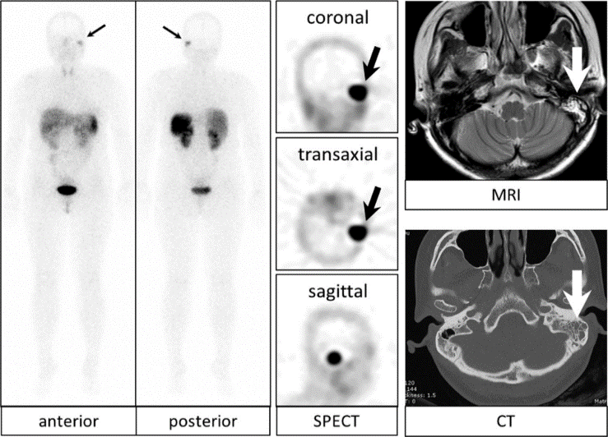
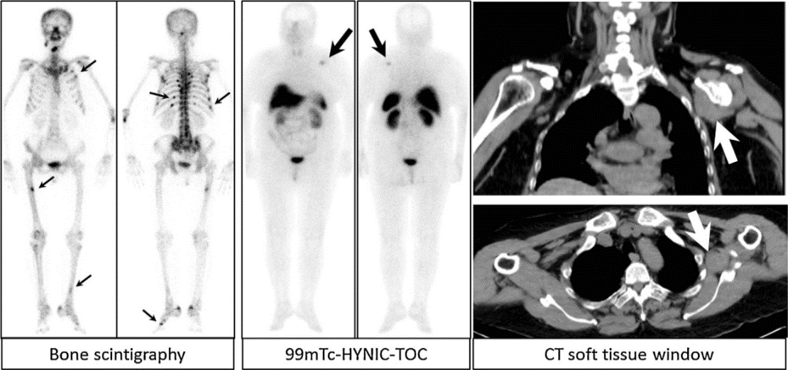
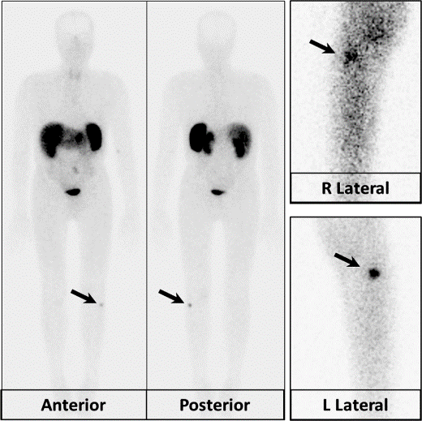
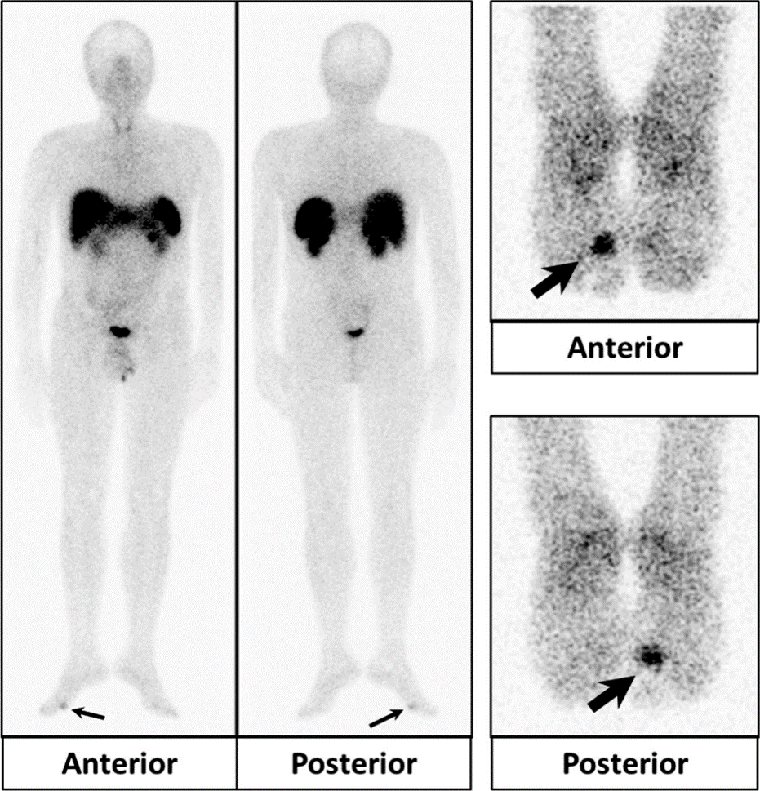
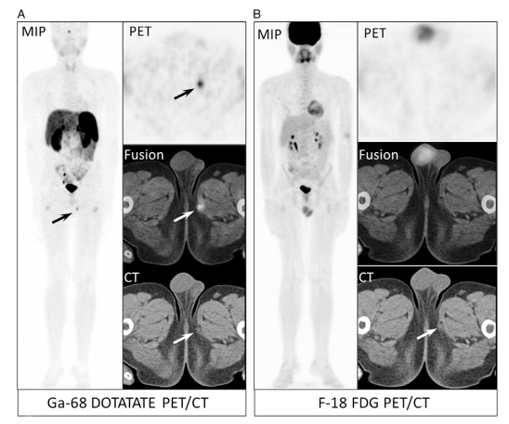
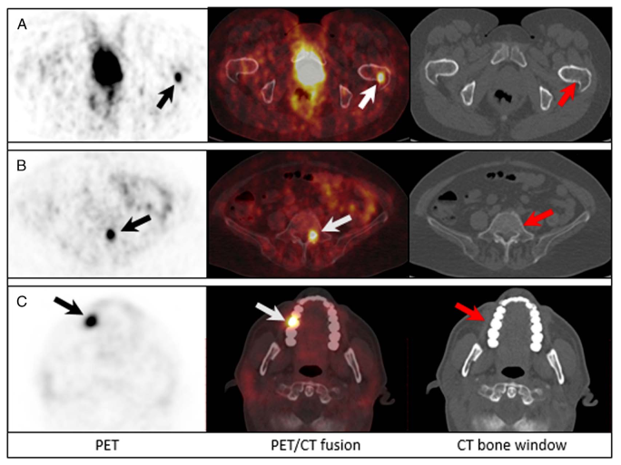
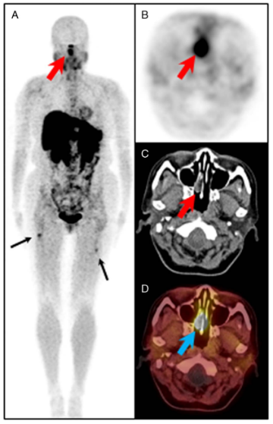
SSTR2 imaging help localize TIO.
^{99m}Tc-HYNIC-TOC SPECT imaging
⁶⁸Ga-DOTATATE PET (+)
FDG (-)
⁶⁸Ga-DOTATATE PET (+)
^{99m}Tc-TOC (-)
FDG (-)
⁶⁸Ga-DOTATATE PET (+)

Slide 9
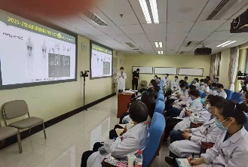
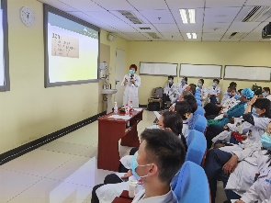
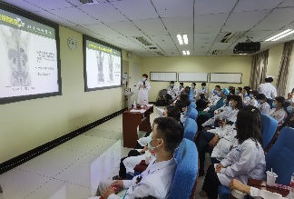
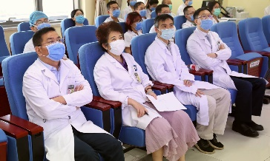
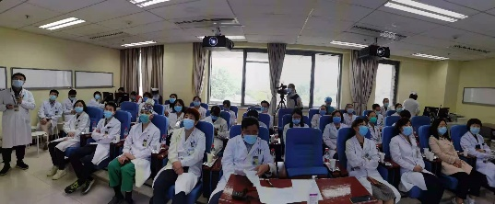
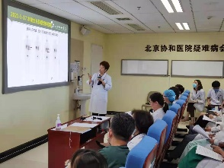
A series of translational research work promote MDT for complex, severe and rare diseases
Before(Sep,2020) 1 cycle 3 cycle 4 cycle(Dec, 2021)
¹⁸F-MFBG shows higher sensitivity than ¹³¹I-MIBG in staging primary pheochromocytoma and metastasis.
¹⁷⁷Lu TATE for patient with advanced GEP NET

Slide 10
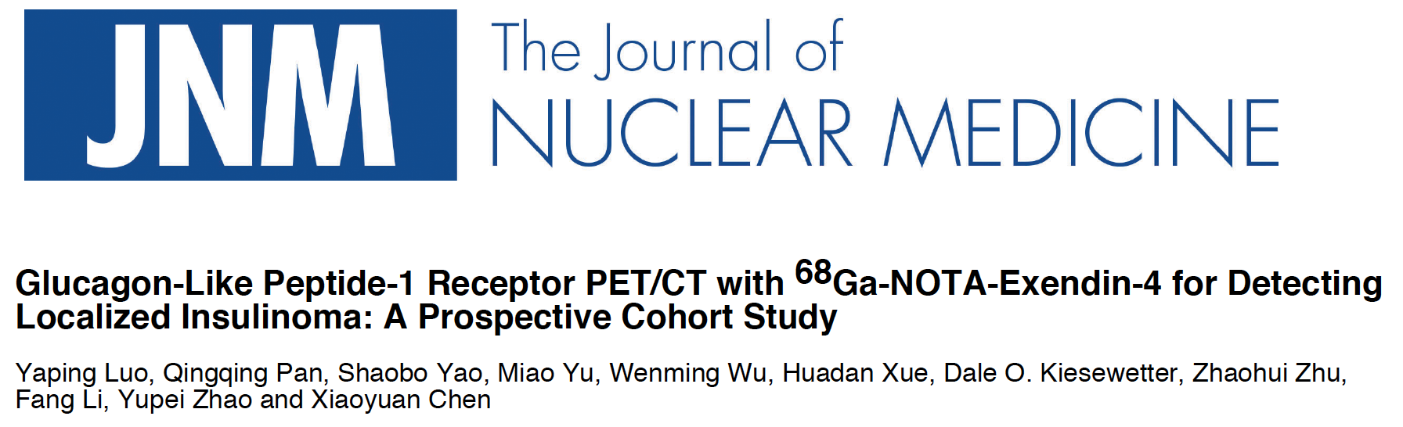
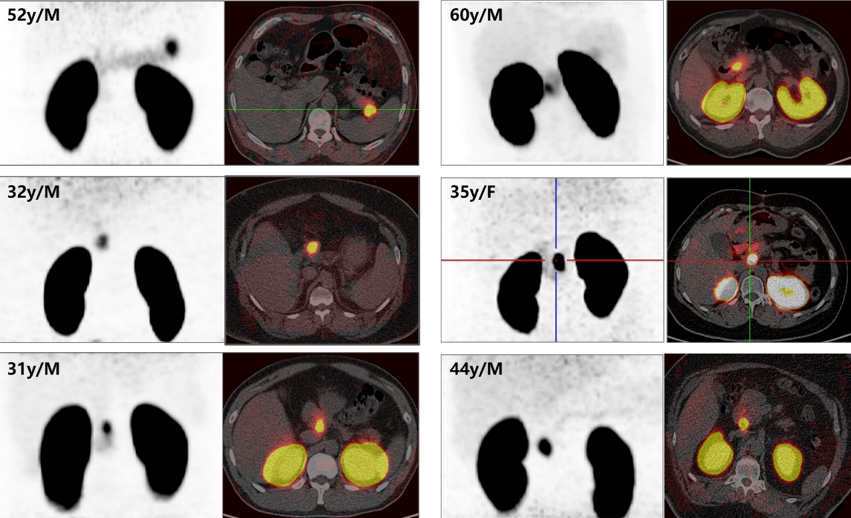
Cohort study on insulinoma detection and localization with GLP-1 receptor imaging
Data from PUMCH (~300 patients)
 | Sen | Spe | Acc | PPV | NPV
⁶⁸Ga-exendin-4 | 99.1% | 100% | 99.4% | 100% | 98.2%
CT | 80.7% | 83.7% | 81.6% | 92.6% | 63.2%
MR | 78.9% | 77.3% | 78.6% | 92.3% | 51.5%
BUS | 79.2% | 80.0% | 79.3% | 95.0% | 44.4%
SSTR | 22.8% | 97.9% | 47.3% | 95.8% | 38.1%

Slide 11
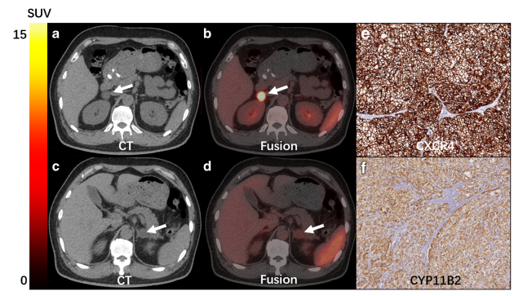
Characterization the functional status of Adrenocortical Masses using CXCR4 receptor imaging
⁶⁸Ga-pentixafor PET/CT determine aldosterone-producing adenoma
CXCR4受体是G蛋白偶联受体（GPCR），⁶⁸Ga-pentixafor与CXCR4受体特异性结合
醛固酮瘤
SAT：正常肾上腺皮质组织 A：APA
无功能腺瘤
Huo L, Ding J, et al. Eur J Nucl Med Mol Imaging(2020) https://doi.org/10.1007/s00259-020-04722-0

Slide 12
Non-invasive NM technology to help
diagnose and classify cardiac amyloidosis
NM technology is well-accepted for ATTR-CM diagnosis and treatment in China since 2019
^{99m}Tc-PYP were employed for Cardiac amyloidosis diagnosis and classification since 1970s
International journey of NM imaging application in cardiac amyloidosis

Slide 13
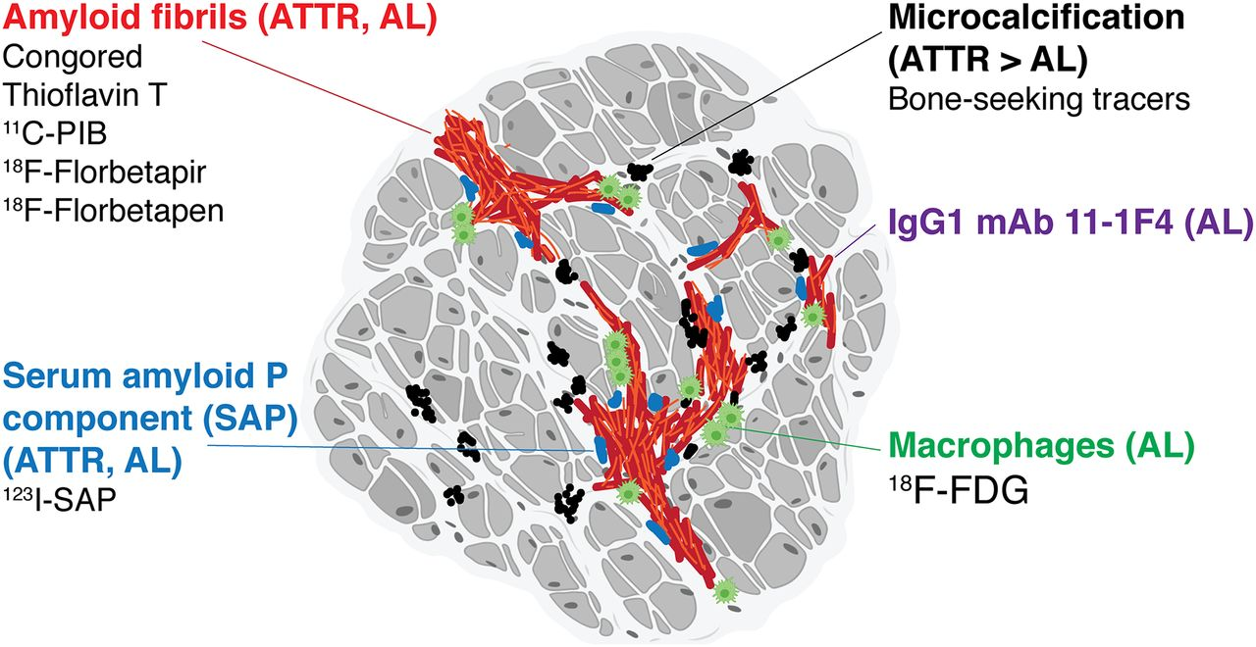
Development of NM technology to improve ATTRm diagnosis sensitivity and AL-CM risk assessment
⁶⁸Ga-FAPI for risk assessment
⁹⁹Tc^{m}-PYP SPECT/CT scan
¹¹ C-PIB, ¹⁸ F-AV45 PET/CT scan
more sensitive than PYP for ATTRm

Slide 14
Set up translational corporation platform with clinical department in PUMCH
Hematology, cardiology, endocrinology and neurology department

Slide 15
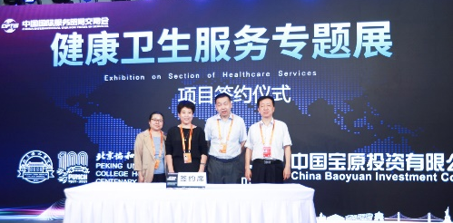
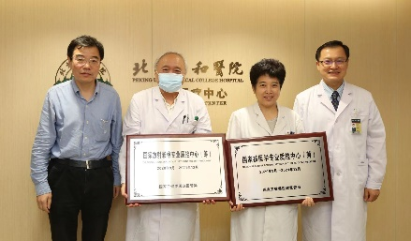
Collaboration with universities, institutions, companies and government for NM translational research in PUMCH
PUMCH NM
（图像采集与诊断）
Nuclide production
Image data analysis
Quality control
Radiopharmaceutical
Beijing Xiantong International Pharmaceutical Technology Co., Ltd.
Yantai Dongcheng Biochemicals Co.,Ltd.
Peking university
Standford university
Beijing Normal University
Fuwai hospital, CAMS.
Huayi Technology Co., Ltd
CHINA NATIONAL NUCLEAR CORPORATION
Tsinghua University
Beijing Institute of Technology
Institute of Automation, Chinese Academy of Sciences
Nanjing University of Aeronautics and Astronautics
Medical college of University of Vienna
Finland national PET center
National center for nuclear medicine quality control

Slide 16
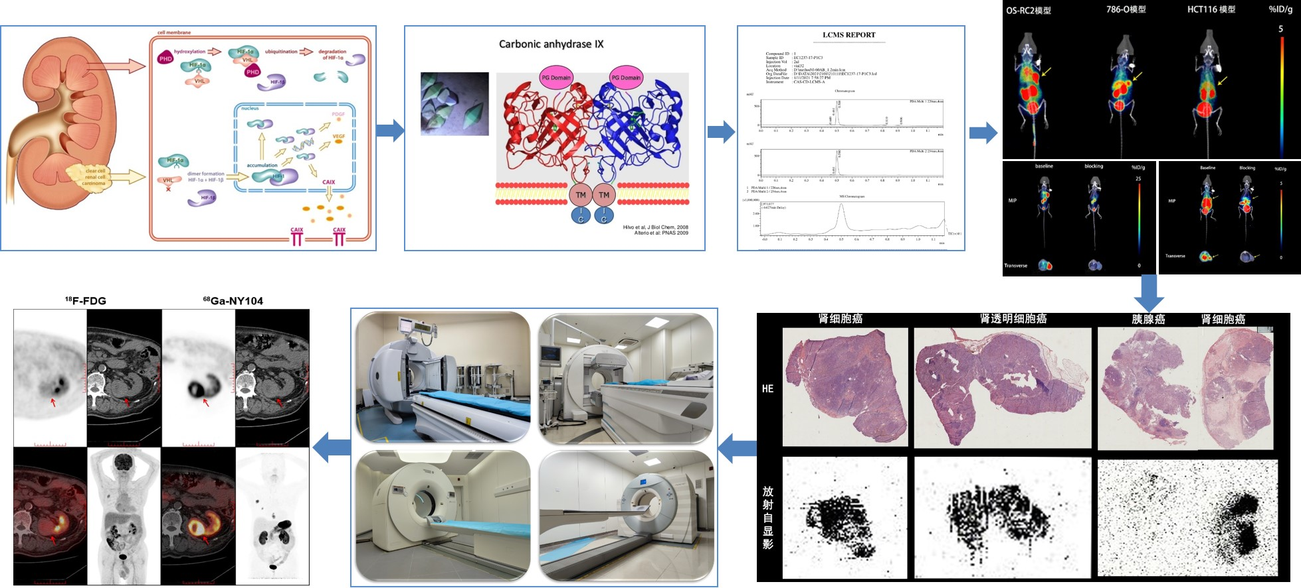
Bench to Bed, characteristic of
NM translational research work in PUMCH
Strengthening basic research and developing new theranostic tracer for renal cell carcinoma.

Slide 17
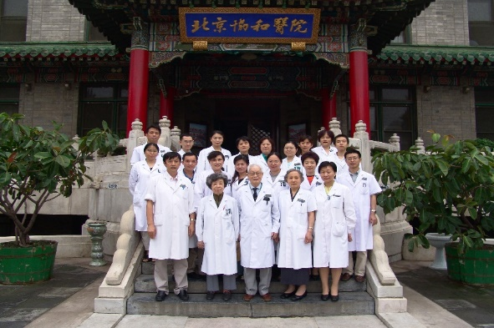
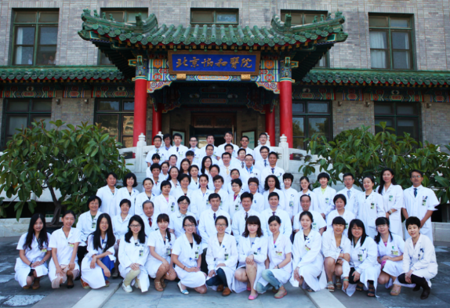
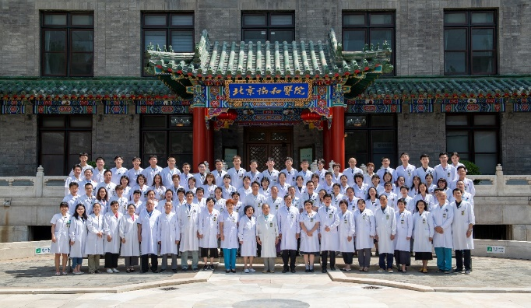
Thank for your attention
huoli@pumch.cn
Nuclear medicine department, Peking Union Medical College Hospital,
1 Shuaifuyuan street, Dongcheng District, Beijing, China.
0086+18612672038
1986
1992
2006
2017
2021

