Slide 1
real time determination of the range and Bragg-peak of protons with a depth profile camera at HZB
A. Dittwald, J. Bundesmann, A. Denker, T. Fanselow, G. Kourkafas
S. Dillenardt
HZB accelerator complex
camera system
LabVIEW – readout and visualization
results
conclusion
patent
pending
23rd International Conference on Cyclotrons and their Application

Slide 2
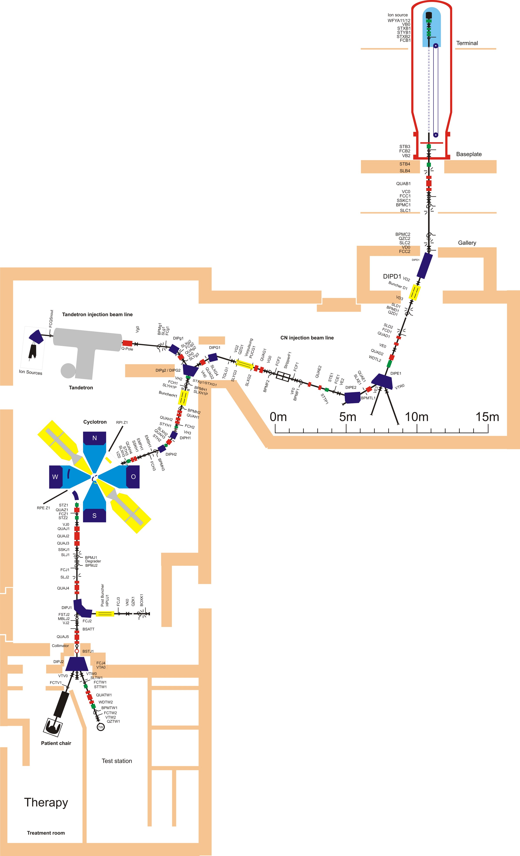
HZB accelerator complex
accelerator
two injector
2 MV Tandetron
6 MV Van-de-Graaff
isochronous sector cyclotron as main accelerator
three target stations
treatment room
experimental station
beam line end for tests in cyclotron vault
eye tumour therapy since 1998 with over 4300 patients
normal determination of the Bragg curve with a water bath phantom
problem: long measuring times

Slide 3
camera system – compact data
Camera system
patent pending
consists of a phantom, a luminescent layer, a housing and a camera (FLIR, monochrome)
low proton beam intensity of 10 pA/cm² (scattered beam is needed)
small size of 35 cm x 20 cm x 20 cm
very light with only 1.5 kg
millimetre paper in front is for alignment of the system
photo is taken in beam direction and laser crosshair for alignment is shown

Slide 4
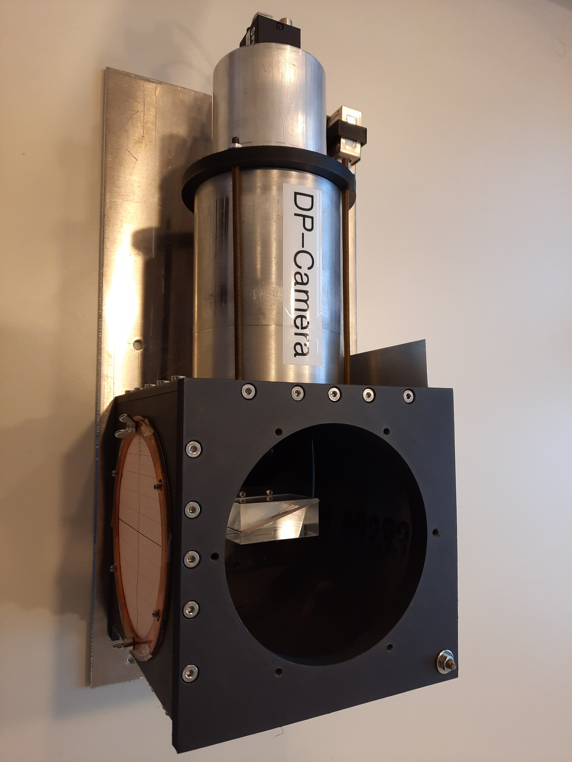
camera system – view inside
Camera System
phantom consists of two plastic blocks with the luminous layer in between -> shows Bragg-curve
camera detects the signals of the luminescent layer and is readout by a LabVIEW code
camera system is placed in a light-tight housing
camera itself is located outside of the proton field

Slide 5
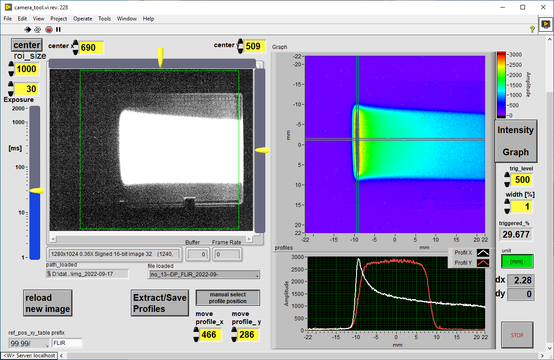
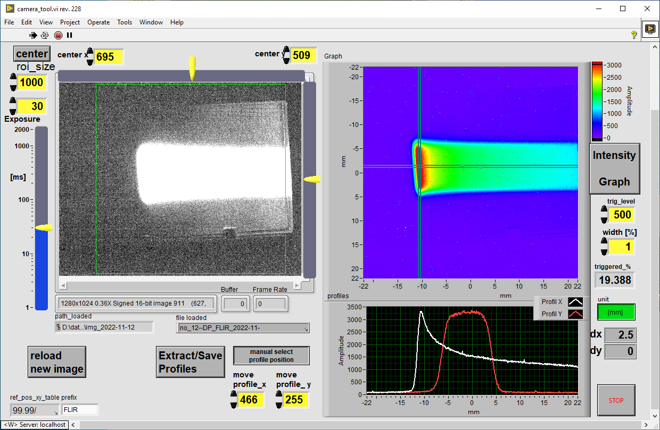
LabVIEW code: visualization of camera image
LabVIEW
left side:
live image with monochrome intensity
ROI area (region of interest) can be selected on the image (green box)
right side:
ROI area is shown with coloured coded intensities
profiles in beam and lateral to beam direction
profiles:
shown below the coloured coded intensities
live feedback of the Bragg-curve (white) and the lateral profile (red)
e.g. different apertures visible
upper image: 20 mm x 20 mm,
lower image: 10 mm x 10 mm

Slide 6
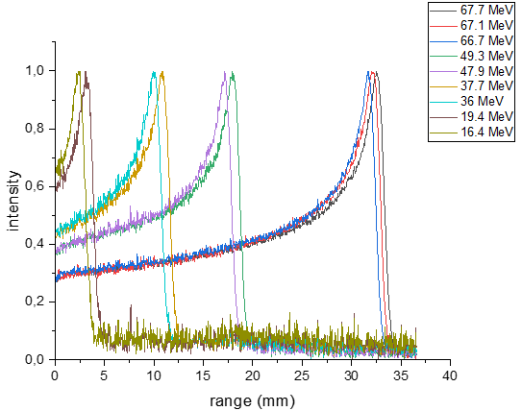
different energies of the proton beam
Results
proton beam energies from 68 MeV down to 16 MeV, achieved with absorber plates
Bragg-peak of beam with different energies directly visible
small steps of 400 keV are clearly discernible
differences between measured and theoretical values are larger at lower energies
energy | camera range [mm] | PSTAR range [mm]
67.1 | 32.96 | 32.61
66.7 | 32.46 | 32.20
19.4 | 3.86 | 3.45
16.4 | 3.02 | 2.57
ranges are taken at 80% of the Bragg-peak
PSTAR: https://physics.nist.gov/PhysRefData/Star/Text/PSTAR.html

Slide 7
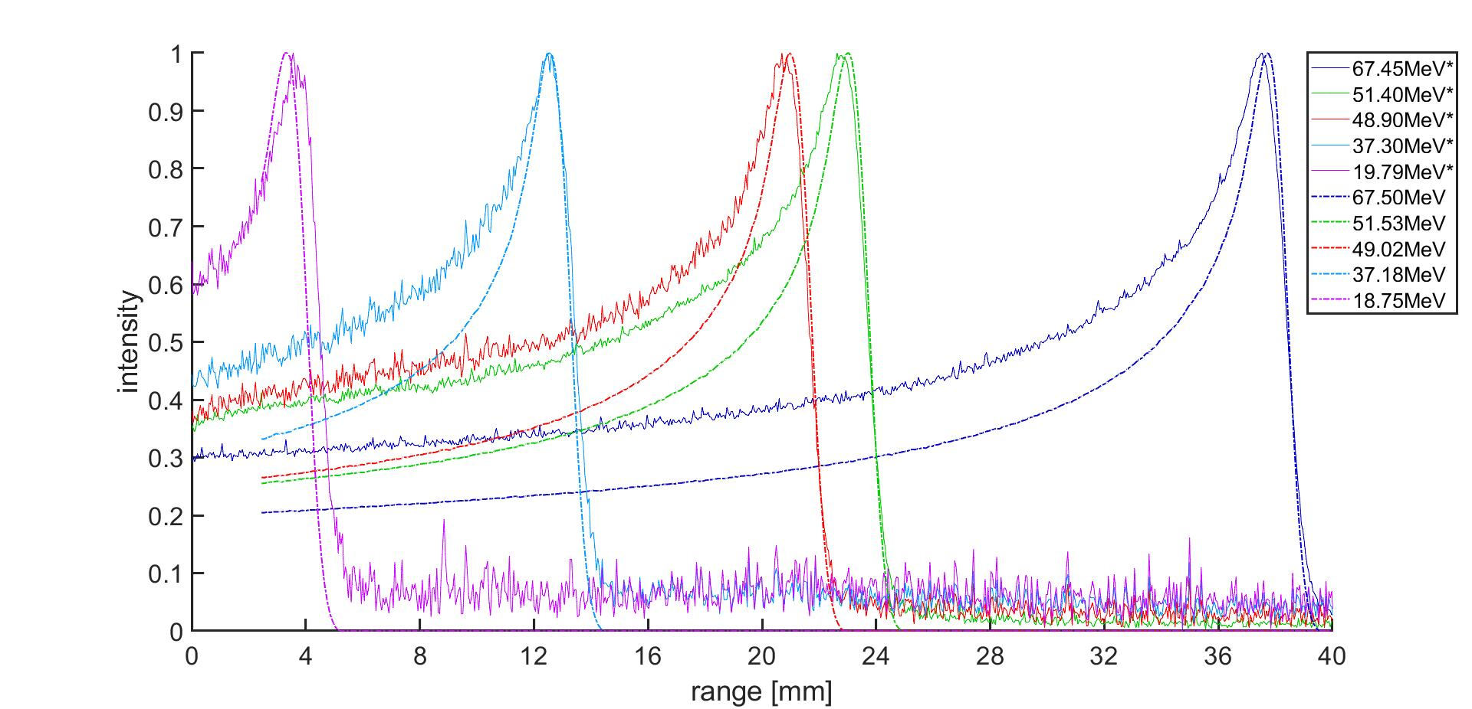
camera system vs. water phantom
results
measured ranges of the camera system were converted to water ranges
in direct comparison the Bragg-curves are very similar
less noisiness of the camera graphs when using scattering system close to the camera -> influence of the beam scattering system (neutrons)
Difference explained by:
uncertainties for phantom and absorber materials or interaction layers
geometry of camera lenses
measurements with the camera system (solid line)
measurements with the water bath (dashed line)

Slide 8
minimum energy resolution
results
single pixel resolution of 40 keV feasible?
thin aluminium foils
ranges are given for phantom material
-> energy loss of 100 keV is measurable
foil thickness [µm] | measured ranges [mm] | calculated energy [MeV]
0 | 33.20 | 67.90
20 | 33.16 | 67.84
40 | 33.13 | 67.81
75 | 33.08 | 67.75
150 | 33.96 | 67.61

Slide 9
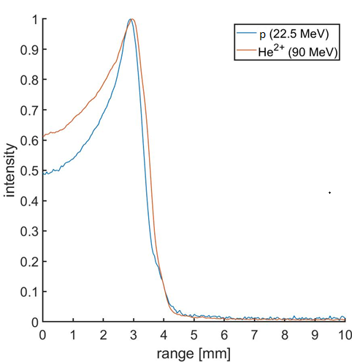
different ion species
results
different ions chosen: p (22.5 MeV), ⁴He²⁺ (90 MeV)
same range for both ions
calculate energies taking to account exit foil and air pass
good agreement for calculated and measured values
difference between calculated energy and measured energy is less than 2%
ion | nominal energy [MeV] | calculate energy [MeV] | measured range [mm] | measured energy [MeV]
p | 22.5 | 19.43 | 3.40 | 19.18
He²⁺ | 90 | 78.48 | 3.37 | 76.02

Slide 10
conclusion
conclusion
inexpensive, lightweight camera system
camera system shows excellent results
works for different ions and energies
minimal energy resolution 100 keV
very good agreement with water phantom
small differences in the measurements

