Slide 1
OPAL Simulation on the Beam Transmission in the Central Region of Medical Cyclotron COMET
Ch. Baumgarten, P. Frey, M. Hartmann, R. Kan, M. Kostezer, A. Muelhaupt, M. Schippers, A. Schmidt, J. Snuverink, H. Zhang(Speaker) :: Paul Scherrer Institute
December 7, WEAO01, CYC2022, Beijing, China

Slide 2
Outline
Introduction
OPAL Simulation
Model of COMET Central Region
Field Maps
Initial Conditions
Simulation Results
Experiment
Summary

Slide 3
The Story Starts from Varian/ACCEL
Top View of COMET Central Region
It was reported by Varian Medical Systems Particle Therapy GmbH, Germany
Puller shifted 0.56 mm towards the center
Beam intensity passing the FFS increases from 2500 nA to 4000 nA
60% improvement
Configuration could be further optimized

Slide 4
Motivation
A high FFS transmission is an important step towards an extracted beam of high intensity
Desirable for FLASH proton therapy.
Simulation may be helpful to quantify the factors correlated with FFS transmission.
Simulation may shed more light on further improvement

Slide 5
OPAL Simulation
OPAL is a parallel open source tool developed at PSI for charged particle optics in accelerators and beam lines.
In OPAL simulation, a particle can only cycle anticlockwise inside a cyclotron.
In medical cyclotron COMET, protons cycle clockwise.
The model in this simulation is a mirror image of the real machine.
Particle tracking starts from the chimney opening at t = 0.
φ₀ is the initial RF phase at t = 0.
V_{puller} = -V₀cos(ωt+φ₀)
ω = 2πf, f = 72.61 MHz, V₀ ≈ 80 kV

Slide 6
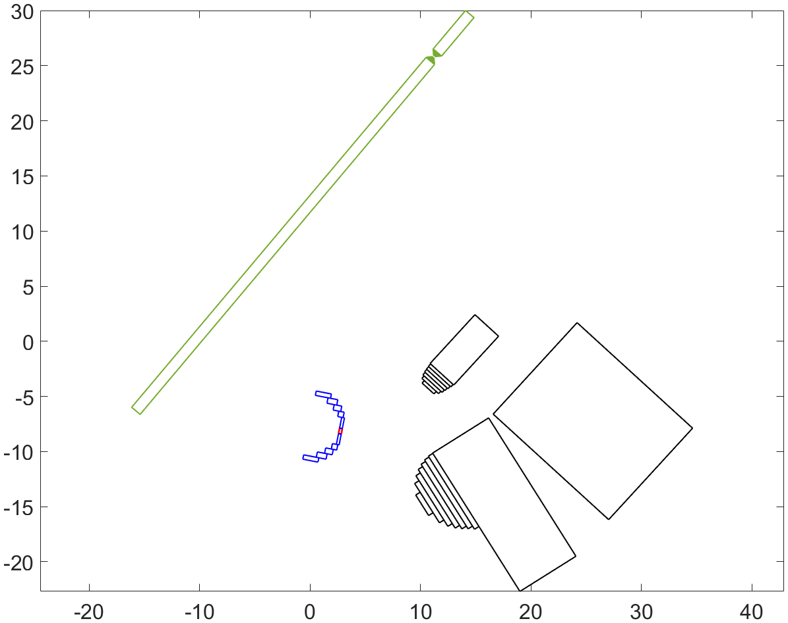
OPAL Model for COMET Central Region
OPAL uses only rectangular collimator blocks in a cyclotron
Chimney is modeled by 12 rectangular collimator blocks
Opening 0.5 mm wide and 3 mm high
Chimney rotation is implemented
Puller is modeled by 16 rectangular collimator blocks
Puller shift is implemented
FFS is modeled by 10 rectangular collimator blocks
Shifting, opening and closing of FFS are implemented
Puller
Chimney
FFS

Slide 7
Radial PROBEs FFS_FRONT & FFS_END
PROBE in OPAL is a rectangular plane defined by its two corners (xstart, ystart, zstart) and (xend, yend, zend)
PROBE has no effect on a passing particle
PROBE registers the state of a particle upon passing the probe
(x, y, z, p_{x}, p_{y}, p_{z})
Two PROBEs are created
FFS_FRONT just in front of FFS
FFS_END just behind FFS
FFS_END
FFS_FRONT

Slide 8
Particle Tracking in Electromagnetic Fields
OPAL features particle tracking through electromagnetic field maps
2D/3D, static/RF, separated/overlapped
2D static magnetic field map in the median plane from TOSCA simulation
Unit: mm & kGauss
∼2.4 T in the central region
∼3 T near extraction
3D E-component of RF field 1700×1700×30 mm³ from ANSYS RF simulation
Unit: mm & MV/m
250 MeV in ∼650 turns
Four maps for four inner trim rods
Hard edge and uniform
Important for beam centering

Slide 9
E-Field in Central Region from ANSYS
0.00 mm puller shift
0.0° chimney rotation
0.57 mm puller shift
5.6° chimney rotation
Field map for a specific puller shift/chimney rotation calculated by ANSYS electrostatic field analysis
Chimney grounded, Dee 1/3 (Puller) at -80cos(φ₀) kV, Dee 2/4 at +80cos(φ₀) kV
φ₀ = -85:5:-75°, -74:1:-49°, -50:5:-25°, 33 φ₀ points
φ₀ from -75° to -50° important for FFS transmission

Slide 10
Zero Potential Line Shifting with Puller Voltage
0.00 mm puller shift
0.0° chimney rotation
0.57 mm puller shift
5.6° chimney rotation
Zero potential lines are determined also after applying ±80cos(φ₀) kV on Dees and 0 on chimney
Zero potential lines shift and bend outwards when φ₀ decreasing from ­0 to -80°
For φ₀ around -80°, zero potential lines bend partially outside of chimney opening

Slide 11
Initial Conditions for Particle Tracking
Reference particle starts at the center of zero potential line
E₀ = 1 eV, p₀ = 4.33E4 eV/c
10000 protons are generated from a Gaussian distribution
σ_{x} = 0.5/2/3 = 0.083 mm
σ_{z} = 3/2/3 = 0.5 mm
σ_{y} may be set to 0
Protons start on zero potential
surface approximately
σ_{px} = σ_{py} = σ_{pz} = 3.06E4 eV/c
Equivalent to σ_{Ex} = σ_{Ey} = σ_{Ez} = 0.5 eV
New
Chimney
Used
Chimney
Opening Size
0.5 × 3 mm²
Left side more eroded

Slide 12
Particle Distribution on FFS Front Surface
0 mm puller shift
0° chimney rotation
ɸ₀: -85° to -25°
right to left
Δɸ₀: 5°
Similarity between simulation and photo
d-axis: intersection between the FFS front surface and the median plane
d: distance to the center of FFS slit projected on d-axis

Slide 13
d-Histogram after 0.57 mm Shift/5.6° Rotation
0.57 mm Puller Shift/5.6° Chimney Rotation
V₀ = 79.6 kV
Higher FFS transmission requires basically narrower beam closer to FFS over a wider range of RF phase
FFS transmission depends on many factors
Position and aperture of FFS, puller position, chimney orientation, peak puller voltage, etc.

Slide 14
$\overline{d}$ and σ_{d} on FFS Front Surface vs. φ₀
V₀ = 79.6 kV
Mean beam position $\overline{d}$ and RMS width σ_{d} can be derived for each RF initial phase φ₀
The plot shows that the beams from the modified configuration fit better to FFS at V₀ = 79.6 kV

Slide 15
Number of Protons Passing FFS vs. φ₀
V₀ = 79.6 kV
Number of protons passing FFS N can be derived by particle tracking for a chosen φ₀
N plotted against φ₀ for original and modified chimney/puller configurations
FFS transmission may be derived from an integral over φ₀, equivalent to time t
The ratio between FFS transmission from modified/original configuration is around 1.7

Slide 16
Integrated FFS Transmission vs. V₀
V₀<V_{threshold}, 0 transmission
V₀>V_{threshold}, transmission increases
V₀=V_{optimal}, maximal transmission
V₀>V_{optimal}, transmission decreases
V₀∼80 kV, transmission significantly higher after puller shift/chimney rotation
Maximal transmission
Maximal transmission
V_{optimal}
V_{optimal}
V_{threshhold}

Slide 17
Experiment in COMET Cyclotron
Shim 0.57 mm thick
Thickness of shim: 0.57 mm
Clockwise chimney rotation: 5.6°
FFS aperture: 0.16 mm before
0.20 mm after
Radial probe 310 mm from center
No obstacle in between
Higher output on radial probe
FFS transmission 2.8 times higher
 | Arc current | Output
before | 80 mA | 368 nA
after | 80 mA | 1310 nA
Puller
Shim

Slide 18
Beam on Radial Probe vs. Voltage on RF Pickup
After modification
Beam current on radial probe RMJ was measured as the function of the voltage on pickups in Dees CMJLL.
The measured curve looks similar with the simulated curve of FFS transmission vs. V₀.
Operation point CMJLL = 8.4 V, RMJ = 500 nA, near maximum.
The modified configuration is almost optimal for FFS transmission.
CMJLL = 8.4 V corresponds to V₀ = 79.6 kV
0.57 mm Puller Shift/5.6° Chimney Rotation

Slide 19
Summary
The simulated particle distribution on the FFS front surface looks similar to a photo of the front side of a FFS plate.
Both simulation and the measurement indicate that the FFS transmission can be significantly improved after a 0.57 mm puller shift and a 5.6° chimney rotation.
The simulated curve of FFS transmission vs. V₀ fits well with the measured curve of the beam current on the radial probe vs. the average voltage on the pickups inside Dees, which indicates that the peak voltage on the puller is ∼79.6 kV for the routine operation.
The configuration of the central region can be further optimized to get higher FFS transmission.
The beam acceleration and extraction after the modification will be further verified through a combination of simulation and experiment.

Slide 20
Acknowledgement
Thank you for your attention!
My thanks go to
All my co-authors for excellent team work.
Oliver Boldt from Varian for communicating results and sharing experience.
Andreas Adelmann and Jianjun Yang for their support on the application of OPAL.
Lukas Stingelin for providing RF field maps.
Markus Schneider for support on the experiment with RF system.
All our students, Anouk ter Brugge, Christina Wouters, Jeroen Veenendaal, Chris van Herwaarden, Stijn Oolbekkink, Melina Lüthi, and Irene Rusetski for their invaluable contributions.

