Slide 1
Simulation and analysis of HIMM-IC
beam dynamics with OPAL
G. L. Dou^{1,2}, B. Wang¹，X. Chen^{1,2}, X. W. Wang¹, Q. G. Yao¹,, L. Yang¹,, C. C. Li¹ , L. T. Sun^{1,2} and H. W. Zhao^{1,2}
¹ Institute of Modern Physics, Chinese Academy of Sciences
² School of Nuclear Science and Technology, University of Chinese Academy of Sciences
2022.12.05

Slide 2
Content
Background
Operation status and problems
Simulation of Beam dynamics in OPAL
Summary and Outlook

Slide 3
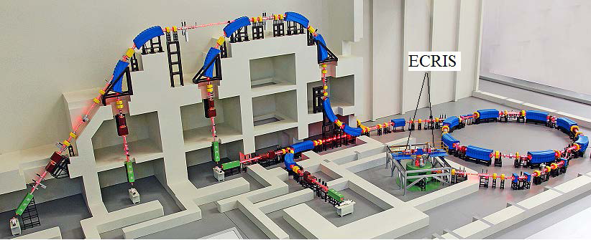
Background
China’s carbon ion therapy facility-HIMM
Heavy Ion Medical Machine
2 ECR ion sources
~7MeV/u Cyclotron
120-400 MeV/u Synchrotron
4 Treatment terminals
5 fixed irradiation ports
Maximum particle number
in the terminal (ppp) : 1.2E9
Synchrotron
Cyclotron
Fig.1 Schematic view of HIMM

Slide 4
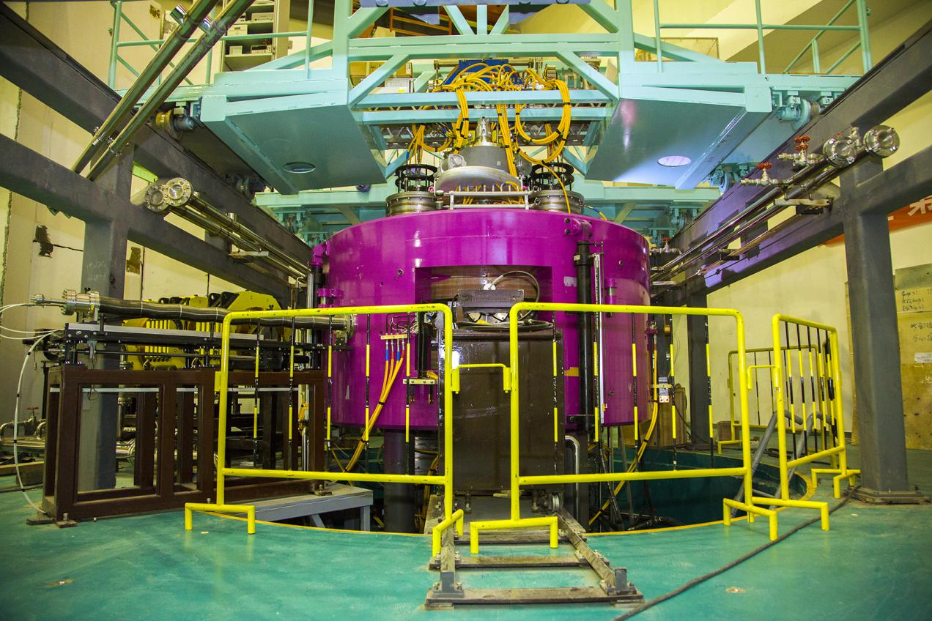
Background
China’s carbon ion therapy facility-HIMM
Heavy Ion Medical Machine-Injection Cyclotron
Compact Cyclotron
No Trimming coils
2.92m Diameter
~7 MeV/u 10 μA 12C5+
4 straight edge Sectors
Bc@1.212T Bmax@1.732T
2 RF resonators@31.02MHz
Emax@70kV
Fig2. HIMM-IC

Slide 5
Operation status and problems
Year | Operation Time(h) | Breakdown Time(h) | Operation efficiency
2020 | 7296 | 31.62 | 99.57%
2021 | 7536 | 66.05 | 99.12%
2022 | 6936 | 54.15 | 99.22%
Table1. Operation status
Fig3. Transmission
@THBI2 Status Report on the Cyclotron Injector for HIMM by Bing Wang(IMP, CAS)

Slide 6
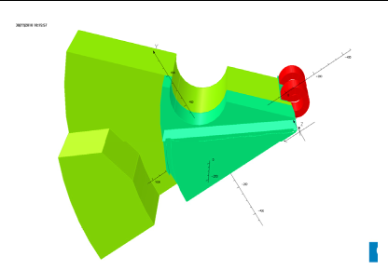
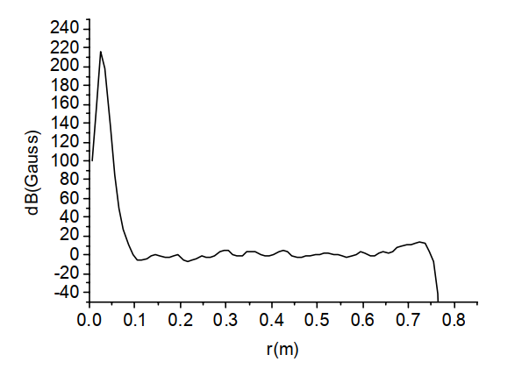
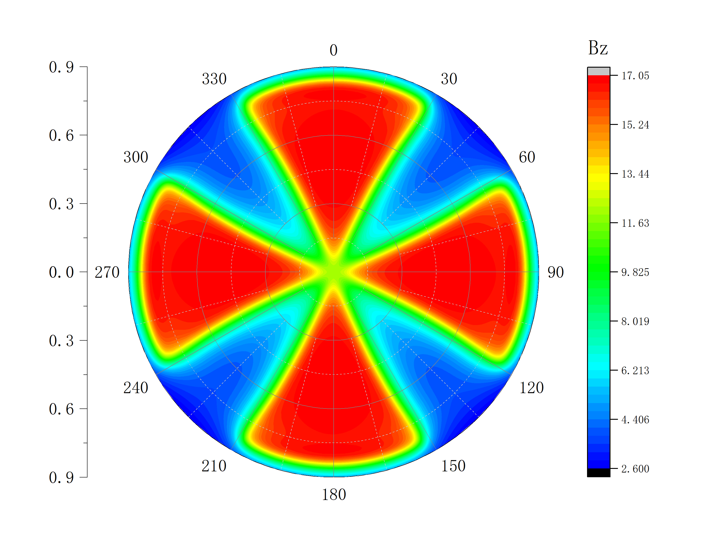
Simulations of beam dynamics
Analysis of Isochronous magnetic field
Fig4. Magnet design Model
Fig5. Errors with theoretical field
Fig6. Measurement Bz Map

Slide 7
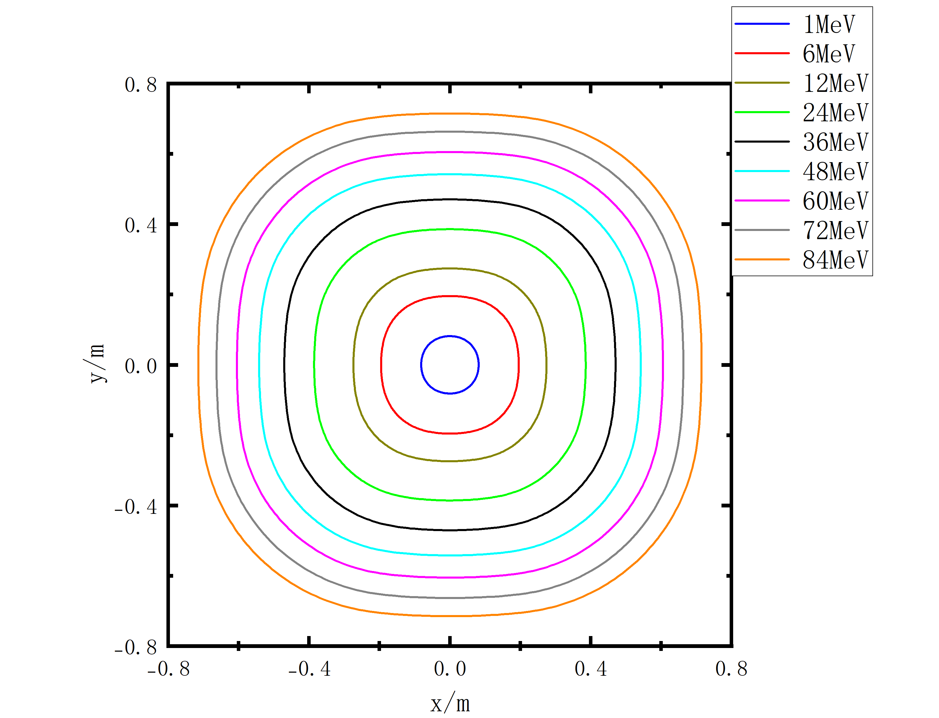
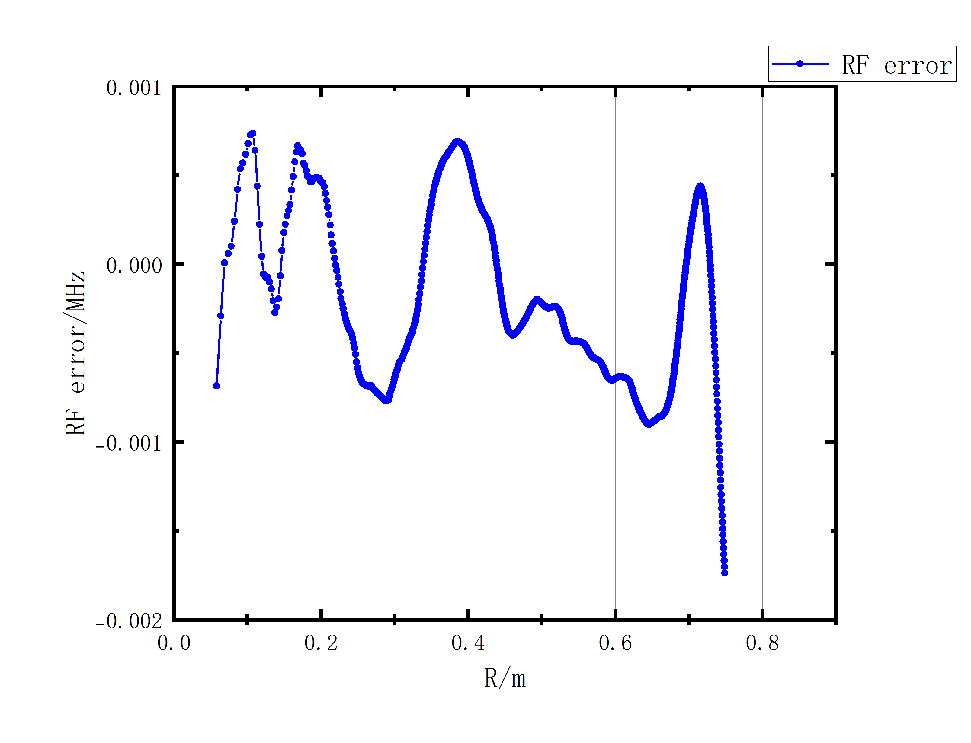
Simulations of beam dynamics
Analysis of Isochronous magnetic field
Static Equilibrium Orbit
Fig7. Static Equilibrium Orbit
Fig8. RF Error

Slide 8
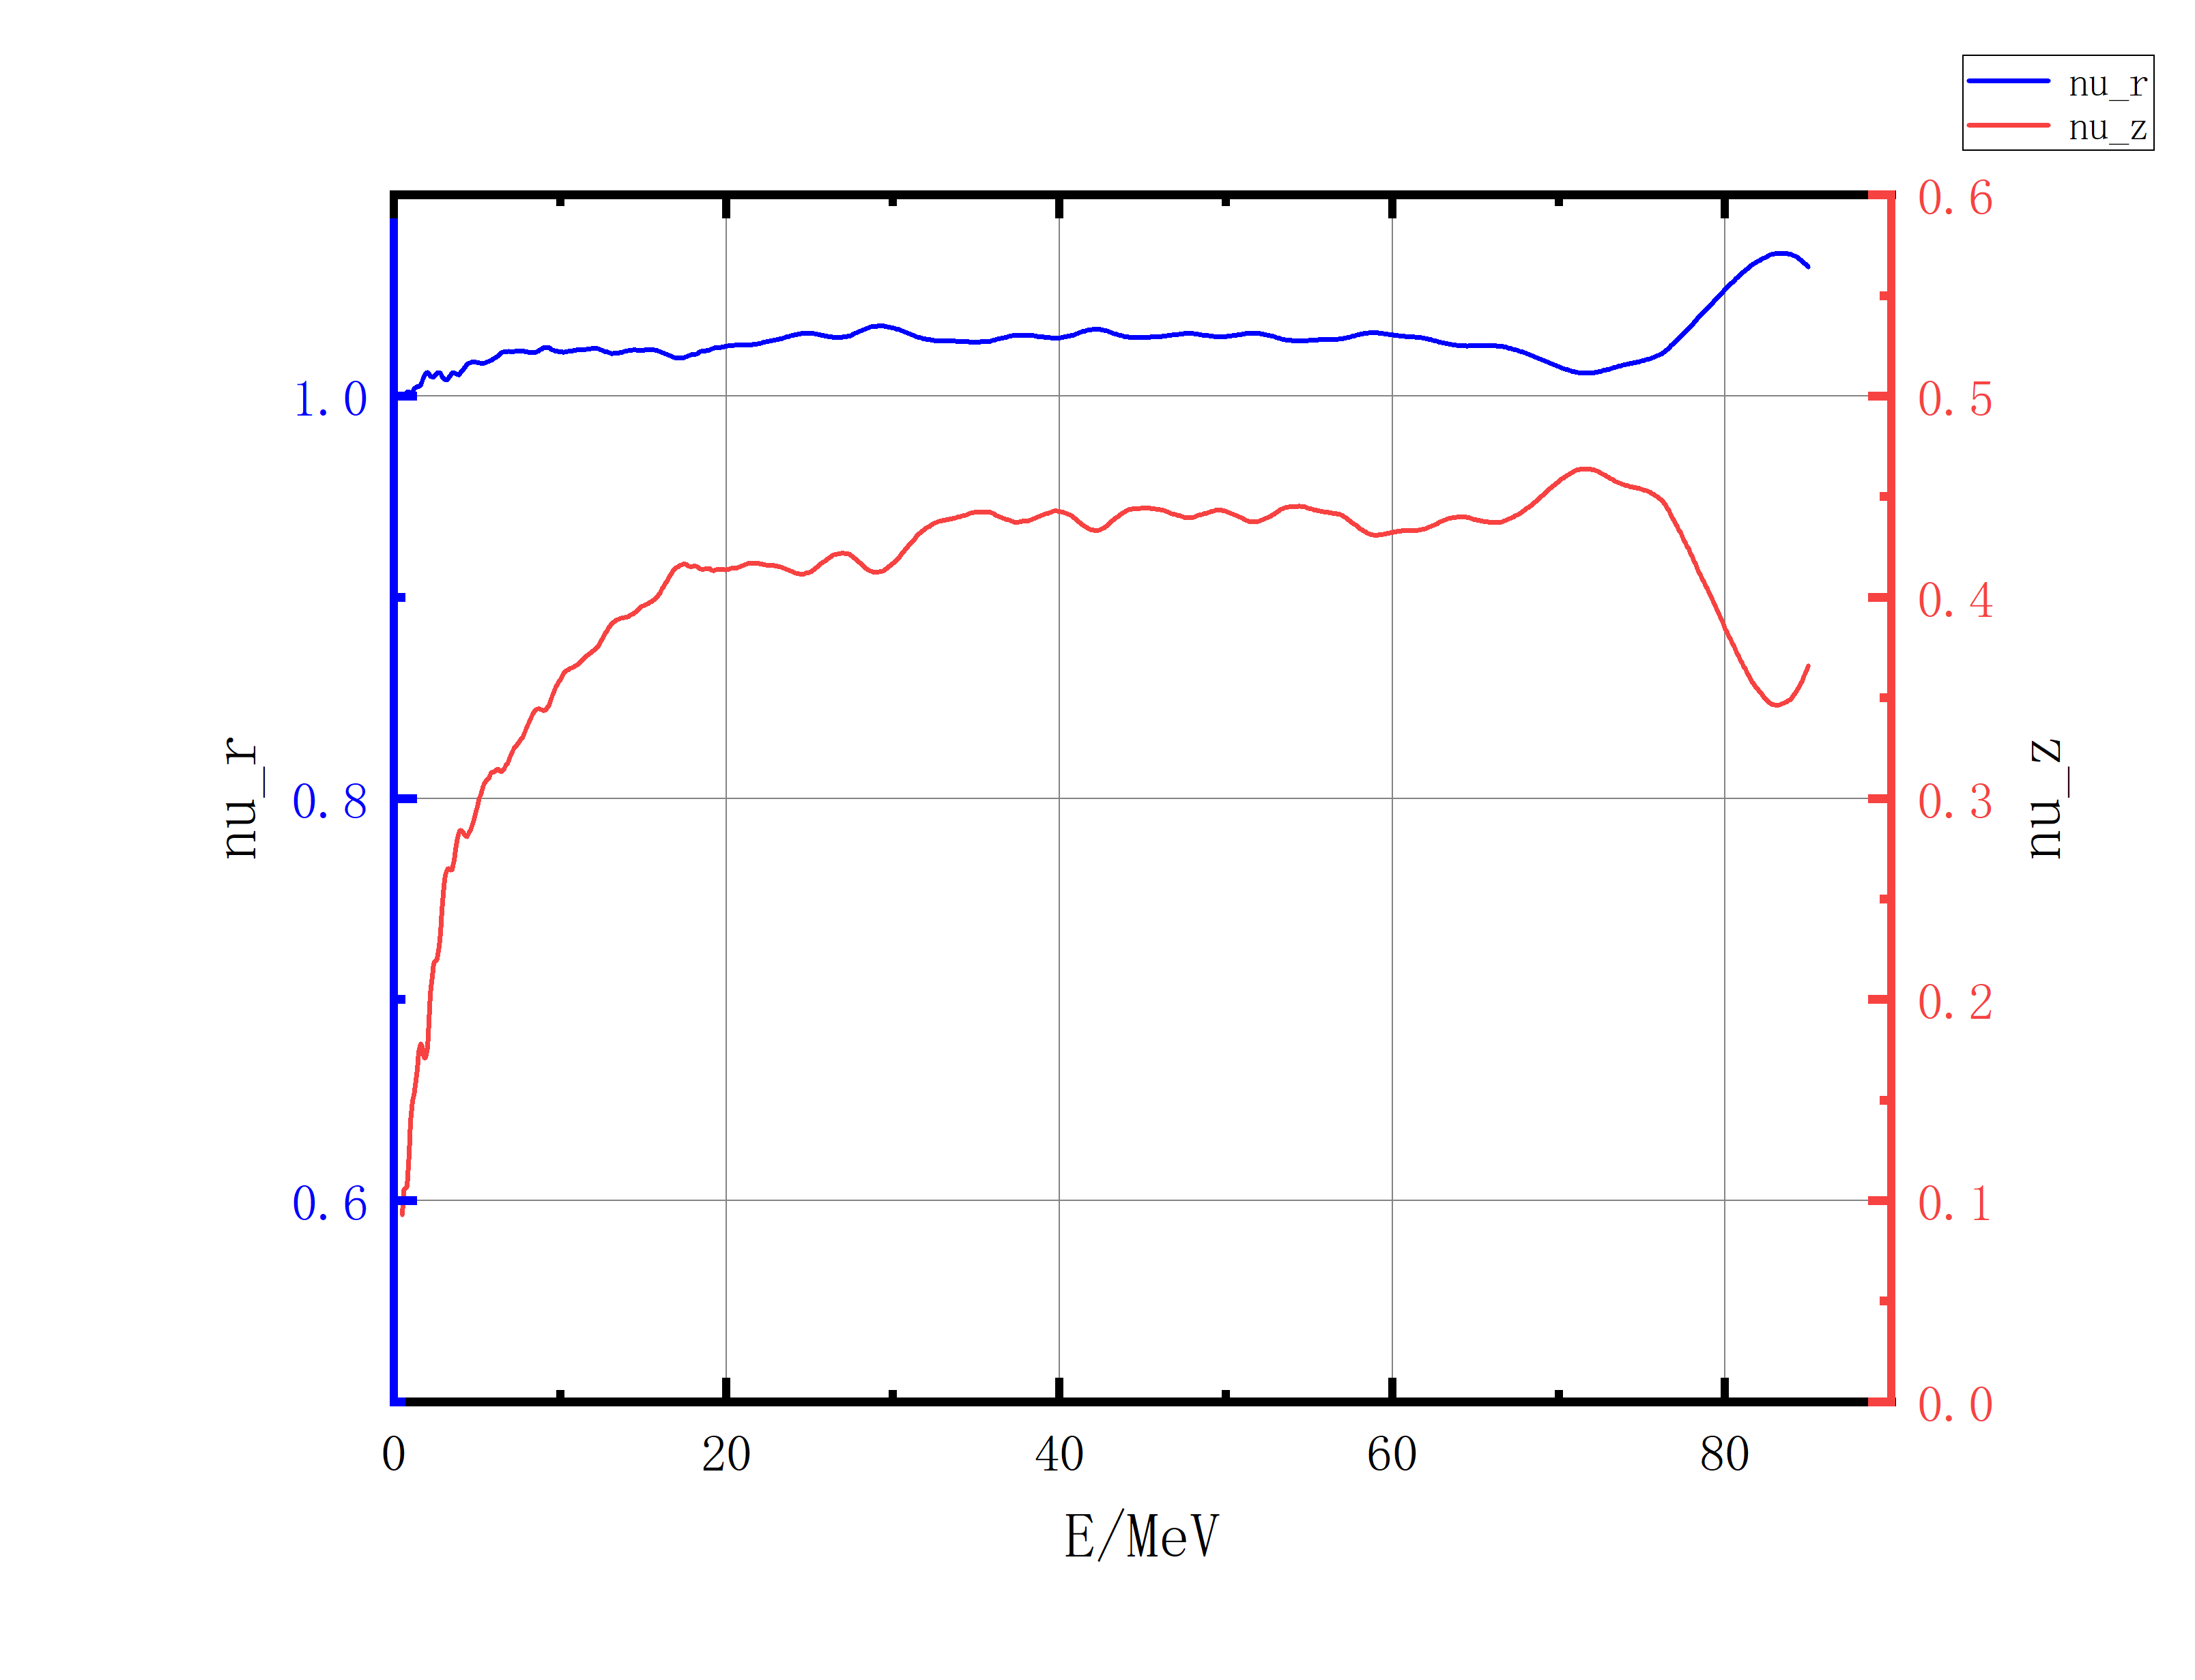
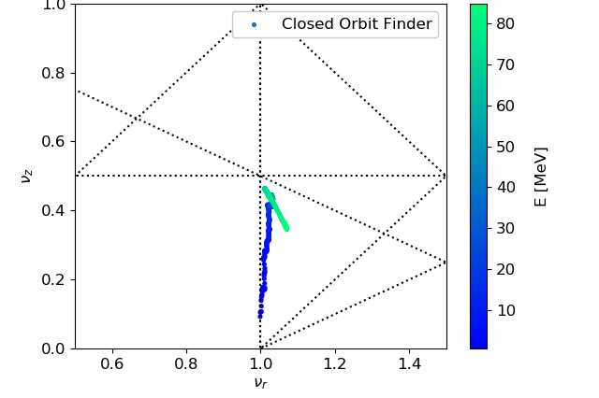
Simulations of beam dynamics
Analysis of Isochronous magnetic field
Tune Calculation
Fig9. Static Equilibrium Orbit
Fig10. Tune Diagram

Slide 9
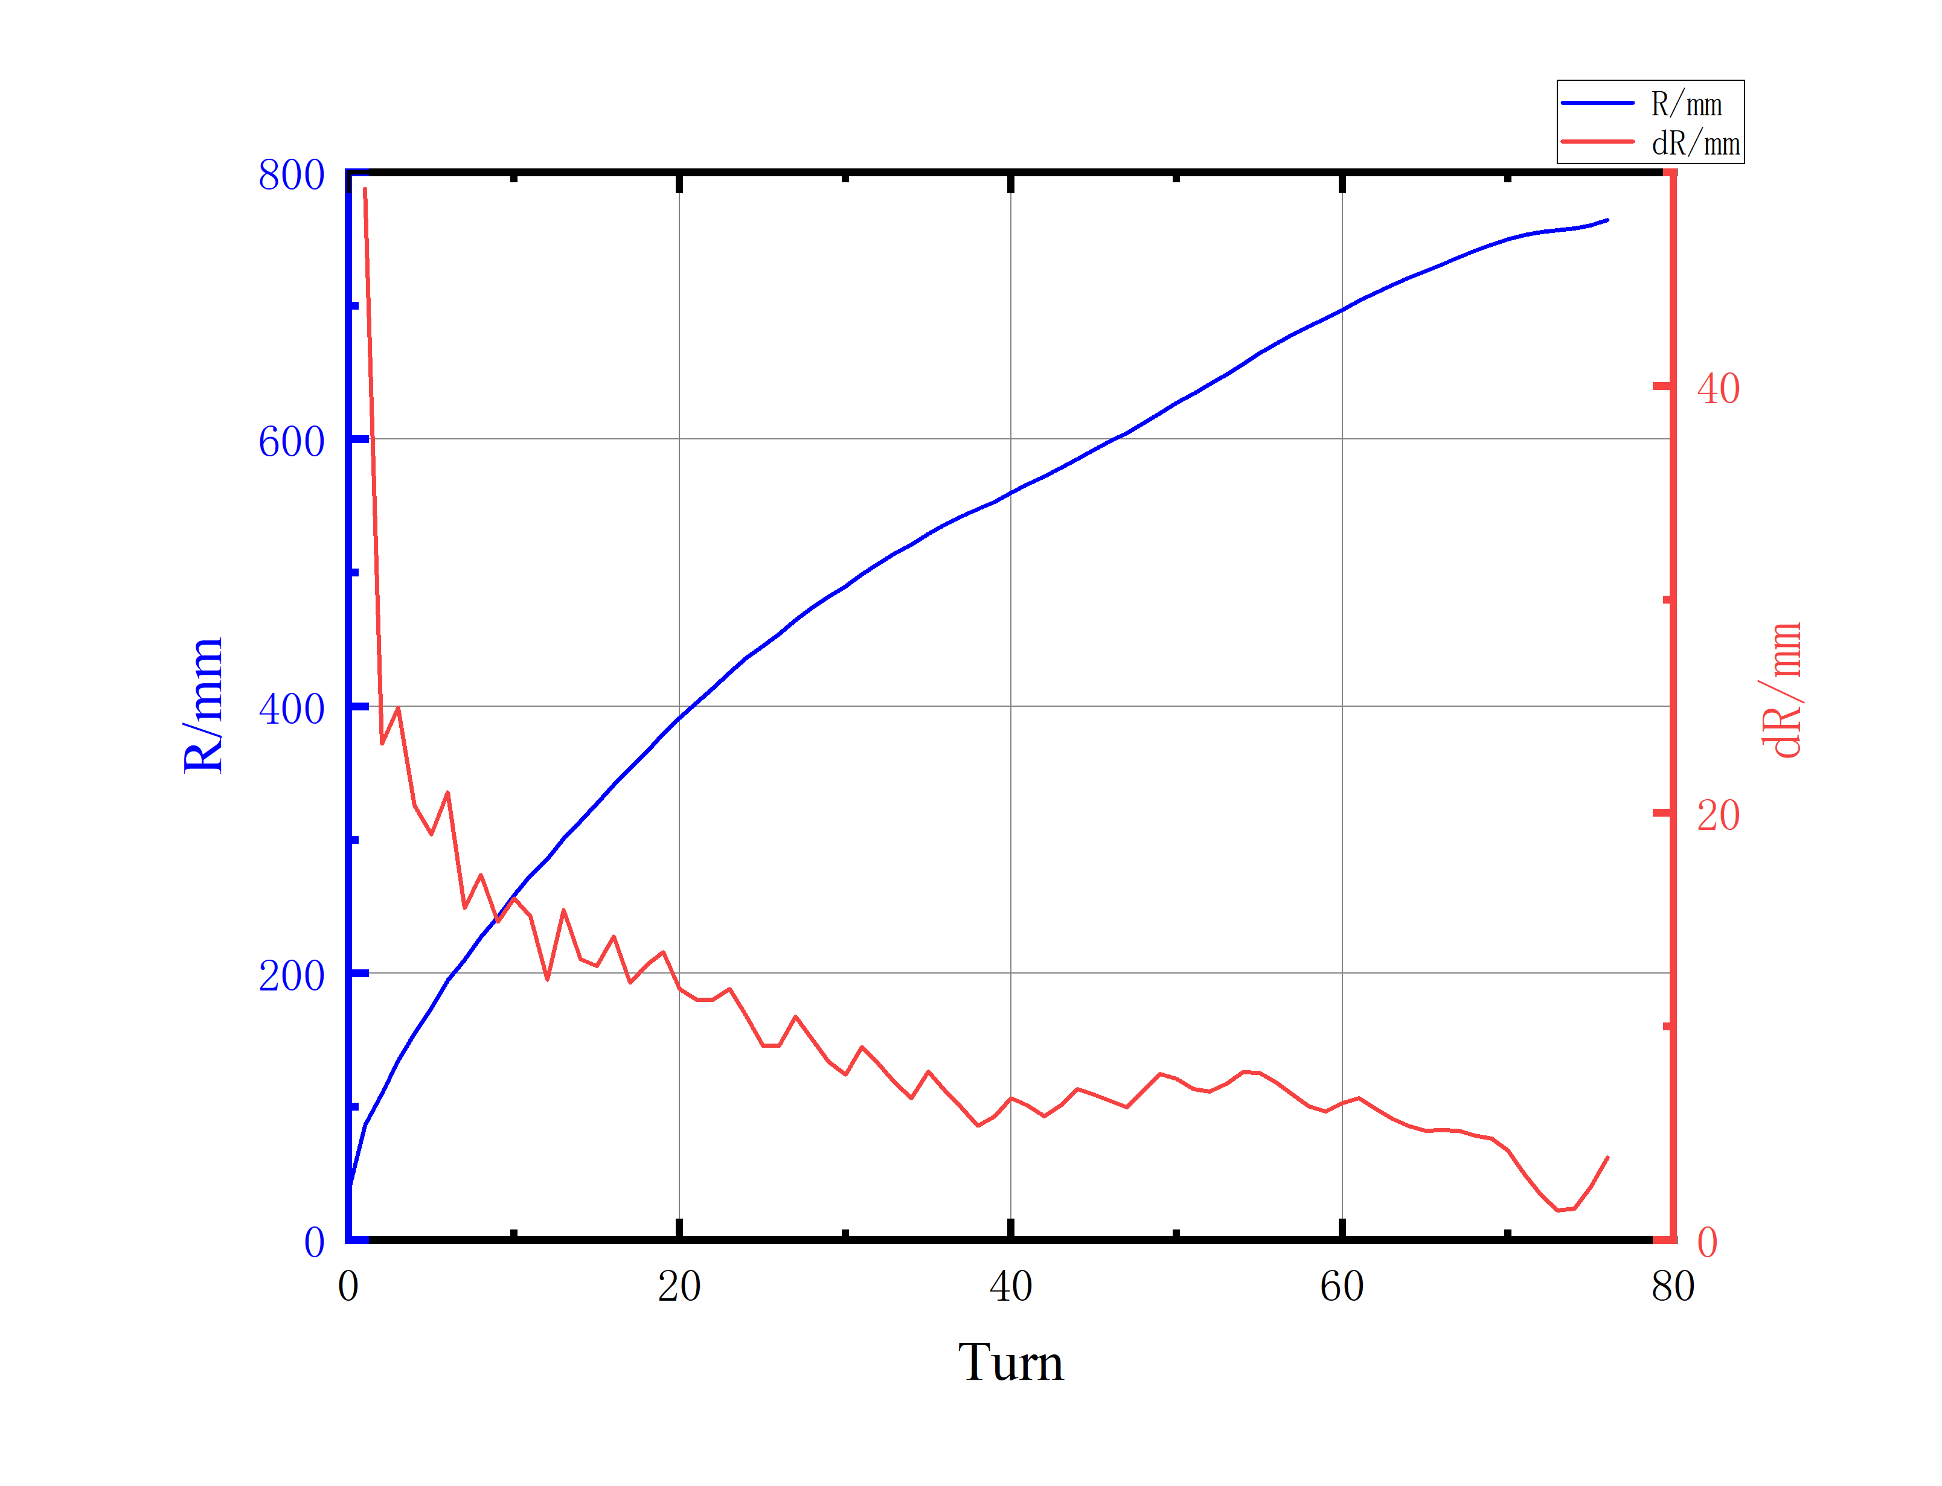
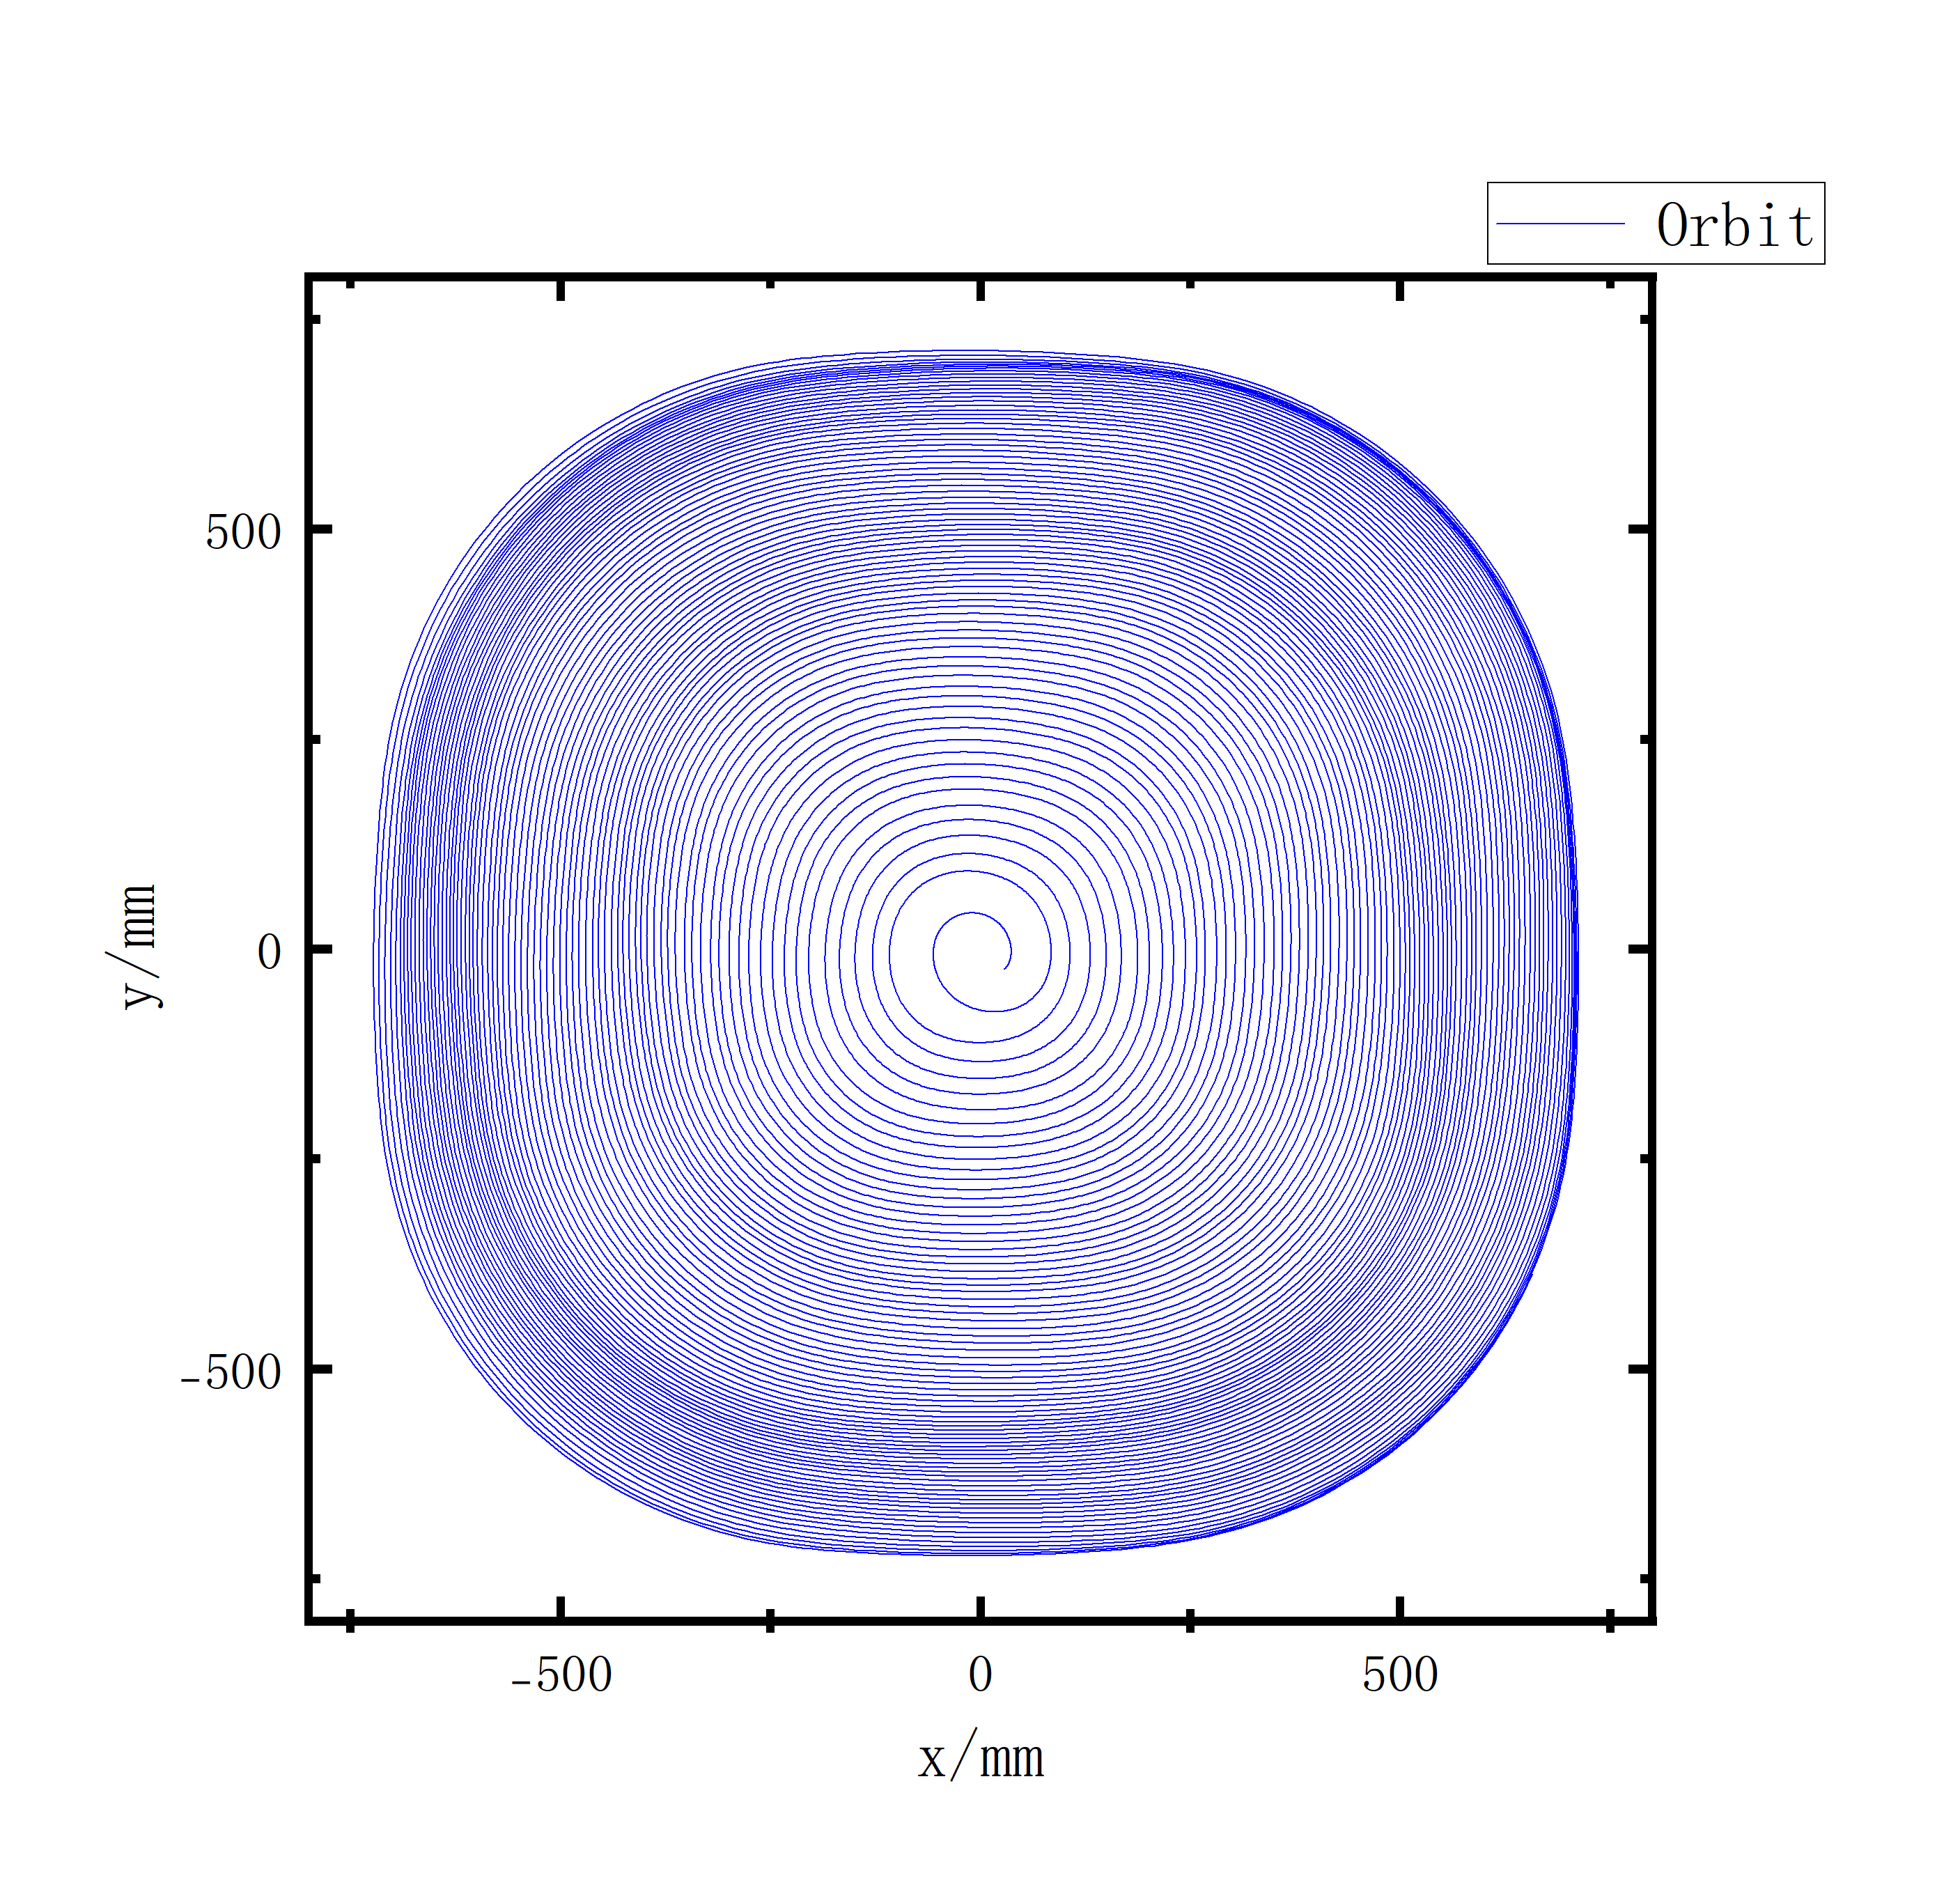
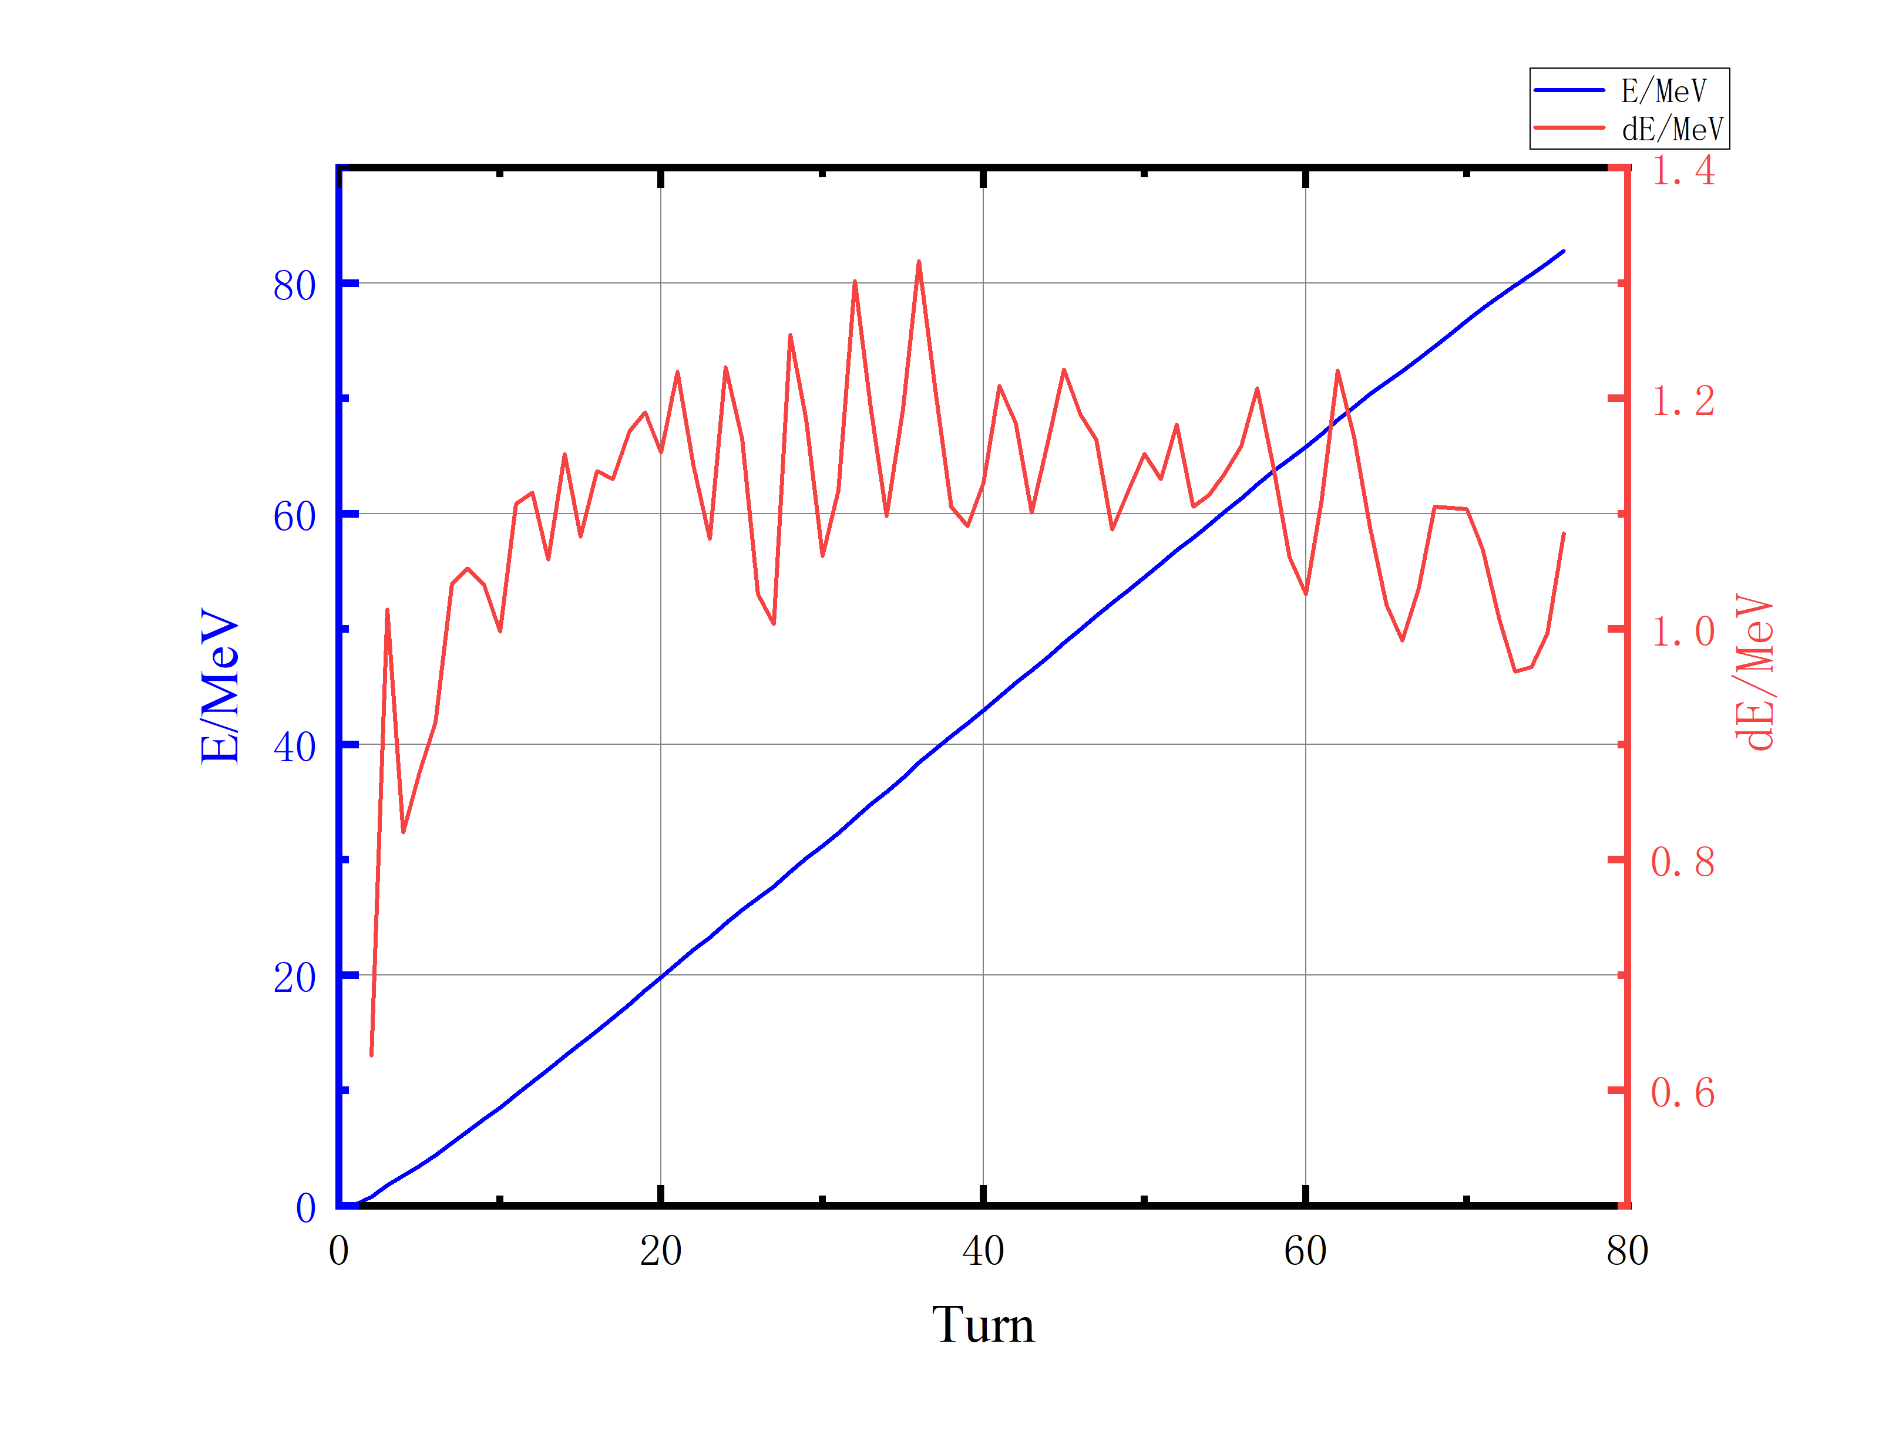
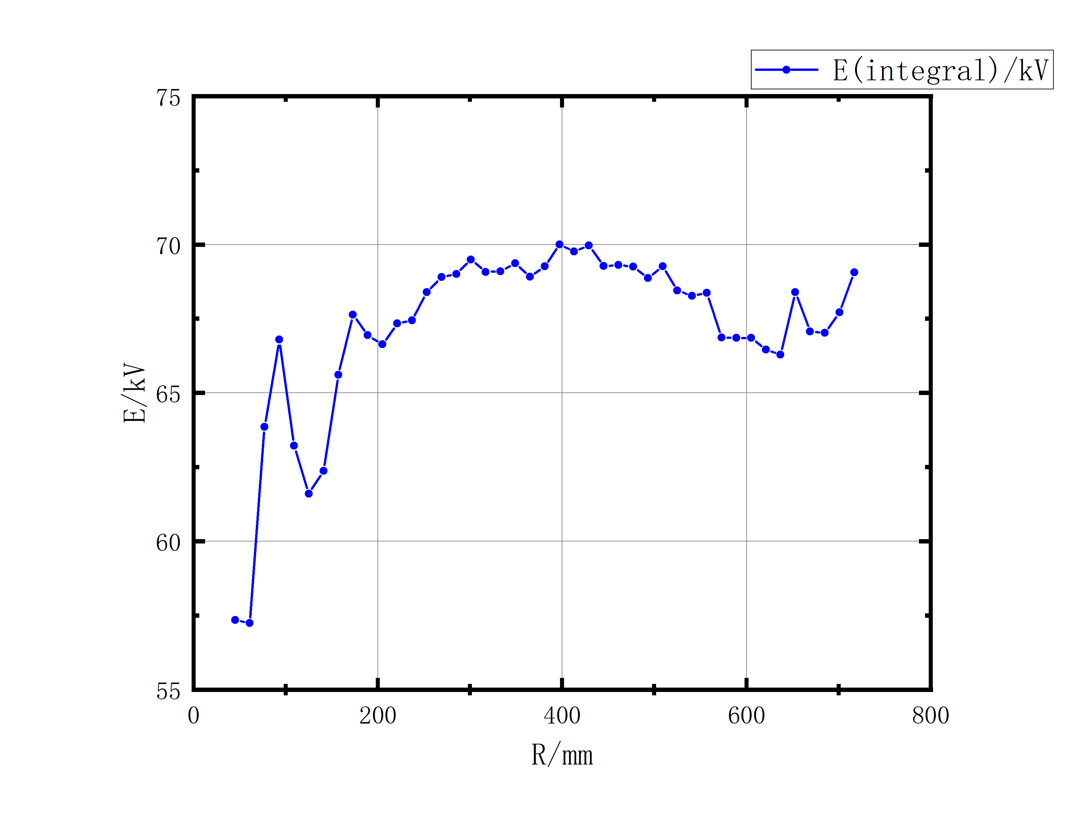
Simulations of beam dynamics
Acceleration Orbit(Single Particle)
3D RF E-fields
2D Measurement B-fields
@5mm
77 turn@84.971MeV
dR(77)~5mm
dE(average)~1.2MeV
@1.2MeV
Fig11. Acceleration Orbit
Fig12. R-dR & E-dE
Fig13. dU@integral by CST

Slide 10
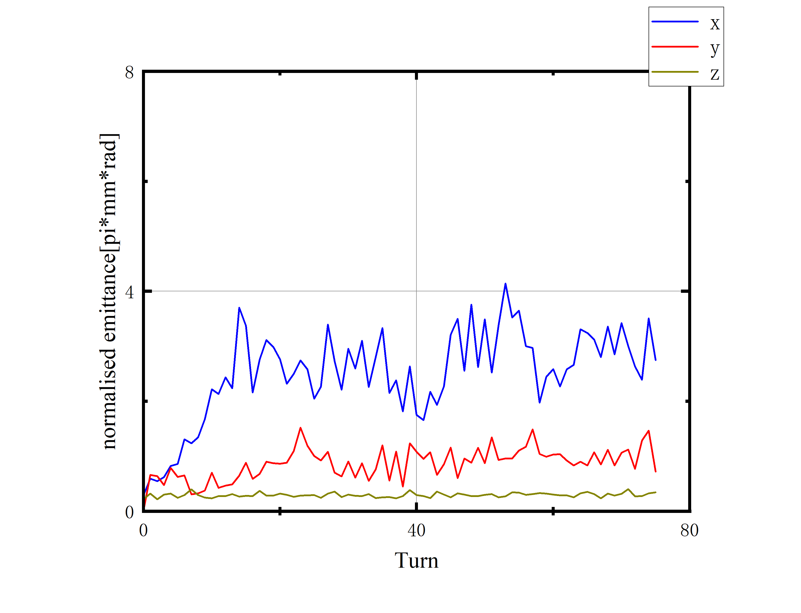
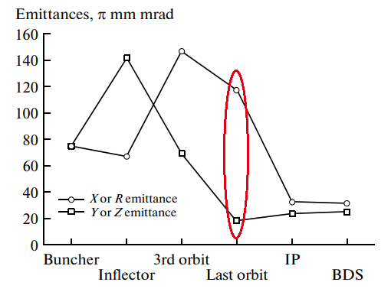
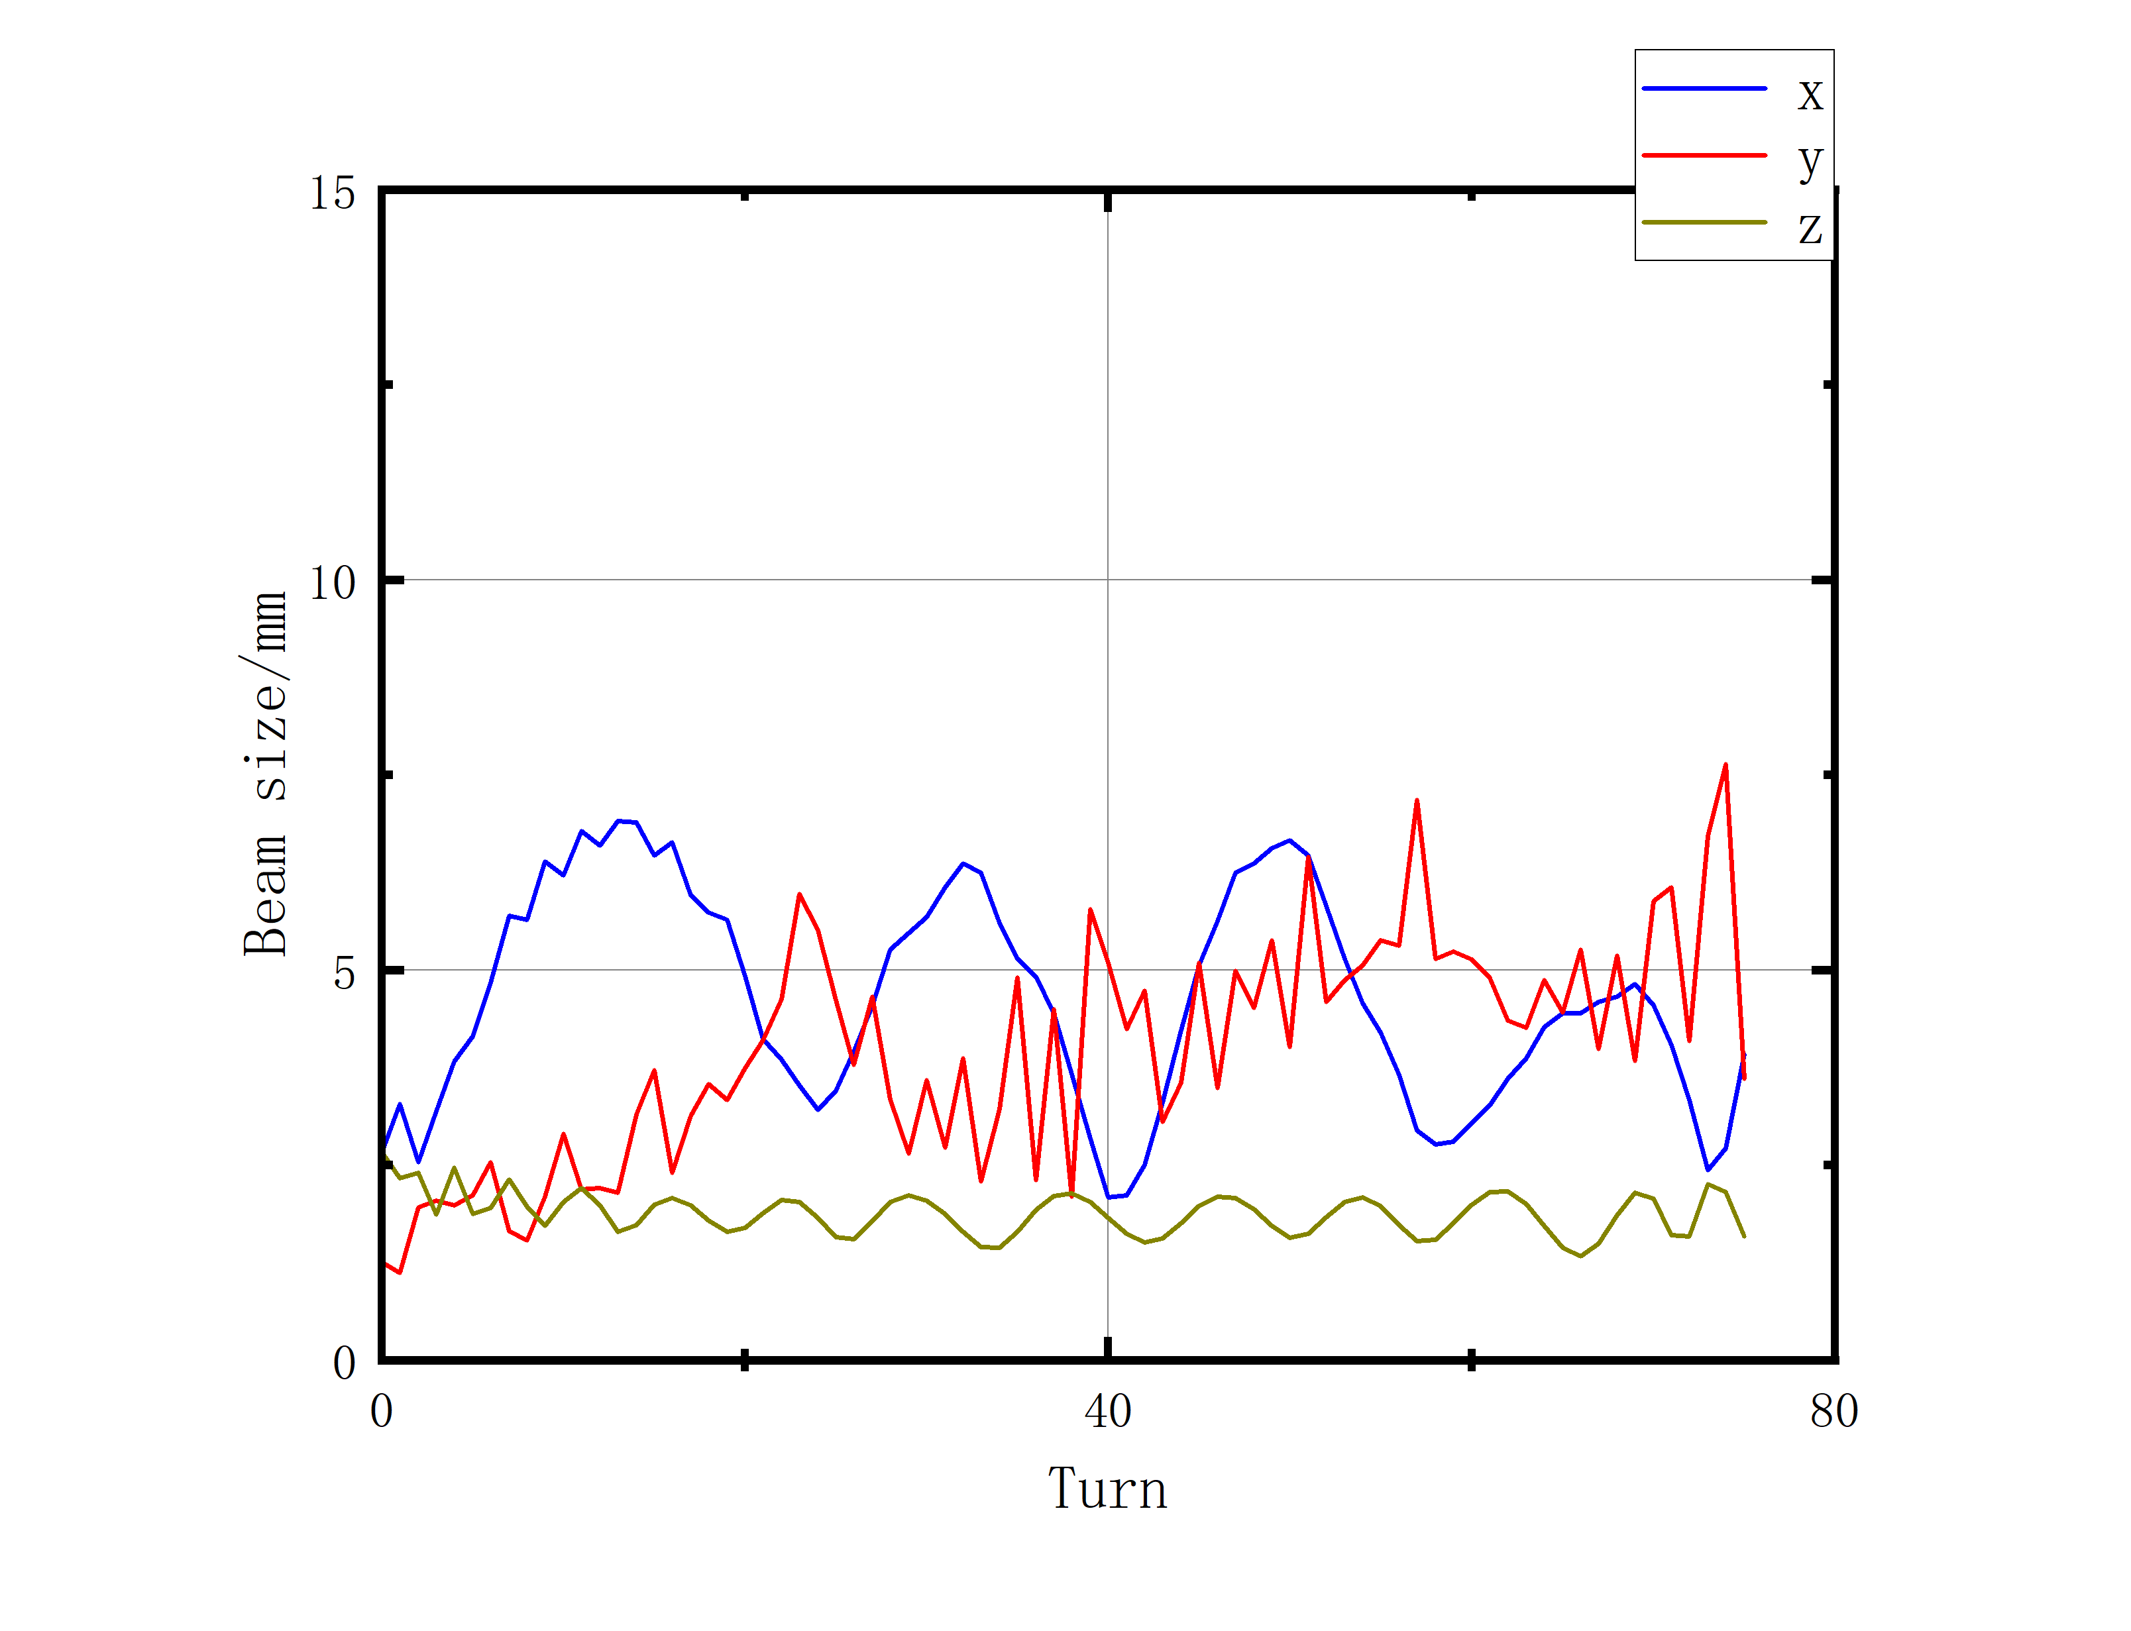
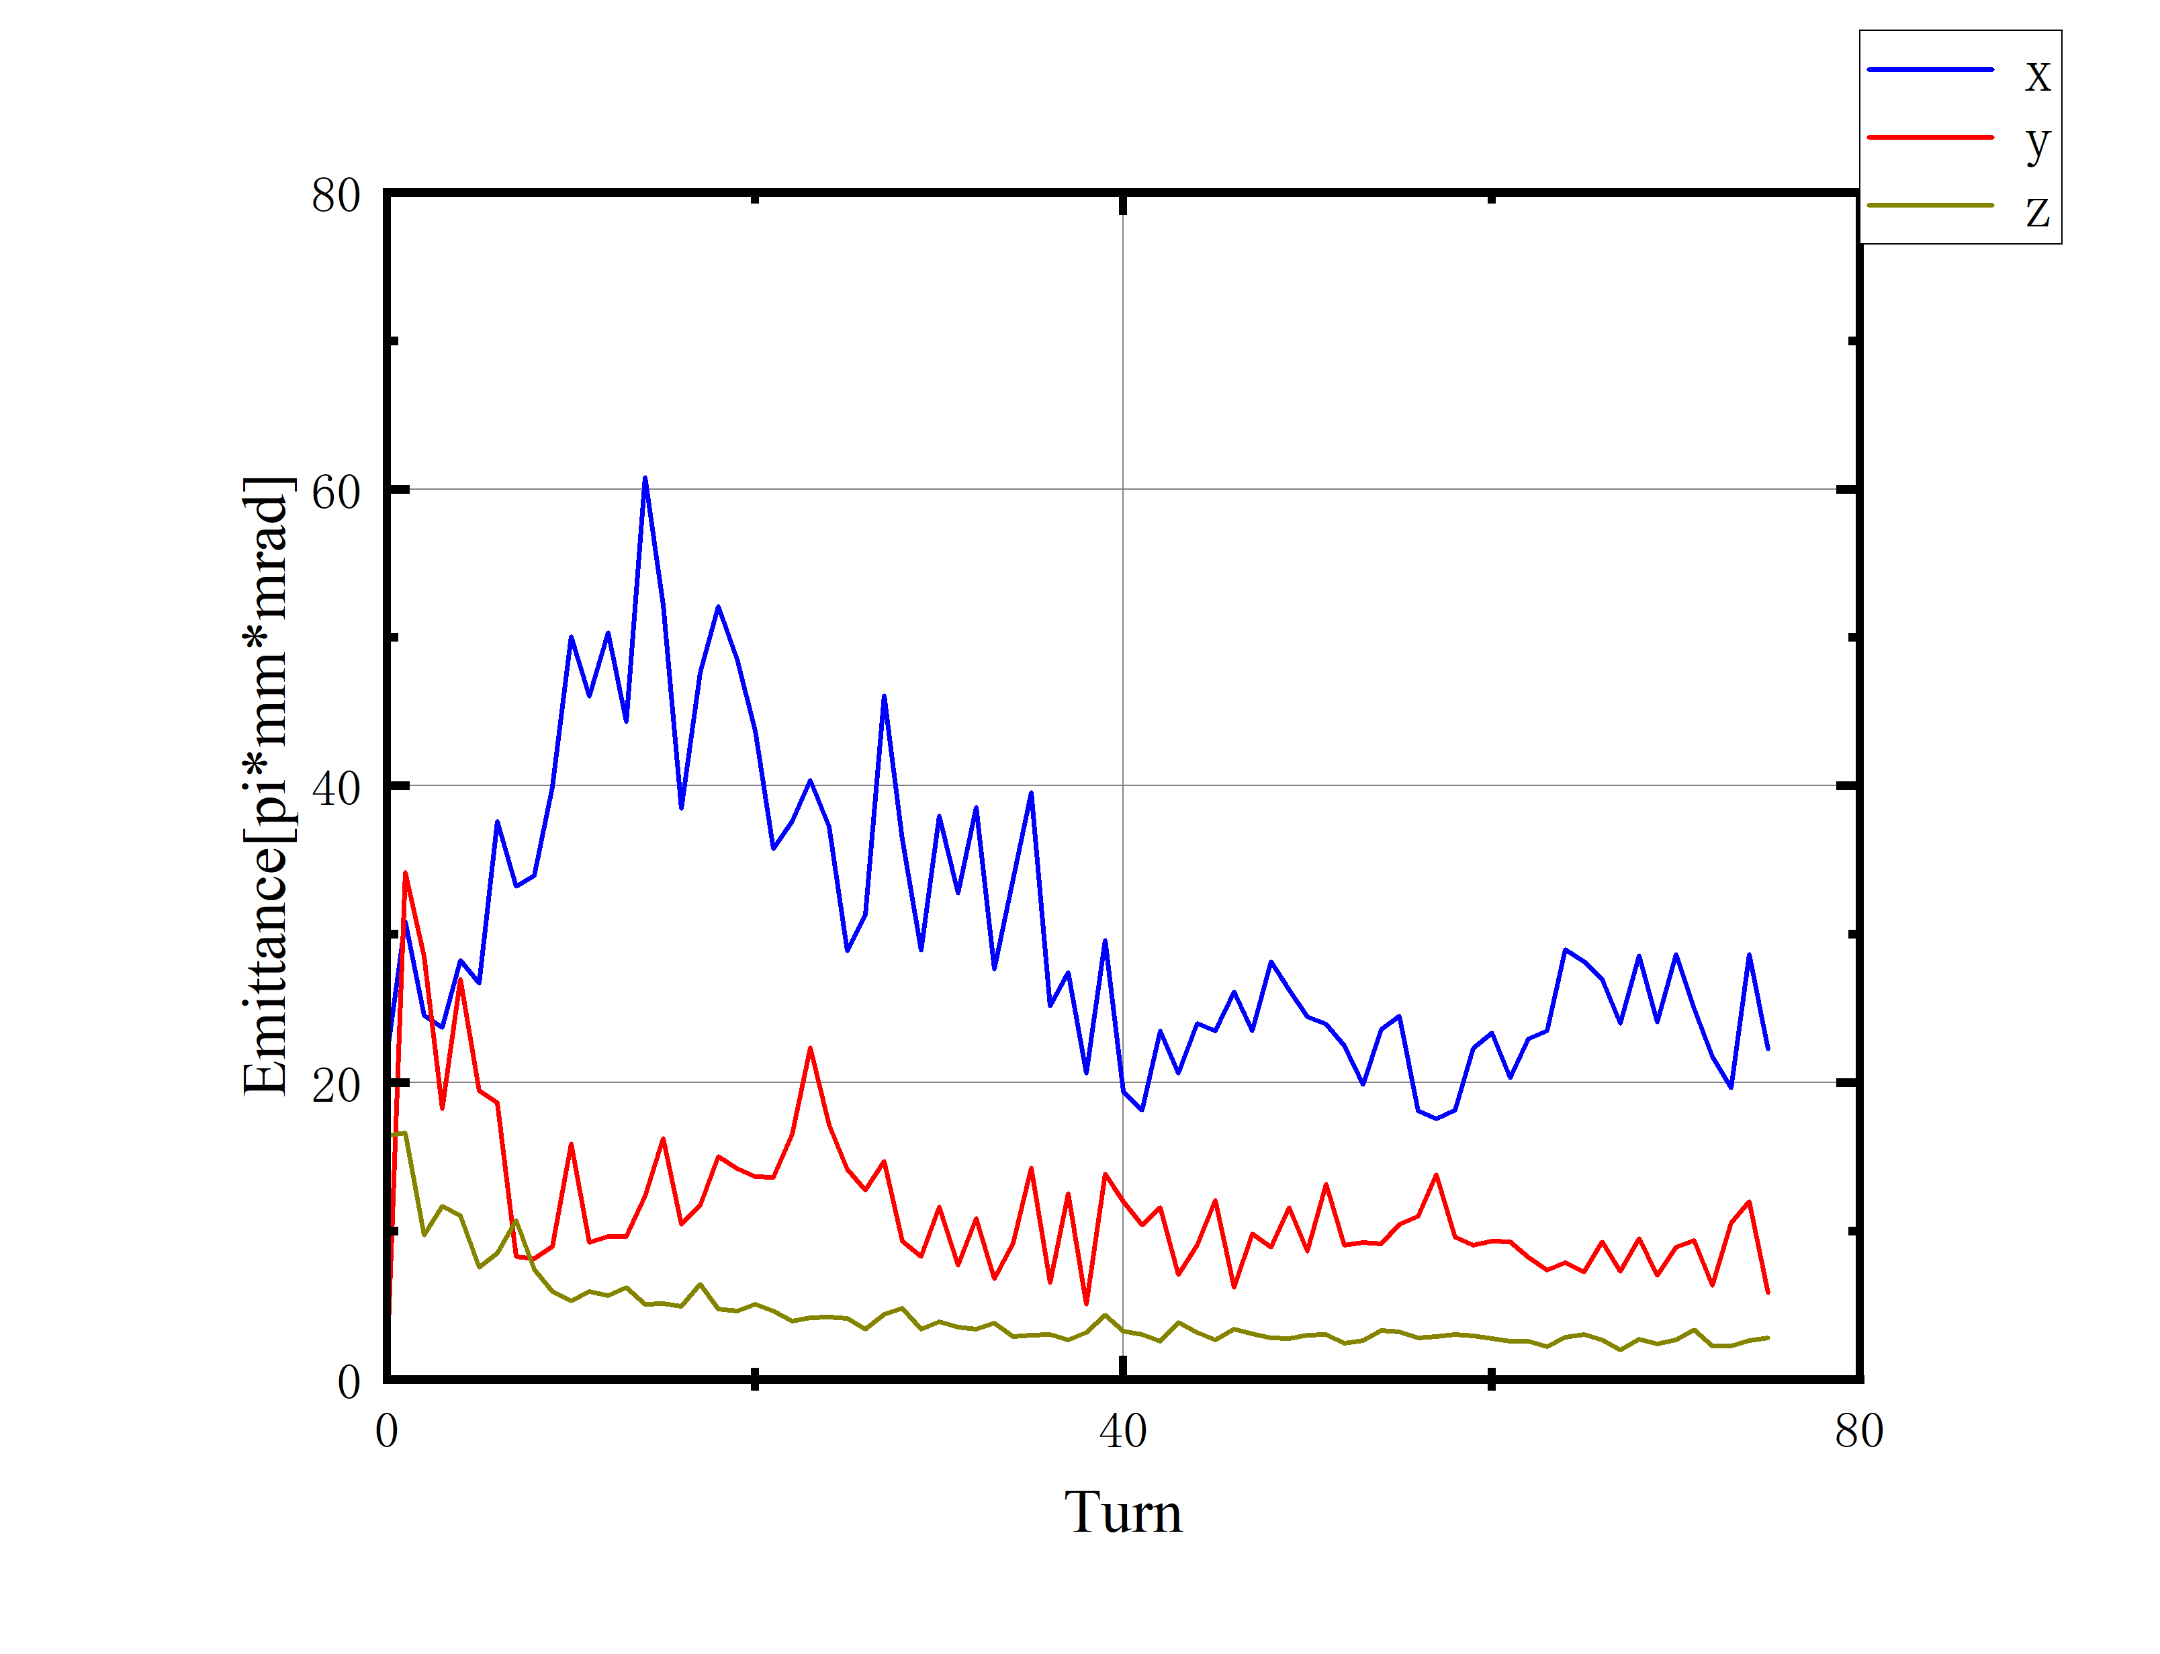
Simulations of beam dynamics
Acceleration Orbit(Multiparticle)
1e5 particle@20μA
@3.6mm
@27π
Fig14. Beam size
Fig16. Emittance from SNOP
Fig15. Emittance

Slide 11
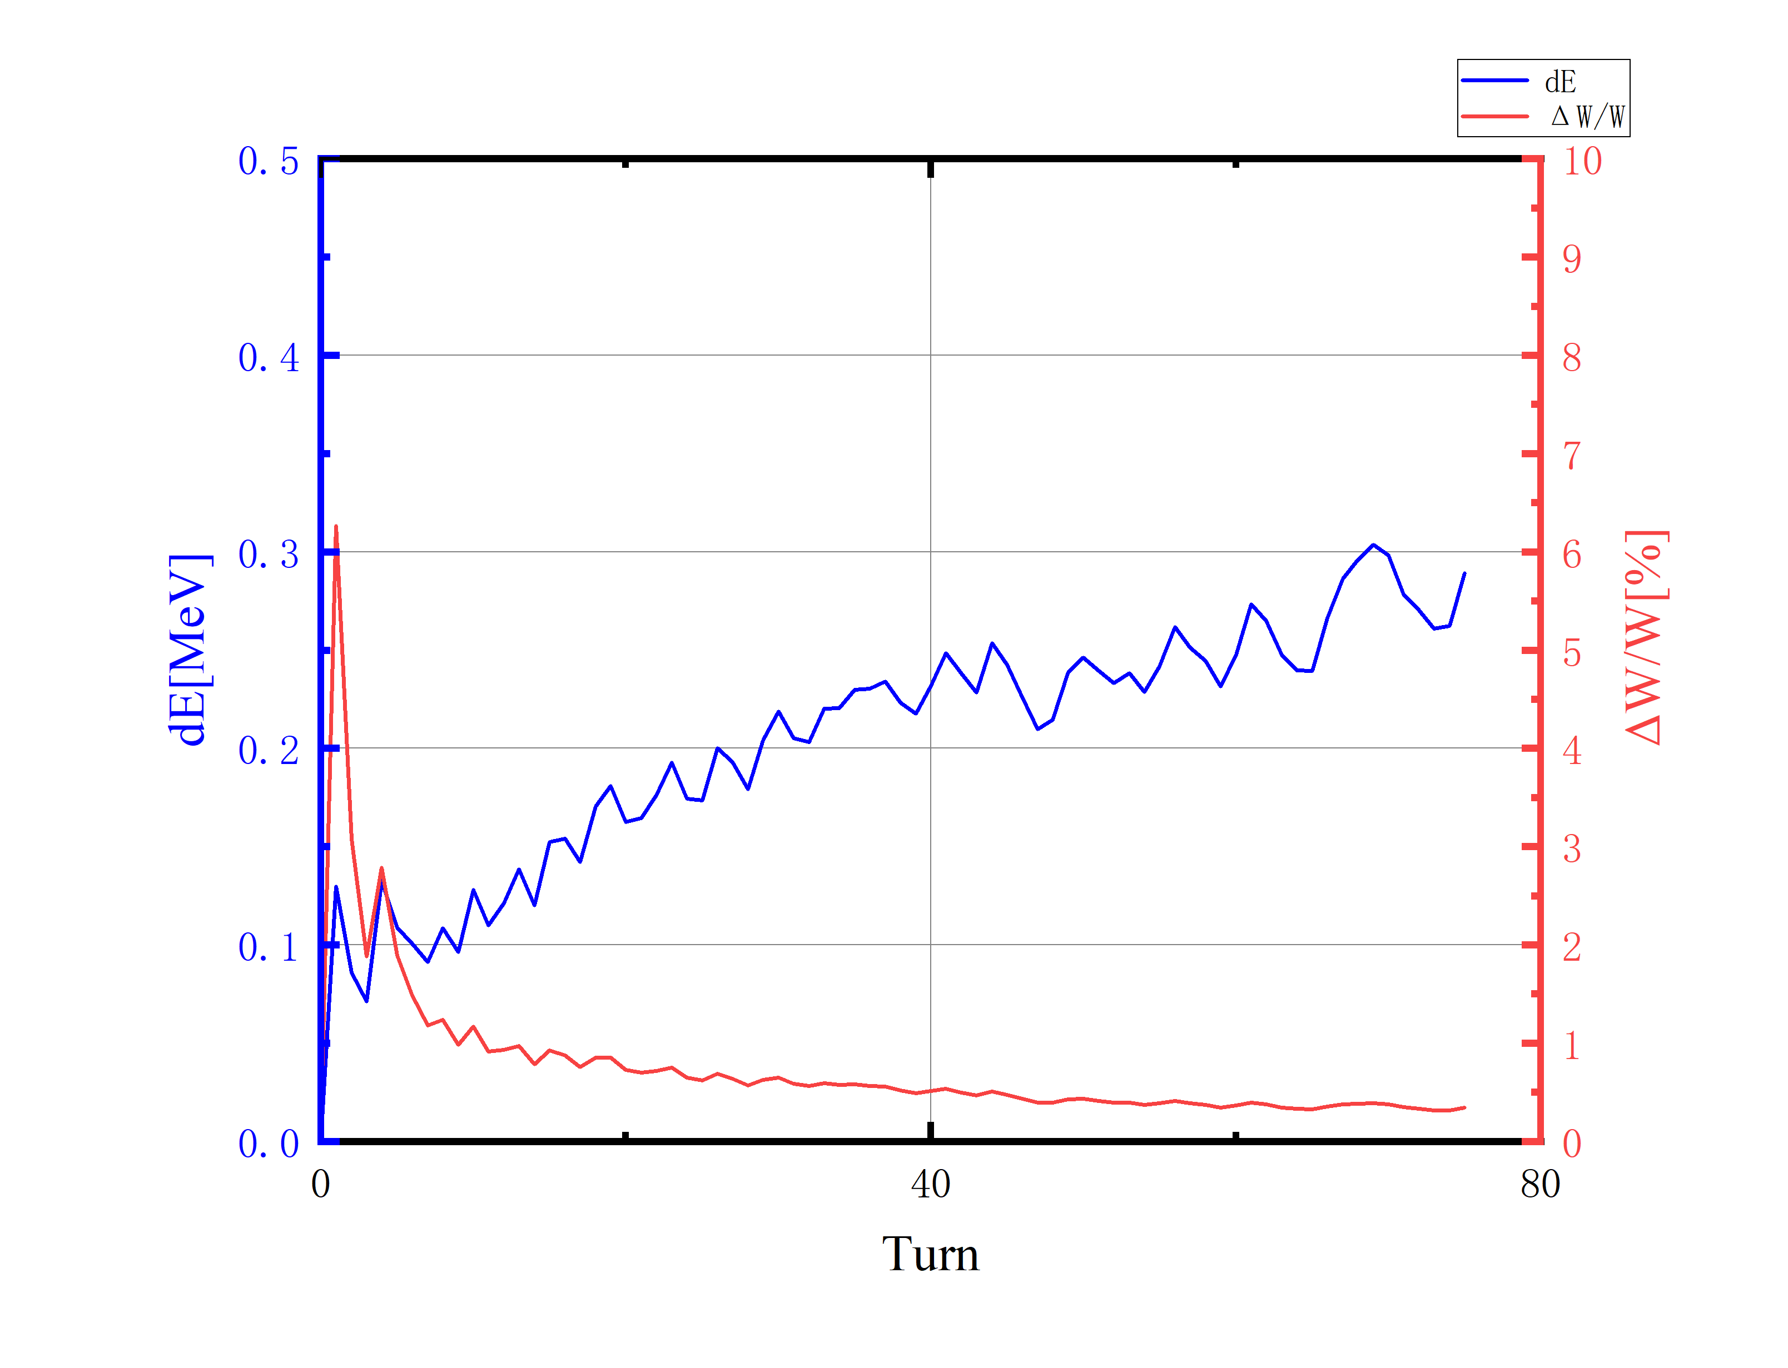
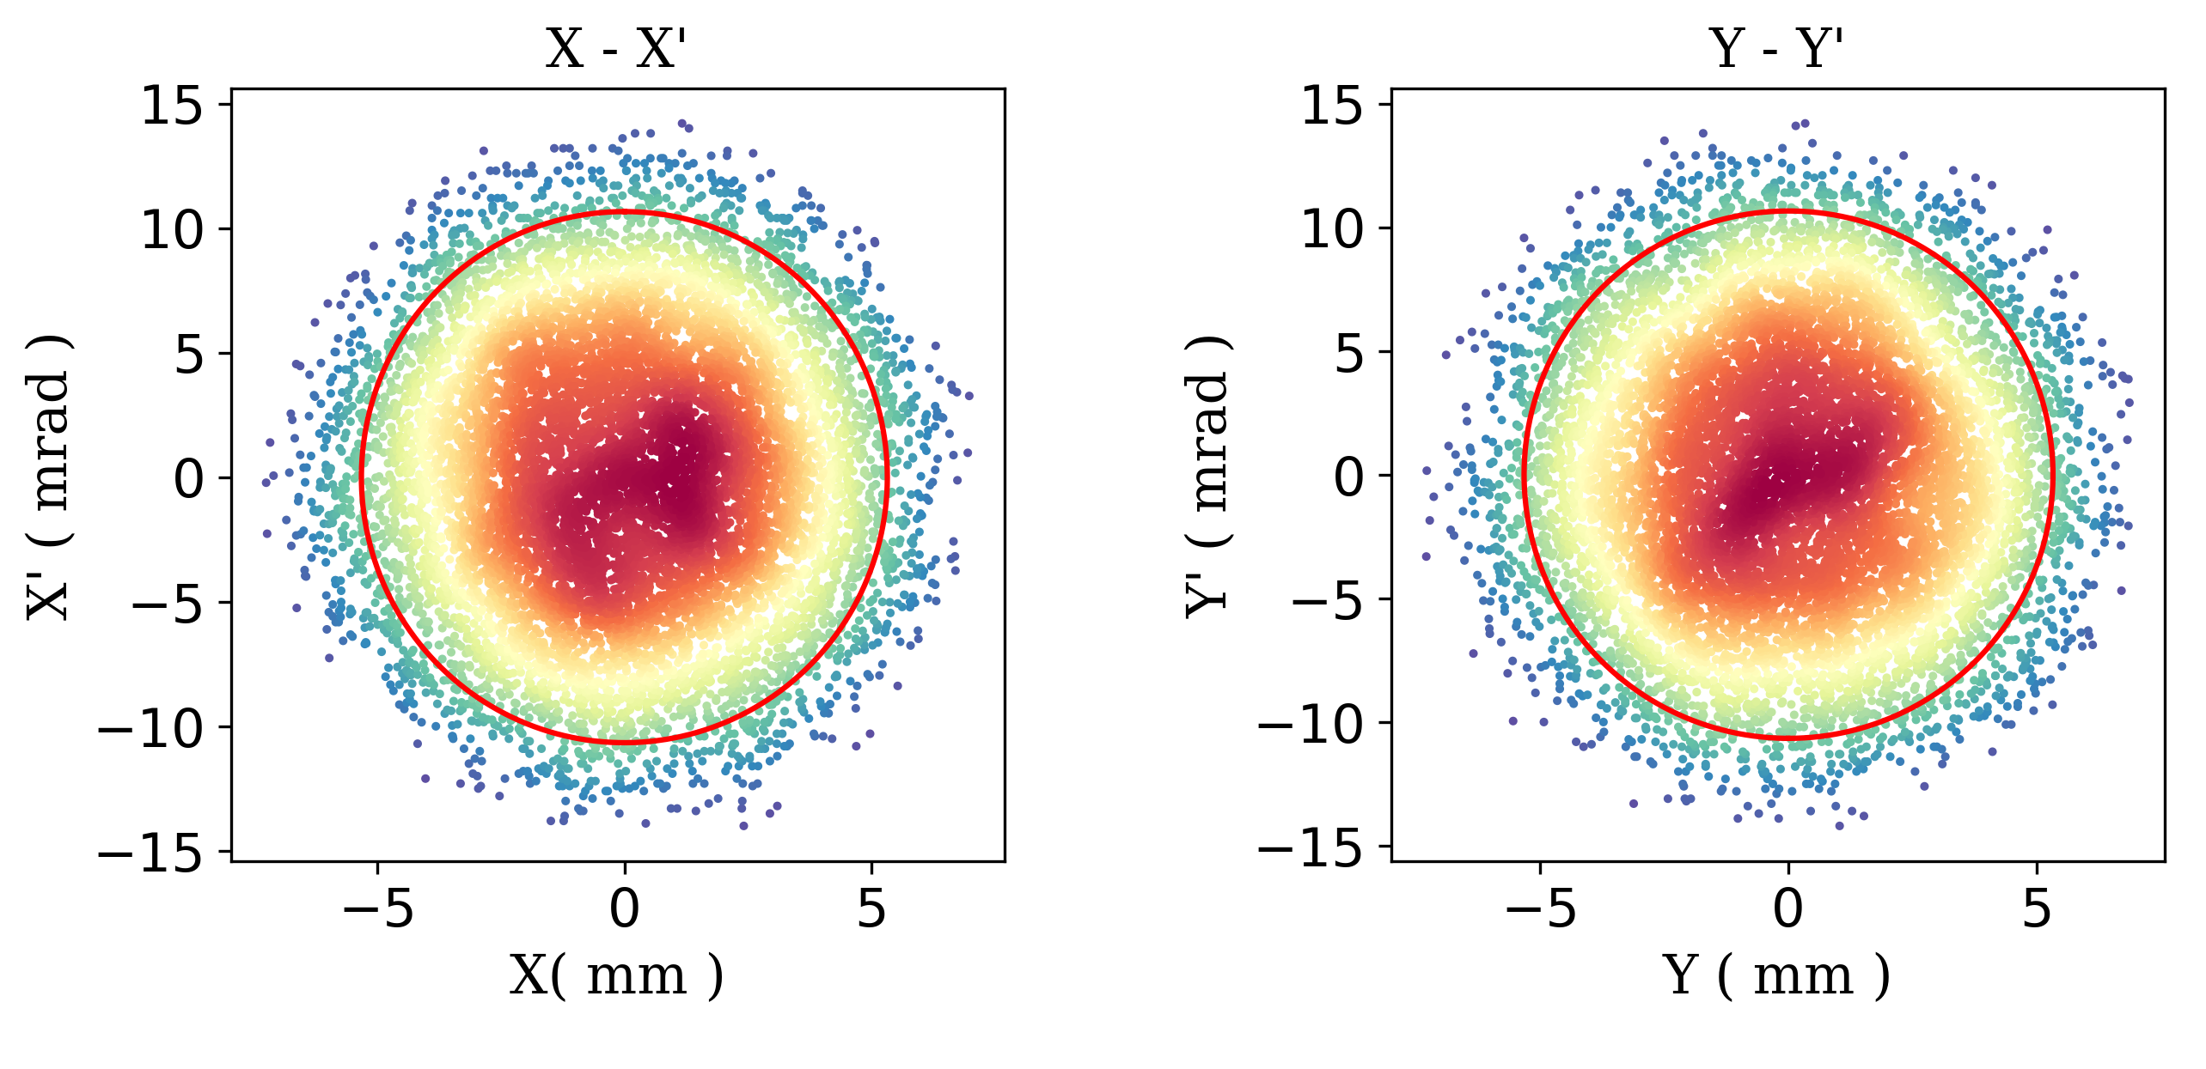
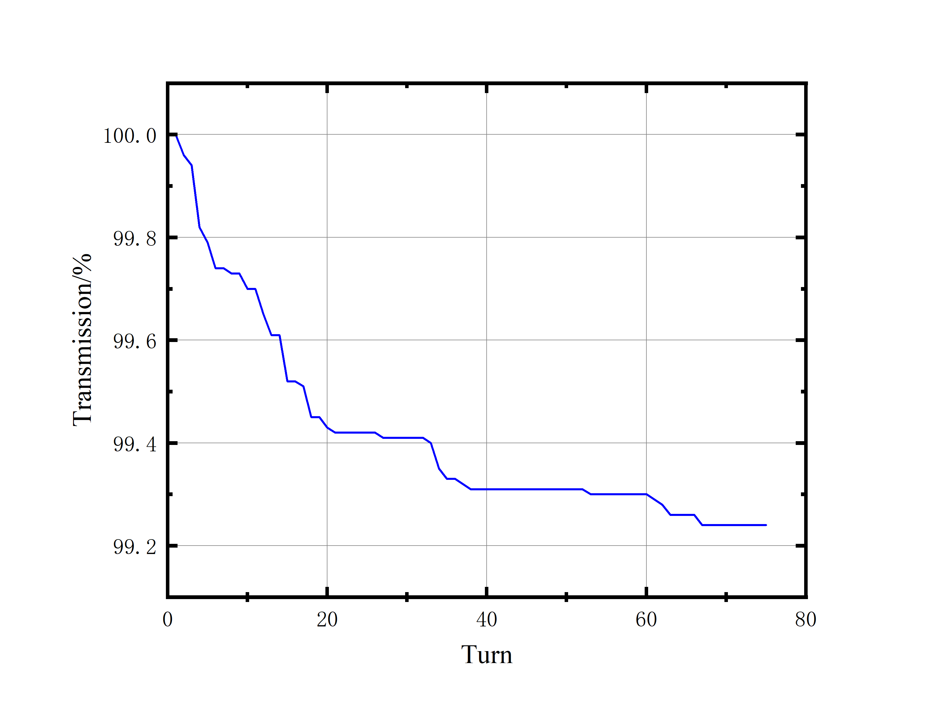
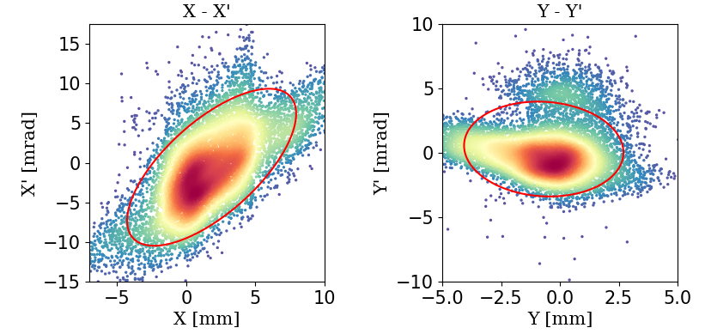
Simulations of beam dynamics
Acceleration Orbit(Multiparticle)
@0.5%
Fig18. Energy Spread
@99.2%
Fig17. Transverse Phase space
Fig19. Acceleration Transmission

Slide 12
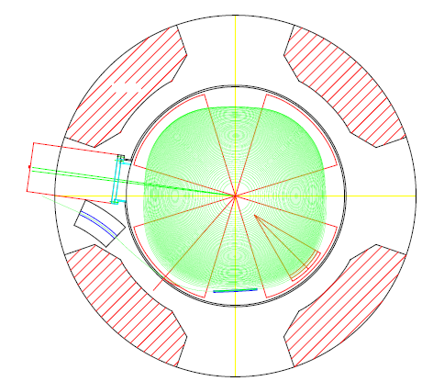
Simulations of beam dynamics
Extraction System(still modeling)
Some tips:
OPAL-cycl
Element:Collimator or Septum
Polyline construction
3D E-fields and 2D B-fields
Magnet
Channel
GCC
Bump Coil
ESD
Fig18. Overview of HIMM-IC

Slide 13
Summary and Outlook
Summary
Isochronous and focusing of B-field is good;
Transverse emittance in good agreement with SNOP;
Acceleration transmission in good agreement with experimental data;
Problems: big radial emittance and small turn separation.
Outlook
Modeling of extraction system;
End to end simulation.

Slide 14
Thanks for your attention!
Acknowledgement:
PSI OPAL Group. @Dr. Andreas Adelmann, Dr. Hui Zhang, Dr. Pedro Calvo Portela,
Dr. Daniel Winklehner, ······et al
CIAE. @Dr. Tianjian Bian, CIRP. @Dr. Huanfeng Hao, CNNC. @Dr. Jianjun Yang ······

