Slide 1
Stripping Extraction and Lorentz Dissociation
Hui Wen Koay
TRIUMF

Slide 2
Outlines
Introduction
Lorentz Dissociation
$H^{−}$
$H_{2}^{+}$
$H_{3}^{+}$
Conclusion and prospects

Slide 3
Introduction
Electrostatic extraction | Stripping extraction
$$H^{+}$$ | $H^{−},H_{2}^{+},H_{3}^{+}$ etc.
No magnetic field or energy limit from Lorentz dissociation A large final turn separation and small beam size is needed Activation from beam loss | Turn separation is not necessary A limited magnetic field and maximum energy (to prevent a large Lorentz loss) Regular replacement of extraction foil
PSI, iThemba, RIKEN etc. Commercial cyclotrons: IBA-C235 | TRIUMF, Dea$δ$alus(plan) Commercial cyclotrons: TR30, IBA-Cyclone 30 etc.

Slide 4
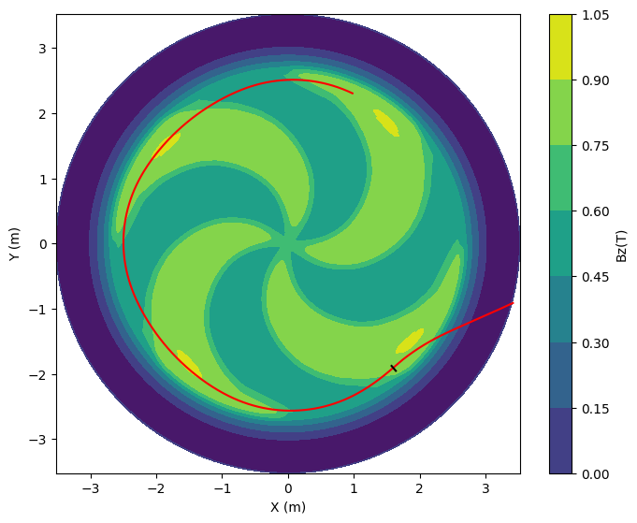
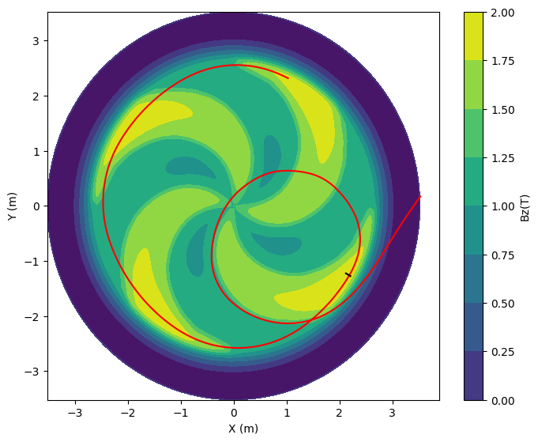
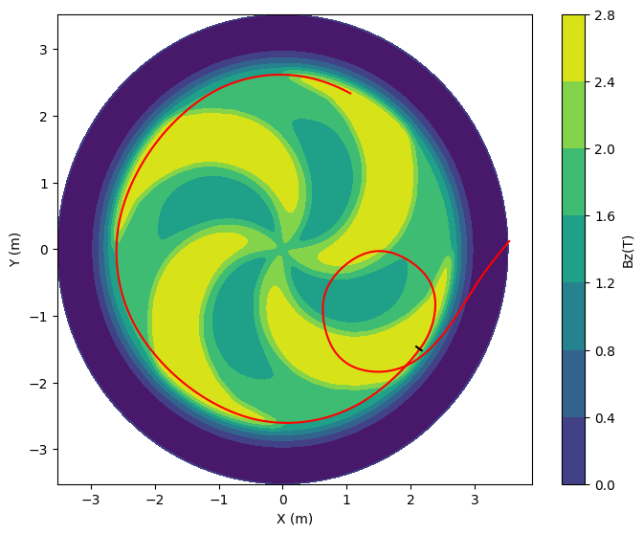
Stripping Extraction
$$Bρ=m_{0}cγβ≅Aγβ\left(3.1 Tm\right)$$
$$H^{−}$$
$$H_{2}^{+}$$
$$H_{3}^{+}$$

Slide 5
What is Lorentz dissociation??

Slide 6
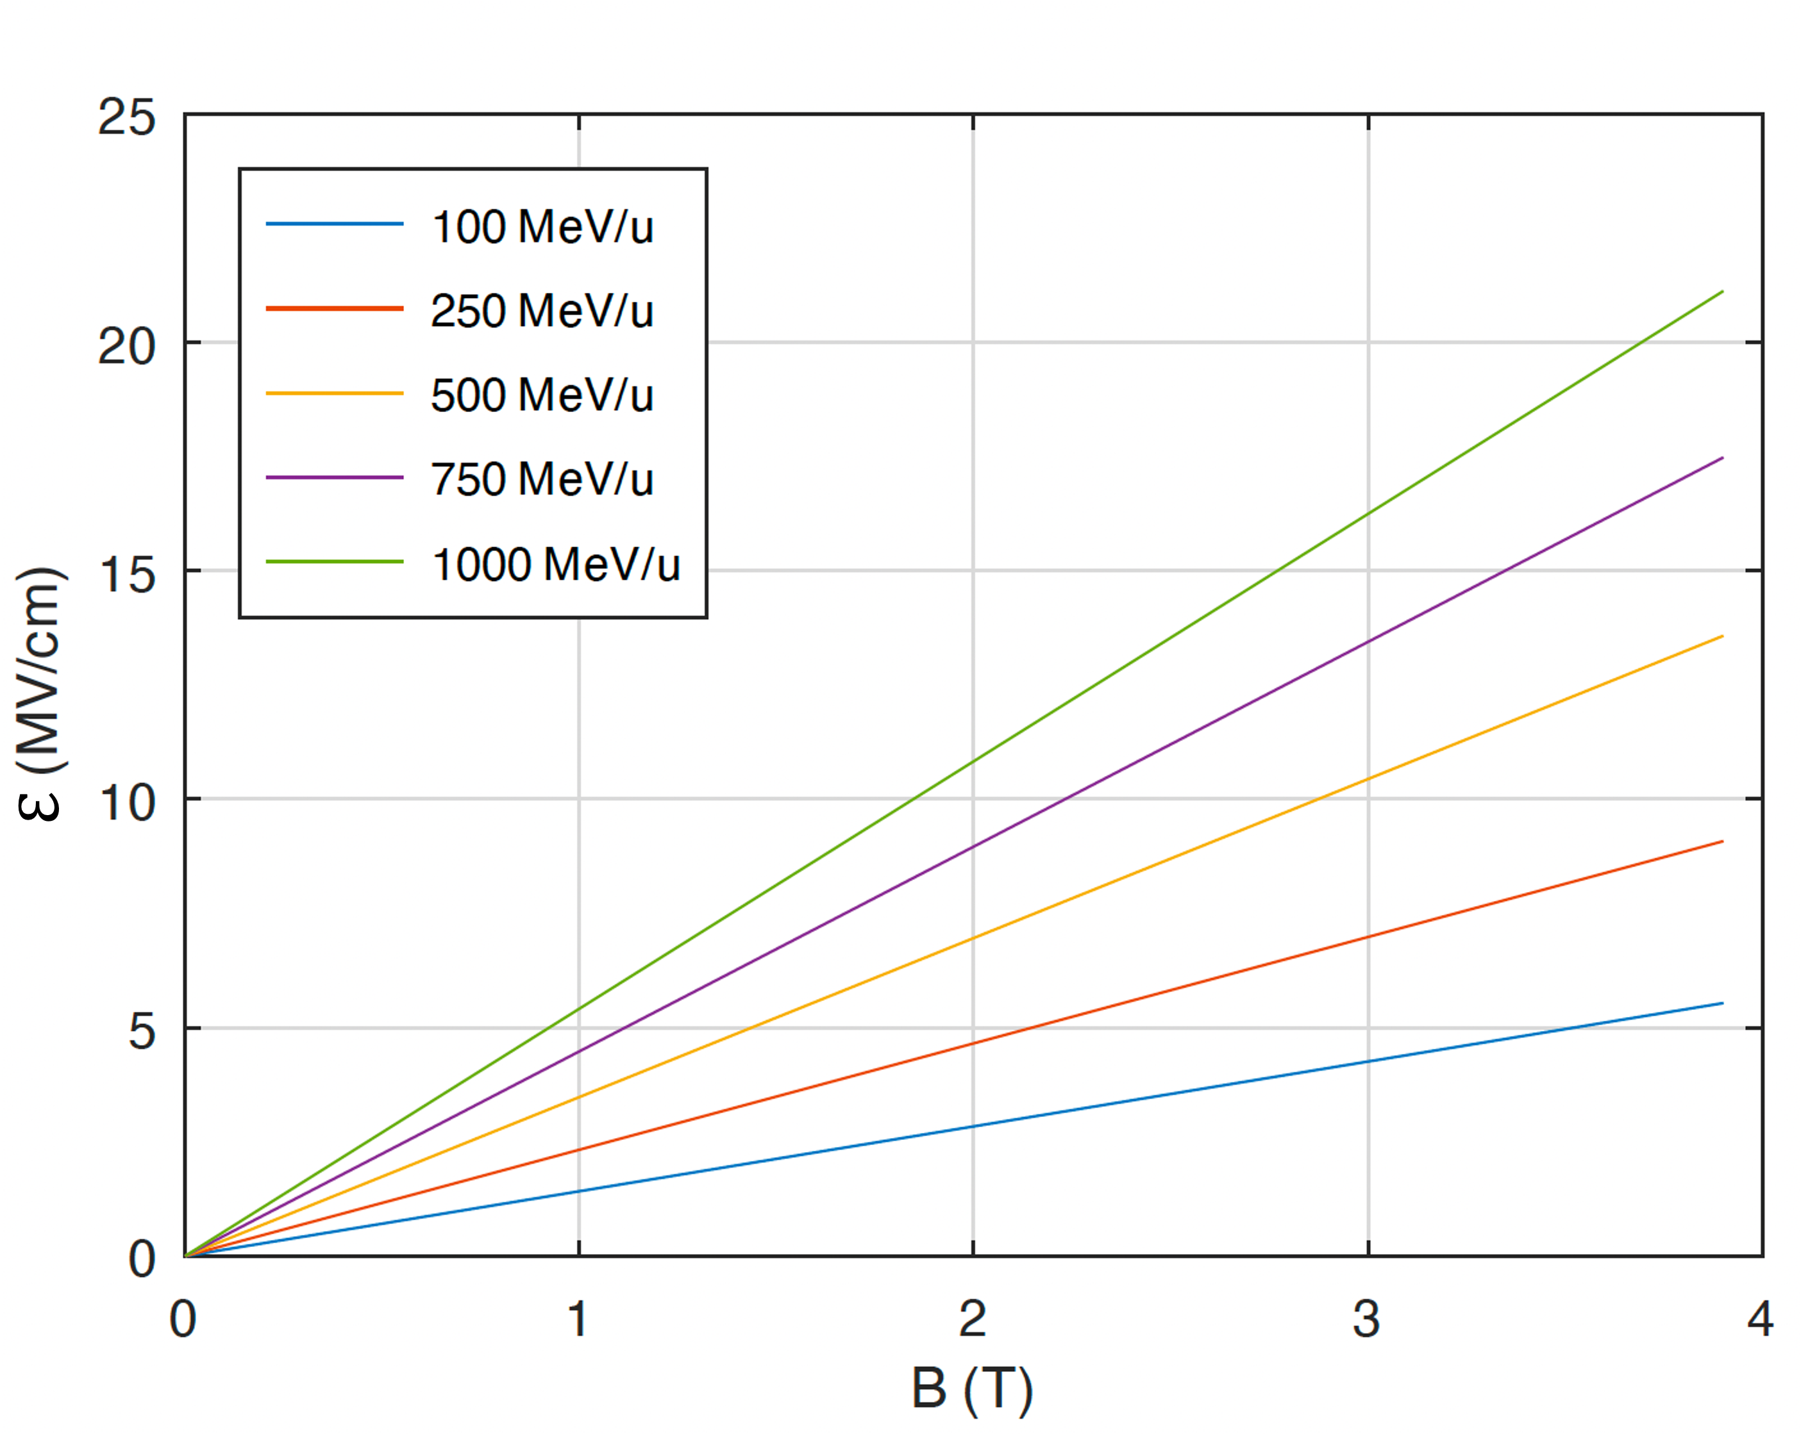
Equivalent Electric Field
$$ℰ_{∥}=E_{∥}$$
$$ℰ_{⊥}=\frac{{\left(E+v×B\right)}_{⊥}}{\sqrt{1−β^{2}}}$$
$$∴ℰ=γβcB_{z}≅\left(3MV/cm\right)γβ(B_{z}/T)$$

Slide 7
WKB Approximation
e
$$\frac{ℏ}{2m} \frac{d^{2}Ψ(x)}{dx^{2}}=\left[V\left(x,ℰ\right)−E\right]Ψ\left(x\right)$$
$$p\left(x,ℰ\right)=\sqrt{2m [V\left(x,ℰ\right)−E]}$$
$$∴τ ∝ e^{\int_{a}^{x_{0}}{|p\left(x,ℰ\right)}| dx}$$
e

Slide 8
Lifetime of H⁻
Experimental lifetime of H⁻, $τ$
$$τ=\frac{A_{1}}{ℰ}\exp{\frac{A_{2}}{ℰ}}$$
$A_{1}=3.07×{10}^{−6}$ Vs/m ;
$A_{2}=4.414×{10}^{9}$ V/m (Keating et. al.)
Integrating it throughout acceleration, the survival fraction $f$ per distance ($s$) becomes:
$$\frac{df}{ds}=−\frac{f}{γβcτ}$$
$$f=f_{0}\exp{−\frac{Δs}{γβcτ}}$$
The integrated fractional loss $F$throughout acceleration is
$$∴F=1−f$$

Slide 9
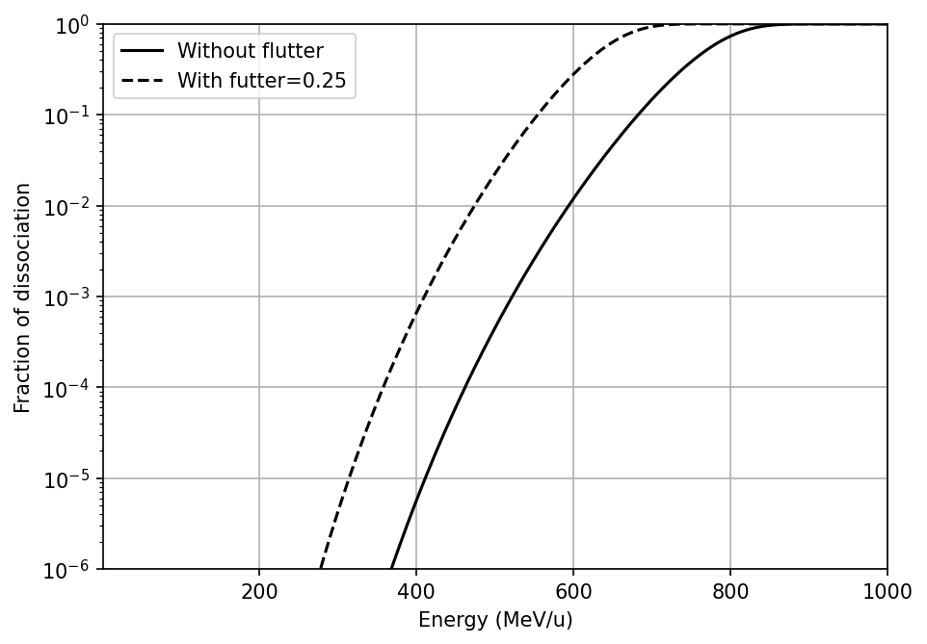
Example: Lorentz Dissociation of H⁻
$\sim$5% at 520 MeV
Closed to the loss in TRIUMF cyclotron
$$B=0.46 T$$

Slide 10
Power Loss Limit
Power loss limit of a proton beam $P_{m}≈1$ W/m for hands-on maintenance
Losses are usually spread along the inside surface of the outer wall of the vacuum chamber.
Taking the circumference of the vacuum wall to be $2π\hat{R}$, where the radius is the radius at the highest energy $\hat{R}=\frac{\hat{p}}{eB}$

Slide 11
Lorentz Dissociation of H⁻
Solid line: Lorentz dissociation at respective B
Dashed lines: Power loss limit at 1 mA
Blue dots: Max allowed energy for hands-on maintanence

Slide 12
Outlines
Introduction
Lorentz Dissociation
$H^{−}$
$H_{2}^{+}$
$H_{3}^{+}$
Conclusion and prospects

Slide 13
General Introduction of H₂⁺
Binding energy $\sim$ 2.7 eV
Internuclear distance $\sim 1.06 Å$
Mainly pre-dissociate through
$$H_{2}^{+}→H_{}^{+}+H$$
Lack of experimental verification of Lorentz loss of $H_{2}^{+}$
H⁺
e
H⁺
$$1.06 Å$$

Slide 14
Theoretical lifetime of H₂⁺
*Only J=m=0 state is considered (no rotation)
John R. Hiskes (1961) Phy Rev 122-4

Slide 15
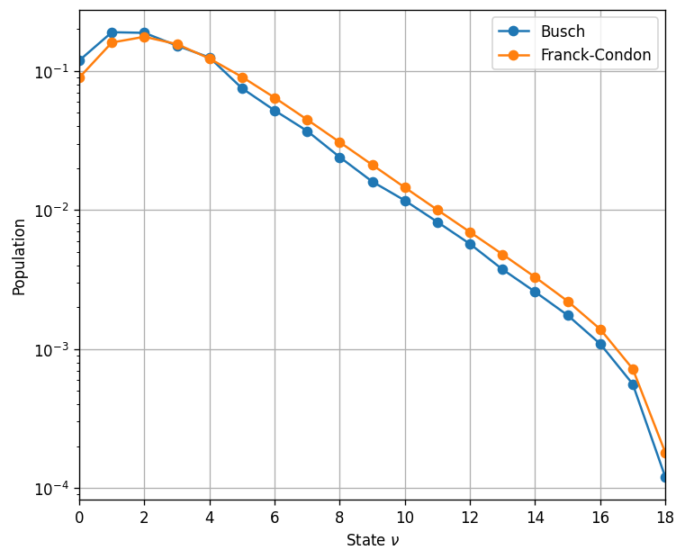
State Population of H₂⁺

Slide 16
Lorentz Dissociation of H₂⁺

Slide 17
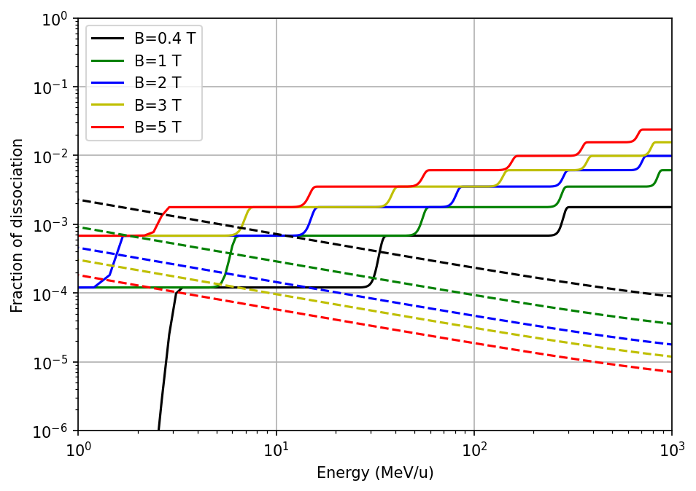
Lorentz Dissociation of H₂⁺
Solid line: Lorentz dissociation at respective B
Dashed lines: Power loss limit at 1 mA
Blue dots: Max allowed energy for hands-on maintanence

Slide 18
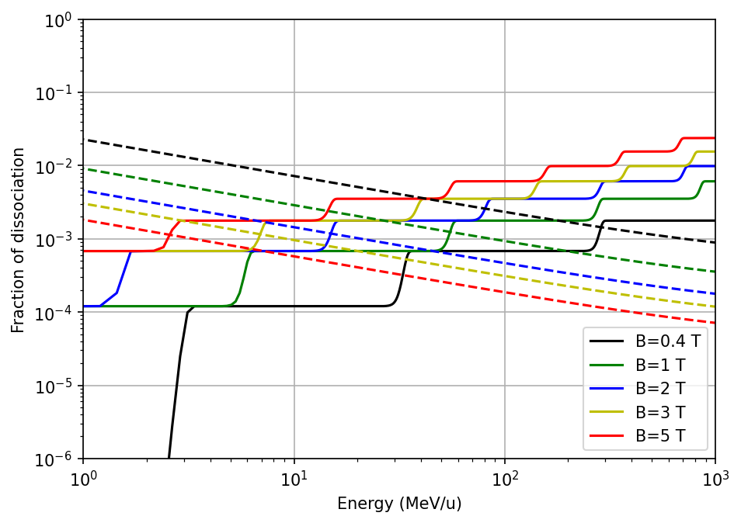
Lorentz Dissociation of H₂⁺
Solid line: Lorentz dissociation at respective B
Dashed lines: Power loss limit at 100 μA
Blue dots: Max allowed energy for hands-on maintanence

Slide 19
Outlines
Introduction
Lorentz Dissociation
$H^{−}$
$H_{2}^{+}$
$H_{3}^{+}$
Conclusion and prospects

Slide 20
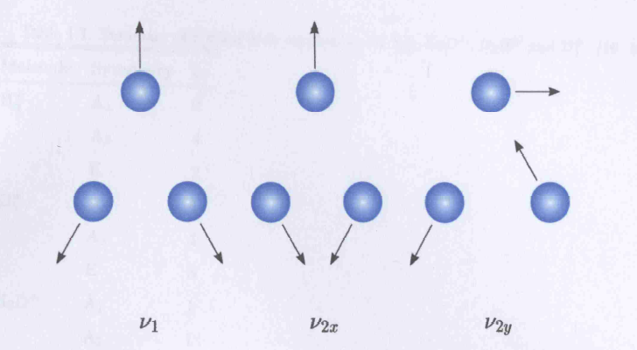
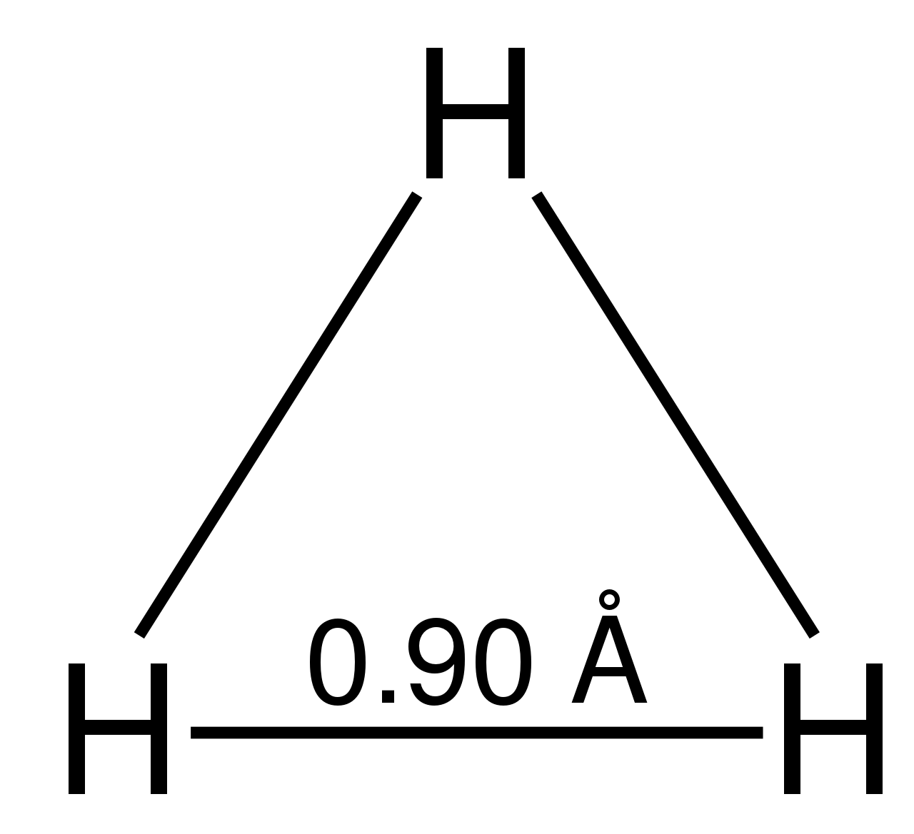
General Introduction of H₃⁺
First detected in 1911 by J. J. Thomson
Binding energy $\sim$ 4.5 eV (7 times of H⁻)
Internuclear distance $\sim 0.90 Å$
Main structure is an equilateral triangle
No permanent dipole moment
Formed from the exothermic reaction
$$H_{2}^{+}+H_{2} →H_{3}^{+}+H (exo \sim 1.7 eV)$$
2 Vibrational modes
(1) Breathing (symmetry) mode (A₁, A₂)
(2) Bending mode -Doubly degenerate (E)

Slide 21
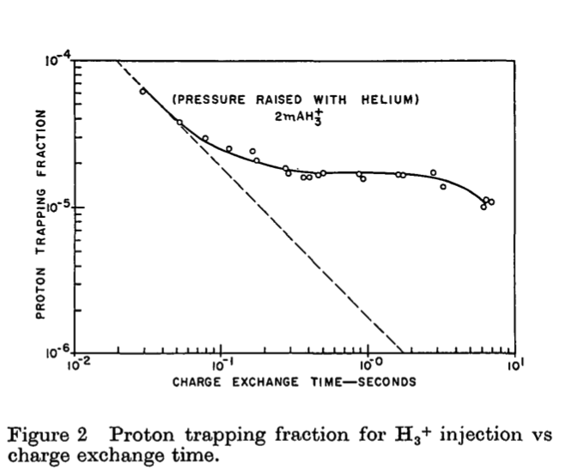
Evidence: Lorentz Dissociation of H₃⁺ at DCX-1
G.R. Haste et al 1965 Nucl. Fusion 5 164
Evidence of Lorentz trapping
Equivalent electric field within the plasma region was 33 to 48 kV/cm

Slide 22
Potential Energy Surface
$ℰ=0$MV/cm
$ℰ=130$MV/cm
$ℰ=206$MV/cm
$ℰ=308$MV/cm
Reckzügel et. Al. (1995) J. Chem. Phys., Vol. 102, No. 19

Slide 23
Dissociation Energy of H₃⁺
Fitting the dissociation energy from previous graph:
$$E_{d}=4.5\exp{−\frac{ℰ}{128}}$$
Example: At 1 GeV/u in a 3 T field, $ℰ \sim 16.3$ MV/cm, $E_{d}\sim 4.0$ eV. Any excited state with energy greater than 4 eV will dissociate

Slide 24
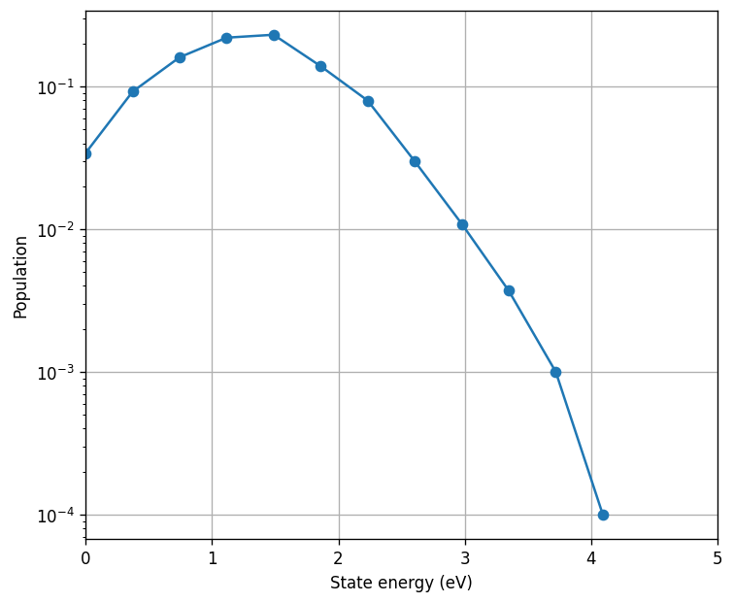
State population of H₃⁺
V.G. Anicich et. al. International Journal of Mass Spectrometry and Ion Processes, 55(2):189–215, 1984

Slide 25
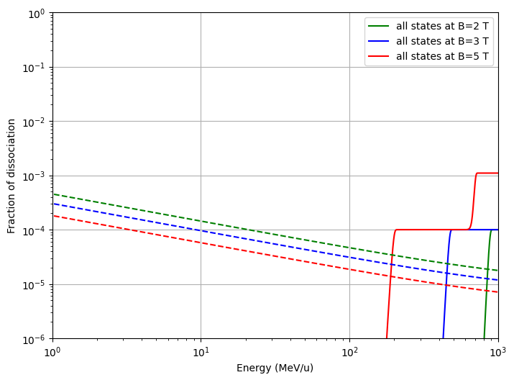
Estimated Lorentz Dissociation of H₃⁺
Assume the Hamiltonian is similar to that of the heteronuclear molecules by Hiskes et. al:
Solid line: Lorentz dissociation at respective B
Dashed lines: Power loss limit at 1 mA
Blue dots: Max allowed energy for hands-on maintanence

Slide 26
Conclusions
Overall, the order of stability goes from H₃⁺>H₂⁺>H⁻ at energy greater than 100 MeV/u.
At low energy < 100 MeV/u, H- is the most cost efficient; while H3+ is the most stable at energy higher than 100 MeV/u.
In general, a larger machine is more conducive for stripping extraction at a high power due to a lower Lorentz dissociation at a lower B and a larger power loss permissible for hands-on maintenance.
Initial state distribution from the ion source is the game-changer: important to be able to tune it accordingly.

Slide 27
Prospects
Experimental verification is NECESSARY, especially for H₂⁺ and H₃⁺, as many practical factors have been omitted.

Slide 28
Thank you!

