Slide 1
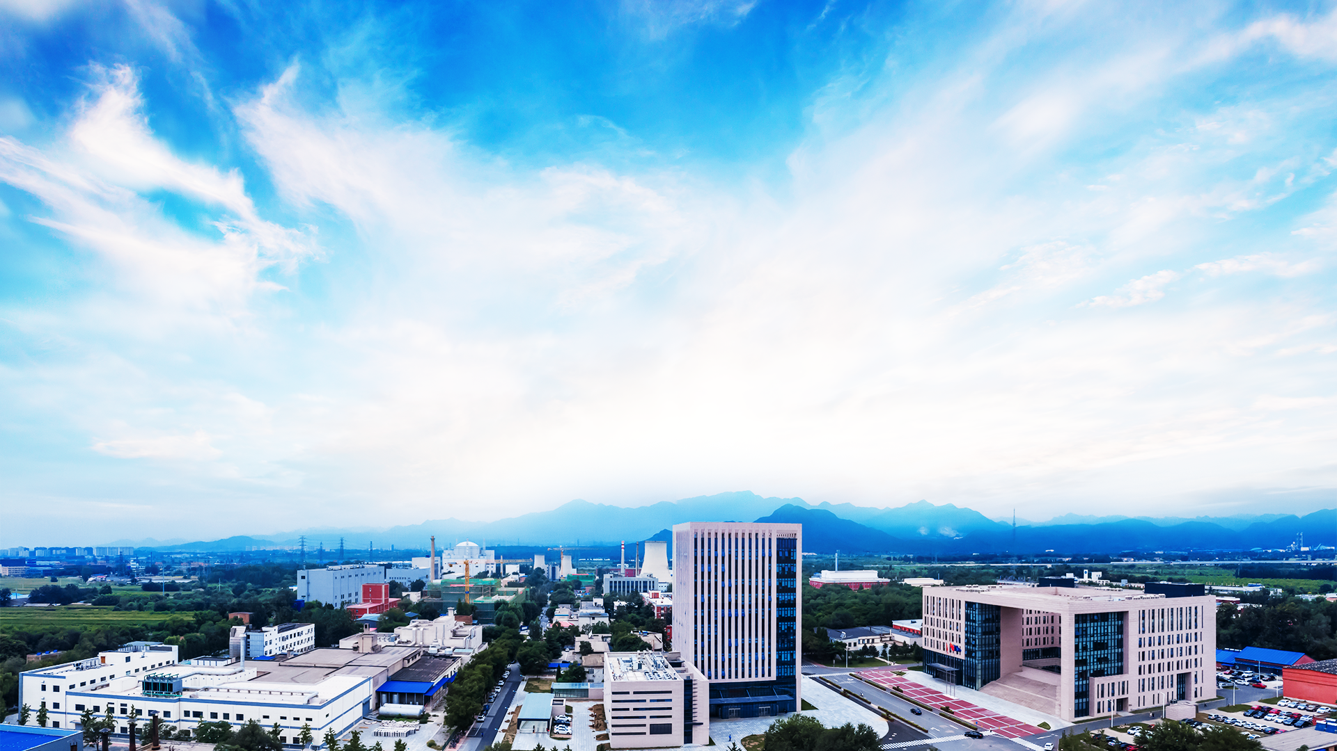
The commissioning of Superconducting Cyclotron CYCIAE-230 at CIAE
Dr. Chuan Wang on behalf of the Cyclotron team at CIAE
2022.12

Slide 2
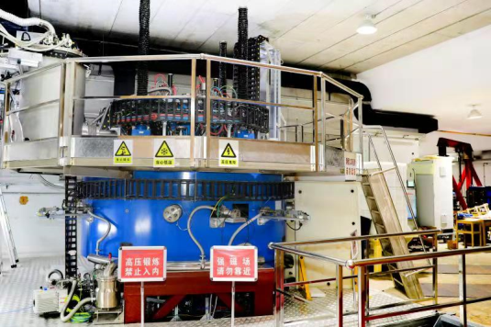
Outline
1
Introduction to CYCIAE-230
Commissioning of subsystems
2
二
主要工作和贡献
Commissioning of CYCIAE-230
3
三
综合小结
4
Summary and the Future Plan
Notes:
报告分三个方面 一、基本信息

Slide 3
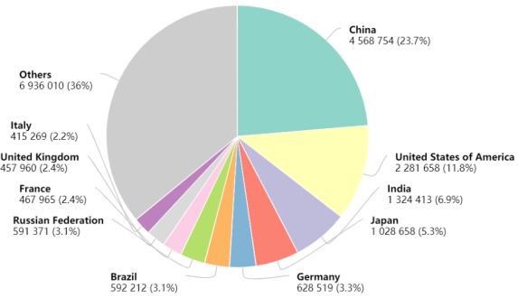
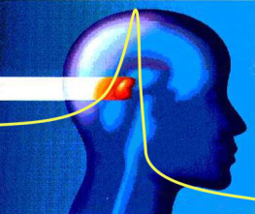
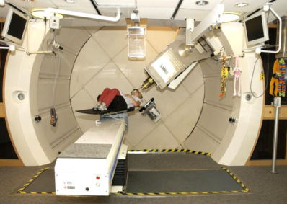
Introduction to CYCIAE-230
Cancer is the 2nd largest cause for death in the world, and the 1st cause for death in China.
According to the latest global cancer data in 2020 released by the International Agency for Research on Cancer (IARC) of the World Health Organization (WHO), there are 4.57 million new cancer cases in China, including 2.48 million men and 2.09 million women, accounting for 23.7% of the world's total. And according to PTCOG, ~60% PT system is based on cyclotron.
Top 10 countries of yearly new cases
China is leading the number of new cases and death.
Estimated by WHO, the yearly new cases will increase 60% in the near 20 years.

Slide 4
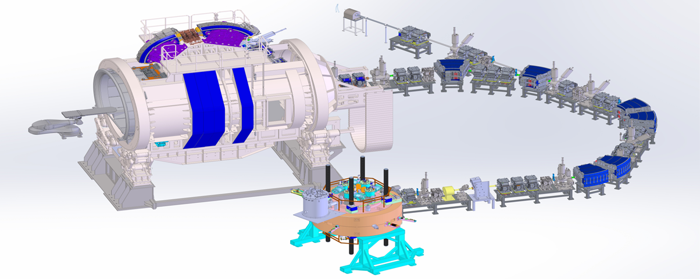
Introduction to CYCIAE-230
Granted by CNNC, the cyclotron project was launched in 2016. The rest of the proton therapy system was granted by Ministry of Industry and Information Technology in 2017.
Gantry
Beam line system
CYCIAE-230 superconducting cyclotron
Energy selection system
Proton beam in the energy range of 200 MeV – 250 MeV has various applications, like proton therapy, SEE test and radiation hardening of microchips, etc.
Notes:
超导回旋建成，及配套束流线、360°旋转舱通过测试，等中心度好于0.3mm，开拓了应用新领域，签订了癌症治疗中心落地协议，宇航器件和集成电路抗辐射研发从100MeV提升到230MeV；还带动了轻量化全超导加速器立项研发。

Slide 5
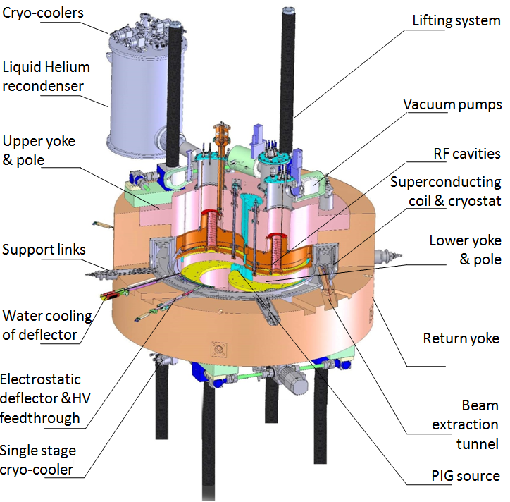
Introduction to CYCIAE-230
Design highlights
Isochronous cyclotron with LTS coil.
Design Parameters of CYCIAE-230 superconducting cyclotron
Beam
Beam current from ion source | 10 μA
Extracted beam energy | 240 MeV
Extracted beam current | A few hundreds of nA
Magnet
Pole structure | Spiral
Pole radius | 85.0 cm
Weight | ~80 tons
Hill gap | 5.0 cm
Central field | 2.3 T
RF Cavity
Number of cavity | 4
RF frequency | ~71 MHz
Harmonic Mode | 2
Cavity Voltage | 80～110kV
RF Amp. output Power | 200 kW
Extraction
Method | Resonance crossing & precessional motion
Elements for extraction | 2 E deflectors and 6 magnetic channels
Deflector voltage | < 100 kV/cm
Deflector gap | 5 – 7 mm
Coils
Coil type | NbTi low temperature superconducting wire
Current density | ≤50A/mm2
Ampere-Turn Number | ~600000 A.T×2
Ion source
Type | Cold cathode Penning ion source

Slide 6
Outline
1
Introduction to CYCIAE-230
Commissioning of subsystems
2
二
主要工作和贡献
Commissioning of CYCIAE-230
3
三
综合小结
4
Summary and the Future Plan
Notes:
报告分三个方面 一、基本信息

Slide 7
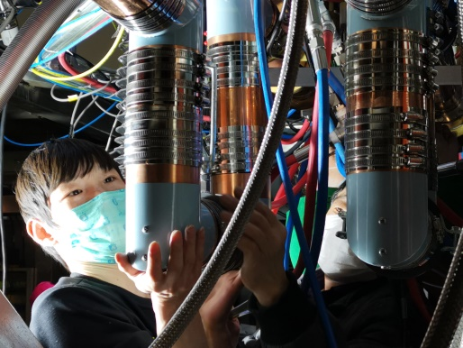
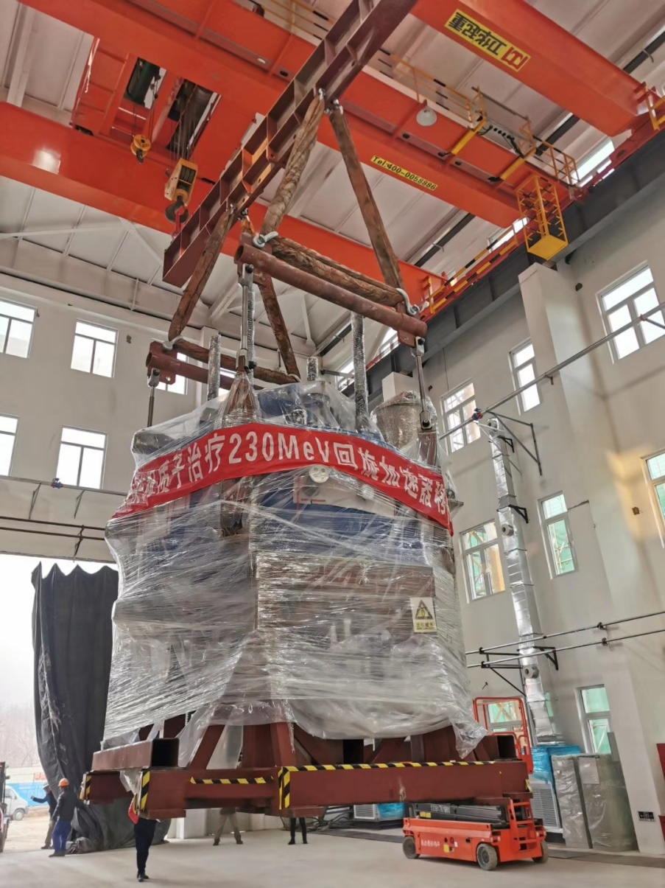
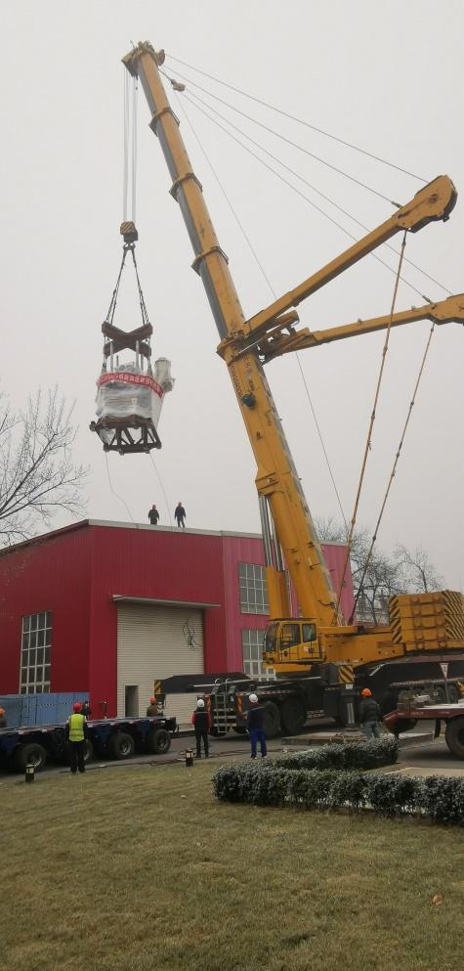
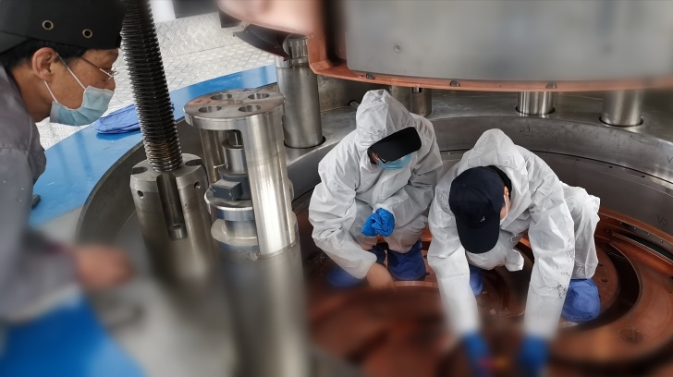
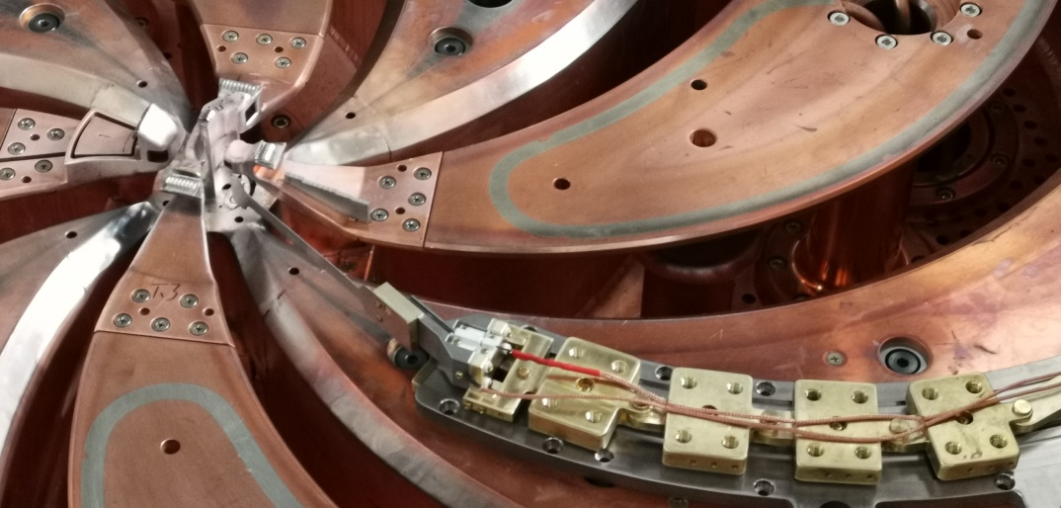
Commissioning of subsystems
Milestone
The commissioning site was ready in Dec. 2019.
In 2019.12, the sc magnet was transferred from the field mapping site to the commissioning site
Then finish the installation of subsystem of the cyclotron, such as RF, ion source, central region etc.
Coaxial line
RF amplifier
中心区6D匹配
Internal target
Commissioning site
2019 12 mapping site
2020 04 got beam in the central region

Slide 8
Outline
1
Introduction to CYCIAE-230
Commissioning of subsystems
2
二
主要工作和贡献
Commissioning of CYCIAE-230
3
三
综合小结
4
Summary and the Future Plan
Notes:
报告分三个方面 一、基本信息

Slide 9
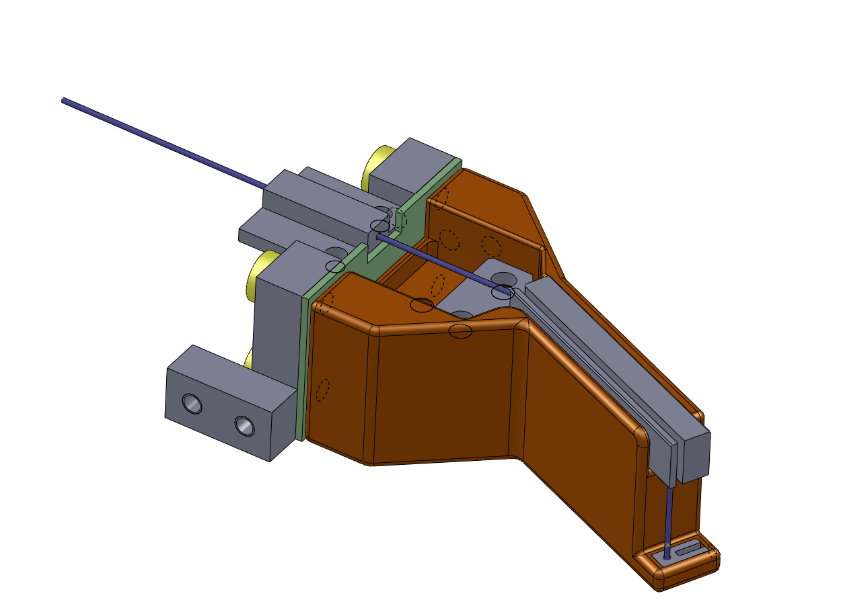
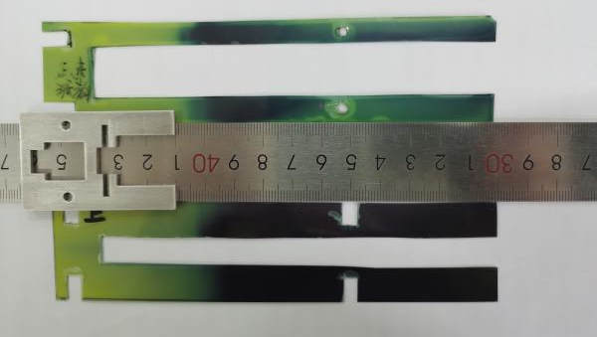
Commissioning of CYCIAE-230-Layout and diagnostics
Electrostatic Deflector 2
MC1
Collimator
Central region collimator
1. radial probe(30~85cm)
2.differential head; stop head (15~30cm)
Electrostatic Deflector 1
Beam extraction channel
C1
Collimator
Reliable diagnostics is the key issue for the commissioning of CYCIAE-230 type SC

Slide 10
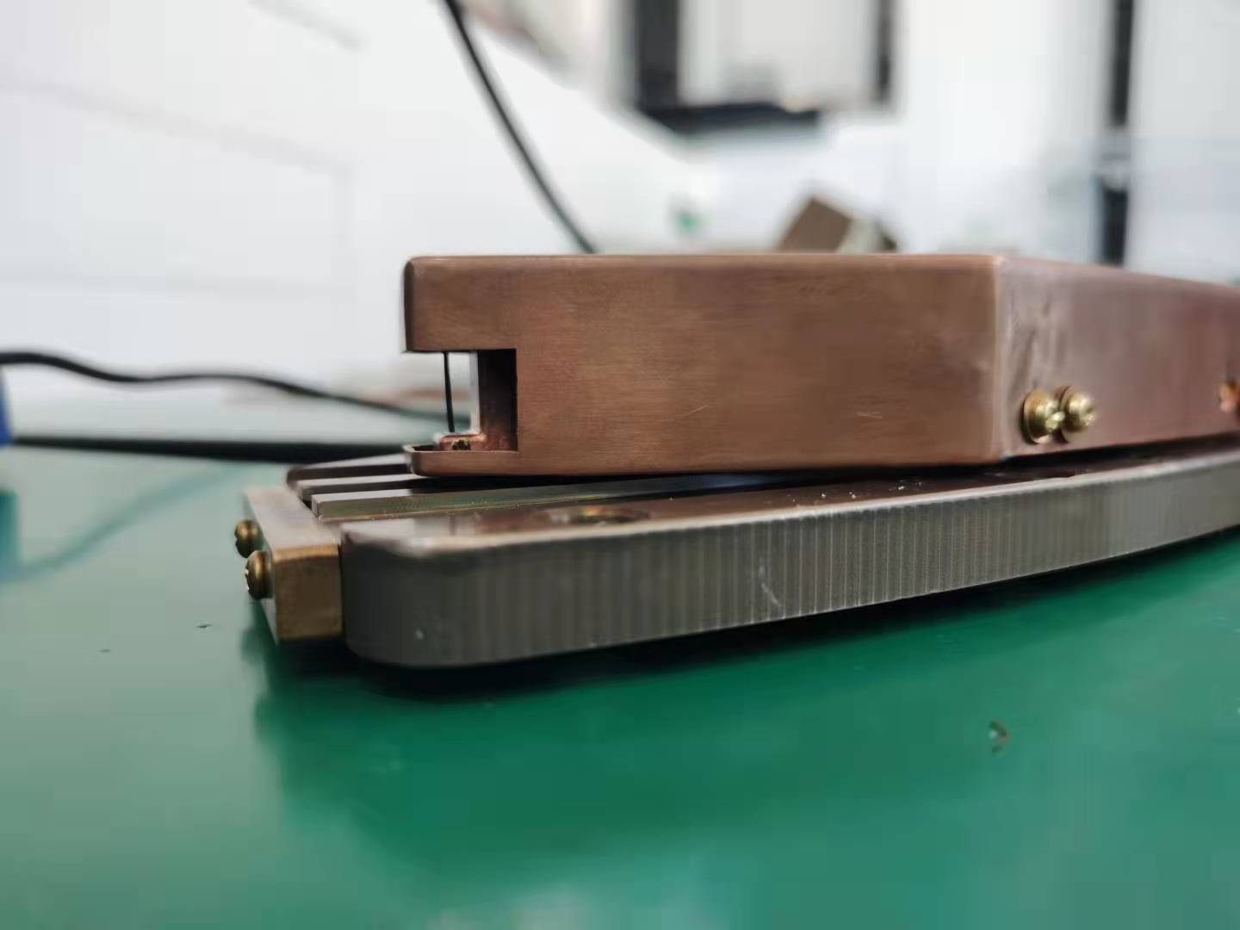
Radial Centering using differential probe
Commissioning of CYCIAE-230-an example of failure
Simulated turn pattern using 0.2mm phase slit.

Slide 11
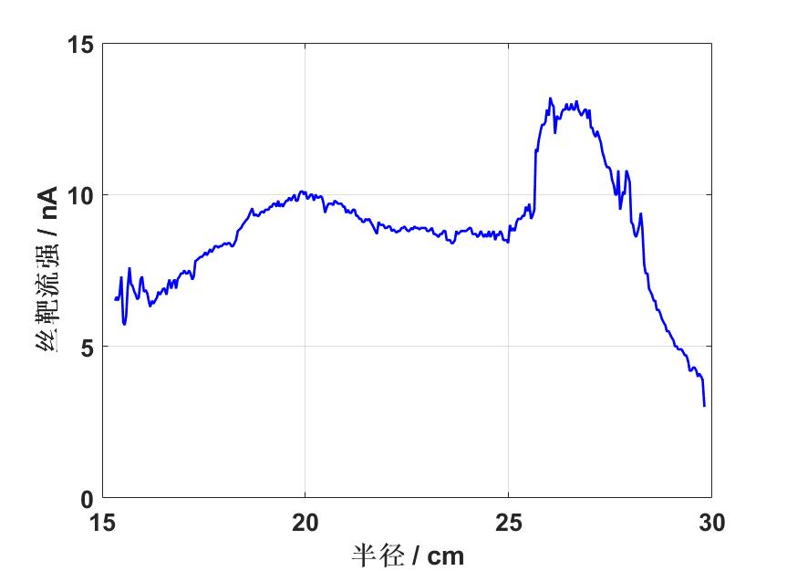
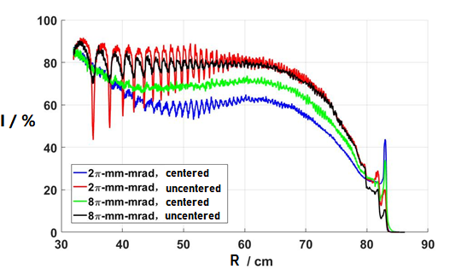
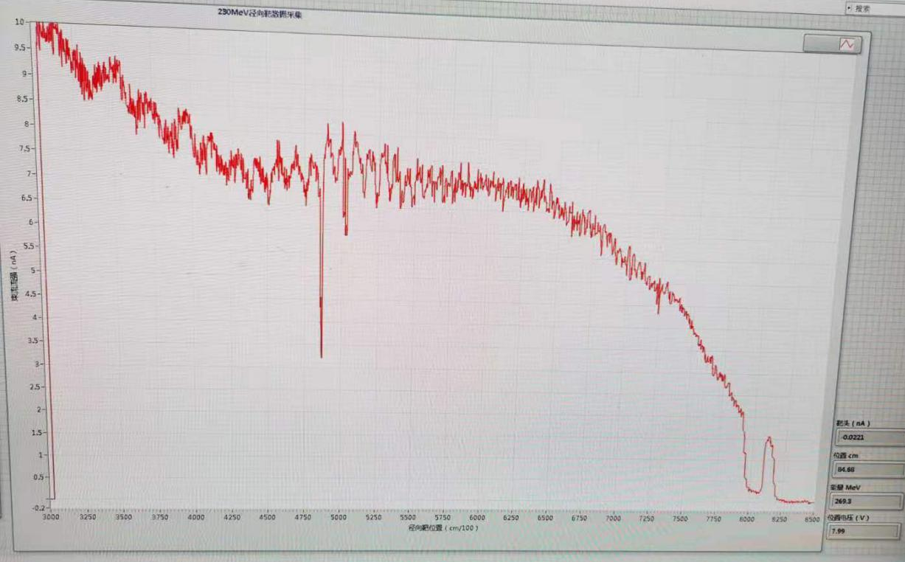
Commissioning of CYCIAE-230-an example of failure
Up to now, the radial alignment is achieved by radial probe.

Slide 12
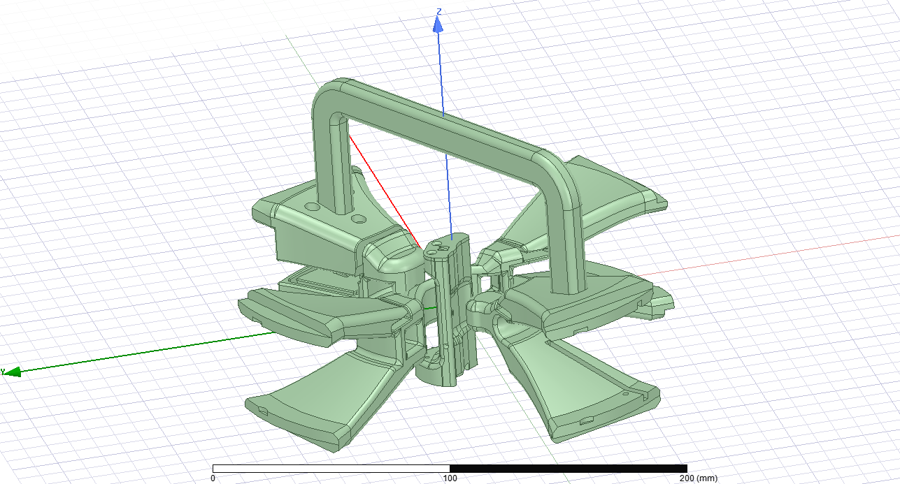
Commissioning of CYCIAE-230-vertical alignment in central region
Traditional way to diagnostic beam position in central region
12根拉杆调节，改进后调节精度0.02mm
The axial alignment of the beam in the central region is achieved by adjusting the position of ion source and central electrode.

Slide 13
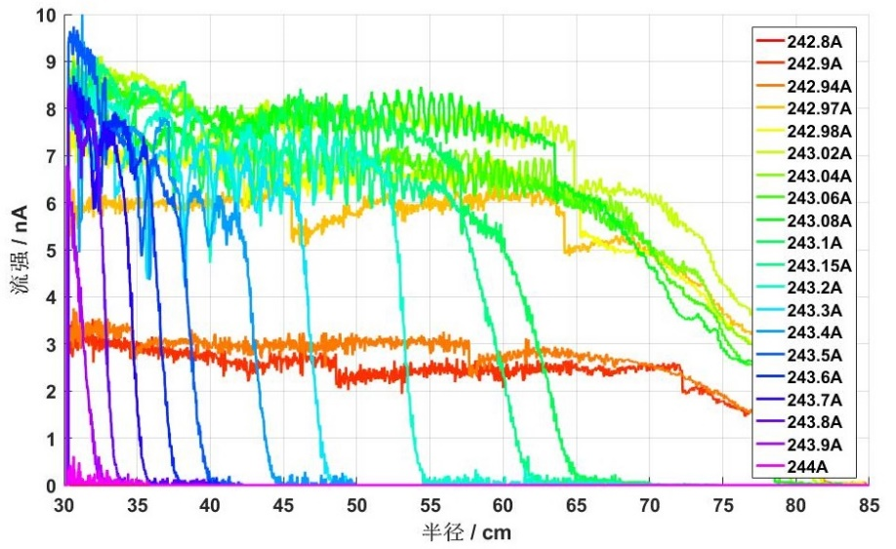
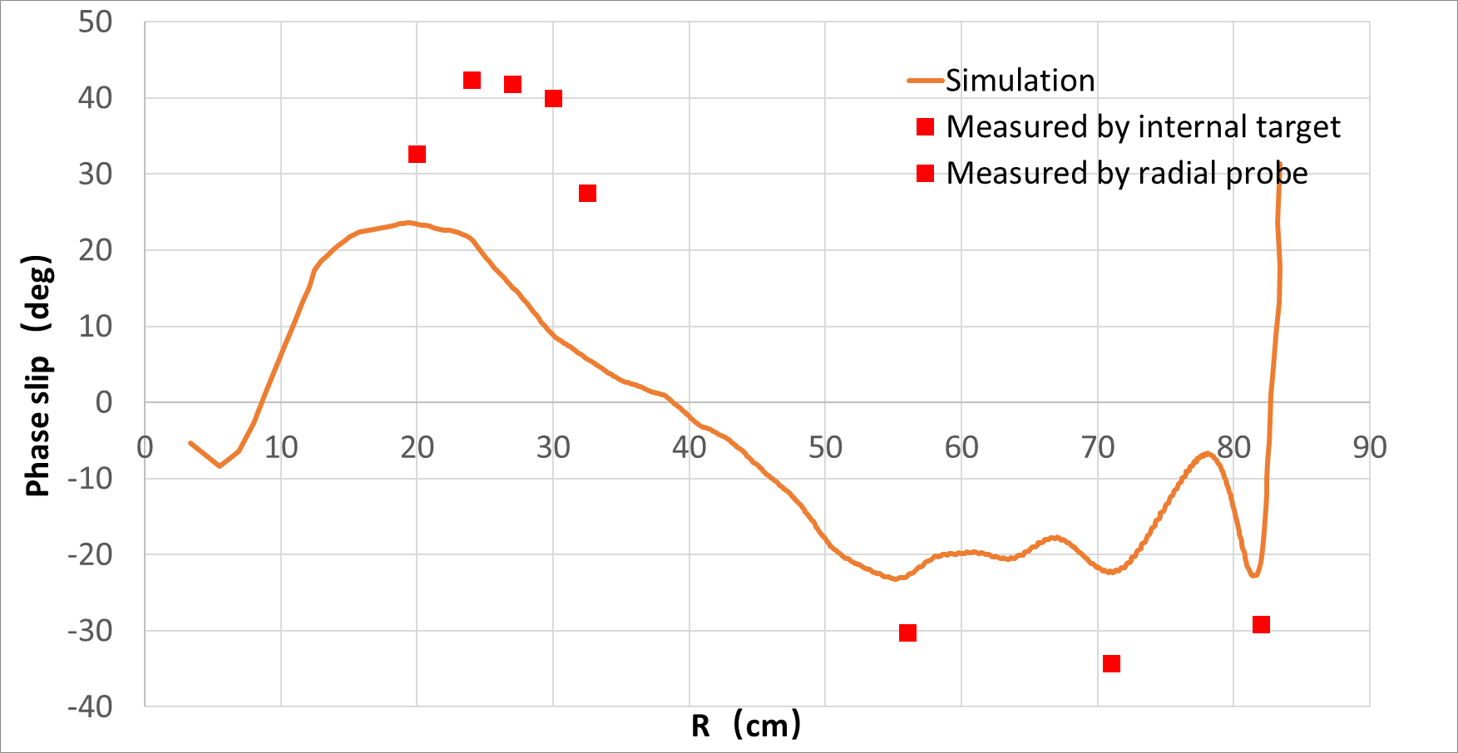
Commissioning of CYCIAE-230-Isochronous measurements
Isochronous measurements using the internal target and the radial probe

Slide 14
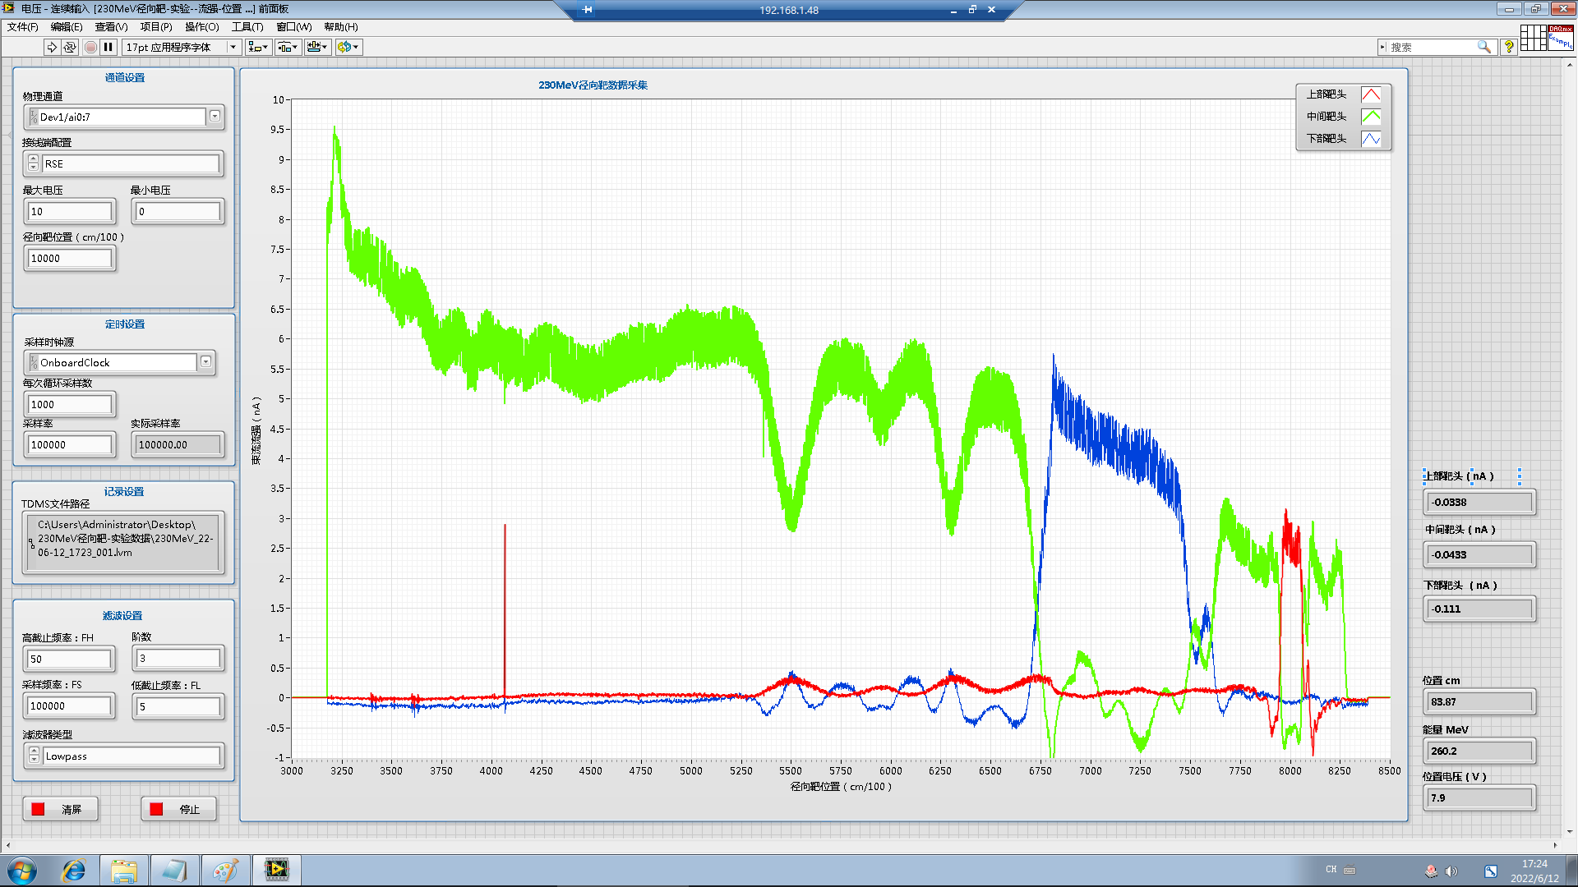
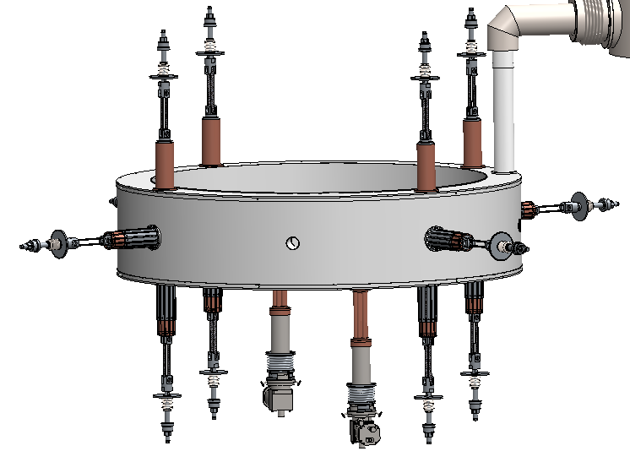
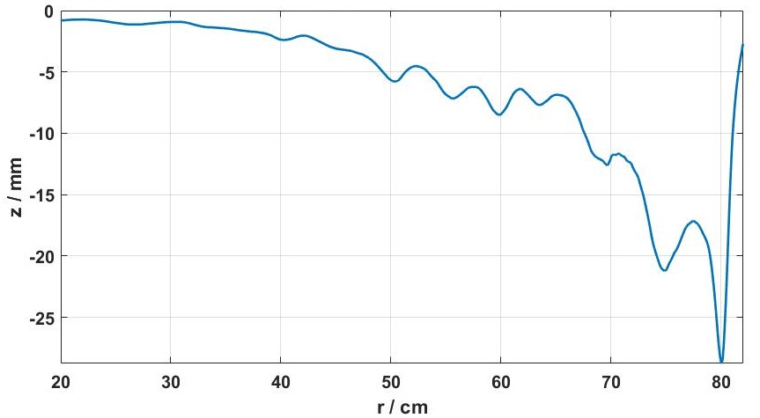
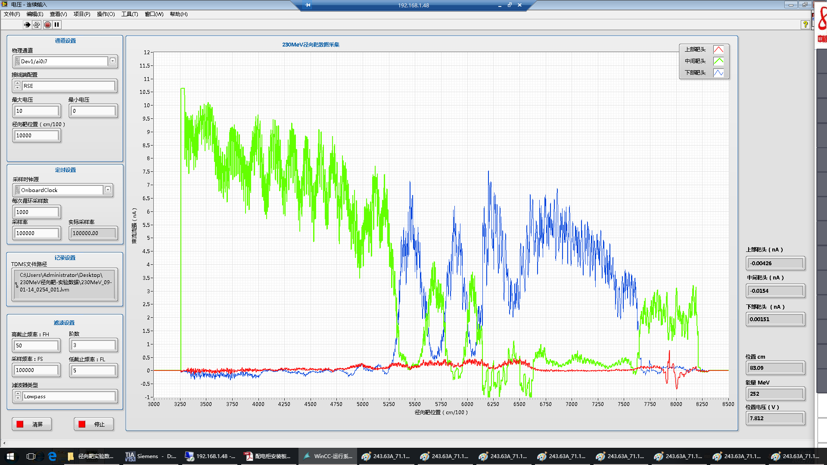
Commissioning of CYCIAE-230-coil position alignments
The position sensitive region near R=80cm, become a good indicator for coil positioning
According to our calculation 1mm coil shift in vertical direction equals to ~30 mm beam shift
12 support links，could achieve positioning precision in 0.02mm
Using radial probe with 3 fingers
Good vertical alignment is achieved.

Slide 15
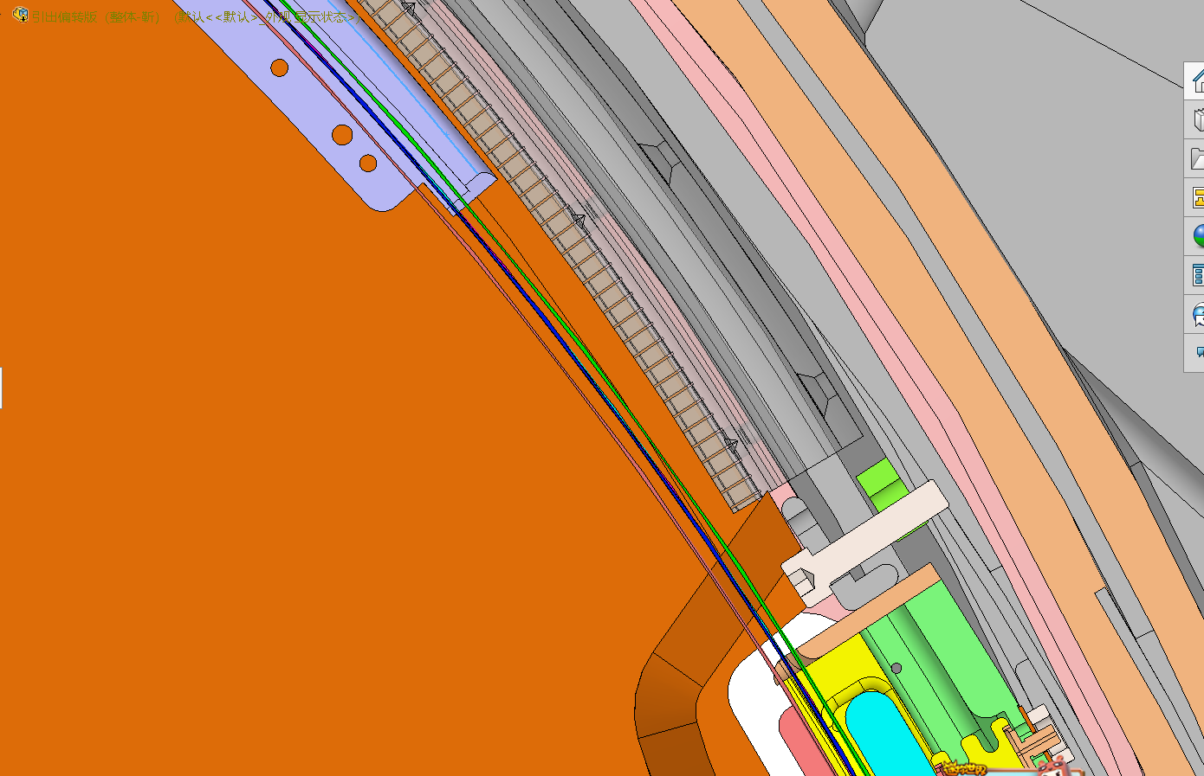
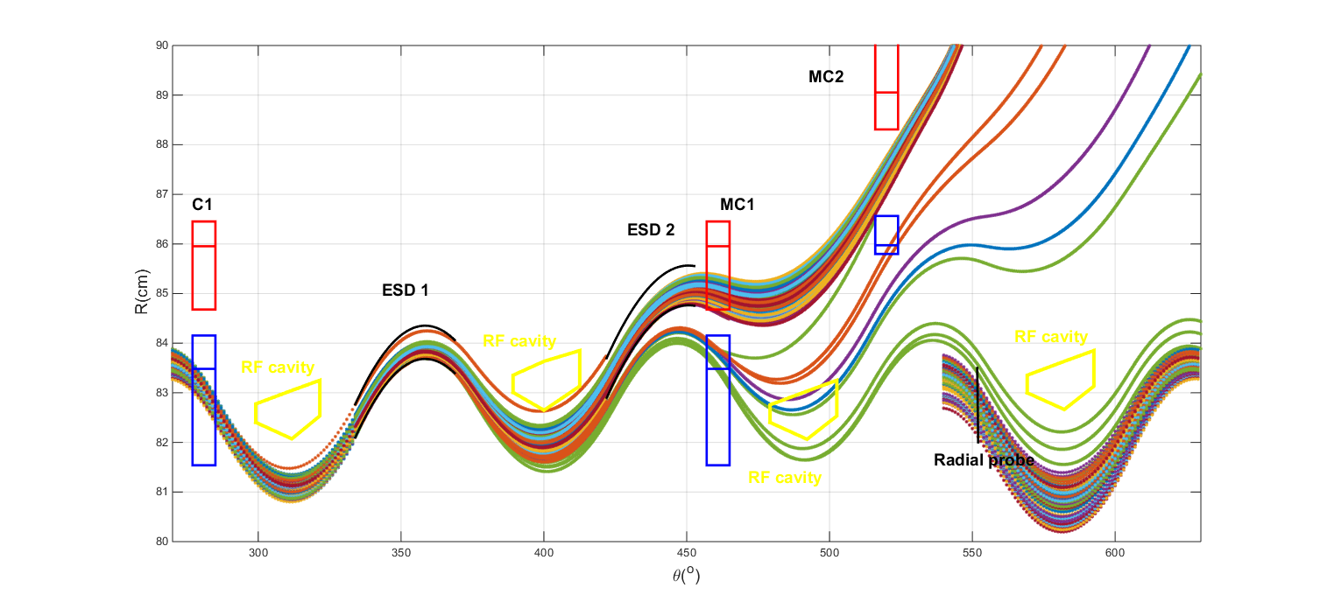
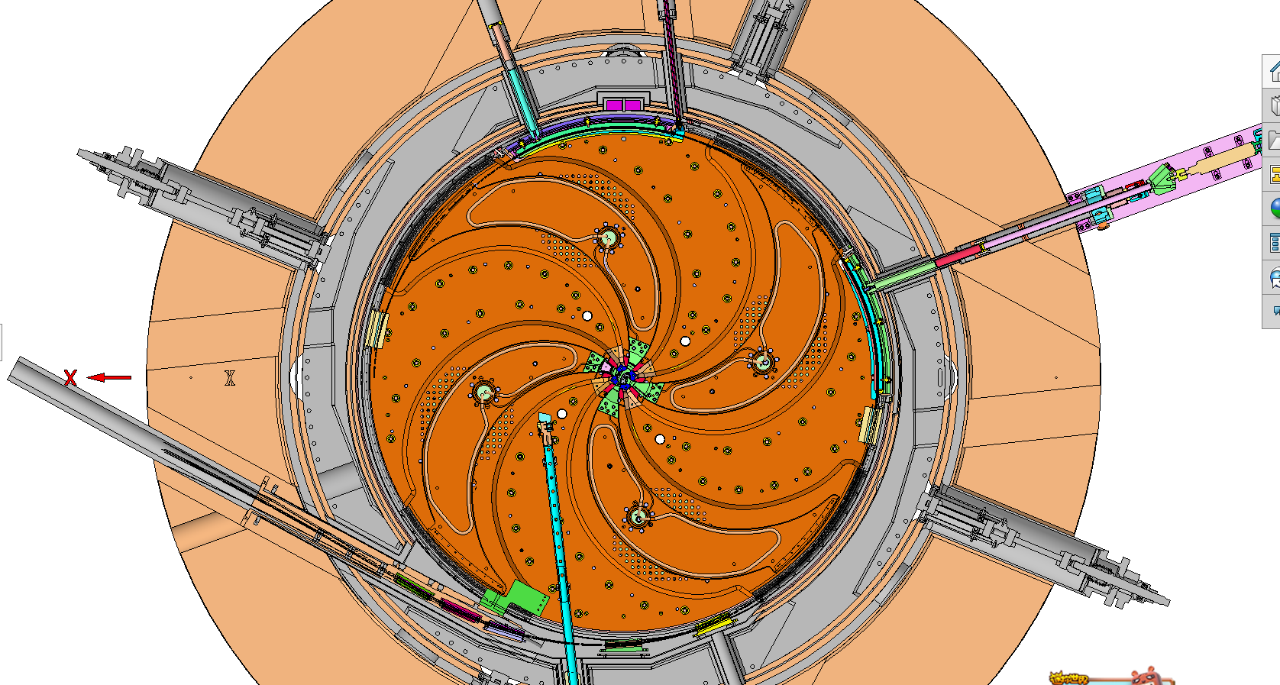
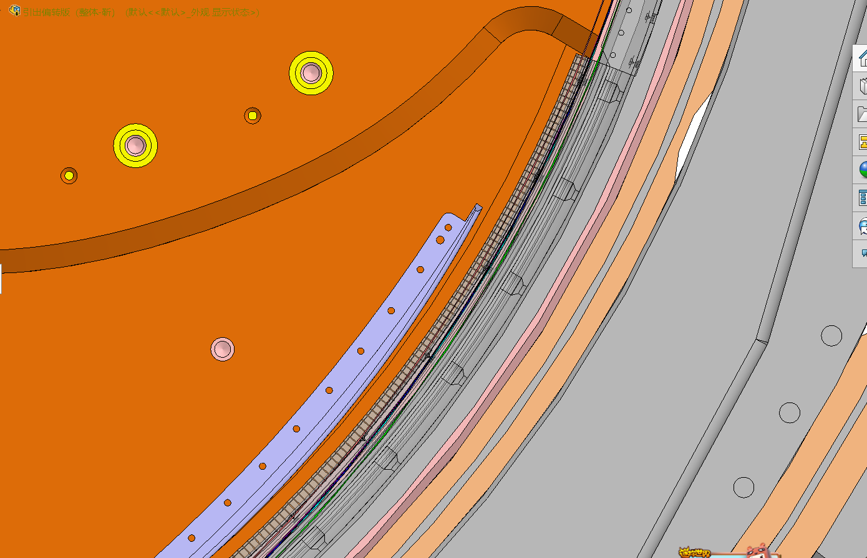
Commissioning of CYCIAE-230-extraction elements alignments
Trajectory design in extraction region
After ~700 turns, the extracted beam must pass the ESDs, MCs and the tailboard of the RF cavities with the tolerance of ~2mm.
The trajectory of the last turn is inside the tailboard before ESD2, and outside the tailboard after ESD2.
The positioning of the extraction elements is important.

Slide 16
Commissioning of CYCIAE-230-extraction elements alignments
Newly developed diagnostics for extraction elements alignments
Probe with radial fingers used for the commissioning of ESDs.
Self shielded probe for the commissioning of MCs.
The positioning of the extraction elements is important.

Slide 17
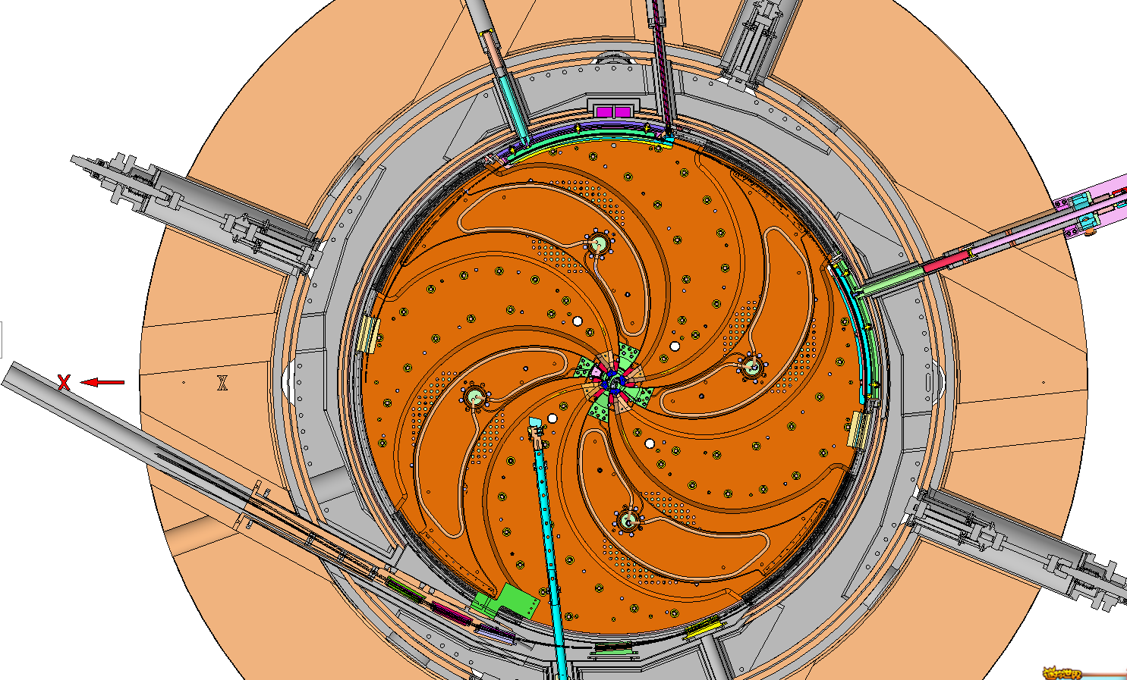
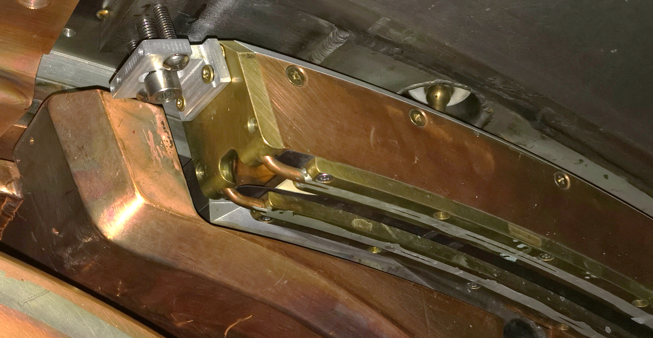
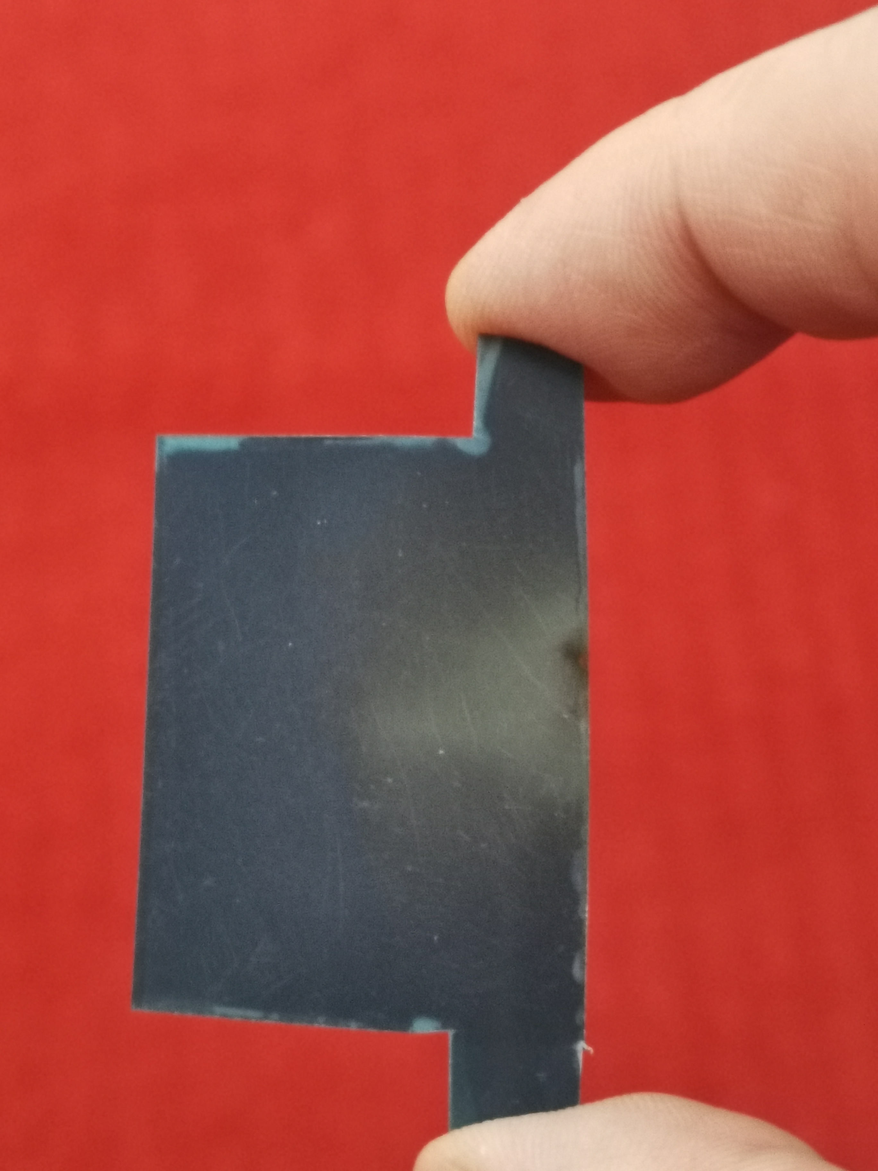
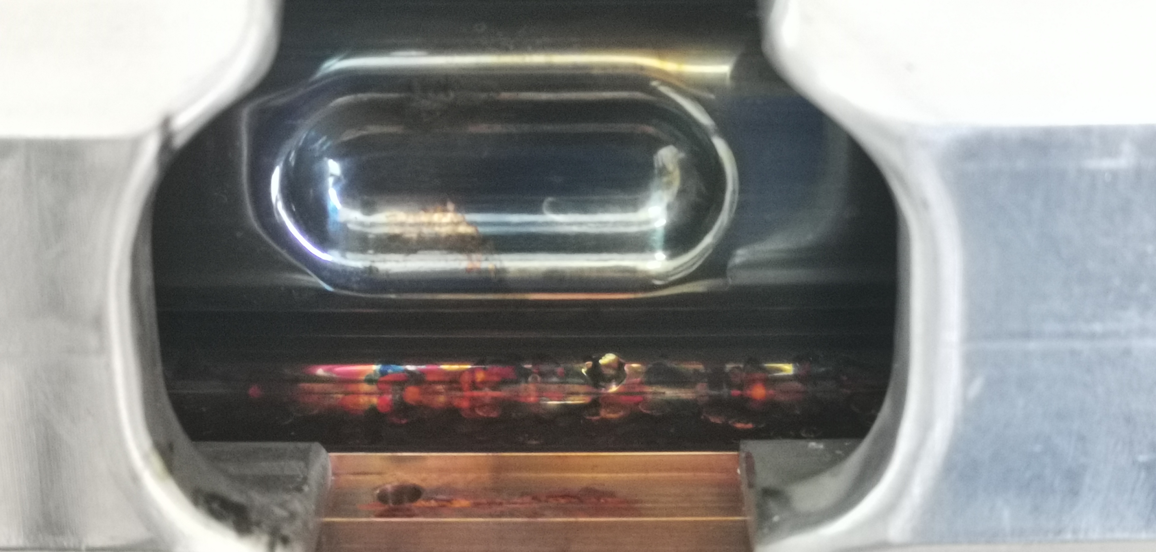
1
提出双功率源“推-拉”四谐振腔加速新方法、攻克高精度调变强磁场分布等技术难题
建成我国首台超导回旋加速器（230MeV)

Slide 18
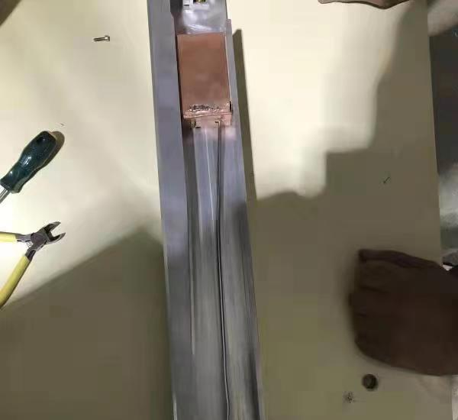
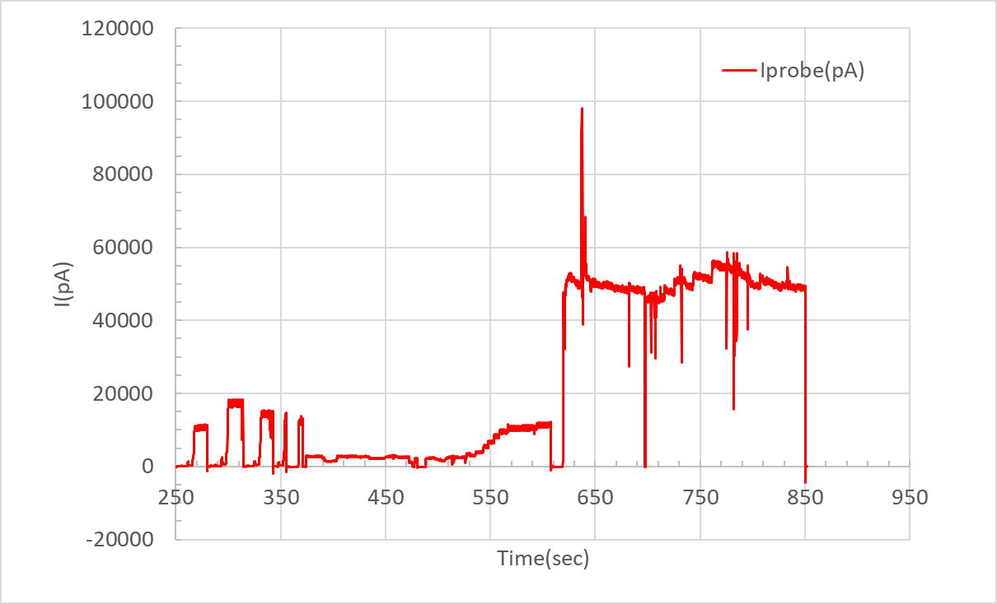
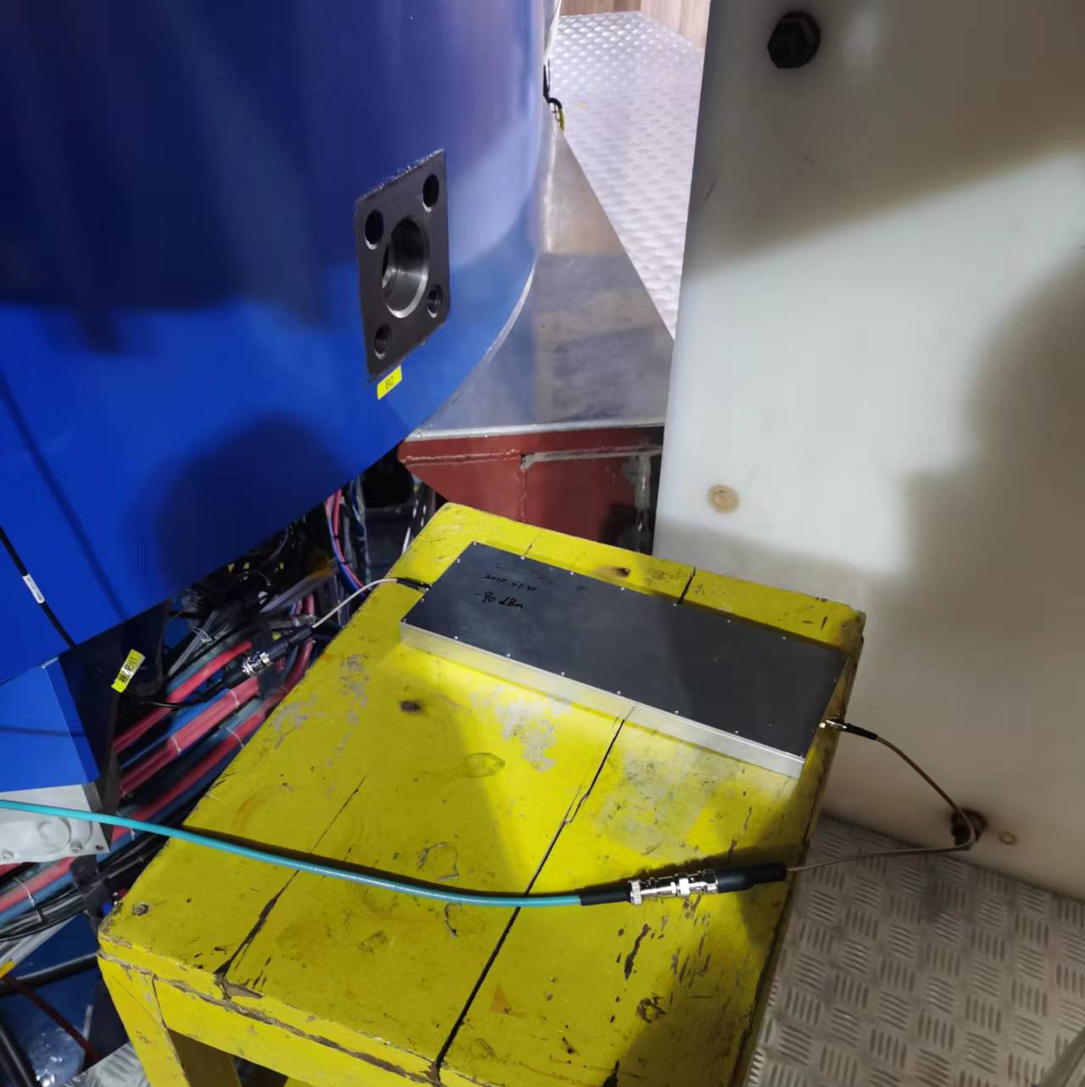
Commissioning of CYCIAE-230-Beam commissioning
Beam extraction test
After ~700 turns, the extracted beam has been measured at the end of the extraction port with a LIBERA current meter.
The beam on the copper target is over 50 nA @ energy of 241.6MeV~242.7MeV (estimated by extraction simulation).

Slide 19
Outline
1
Introduction to CYCIAE-230
Commissioning of subsystems
2
二
主要工作和贡献
Commissioning of CYCIAE-230
3
三
综合小结
4
Summary and the Future Plan
Notes:
报告分三个方面 一、基本信息

Slide 20
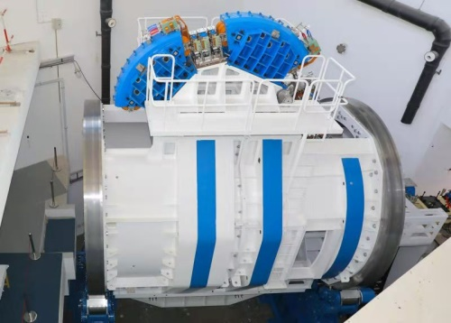
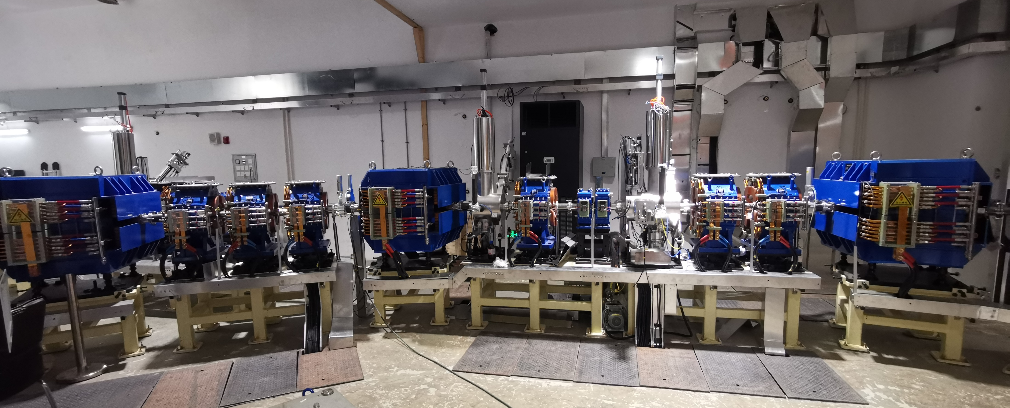
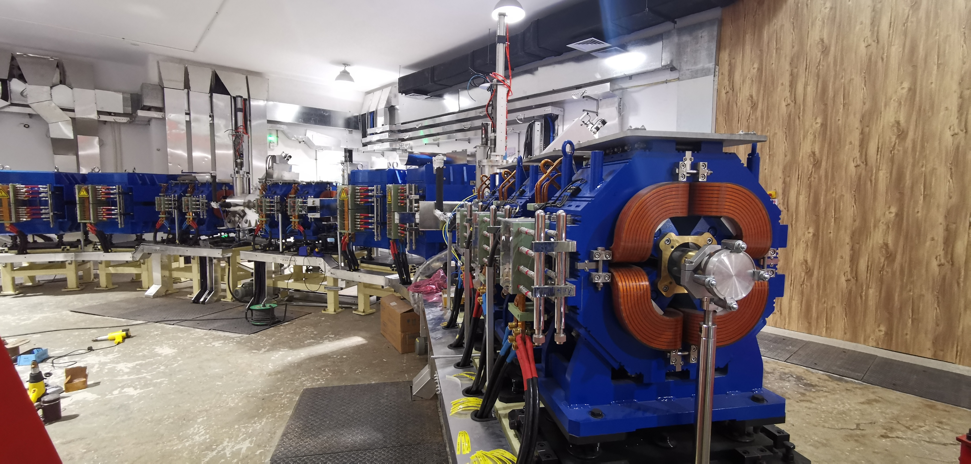
Commissioning of ESS, Beam line and Gantry is on going…
The 160-ton gantry has been tested and the isocenter positioning precision of 0.3mm is achieved during 360-degree rotation test. The commissioning of other parts will be fully performed after obtaining the approval from Beijing Environmental Protection Bureau.
Notes:
超导回旋建成，及配套束流线、360°旋转舱通过测试，等中心度好于0.3mm，开拓了应用新领域，签订了癌症治疗中心落地协议，宇航器件和集成电路抗辐射研发从100MeV提升到230MeV；还带动了轻量化全超导加速器立项研发。

