Slide 1
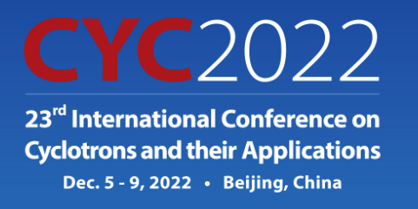
AN OVERVIEW OF THE SOUTH AFRICAN ISOTOPE FACILITY (SAIF) PROJECT
I.L. Strydom
South Africa
iThemba LABS / NRF
(ilr.strydom@ilabs.nrf.ac.za)

Slide 2
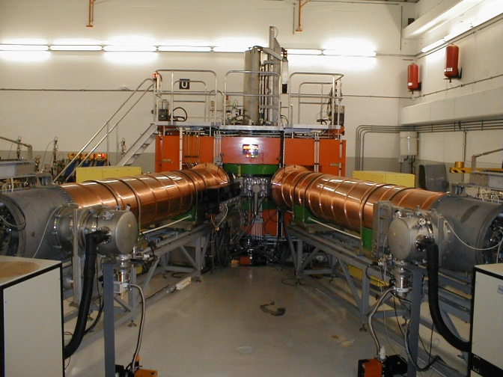
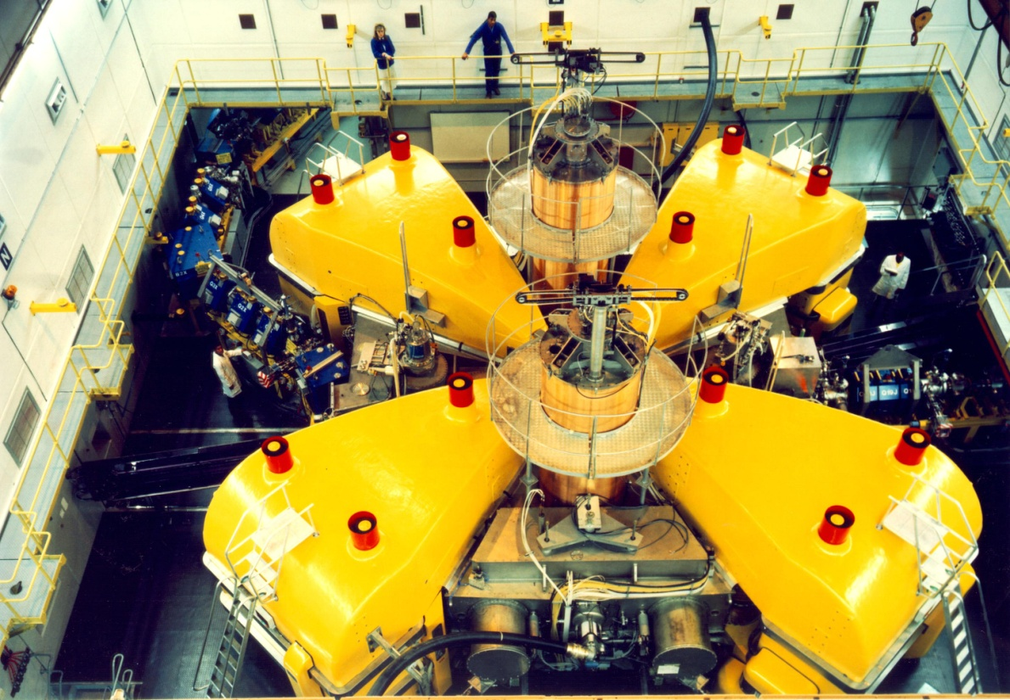
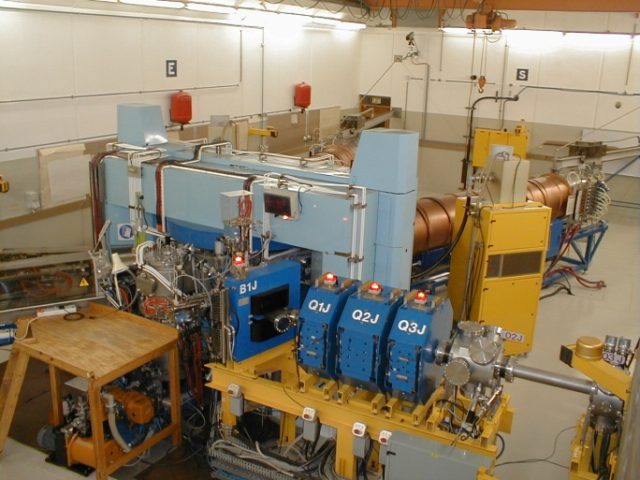
iThemba LABS: South African Isotope Facility
Background
iThemba LABS is a national facility of the National Research Foundation in South Africa:
Our existing facilities:
200 MeV separated-sector cyclotron (SSC)
Two solid-pole injector cyclotrons (different ion sources)
K600 spectrometer
Experimental beam lines (Aphrodite facility, neutron beam facility, radiation biophysics facility
Hotlabs for chemical extraction and cGMP production of radioisotopes and radiopharmaceuticals
11 MeV cyclotron for F-18 production
3 MV Tandetron accelerator for materials science research (Cape Town)
6 MV Tandem accelerator for materials research and AMS (Johannesburg)
Mandate | Beam Time Allocation
 | Historically | Present Time
Sub-atomic physics research | 33% | 10%
Radioisotope production | 33% | 90%
Particle therapy – neutron/proton protocols | 33% | Discontinued
K8 Injector Cyclotron 2
K8 Injector Cyclotron 1
Ageing facility no longer compatible with modern treatment protocols
K200 Separated Sector Cyclotron
IAEA-CN301-177
Slide 2/11
Speaker name: Izak Strydom

Slide 3
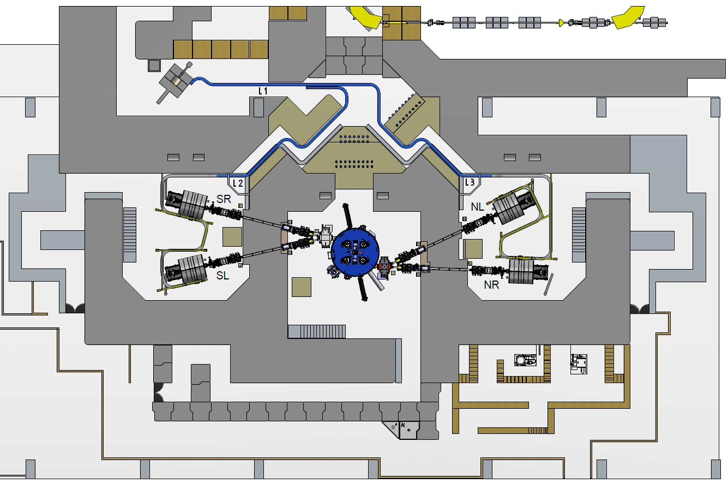
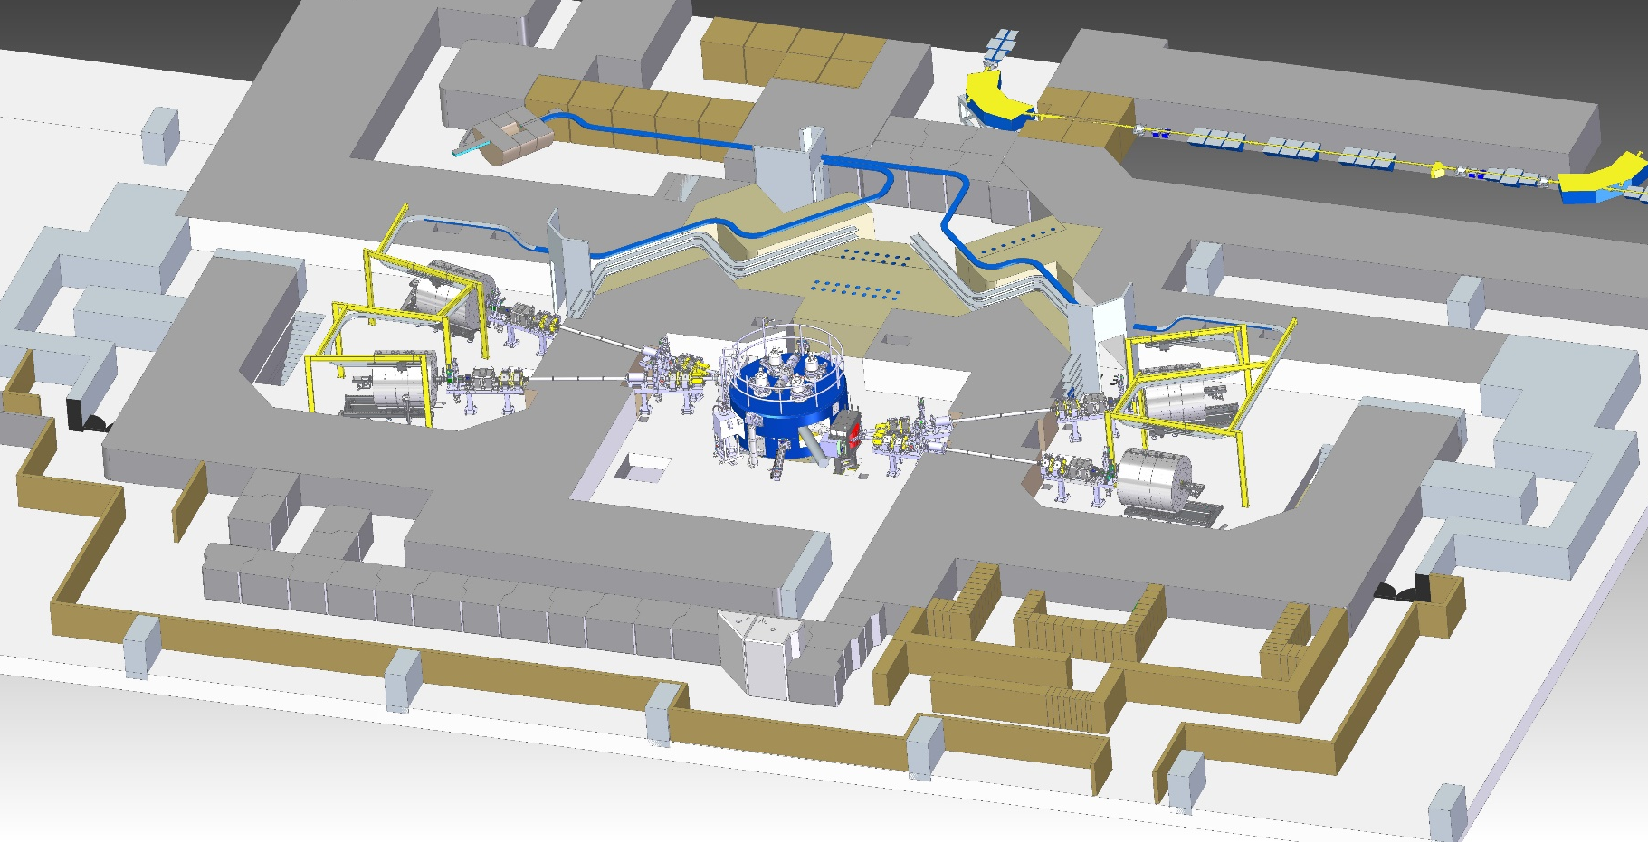
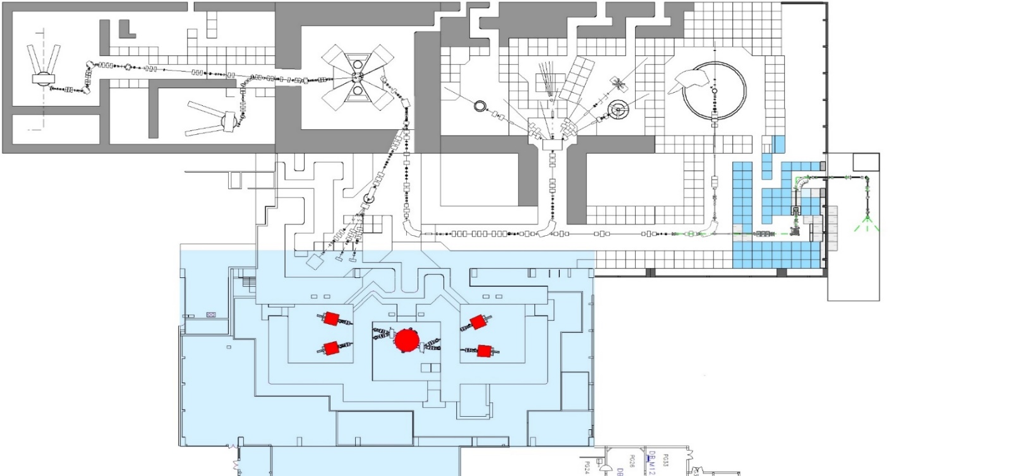
iThemba LABS: South African Isotope Facility
Injector Cyclotrons
Separated Sector Cyclotron
Radiation Biophysics
Neutron Vault
AFRODITE Vault
Motivation for SAIF Project
Objective = Establish a dedicated facility for radioisotope production:
New facility to be retrofitted in 3 existing un-utilised vaults on site which realises significant savings
Installation of a new 70MeV cyclotron and beam lines for isotope production
Migration of the radioisotope production programme from the existing SSC to the 70MeV cyclotron;
Increase the beam time availability at existing SSC complex for physics research
Implementation workstreams:
70 MeV cyclotron procurement
New beamlines procurement
New target stations manufacturing
New buildings for utility services, waste disposal
Regulatory licensing
70 MeV Cyclotron
Beam lines
K600 Spectrometer
New labyrinths
SPC2
SPC1
Trolley track
LERIB
New target stations
SAIF Phase 1
New cooling systems
IAEA-CN301-177
Slide 3/11
Speaker name: Izak Strydom

Slide 4
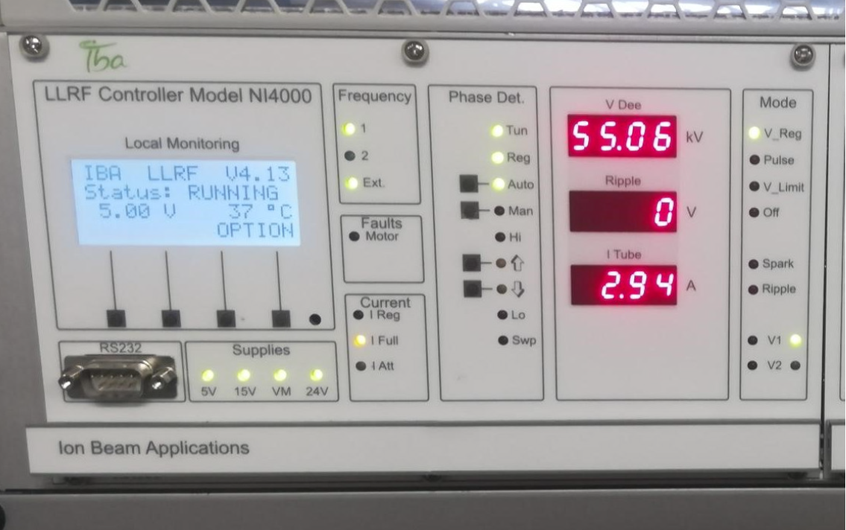
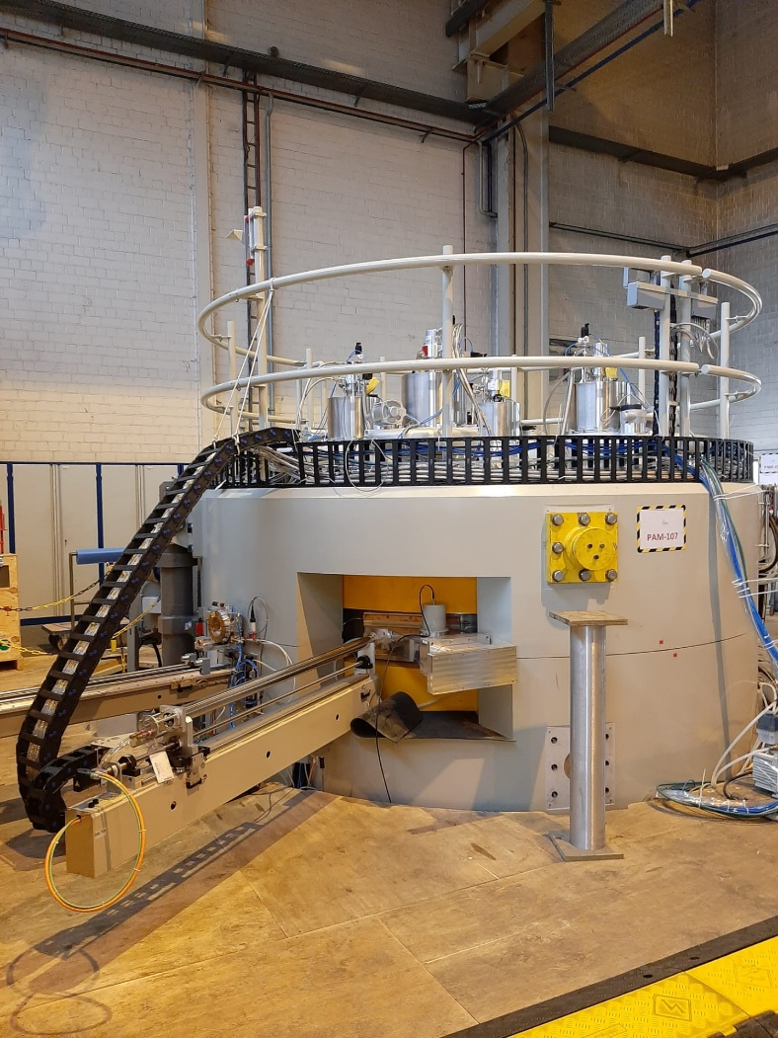
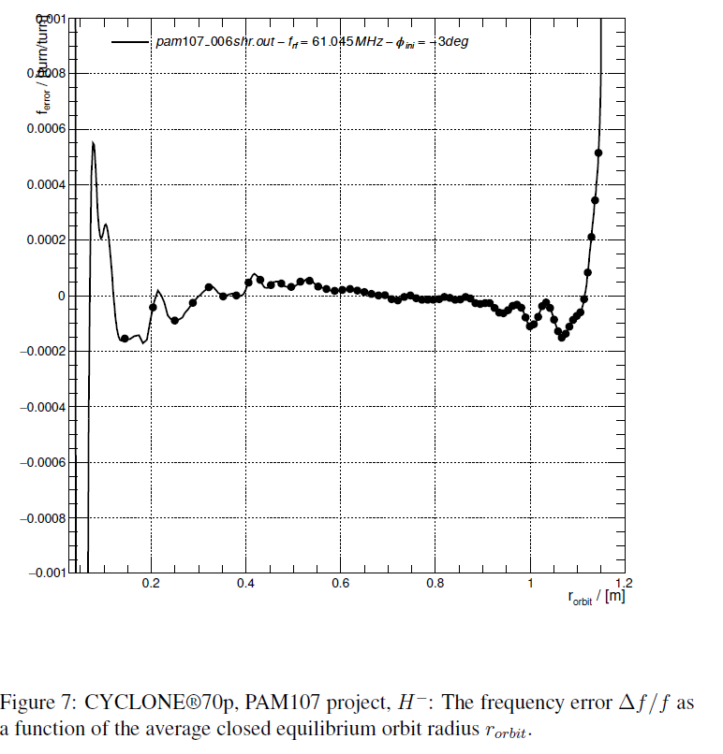
iThemba LABS: South African Isotope Facility
70 MeV cyclotron
Cyclone 70P supplied by IBA Radiopharma Solutions
Variable energy proton beams (30 – 70 MeV)
Multicusp ion source with 10 mA of injected H- current
High-intensity proton beams up to 375 μA per extraction port
Dual extraction ports for simultaneous beam delivery
4-sector magnet of 1.6 Tesla
Directly coupled 100 kW RF system with 2 dees (4th harmonic mode)
4 beam transport lines with beam diagnostics, Faraday cups and neutron shutters
Status of C70 manufacturing & installation
Factory acceptance tests completed in Belgium in July 2021
Delivered to port of Cape Town in December 2021
Installed into the vault in April 2022
IAEA-CN301-177
Slide 4/11
Speaker name: Izak Strydom

Slide 5
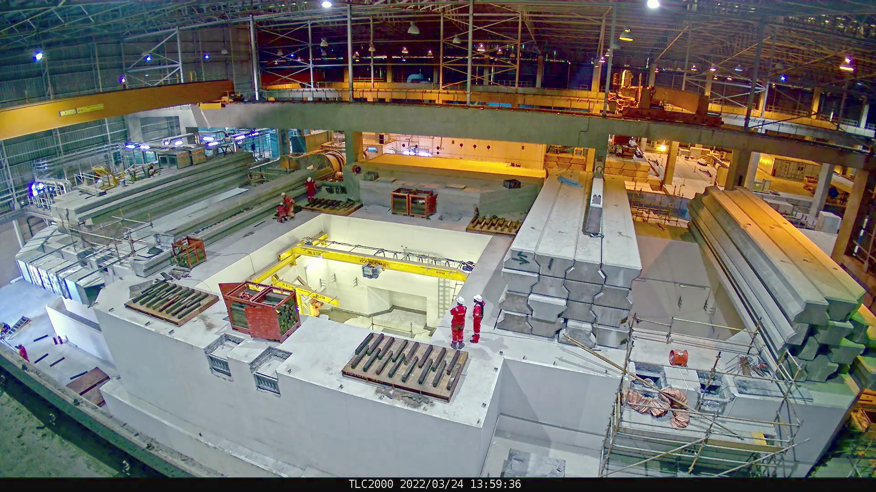
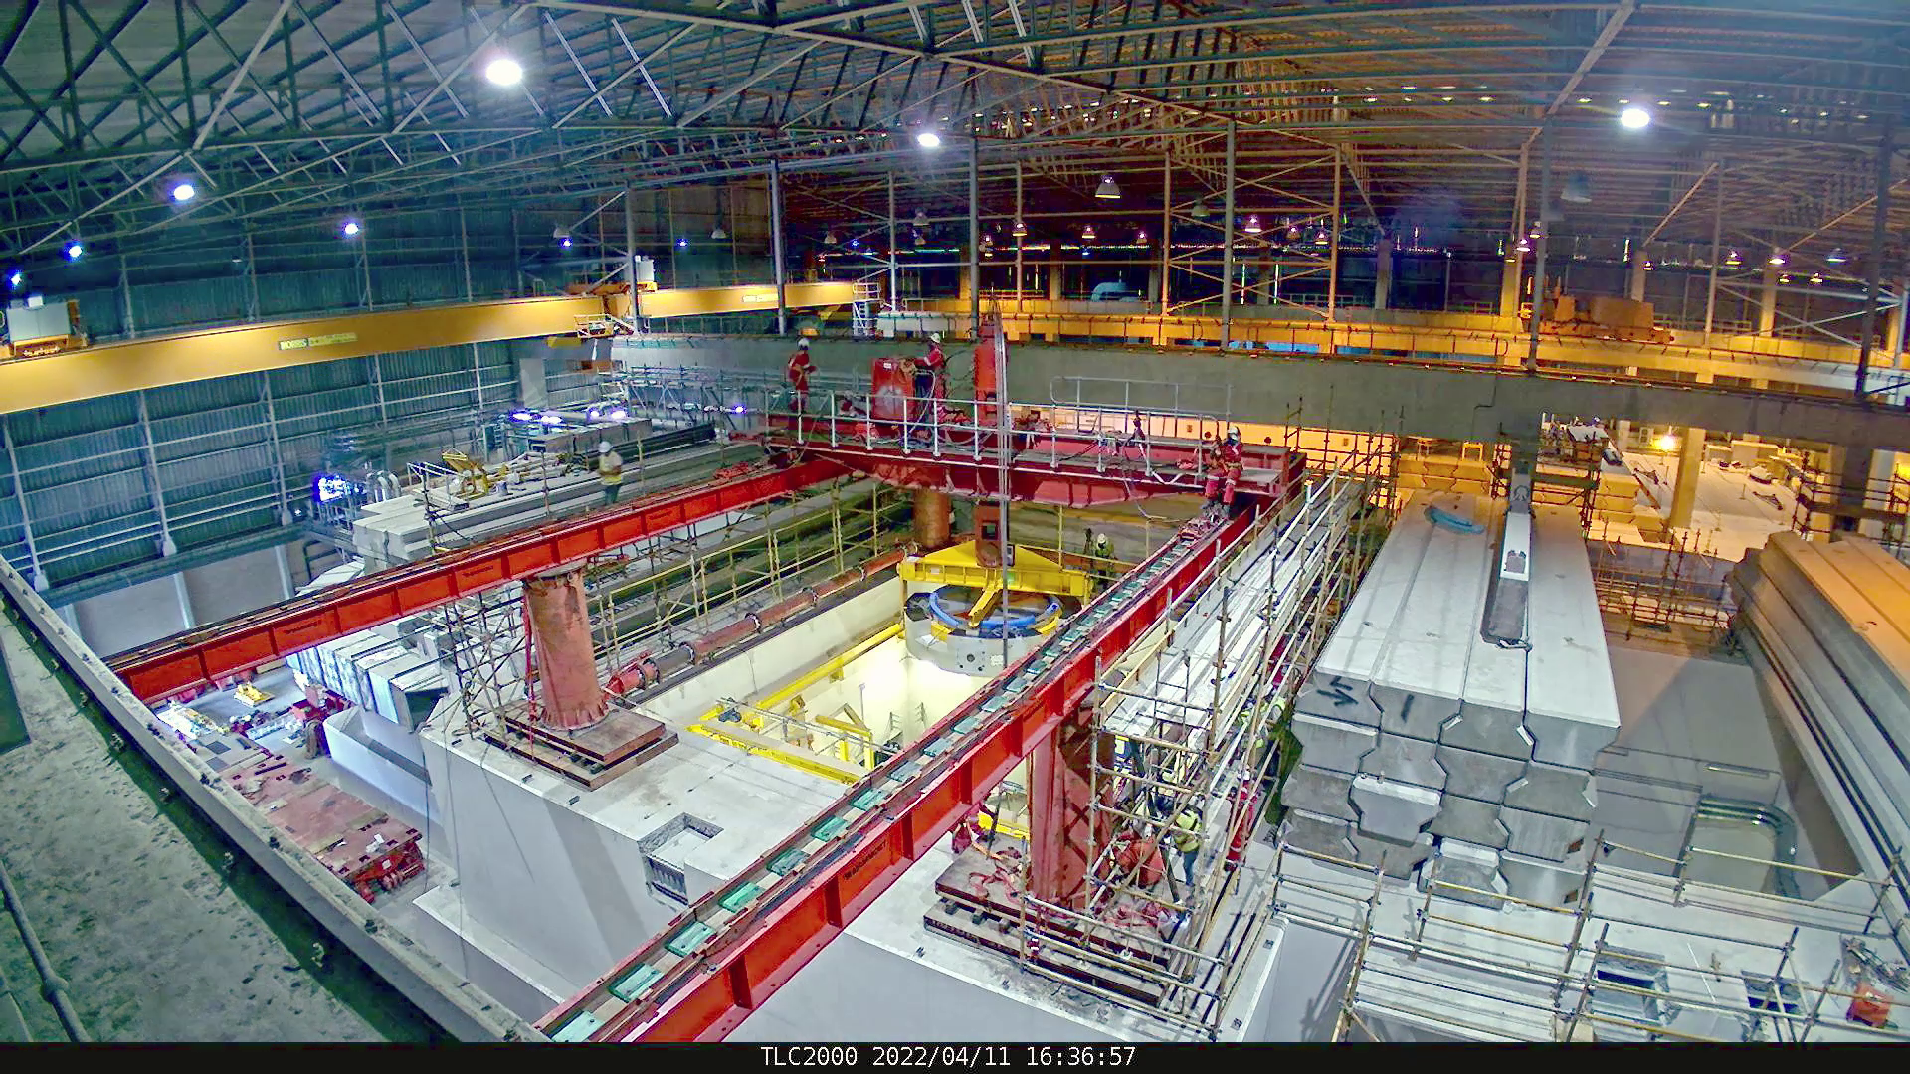
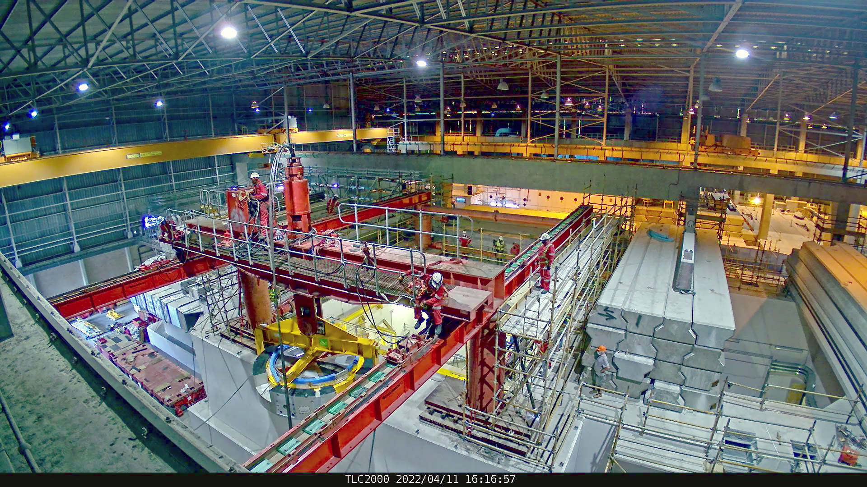
iThemba LABS: South African Isotope Facility
Installation of C70 cyclotron and beam transport lines
IAEA-CN301-177
Slide 5/11
Speaker name: Izak Strydom

Slide 6
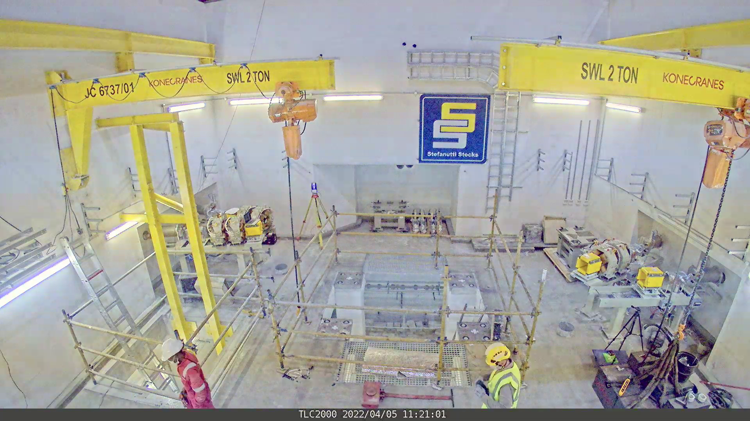
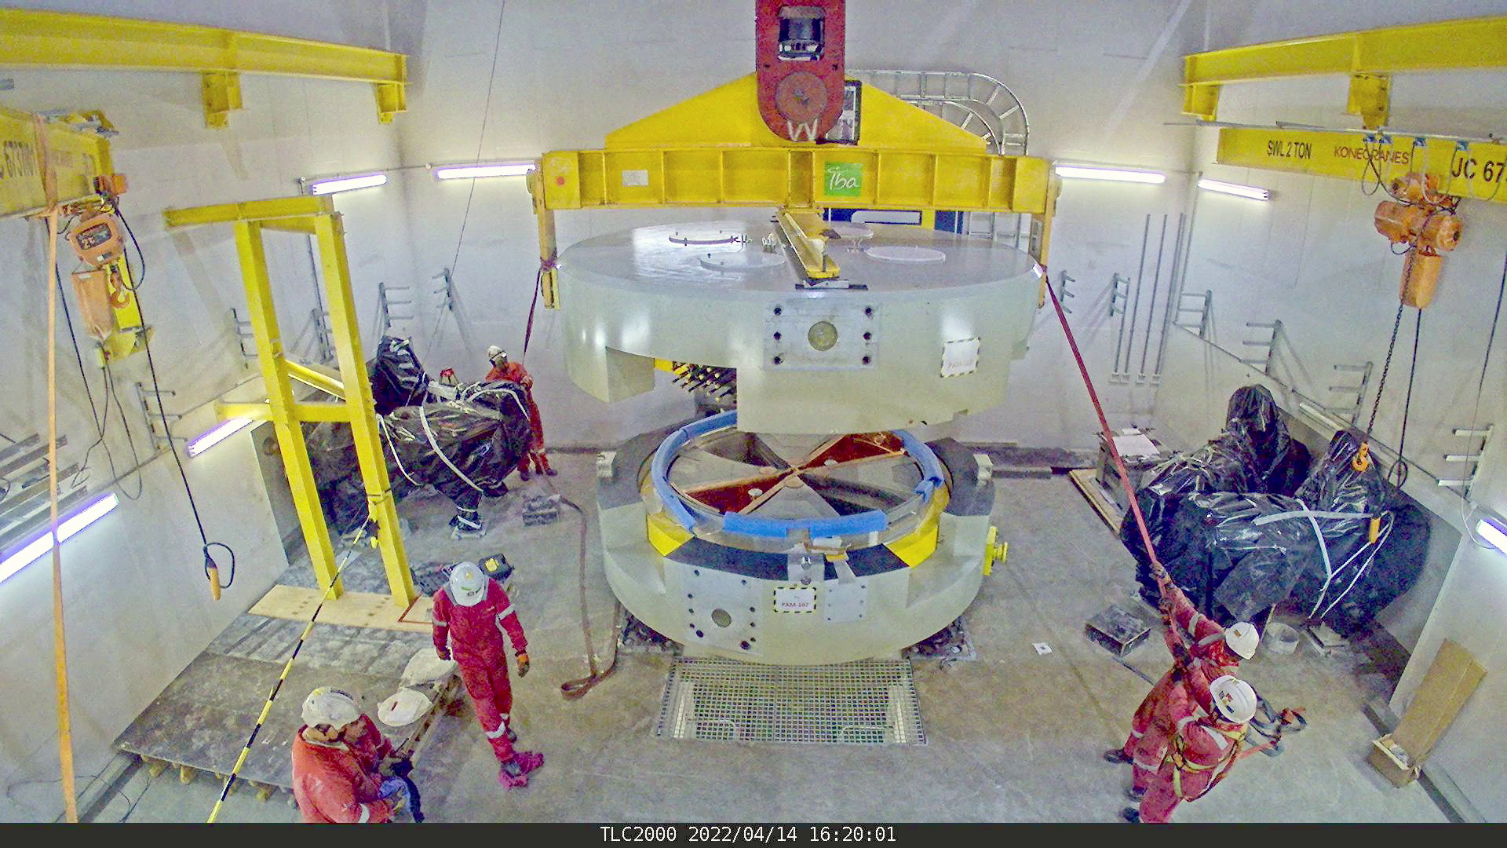
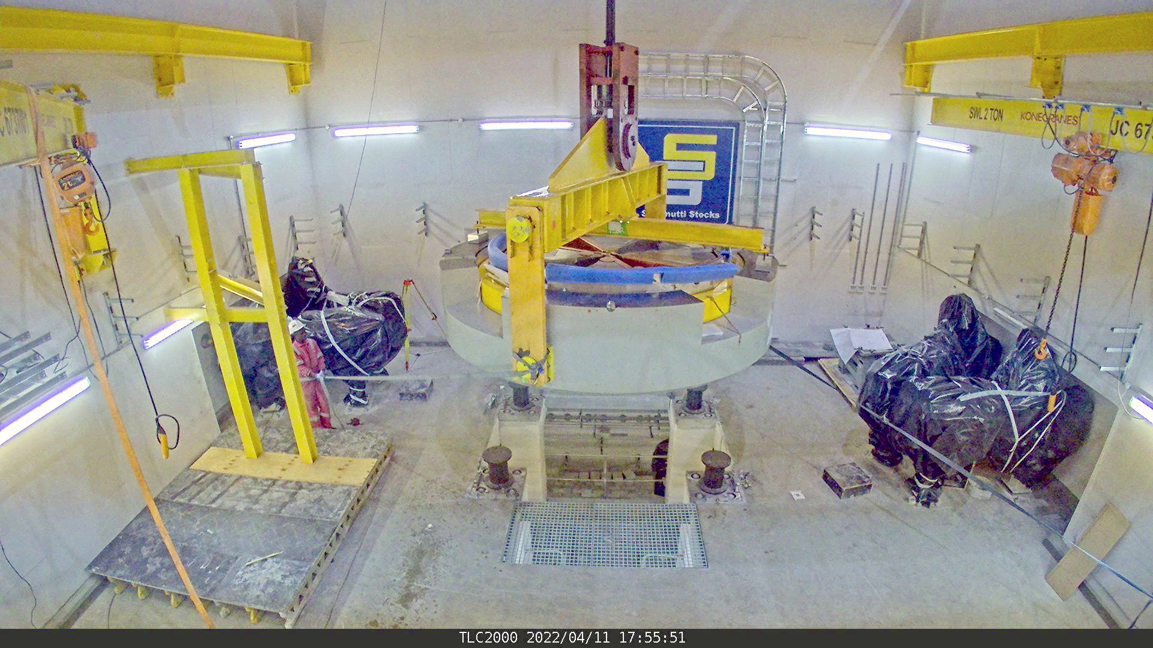
iThemba LABS: South African Isotope Facility
Installation of C70 cyclotron and beam transport lines
IAEA-CN301-177
Slide 6/11
Speaker name: Izak Strydom

Slide 7
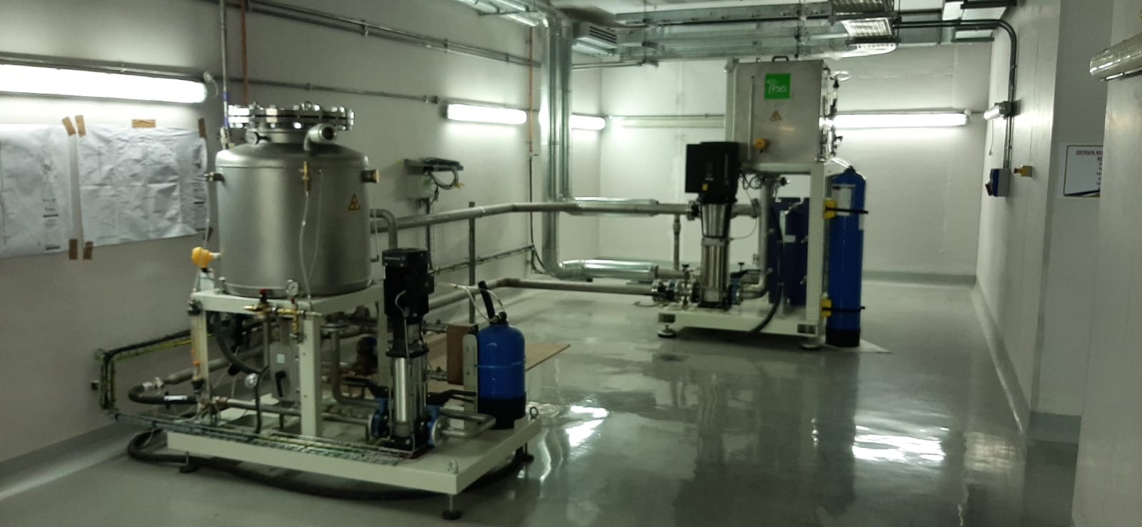
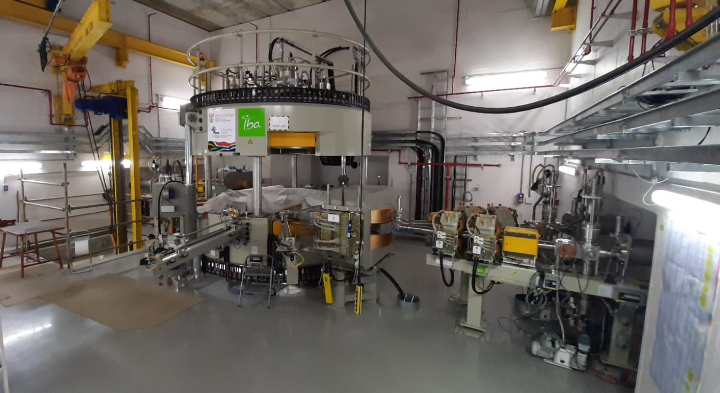
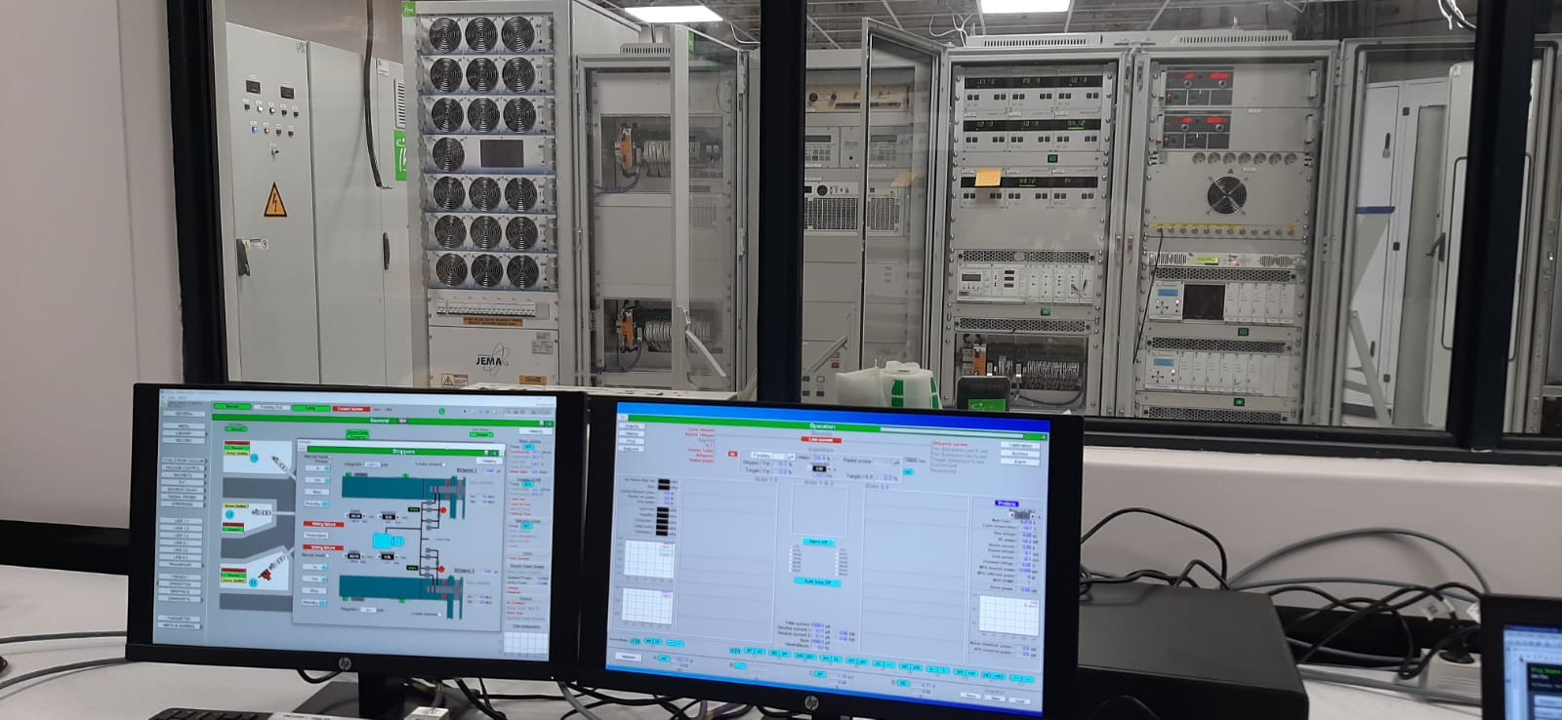
iThemba LABS: South African Isotope Facility
Installation of C70 cyclotron and beam transport lines
Mechanical assembly of C70 99% completed
Wiring and cabling of cyclotron and beam line equipment completed
IBA field engineers on site for PLCs and system testing
IAEA-CN301-177
Slide 7/11
Speaker name: Izak Strydom

Slide 8
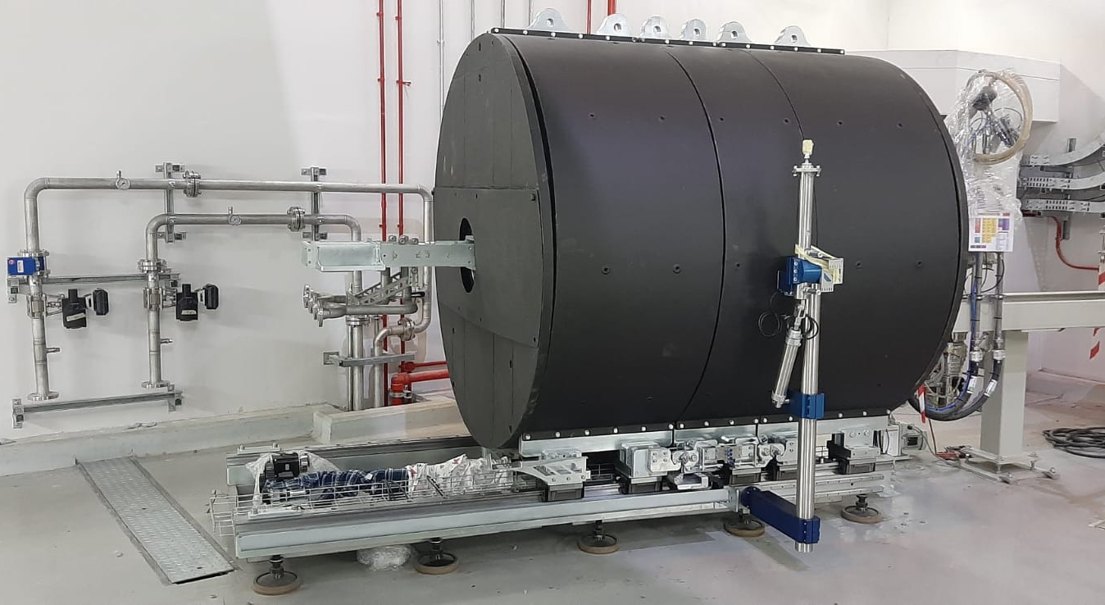
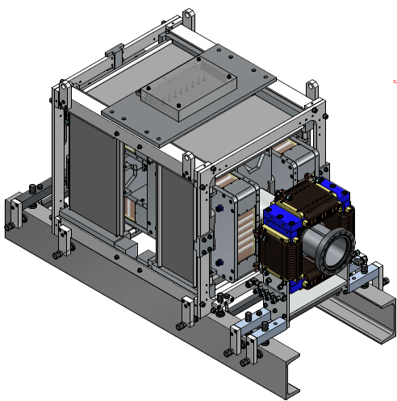
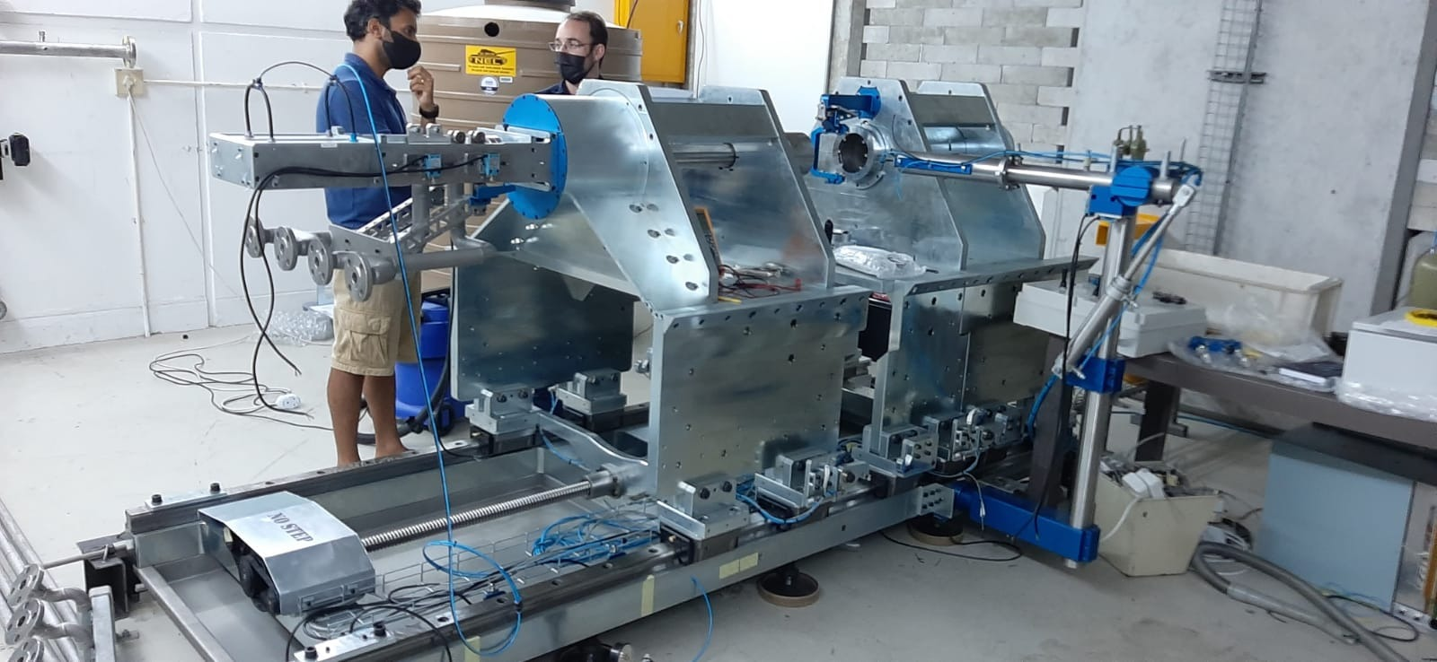
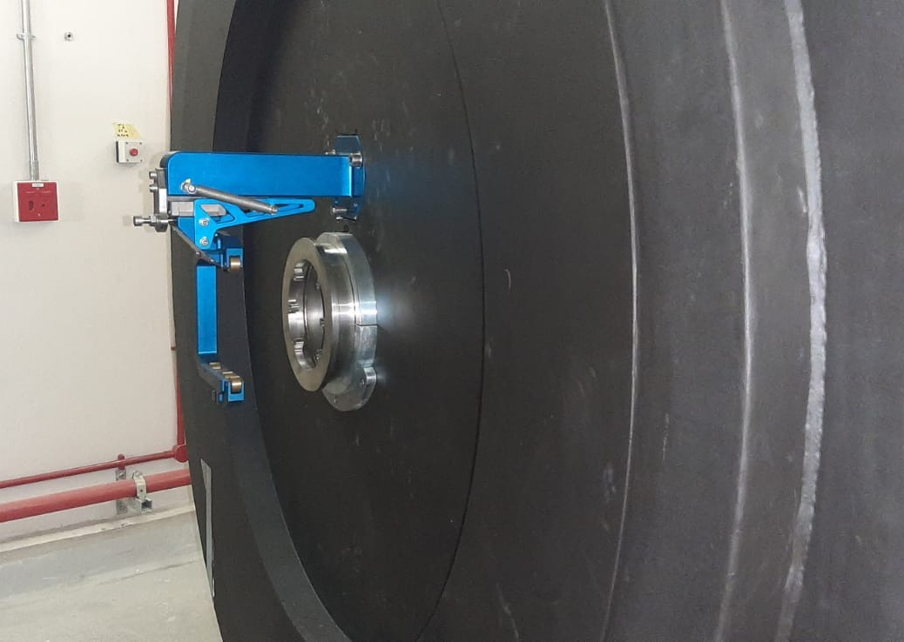
iThemba LABS: South African Isotope Facility
Target Systems
In-house design of target station
Provide local radiation shielding (steel, lead, borated wax)
Accommodate solid targets of Sr and Ga in tandem
Water-cooled target capsules (up to 26 kW heat removal)
Helium-cooled vacuum window
Robotic transfer of target from target stations to chemical processing facility
In-house design of sweeper / steerer magnets*:
H-type dipole magnets with 90° phase difference to sweep the beam in a circular pattern to provide heat dissipation to the vacuum window and target capsule
IAEA-CN301-177
Slide 8/11
Speaker name: Izak Strydom

Slide 9
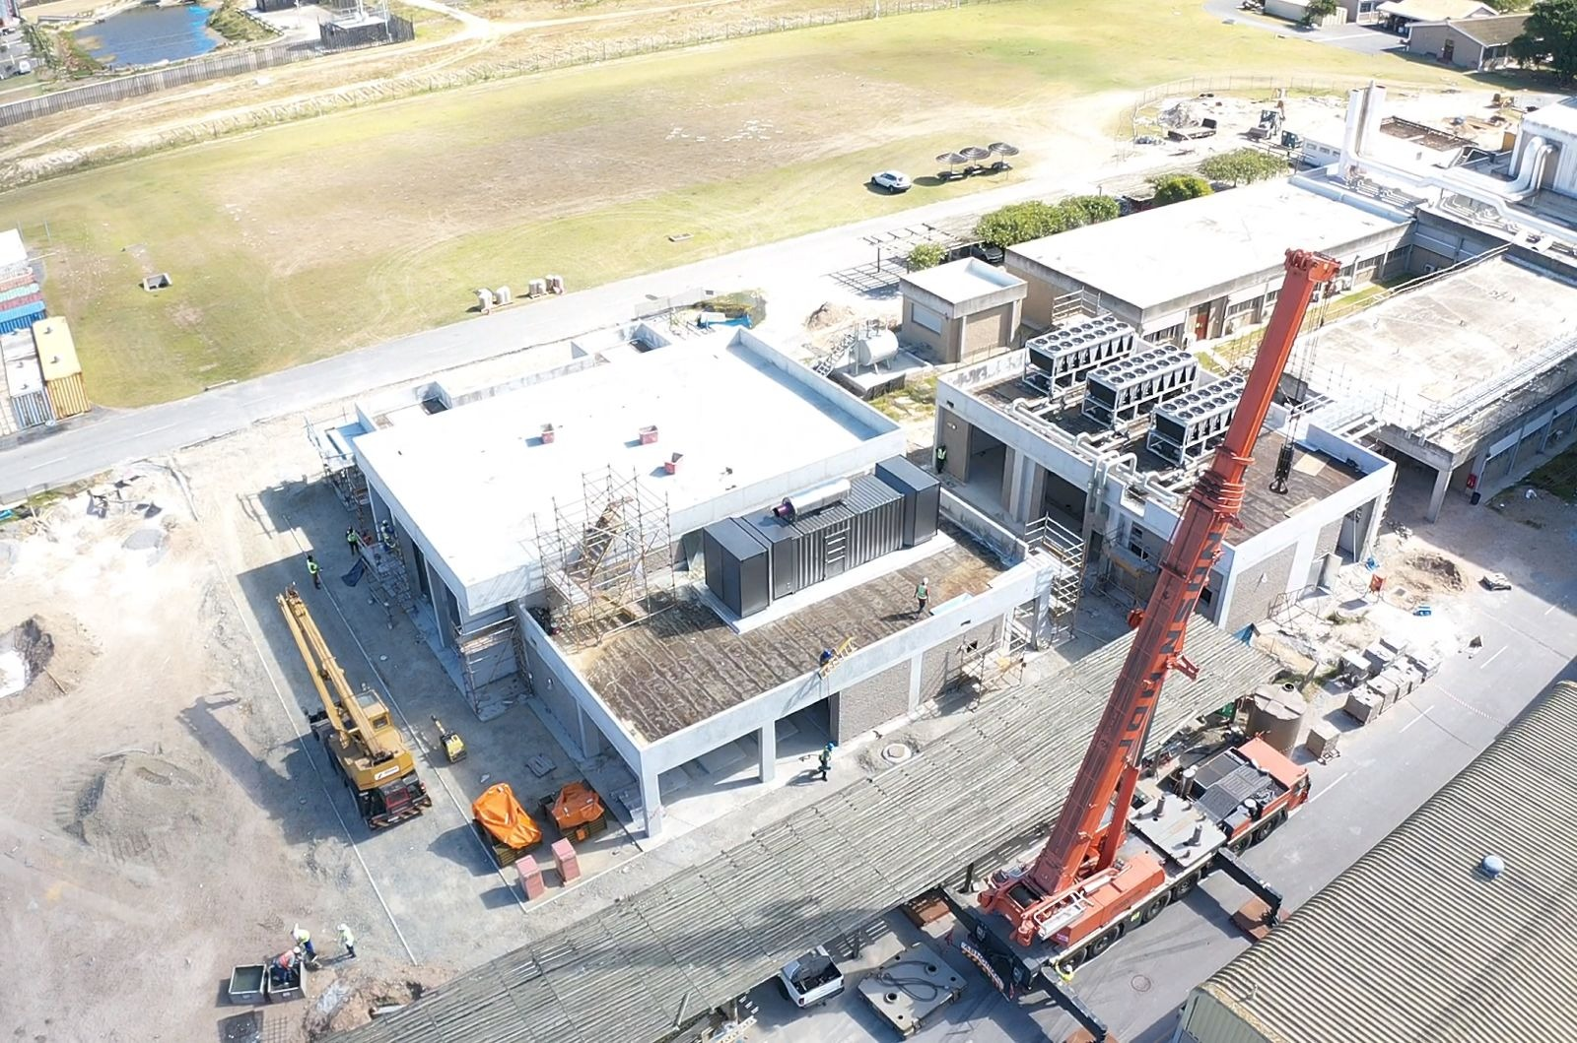
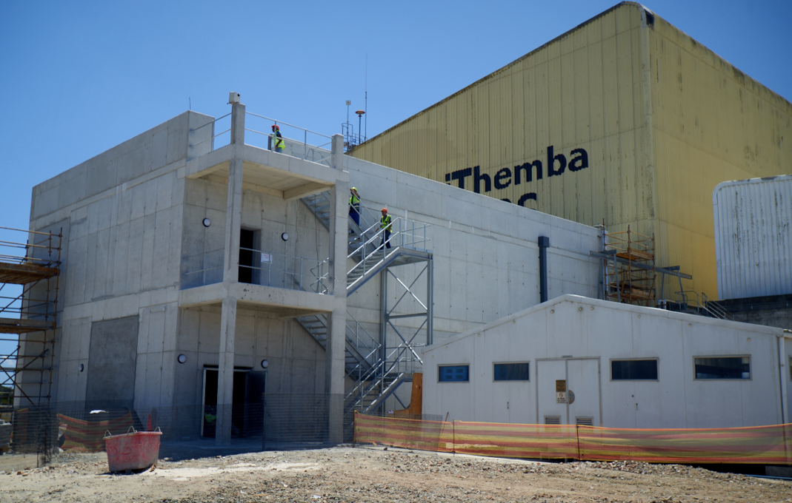
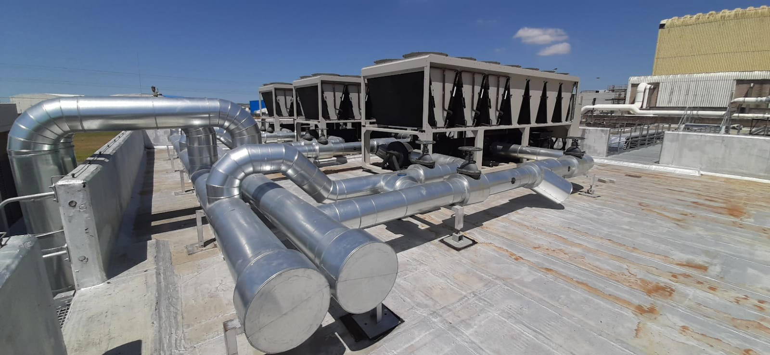
iThemba LABS: South African Isotope Facility
Infrastructure
Construction works entailing the following:
Structural modifications to cyclotron vault and 2x target vaults
Facilities to house power supplies, electronics and control rooms
Mechanical plant room for central water cooling plant
Electrical plant room for power distribution and RUPS
Radioactive waste storage facility (processing & storage of solid & liquid wastes)
HVAC for specified air changes and pressure cascades in controlled areas
Cyclotron and beam transport line cooling systems
Target cooling systems
Supervisory control systems for vault clearance and safety interlocking
IAEA-CN301-177
Slide 9/11
Speaker name: Izak Strydom

Slide 10
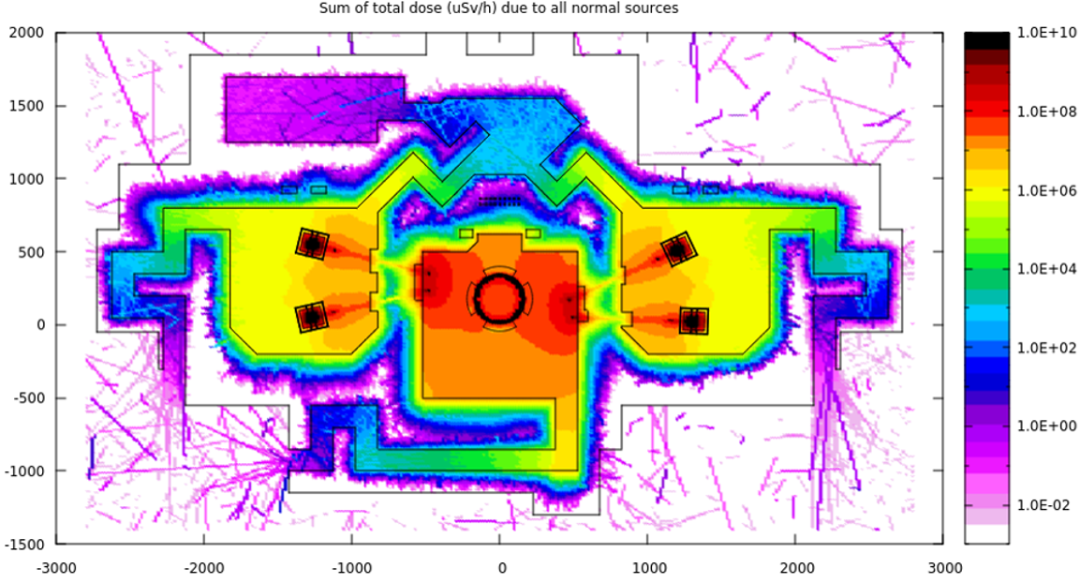
iThemba LABS: South African Isotope Facility
Infrastructure
Vault Modifications – Verification of Design for Radiation Shielding*:
Worst case fluence to dose conversion factors used (FLUKA option EWT74) based on data sets from ICRP74
Acceptable Radiation Levels:
Unrestricted blue areas (ground level outside vaults): < 2.5 μSv/h
Restricted blue areas (on roof): < 15 μSv/h
IAEA-CN301-177
Slide 10/11
Speaker name: Izak Strydom

Slide 11
iThemba LABS: South African Isotope Facility
Remaining work:
Activity | Estimated completion date
C70 cyclotron: Final assembly of mechanical/electrical systems | Dec 2022
Commission central services (HVAC, cooling systems, electrical power) | Completed
C70 cyclotron: RF start | Dec 2022
C70 cyclotron: First beam extraction | Feb 2023
Complete radioactive waste handing facility | Feb 2023
Commission 2x target stations | Mar 2023
C70 cyclotron: Beam transport line commissioning | Feb 2023
C70 cyclotron: Site acceptance testing | Apr 2023
Complete regulatory licensing process | Apr 2023
IAEA-CN301-177
Slide 11/11
Speaker name: Izak Strydom

Slide 12
Thank you
Acknowledgements
iThemba LABS
National Research Foundation
IBA Radiopharma Solutions

