Slide 1
Accelerator and Detector Developments for the Production of Theranostic Radioisotopes with Solid Targets at the Bern Medical Cyclotron
Alexander Gottstein¹, Saverio Braccini¹,
G. Dellepiane¹, P. Casolaro¹, I. Mateu¹, P. Scampoli^{1,2}
¹ Albert Einstein Center for Fundamental Physics (AEC), Laboratory of High Energy Physics (LHEP), University of Bern, Switzerland
² Department of Physics “Ettore Pancini”, University of Napoli Federico II, Italy
Notes:
Outline:
Compact medical PET cyclotrons: tools for medicine and science
SWAN project in Bern: production and research under the same roof
Positron Emission Tomography: conventional and novel radioisotopes
> Liquid vs solid targets
Production of new radioisotopes for theranostics
> Tools and methods from high-energy physics
> Some achievements with the Bern cyclotron

Slide 2
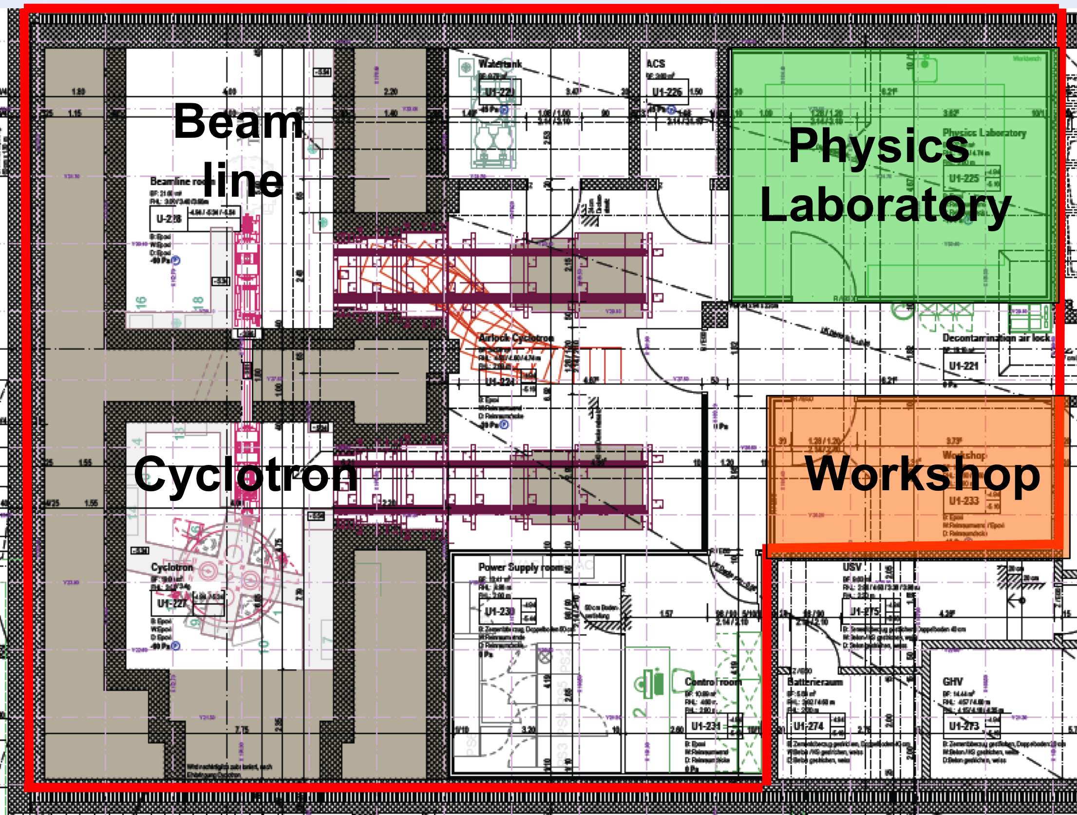
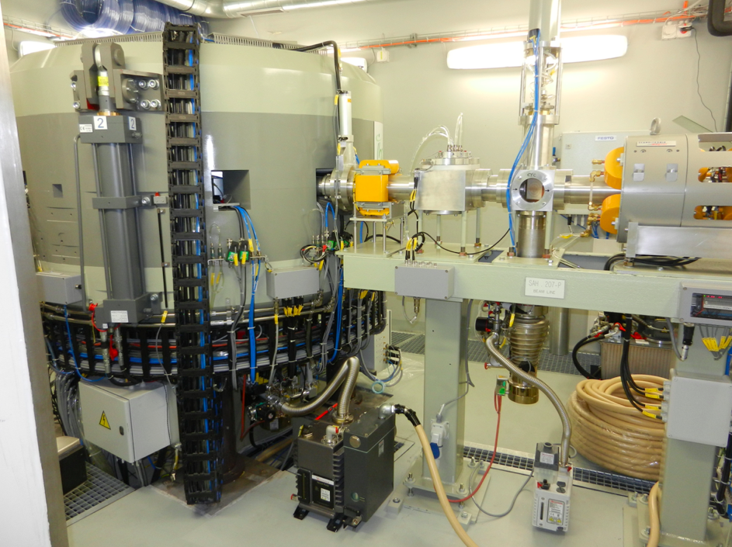
The Bern Medical Cyclotron and its Beam Transport Line (BTL)
IBA 18 MeV high current cyclotron (up to 150 mA) – two H⁻ ion sources
6 ¹⁸F liquid targets for daily production
External beam line in a separate bunker + solid target station: research
Specific method to produce currents down to 1 pA.*
* M. Auger et al., Meas. Sci. Technol. 26 (2015) 094006
Notes:
Production of radiopharmaceuticals is carried out by in-house company SWAN isotopes.

Slide 3
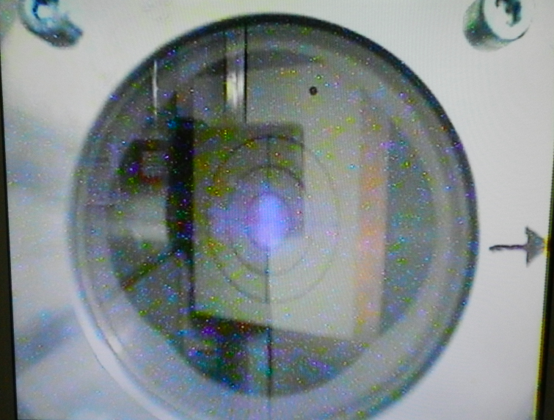
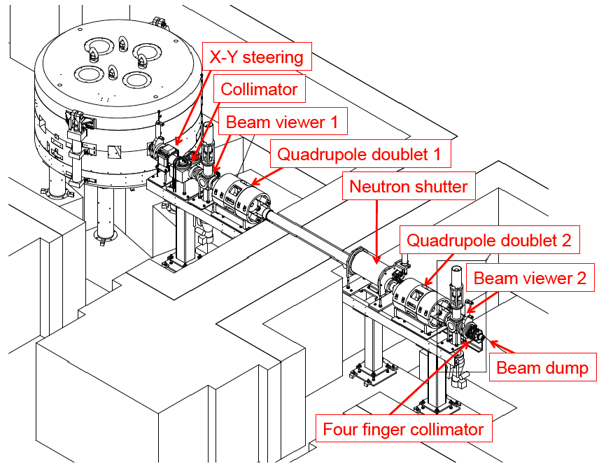
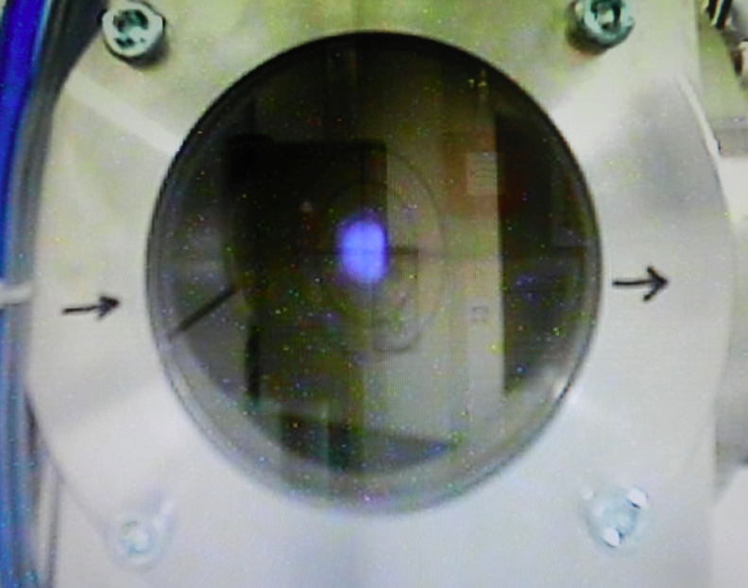
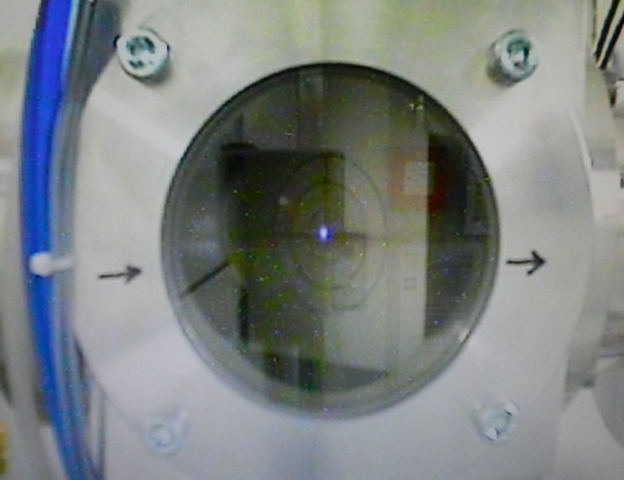
Multidisciplinary Research Activities with the BTL
Beam from cyclotron
Beam from BTL
CYCLOTRONS 2022 - 07.12.2022 - AG - SB
Source: S. Braccini, AIP Conf. Proc. vol. 1525, p. 144, 2013

Slide 4
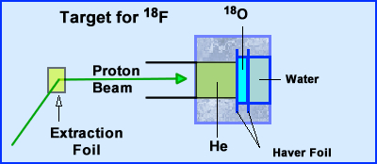
PET Radioisotope Production
Main PET radioisotope: ¹⁸F (t_{1/2} ≈ 110 min.)
¹⁸O (p,n) ¹⁸F
Liquid targets:
~ 1 g
~ 10 mm diameter
Beam: 12 mm FWHM
Emerging PET radioisotope: ⁶⁸Ga
Targets: liquid (common), gas and solid (rare)
Liquid targets are mounted directly after beam extraction
¹⁸F production: 500 GBq in 2 hours (~150 mA)
Beam optimization is crucial!
Notes:
C11: produced with proton bombardment of nitrogen gas; ¹⁴N(p,α)¹¹C
N13: produced with proton bombardement of ‘normal’ water: ¹H + ¹⁶O → ¹³N + ⁴He
O15: It is produced through deuteron bombardment of nitrogen-14 using a cyclotron.
>> ~99% of PET screening is done with F18
>> For Ga68: Dispute on whether to produce it with liquid or solid.

Slide 5
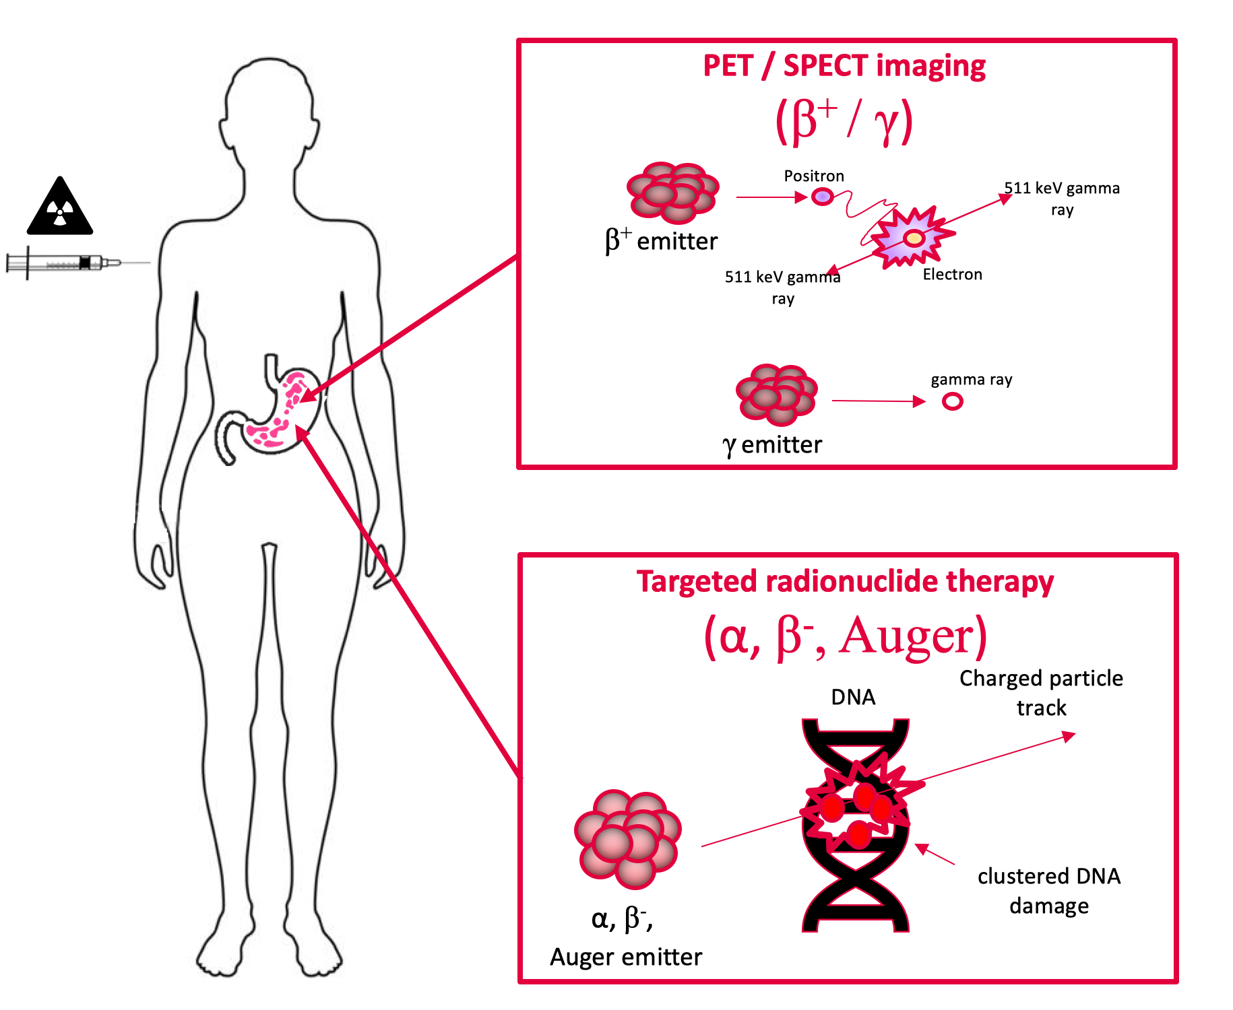
Radionuclides for Theranostics in Nuclear Medicine
Promising pairs of radionuclides:
⁶⁸Ga/¹⁷⁷Lu and ⁶⁸Ga/²²⁵Ac
⁴³Sc/⁴⁷Sc and ⁴⁴Sc/⁴⁷Sc
⁶¹Cu/⁶⁷Cu and ⁶⁴Cu/⁶⁷Cu
¹⁵⁵Tb/¹⁴⁹Tb and ¹⁵⁵Tb/¹⁶¹Tb
Solid targets:
~ 10 mg
~ 5 mm diameter
Material: powder
Beam: ???
Notes:
Used for treatment against Neuroendocrinic Tumors, which can for e.g. in the hormonal system such as in the stomach for example.
Lu = Lutetium
Ac = Actinium
Tb = Terbium
Radiometals, such as:
- Scandium 44
- Gallium 68
- Copper 64
Zirconium 89
➔Radiometals are attracting considerable interest since they can be used to label bothproteins and peptides.
Our Strategy for the Production of Radioisotopes for Theranostics:
> Accurate knowledge of the beam (position, shape, energy)
>> Beam monitoring detectors (will be discussed later)
> Novel target + transfer system
> Accurate knowledge of the production cross sections (impurities!)
> Active system to focus the beam

Slide 6
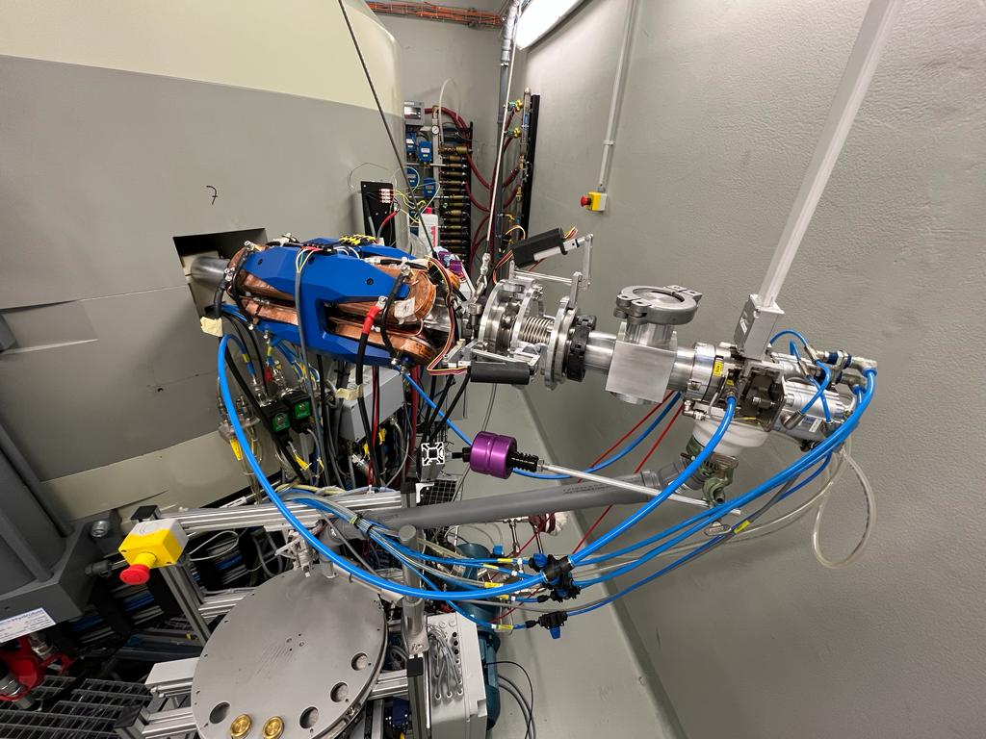
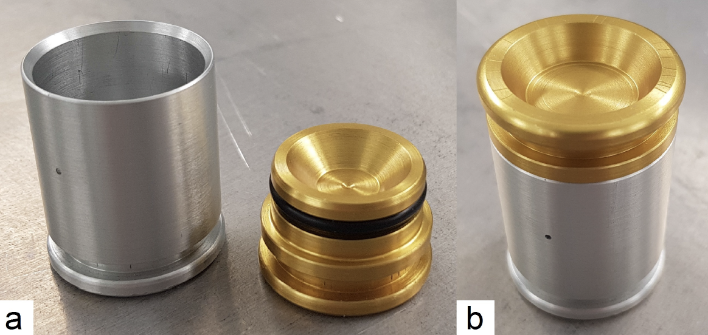
The Solid Target Station (STS)
> IBA Nirta Solid Target Station
> Custom mechanical target transfer system (Hyperloop)
> Pneumatic Transfer System (TEMA) using shuttles:

Slide 7
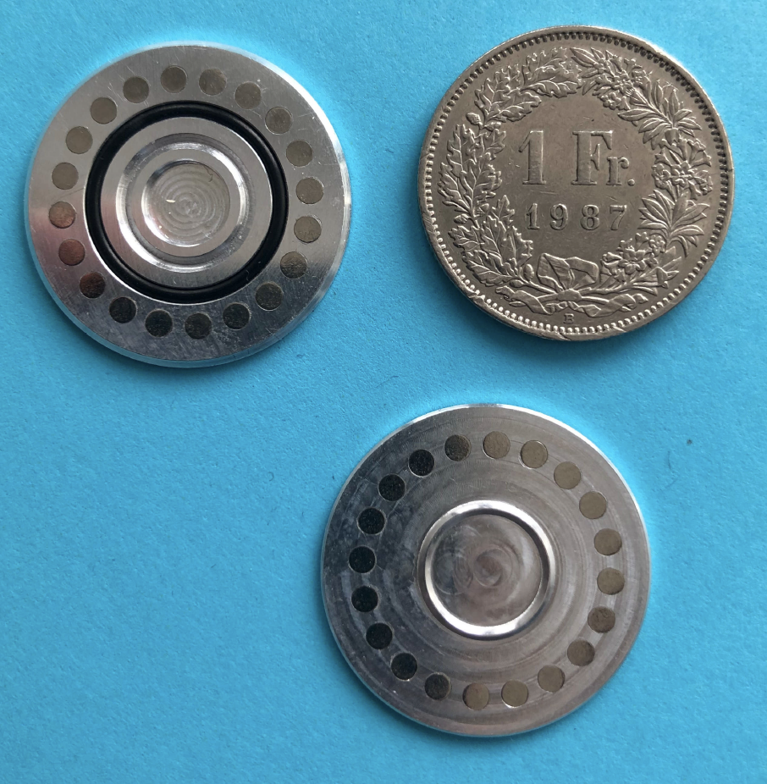
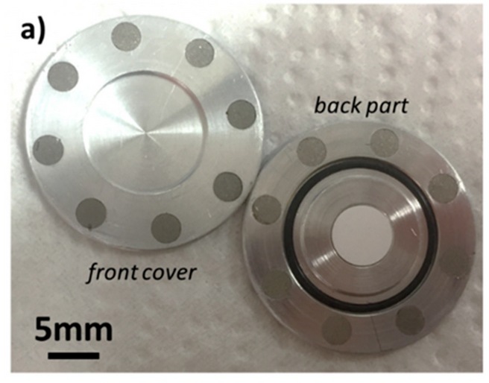
The Target “Coin”
CaO pellet
To bombard enriched targets materials in form of powders
High-purity aluminum
Two halves kept together by permanent magnets
SmCo → T_{Curie} at 350 °C
O-ring (Viton) to avoid radioactive degassing
Variable thickness of the front (energy absorption)
Notes:
SmCo: Samarium–Cobalt ; Alloy (Legierung)

Slide 8
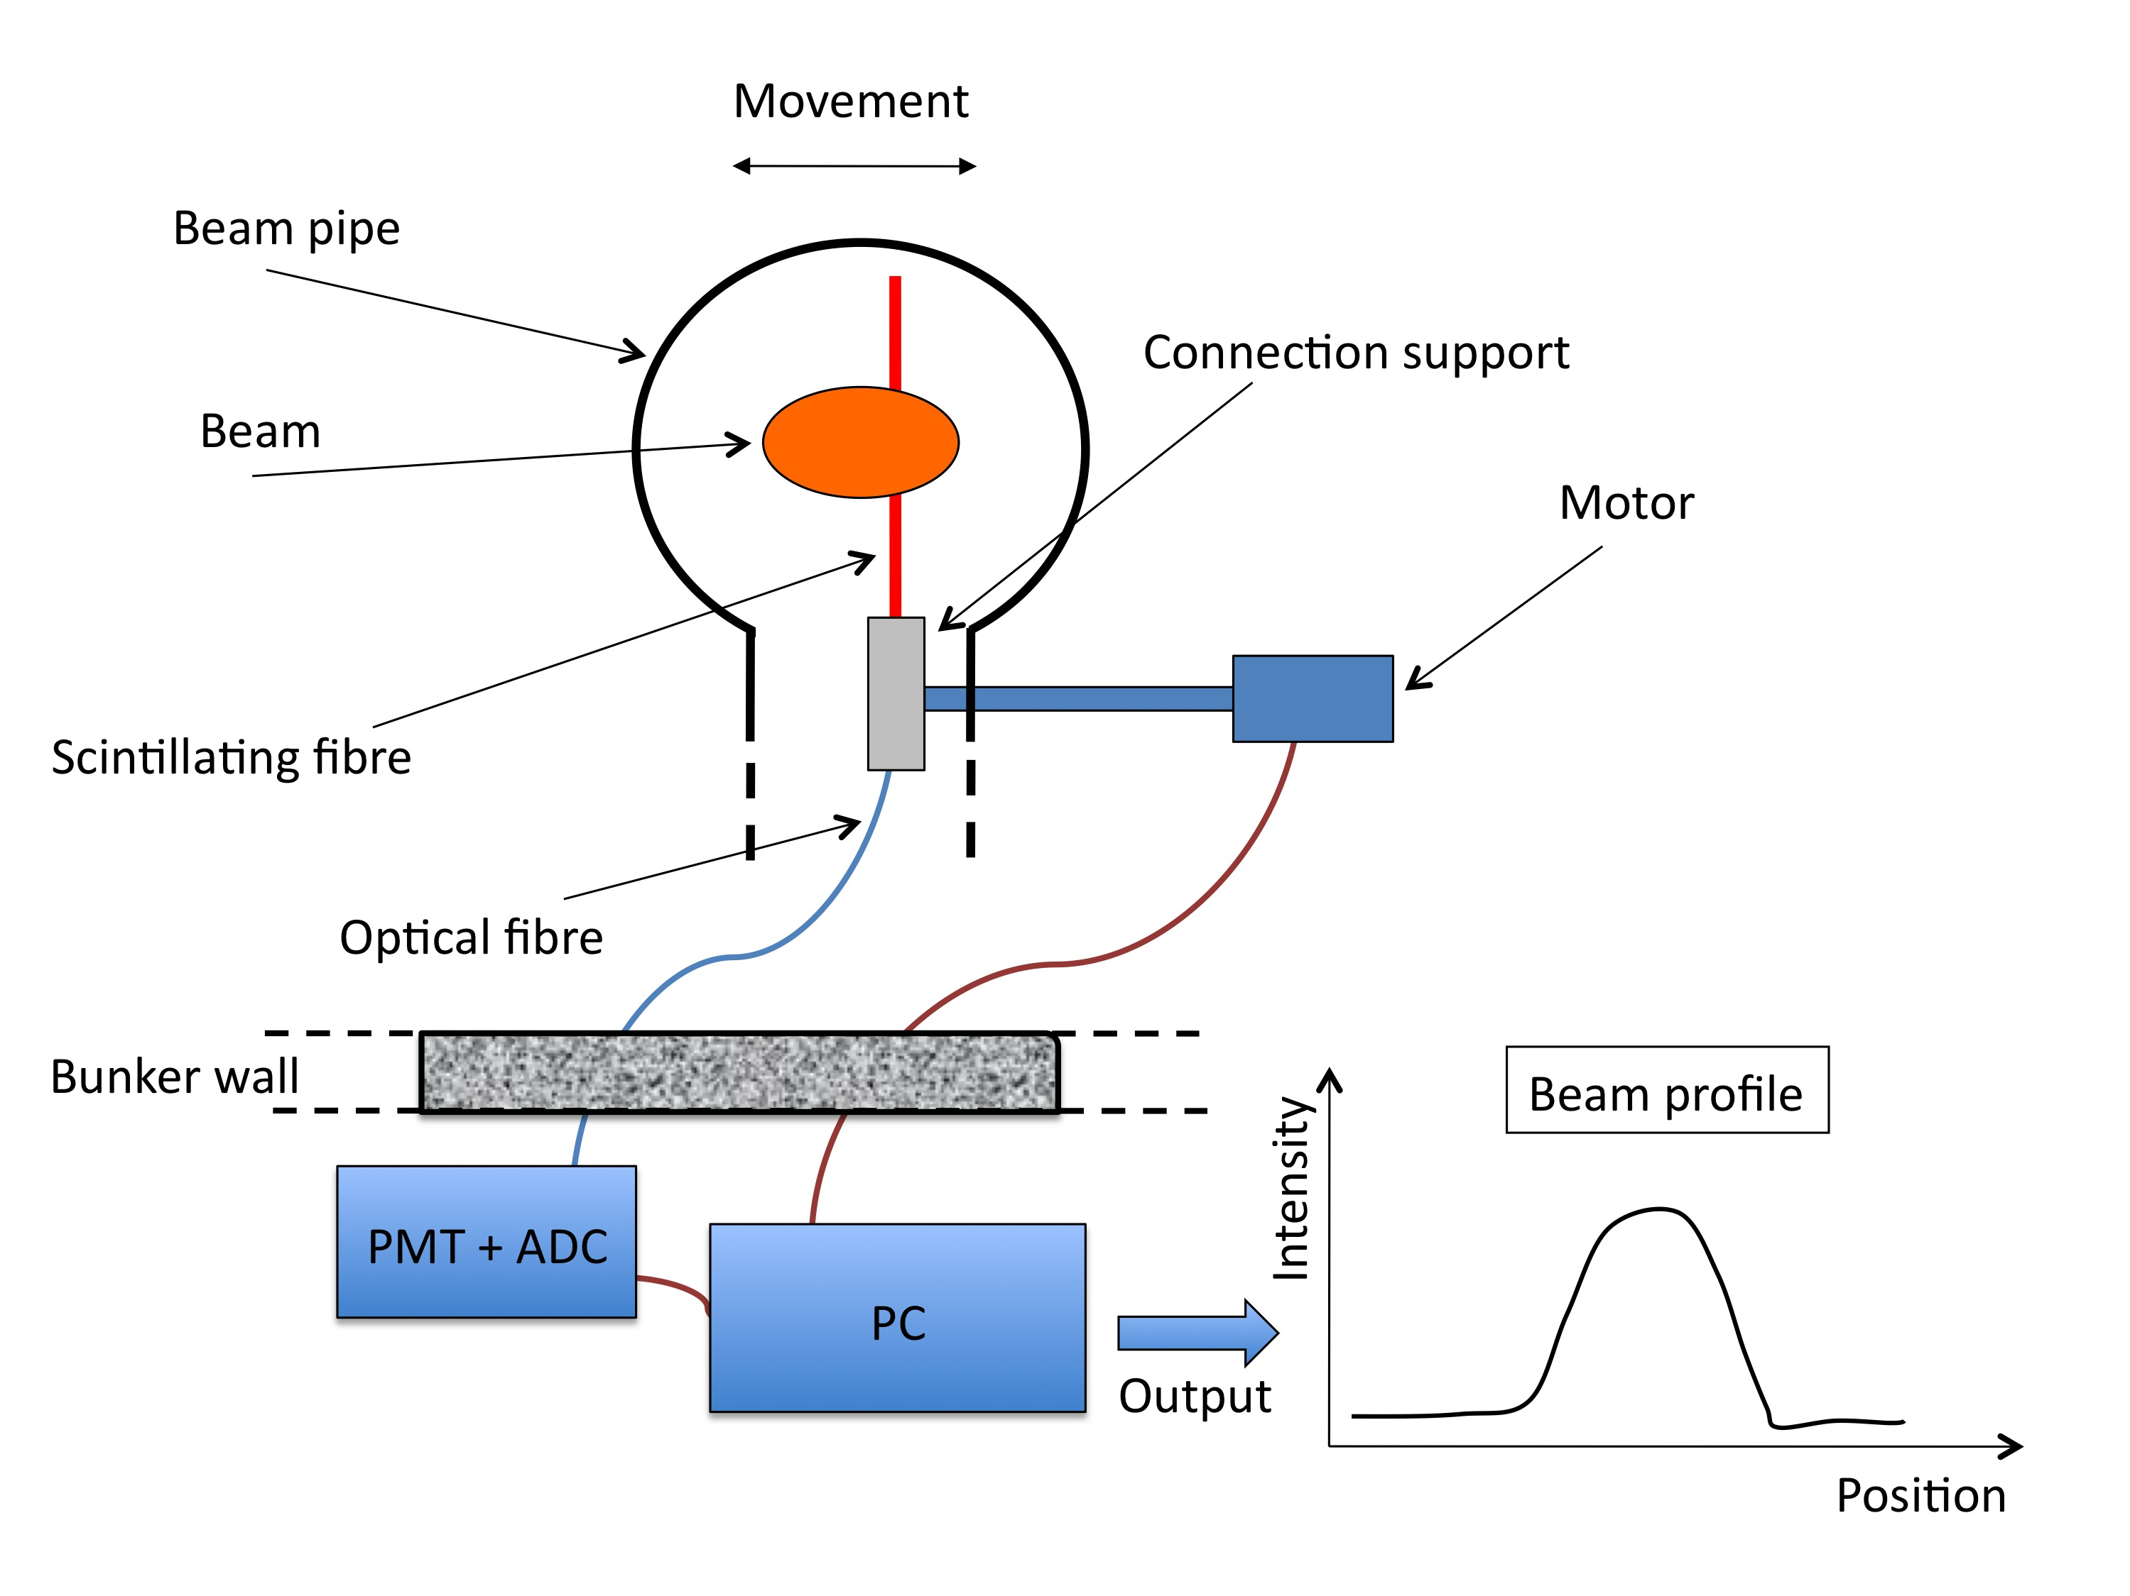
The UniBEaM Detector
1D beam profiler based on (doped) optical fibres passed through the beam
On-line, minimal interference with the beam
Developed by LHEP and commercialized by D-Pace (Canada)
S. Braccini et al., 2012 JINST 7 T02001

Slide 9
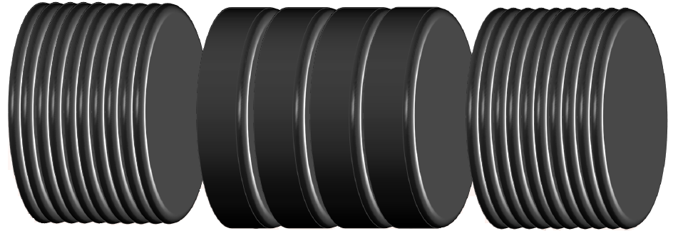
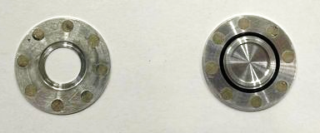
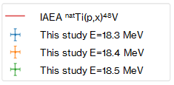
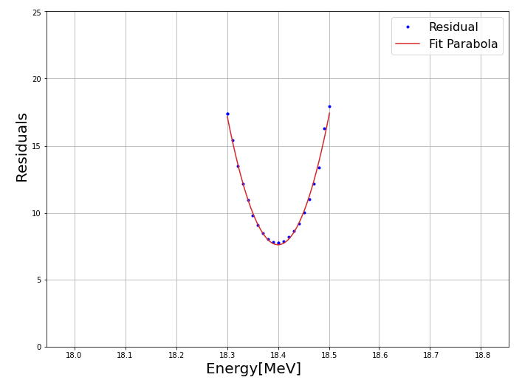
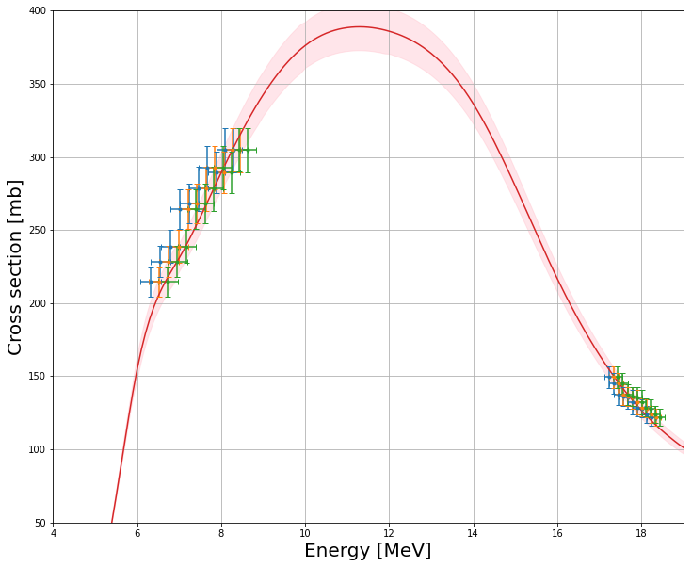
Beam Energy Measurement for the STS using the Coin Target
Titanium
10$×$ 12.5 µm
^{nat}Ti foil
Nb foil
Closed target coin
Monitor reaction
^{nat}Ti(p,X)⁴⁸V
Niobium
4$×$ 125 µm
Covering lid with a 9 mm hole
Containing cup with a 10 mm pocket
Titanium
10$×$ 12.5 µm
Preliminary
Preliminary
E = (18.40 ± 0.05) MeV
Elnaz Zyaee, Master Thesis, 2021; paper in preparation
Notes:
Idea: Using the well known monitor reaction of ^{nat}Ti(p,X)⁴⁸V (proton bombardement of natural Titanium, leading to the production of Vanadium 48), we try to look for the beam energy which minimizes the residuals between experimentally measured activities and the theoretically predicted activities of the aluminium layers.

Slide 10
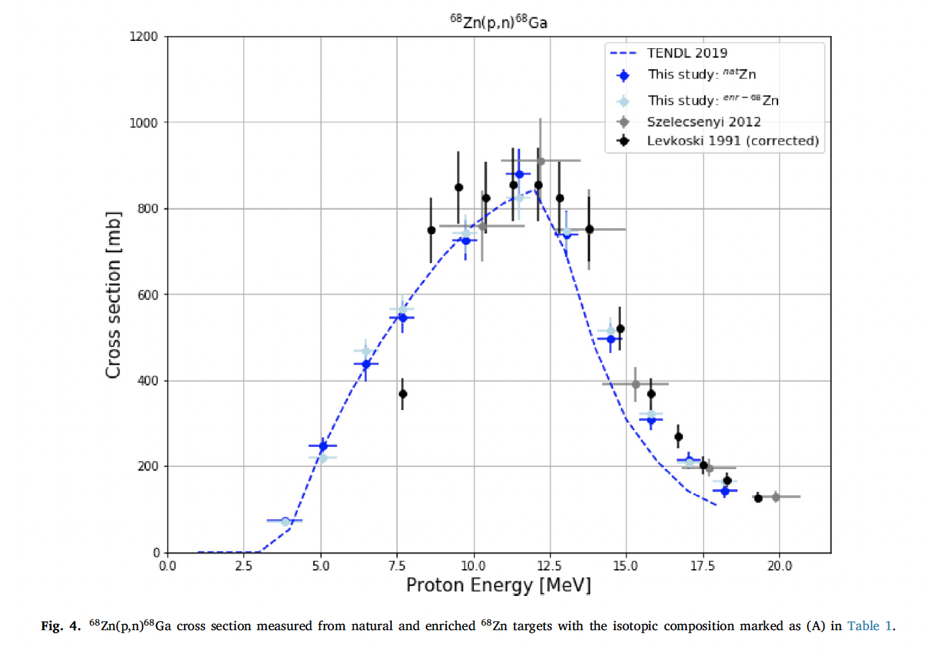
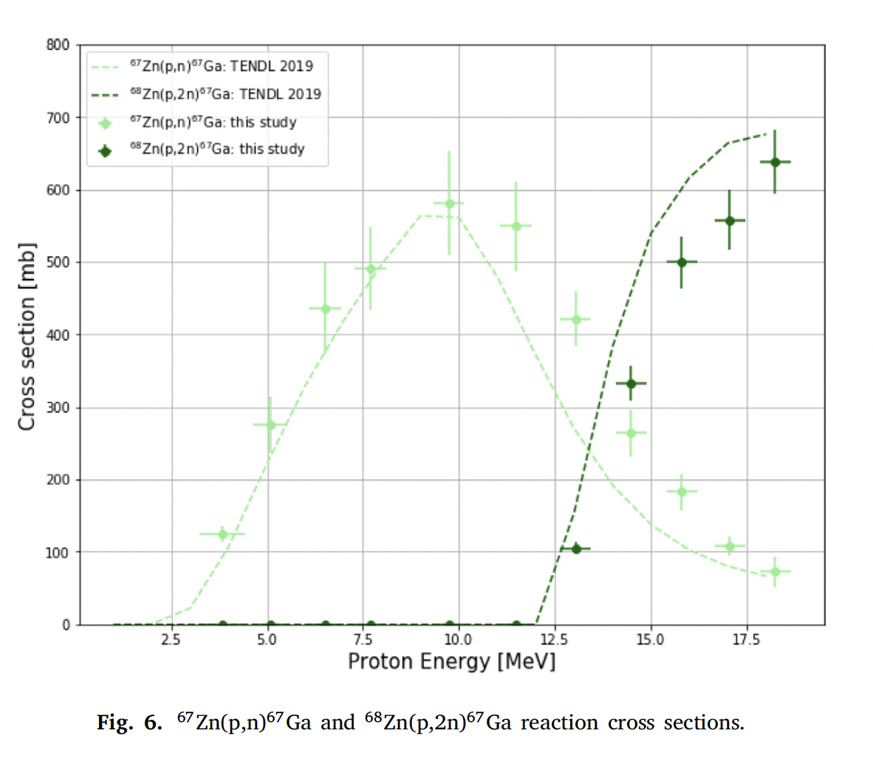
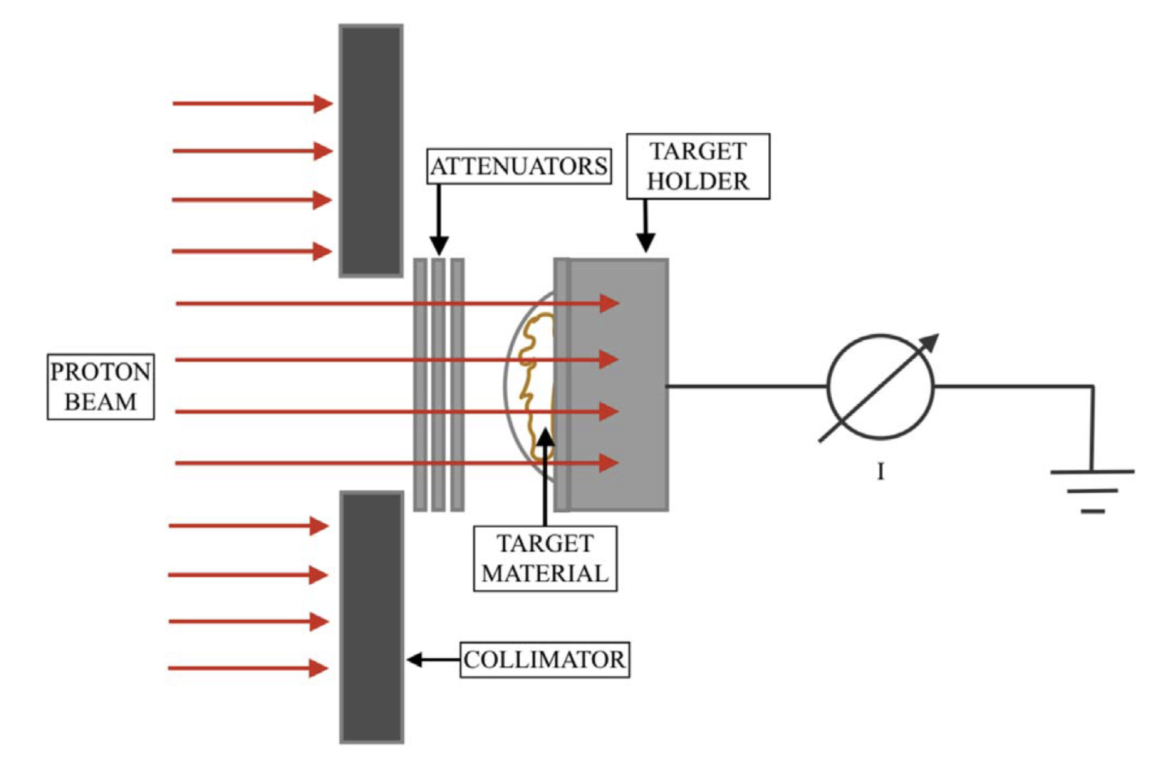
Cross Section Measurements with a Novel Method
⁶⁸Ga
⁶⁷Ga
S. Braccini et al., Optimization of ⁶⁸Ga production at an 18 MeV medical cyclotron with solid targets by means of cross-section measurement of ⁶⁶Ga, ⁶⁷Ga and ⁶⁸Ga, Appl. Radiation and Isotopes, Volume 186, August 2022
Notes:
(collab with PSI and others)
Use of two different enriched materials: the (p,n) and (p,2n) ⁶⁷Ga nuclear reactions can be measured!

Slide 11
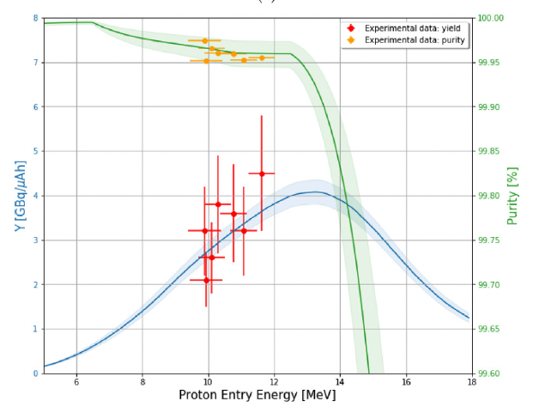
Yield, Purity and Production Tests with Solid Targets: Example of ⁶⁸Ga
⁶⁸Ga
Notes:
Our result from our paper!
Gallium feasible with solid targets with quantity and quality for clinical applications.

Slide 12
Some produced Radioisotopes
*
**
Further medical radioisotopes under study: ⁴³Sc, ⁴⁷Sc, ⁶⁷Cu and ¹⁶⁷Tm
⁴⁸V and ^{X}Pm for fundamental physics research
G. Dellepiane et al., Research on theranostic radioisotope production at the Bern medical Cyclotron,
Il Nuovo Cimento, 2021
* High Efficiency Cyclotron Trap Assisted Positron Moderator, Instruments 2 (2018) 10.
** High-resolution laser resonance ionization spectroscopy of ¹⁴³⁻¹⁴⁷Pm, Eur. Phys. J. A (2020) 56:69
Notes:
Tm = Thulium

Slide 13
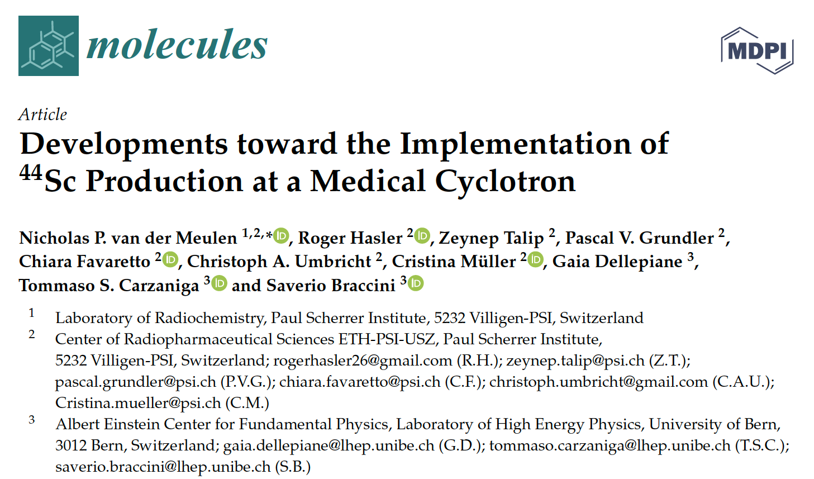
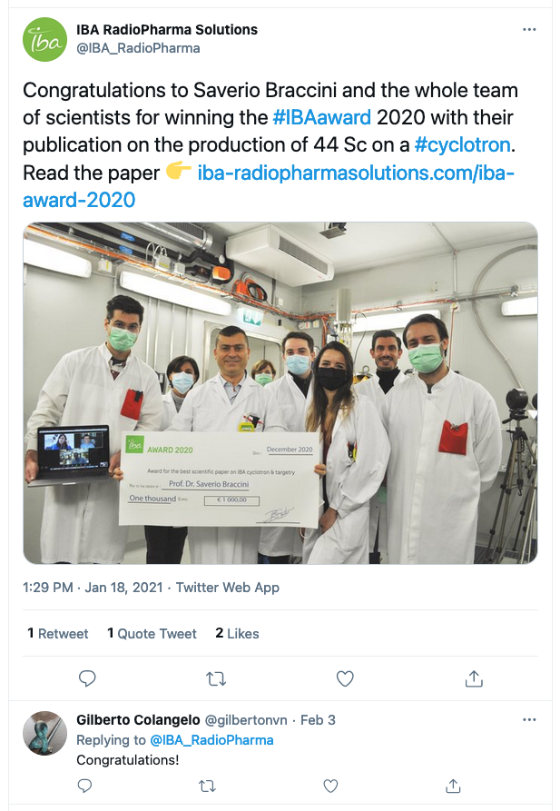
⁴⁴Sc is ready for Clinical Applications
Molecules 2020, 25(20), 4706
> in collaboration with PSI
IBA Award 2020

Slide 14
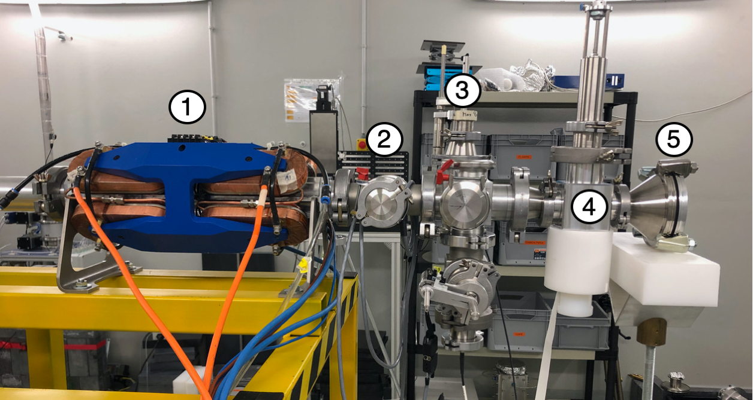
Work in Progress: Automatic Focusing System (AFS)
①: Mini-PET Beamline (MBL)
②: Drift space
③: Two-dimensional UniBEaM
④: π² detector
⑤: Beam dump
> Production yield improved by a factor 20 if compared to an unfocused beam

Slide 15
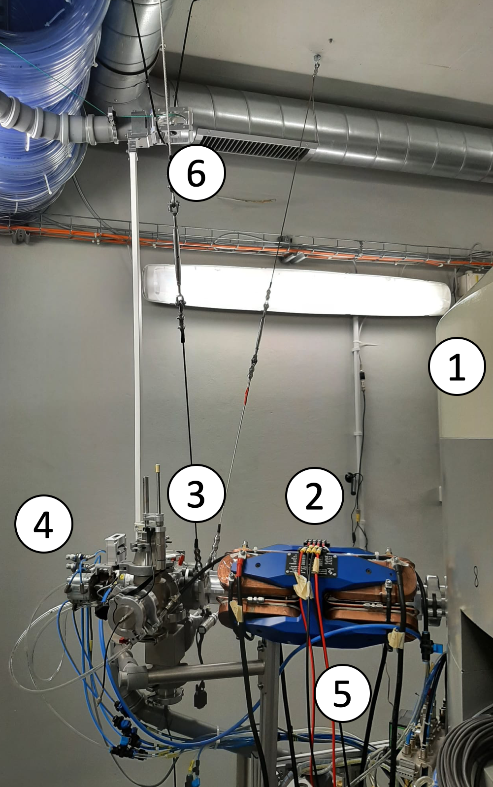
AFS installed on the Solid Target Station (STS)
①: Cyclotron
②: Mini-PET Beamline (MBL)
③: Two-dimensional UniBEaM
④: Solid Target Station (STS)
⑤: Solid Target Transfer System (STTS)
⑥: Solid Target Loading System (STLS or Hyperloop)
> Replace ③ with a more suitable device to monitor beam shape and intensity at high dose rates.
Häffner, P. D. et al., An Active Irradiation System with Automatic Beam Positioning and Focusing for a Medical Cyclotron, Appl. Sci. 2021, 11(6), 2452; P. Häffner, PhD Thesis, 2021

Slide 16
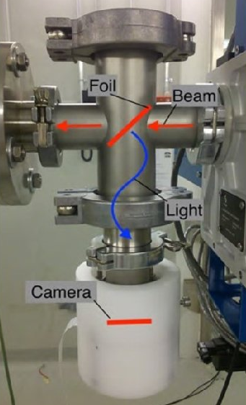
2D Beam Monitoring: π² and Collar
π²: Beam monitor based on coated aluminium foil and a camera, to measures 2D beam profile and intensity non-destructively.
Collar: Non destructive beam monitor based on doped silica fibres to enhance production yield of radioisotopes for theranostics.
Notes:
π2: 2D non-destructive beam monitor based on a thin aluminium foil coated with P47 scintillating material and a camera. It measures the transverse position, shape, and intensity of the beam.
Collar:
Collaboration with TRIUMF (Canada)
Fully non destructive beam monitor detector to enhance the production of radioisotopes for theranostics using solid targets
Based on doped optical fibres
First prototype installed and tested in the Beam Transfer Line (BTL) of the Bern cyclotron

Slide 17
π² in Action:
2D beam profile measured by the π² detector before and after beam optimisation by AFS

Slide 18
Thank you for listening!

Slide 19
Acknowledgements
Seniors and PostDocs: S. Braccini, P. Scampoli, I. Mateu, P. Casolaro, L. Mercolli, L. Franconi, C. Belver Aguilar
PhD students: G. Dellepiane, A. Gottstein, A. Oliveira, P. Häffner (2021), T. Carzaniga (2019), K. Nesteruk (2017)
Master and Bachelor Students: M. Schmid (2021), E. Zyaee (2021), N. Voeten (2022), D. Wüthrich (2019), J. Askew, D. Wermelinger, M. Wenger, N. Kämpfer (2022)
LHEP mechanics and electronics workshop crew
https://www.lhep.unibe.ch/research/medical_applications/

