Slide 1
CYC’2022 Summary
Yuri Bylinskii, TRIUMF
Joachim Grillenberger, PSI

Slide 2
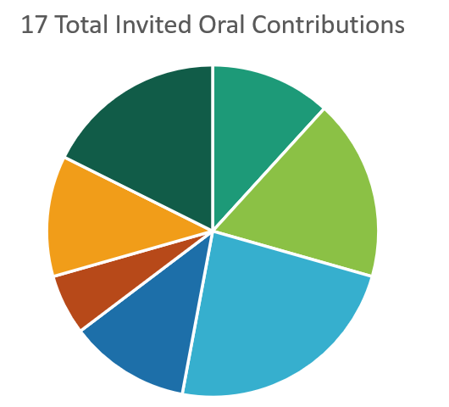
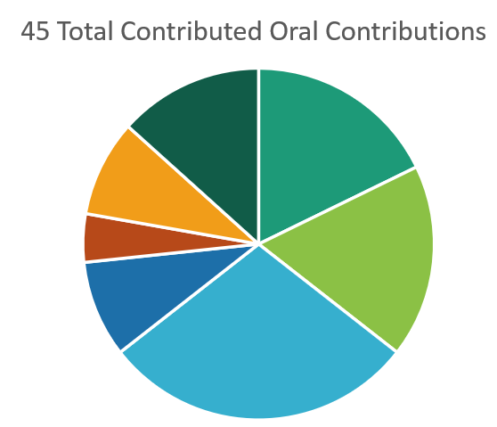
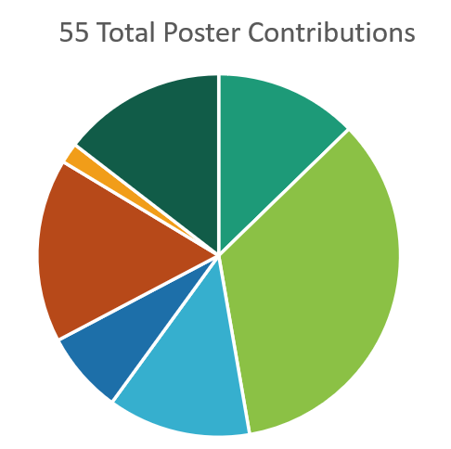
18 Invited talks, 45 Contributed orals and 55 Posters, in total, 118 Contributions
Notes:
A general overview of abstract submissions under different topic categories is shown here

Slide 3
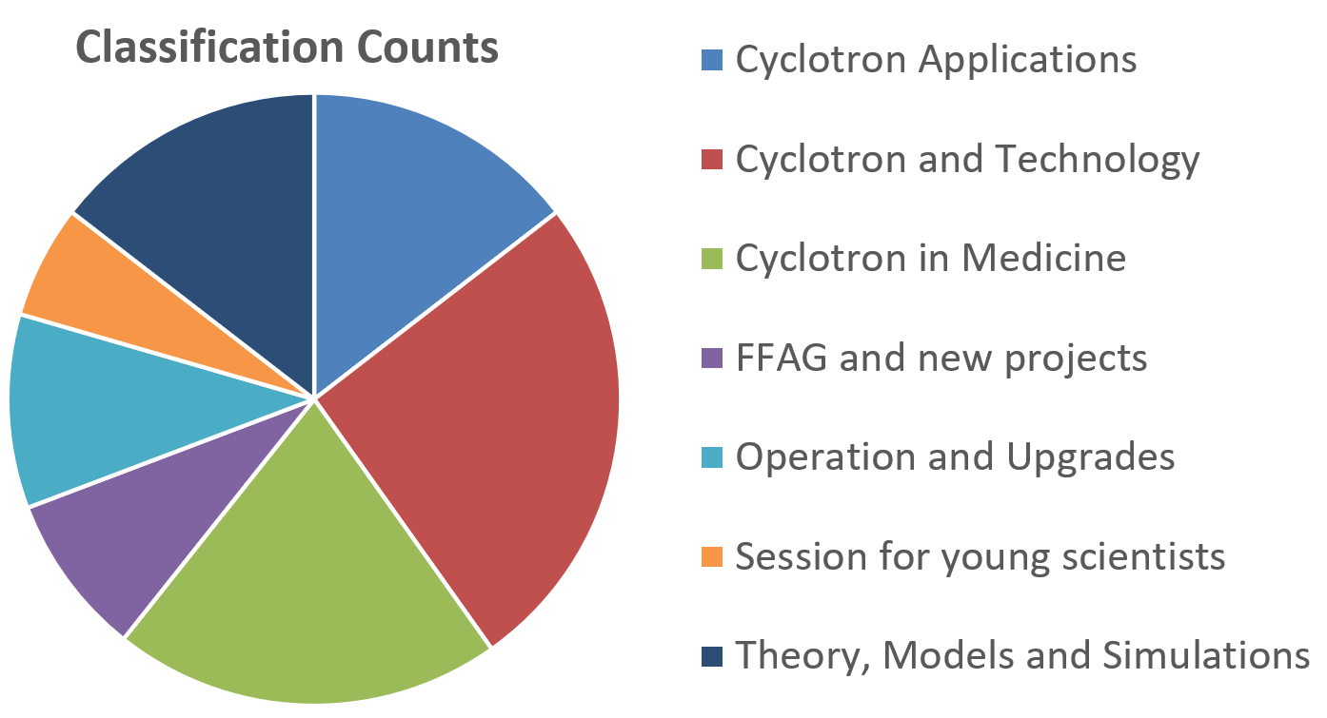
7 topics for the conference
“Cyclotron and Technology” - 30 papers
“Cyclotron in Medicine” - 24 papers
“Theory Models and Simulations” - 17 papers
“Cyclotron Applications” - 18 papers
“Operation and Upgrades” – 12 papers
“FFAG and new projects” – 10 papers
“Session for young scientists” – 7 papers
Notes:
There are 7 topics in this conference, of which
17 abstracts were submitted for Cyclotron Applications
29 for Cyclotron and Technology;
21 for Cyclotron in Medicine;
10 for FFAG and new projects ;
12 for Operation and Upgrades;
7 for Session for young scientists
and 17 for Theory, Models and Simulations;

Slide 4
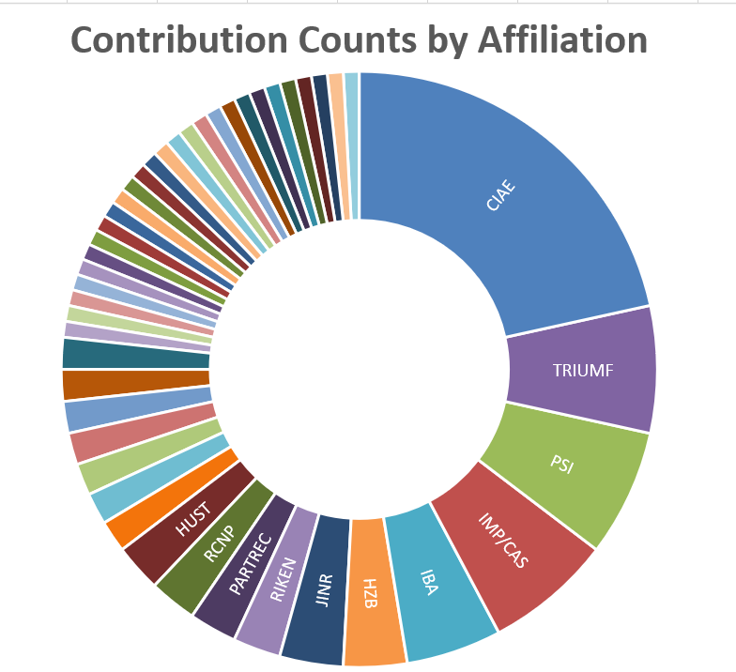
The conference abstracts come from 45 different affiliations
CIAE - 25 abstracts
Followed by IMP, PSI, and TRIUMF - 8 abstracts each
IBA has 6, and JINR and HZB - 4 abstracts each
HUST, RCNP, PARTREC, and RIKEN - 3 abstracts each
Others - 1 or 2 abstracts
Notes:
The participants who submitted abstracts for this conference came from 113 institutions. CIAE submitted the most abstracts, with 24.

Slide 5
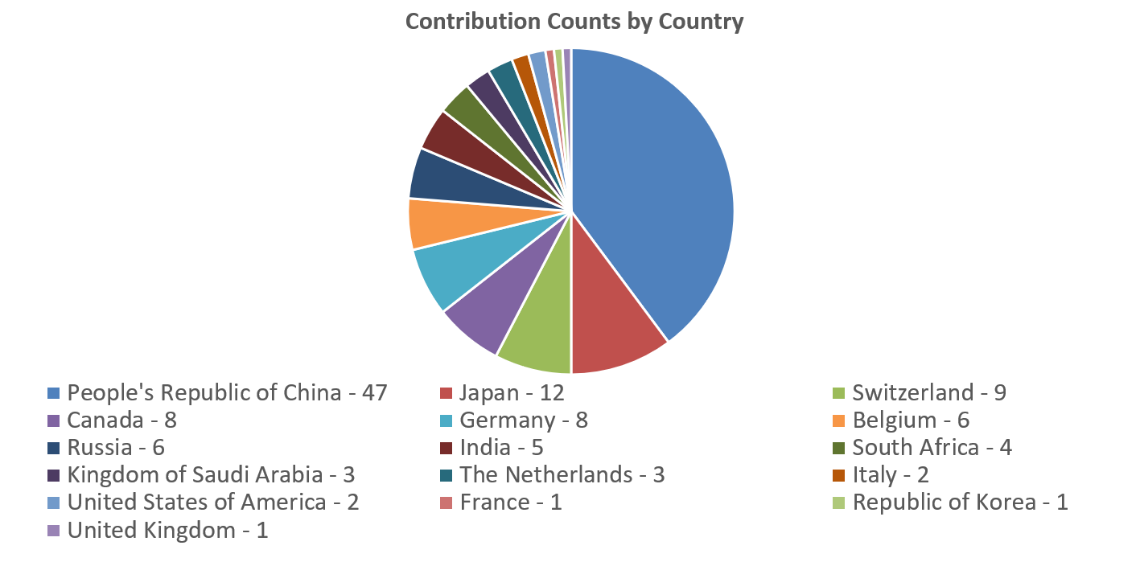
Statistics of the abstract submissions by Country
The abstracts are coming from 16 countries.
Among them, China submitted 47 abstracts, about two-fifths of the total.

Slide 6
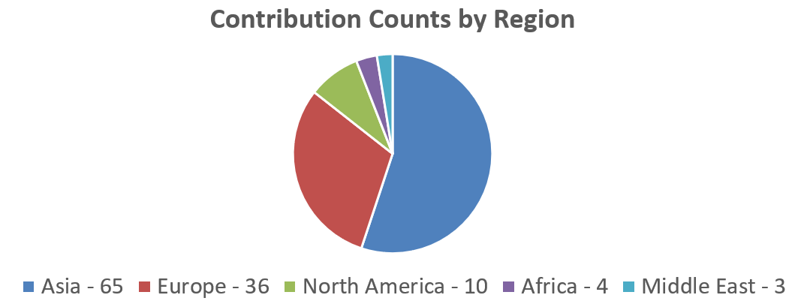
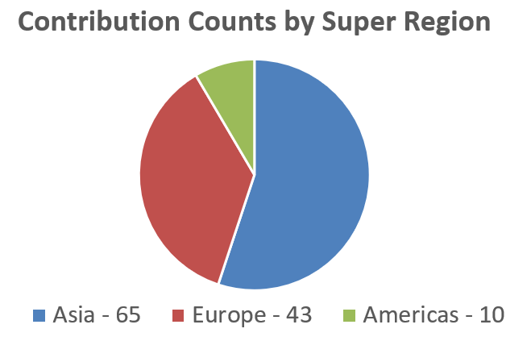
Statistics of the abstract submissions by Region and Super Region

Slide 7
Registration Statistics
Grand total: 237 participants
> 40 students attended the conference

Slide 8
Conference Highlights

Slide 9
New Projects & Proposals

Slide 11
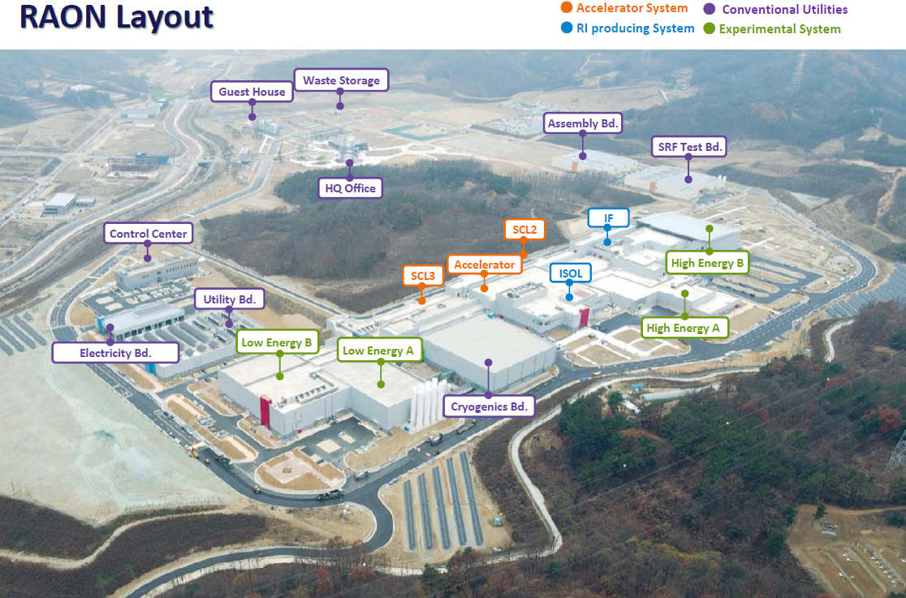
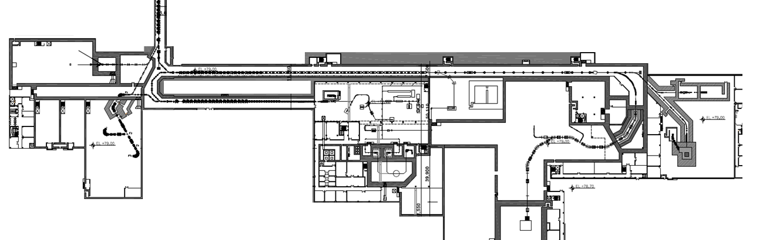
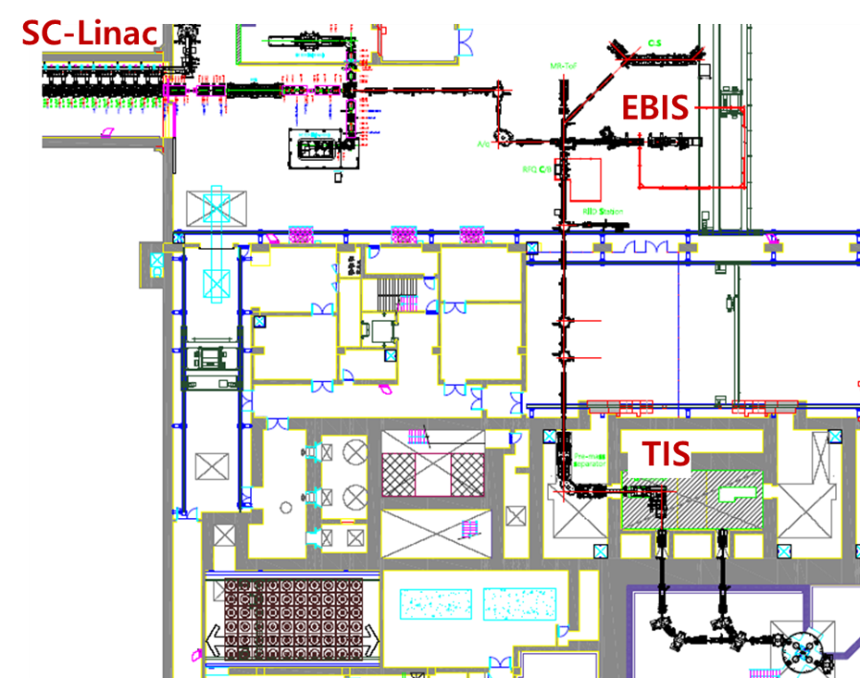
Institute for Basic Science, Korea
RI beam production by ISOL method for RISP
ISOL: Isotope Separation On-Line
SCL2
SCL3
Period: 2011.12~ 2022.12
Budget: ~1.3 billion USD (~0.9 billion for building and land)
Total area: ~0.95 km²
70 MeV proton Cyclotron
2. In-flight fragment
separator
1. ISOL system
Layout of ISOL
Beam direction
IBA C70 cyclotron

Slide 12
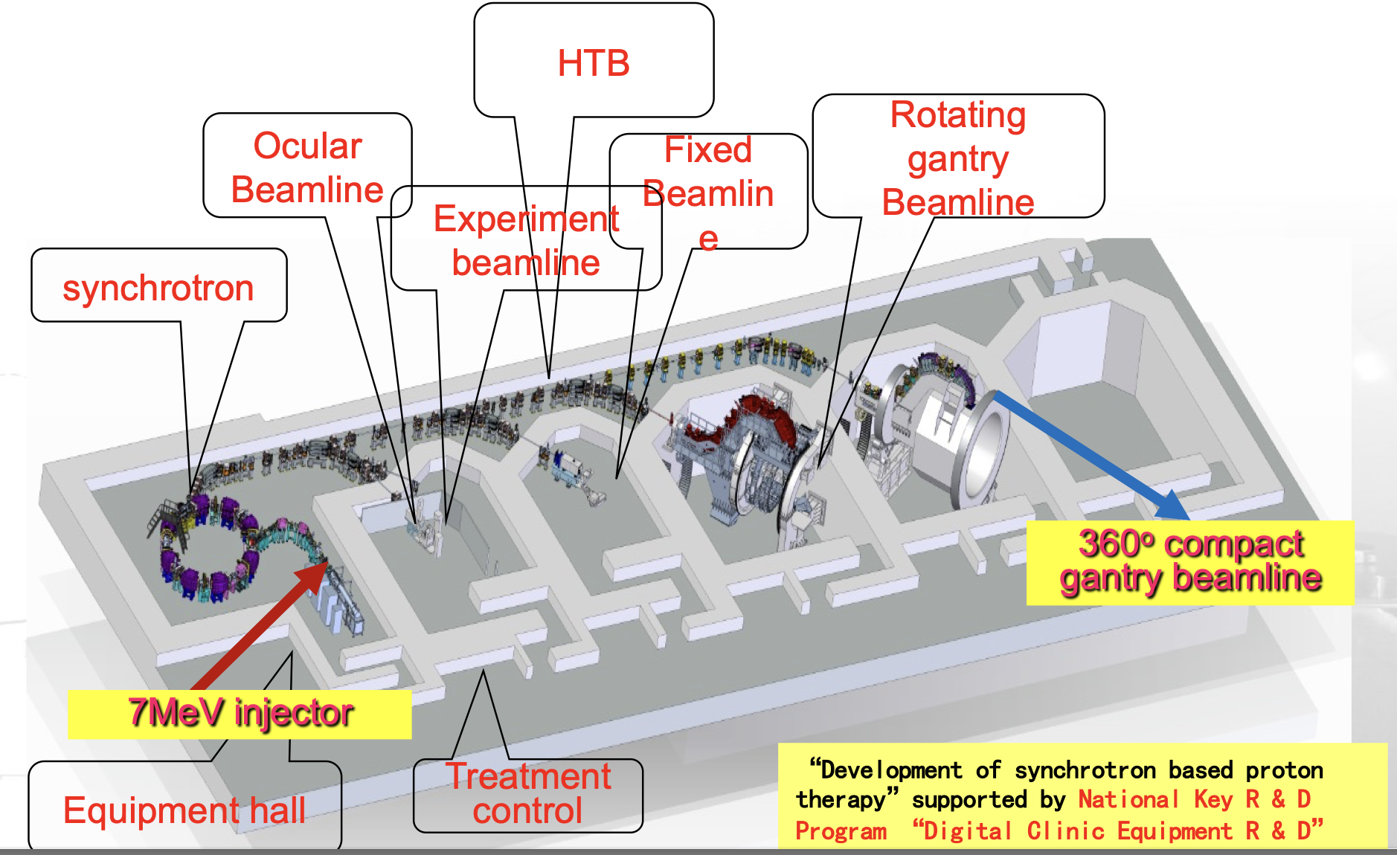
THB1-3: SAPT- A synchrotron based proton therapy
Manzhou Zhang
A very nice overview of the synchrotron based proton therapy center in Shanghai. It is amazing what they acheived in such short time. The hardware devolopment started in 2014 and the clinical trials where finished ahead of schedule. The facility is not much larger than a cyclotron based facility. Therefore, this talk proofs that synchrotrons are serious competitors to cyclotrons. It is a pity they still have to wait for the permisson to open. Could have been invited, too.

Slide 13
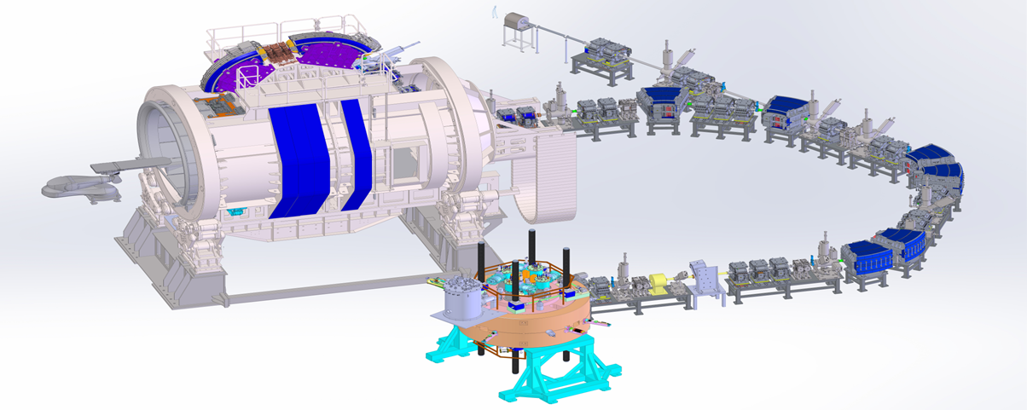
Introduction to CYCIAE-230
Granted by CNNC, the cyclotron project was launched in 2016. The rest of the proton therapy system was granted by Ministry of Industry and Information Technology in 2017.
Gantry
Beam line system
CYCIAE-230 superconducting cyclotron
Energy selection system
Proton beam in the energy range of 200 MeV – 250 MeV has various applications, like proton therapy, SEE test and radiation hardening of microchips, etc.
Notes:
超导回旋建成，及配套束流线、360°旋转舱通过测试，等中心度好于0.3mm，开拓了应用新领域，签订了癌症治疗中心落地协议，宇航器件和集成电路抗辐射研发从100MeV提升到230MeV；还带动了轻量化全超导加速器立项研发。

Slide 14
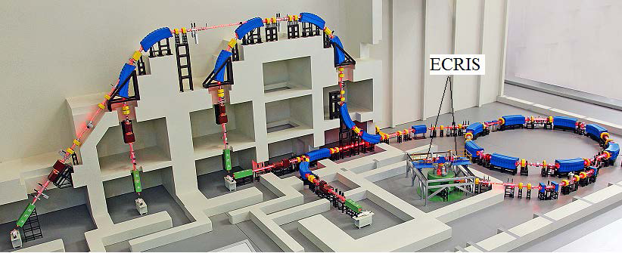
China’s carbon ion therapy facility-HIMM
Heavy Ion Medical Machine
2 ECR ion sources
Compact Cyclotron:
2.92m Diameter
No Trimming coils
~7MeV/u, 10 μA, 12C5+
120-400 MeV/u Synchrotron
4 Treatment terminals
5 fixed irradiation ports
Maximum particle number
in the terminal (ppp) : 1.2E9
Synchrotron
Cyclotron
Fig.1 Schematic view of HIMM

Slide 15
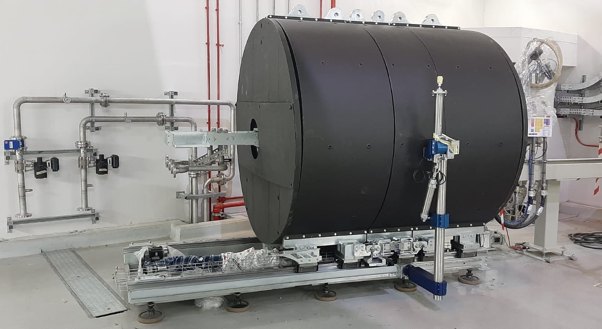
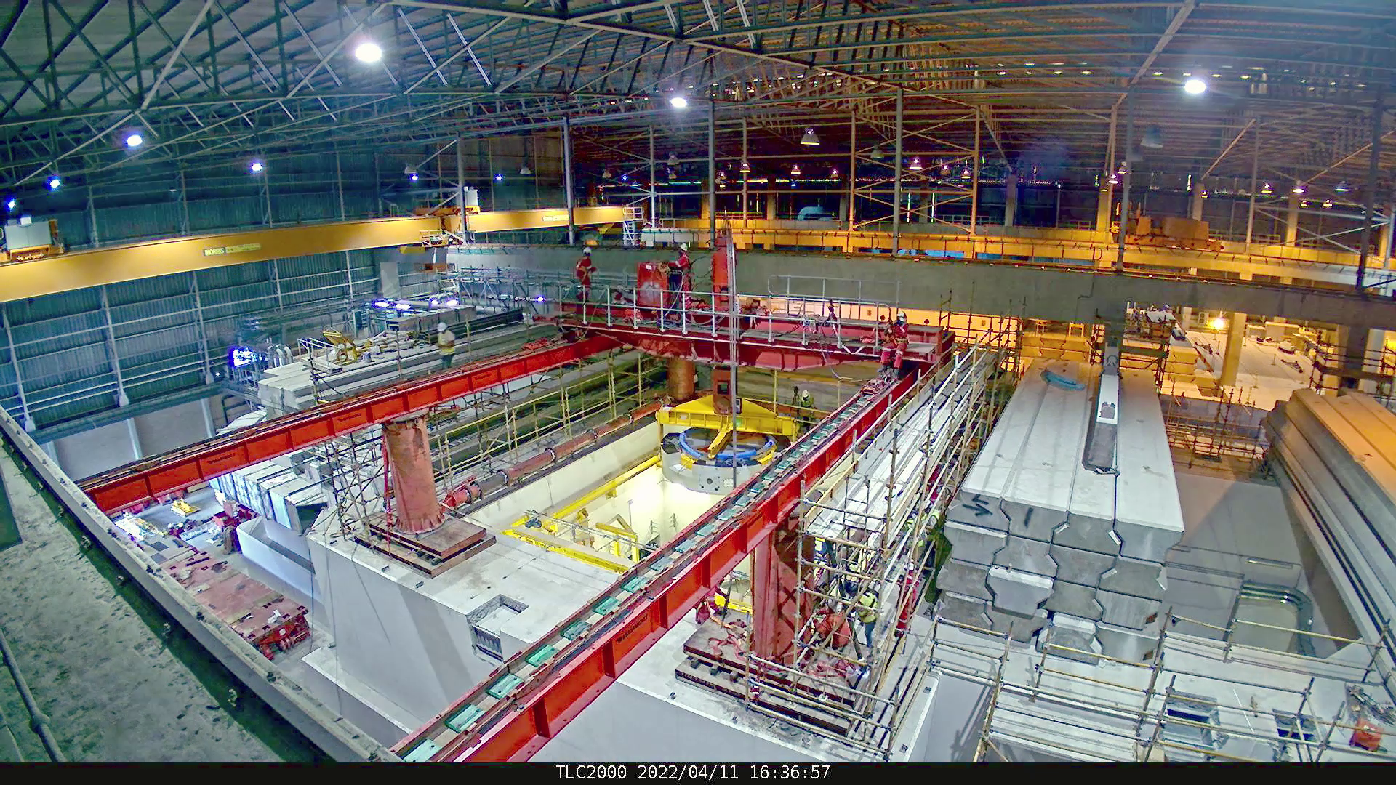
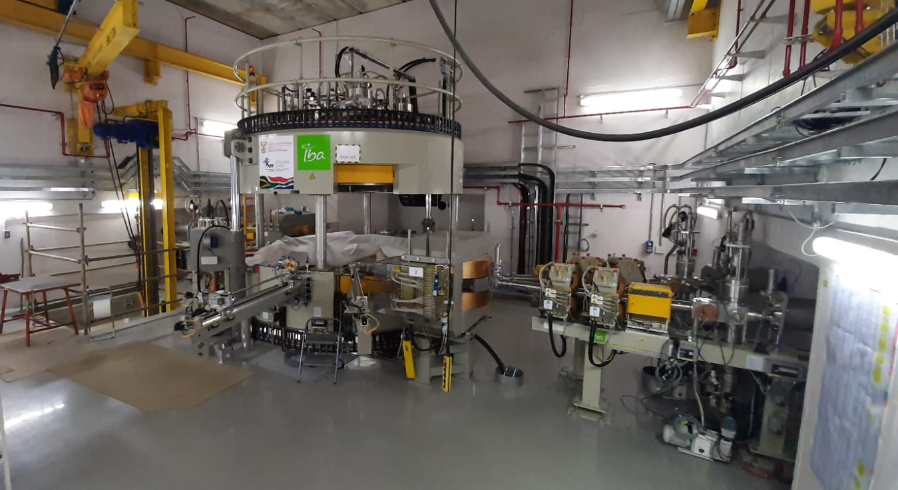
WEB1-1: : An overview of the south African ISOTOPE FACILITY(SAIF) PROJECT
Izak Le Roux Strydom
Really nice and impressive overview over the Isotope Production at iThemab Labs. Slide 5 for the installation of the magnet, and slide 8 showing the target system are impressive in particular.
Installation of C70 cyclotron and beam transport lines at iThemba

Slide 16
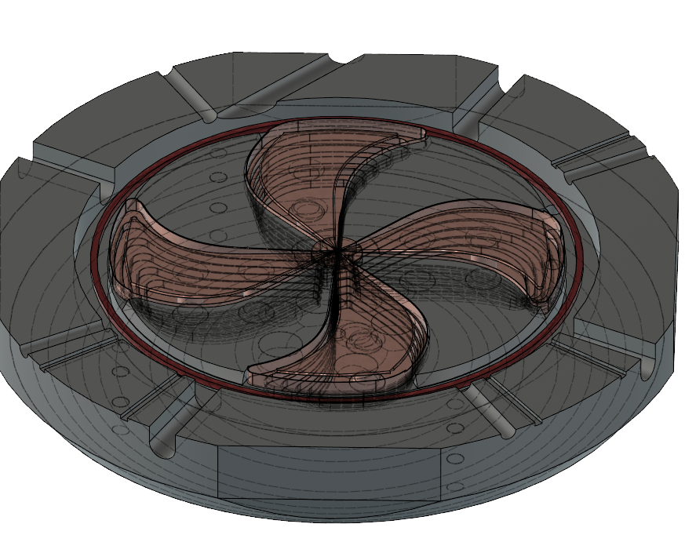
MSC230 – Medical Superconducting Cyclotron
Accelerated Particles | Protons
Magnet Type | Compact, SC coil, warm yoke, B≈1.5 T
Number of Sectors | 4
Number of RF Cavities | 4
Ion Source | Internal, PIG
Final Energy | 230 MeV
Number of Turns | 600
Dees and Cavities
Sectors
Yoke
Inside the MSC230

Slide 17
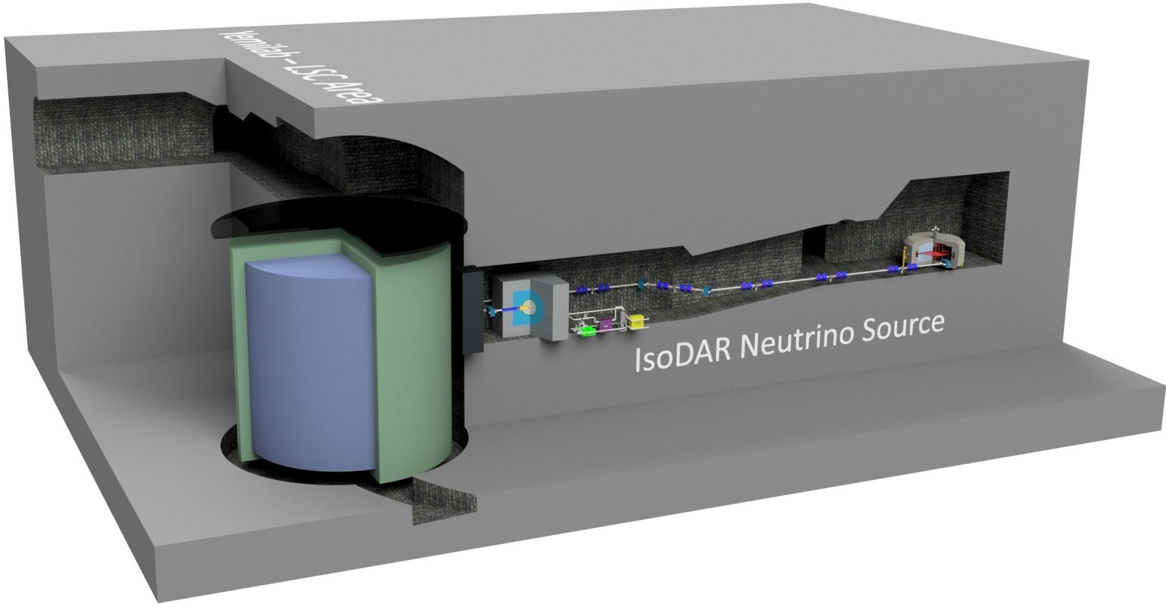
$${\overline{ν}}_{e}$$
$${\overline{ν}}_{e}$$
$${\overline{ν}}_{e}$$
$${\overline{ν}}_{e}$$
$${\overline{ν}}_{e}$$
$${\overline{ν}}_{e}$$

Slide 18
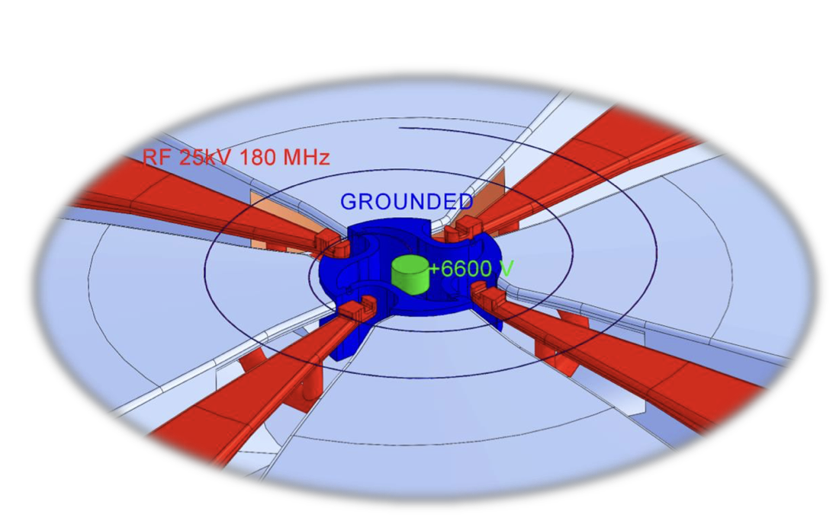
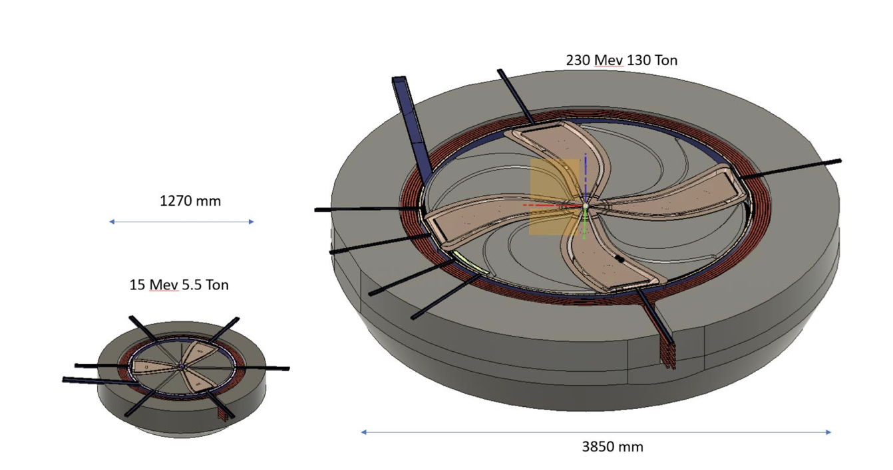
THB1-2: A new concept of cyclotrons for medical applications
Oleg Karamyshev
The goal of this interesting study is the design of a more compact and lighter design of a cyclotron for medical and industrial applications. In the past, the trend was to increase the B field and thus the decrease the pole radius. This approach intends to make RF and Coil more compact by increasing RF frequency, decreasing the dimensions of the valley, which leads to less A-turns in magnet, thus making the coil smaller, which will lead to smaller yoke.
The concept would lead to a lower poer consumption and smaller footprint of such a machine, thus lower cost. Very interesting for industry.
Central region. Interesting solution for the capture issue at high frequency by putting the ion source on +6.6kV. 8th harmonic acceleration mitght be difficult, though.

Slide 19
Status reports

Slide 20
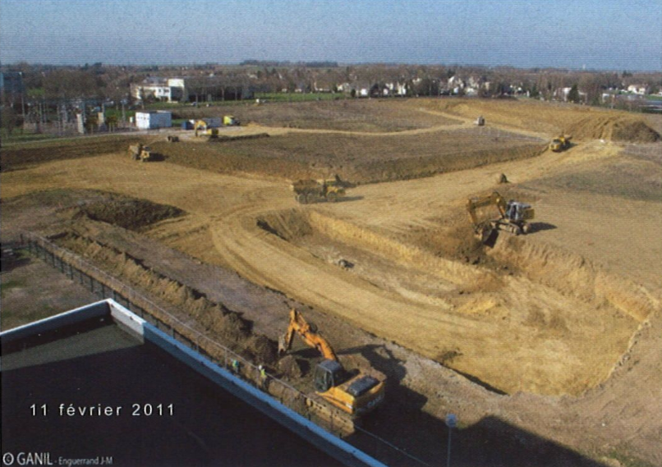
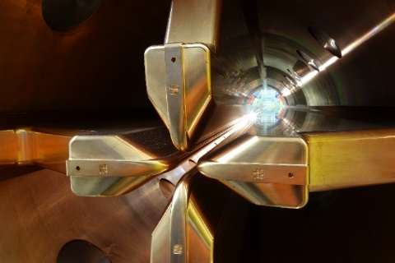
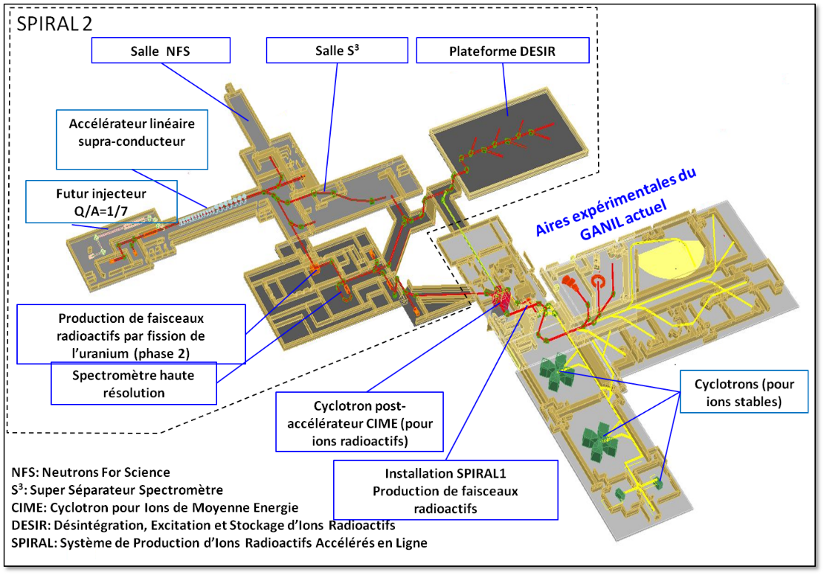
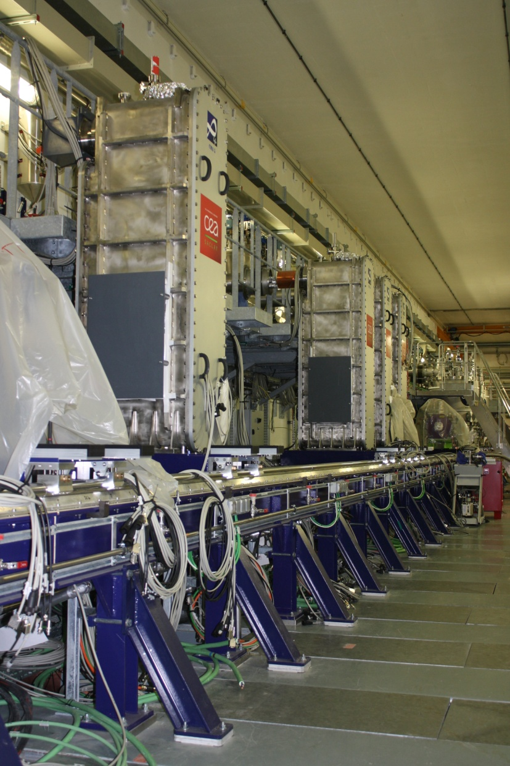
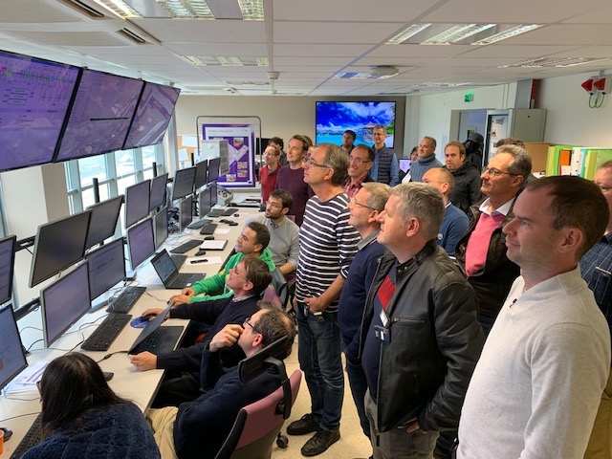
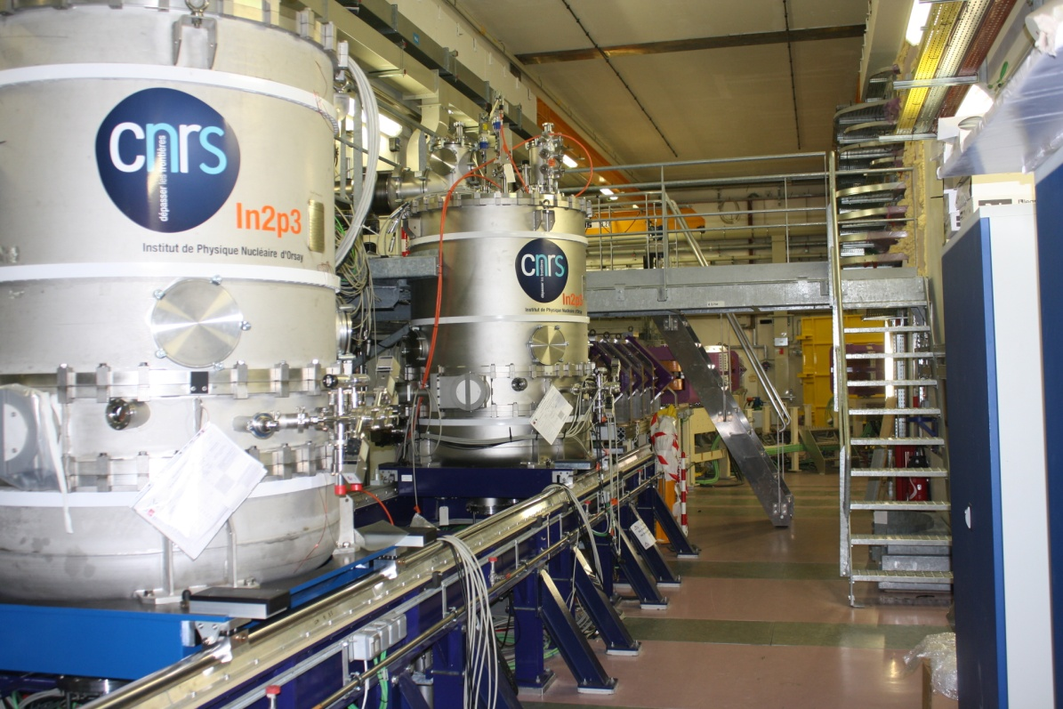
SPIRAL2 Project
2011 : excavation
SPIRAL2
2015: 1st beam in RFQ
2005 : Project launched
Original project, including post-acceleration of fission products in CIME
October 28th, 2019 : 1st beam in the LINAC

Slide 21
Upgrade of the RCNP AVF Cyclotron

Slide 22
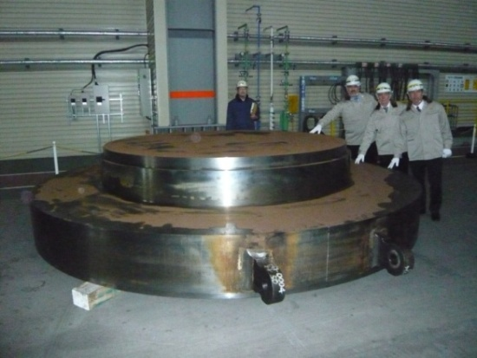
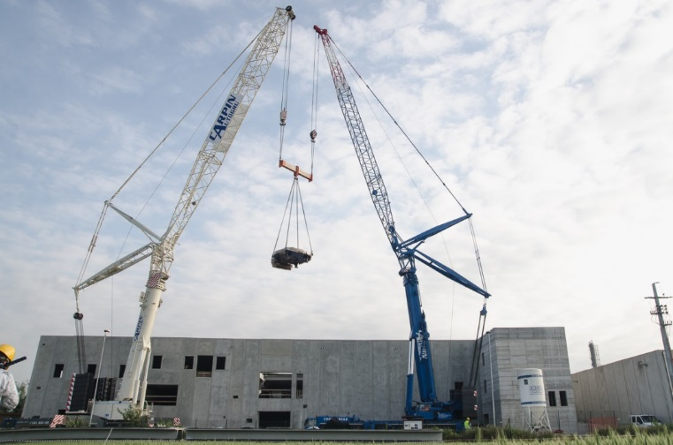
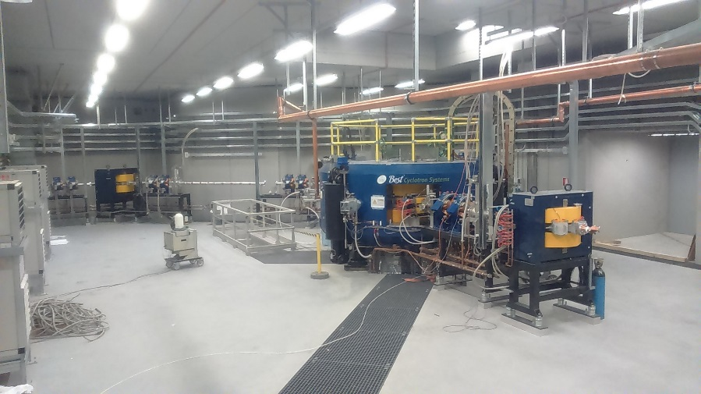
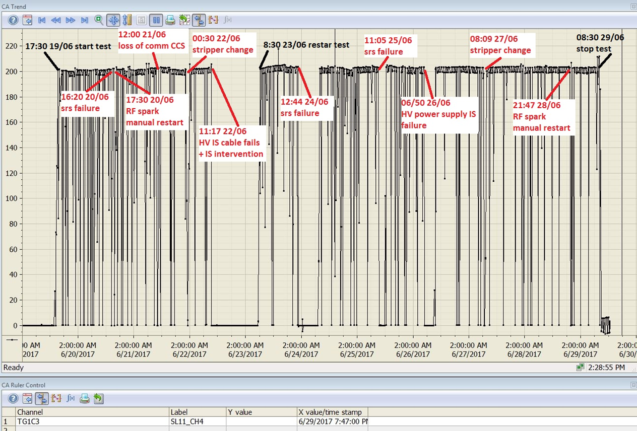
Status of SPES Cyclotron at Laboratori Nazionali of Legnaro -INFN
2011-2014 Study, Design ,Construction and factory tests
2015
Installation at LNL
2016
First beam and commissioning
2017
Site Acceptance Test and final delivery
2018
INFN operation

Slide 23
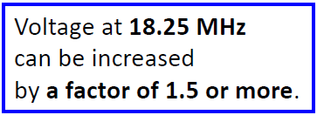

Slide 24
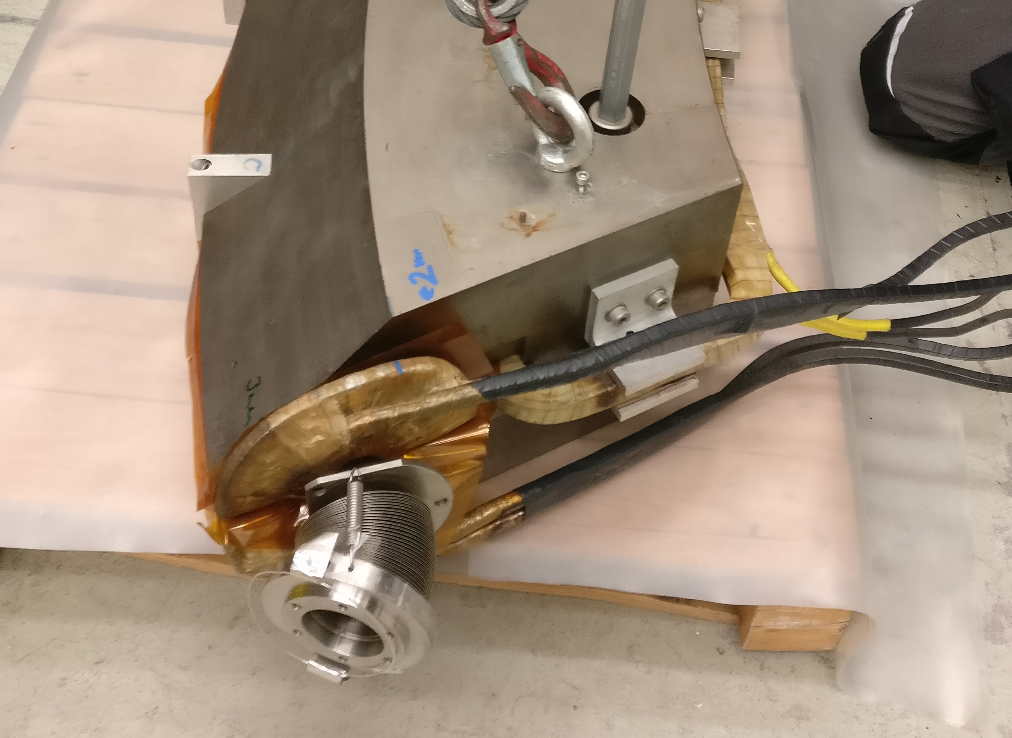
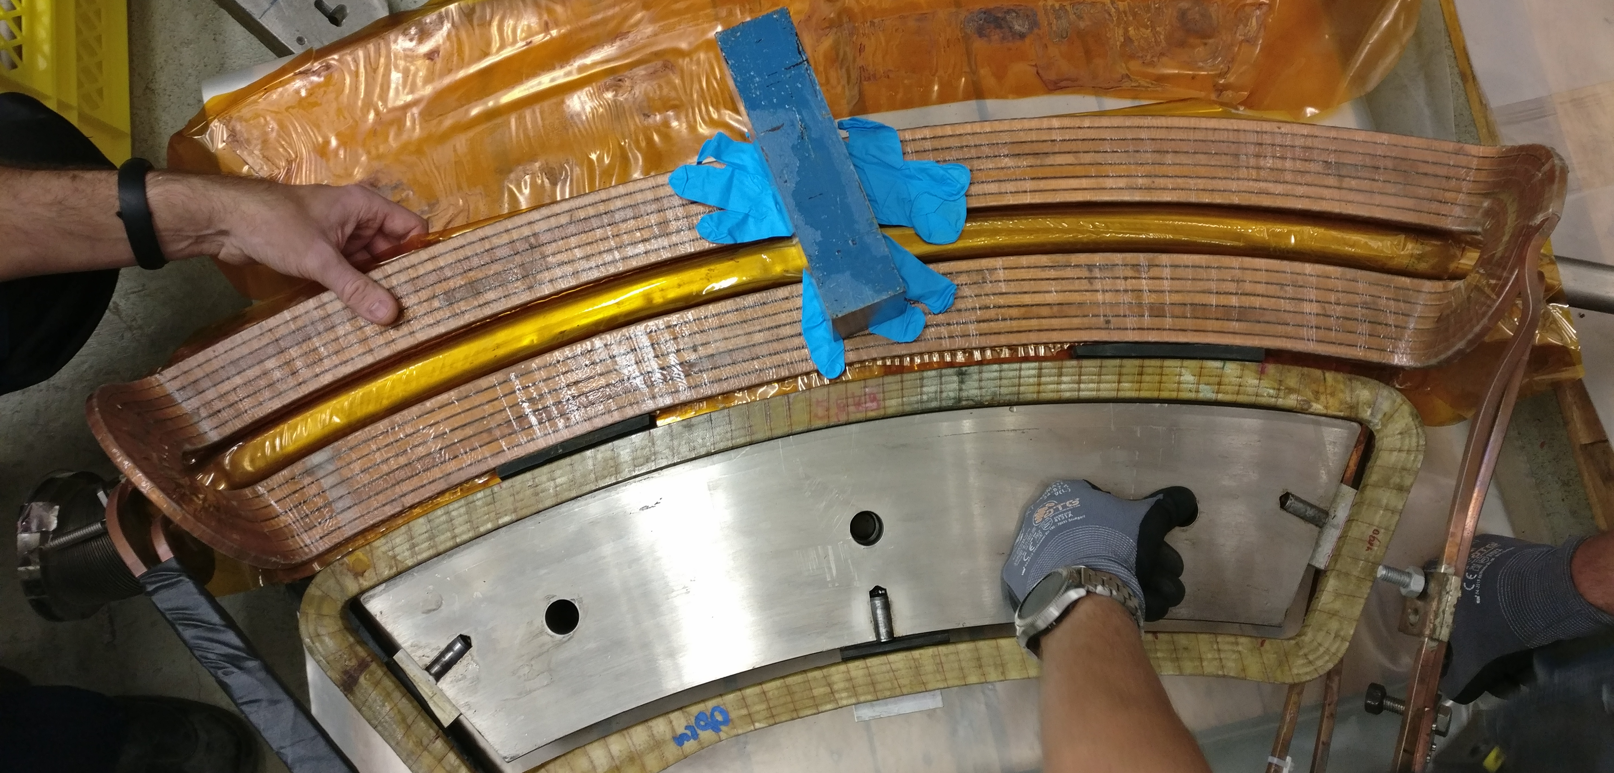
Major Event: Repair of Extraction
Status of the HZB Cyclotron
time consuming:
opening of cyclotron (extraction valley) necessary
open all the feed-throughs for phase probes
after repair: pumping and conditioning of electrostatic elements
our luck: spare extraction coil according to original drawings already ordered and at HZB
since several decades: correction coil never used, even not connected!
now: correction coil necessary, otherwise no extraction possible!
most likely: slightly different position of vacuum chamber
extraction coil
correction coil
vacuum chamber
yoke

Slide 25
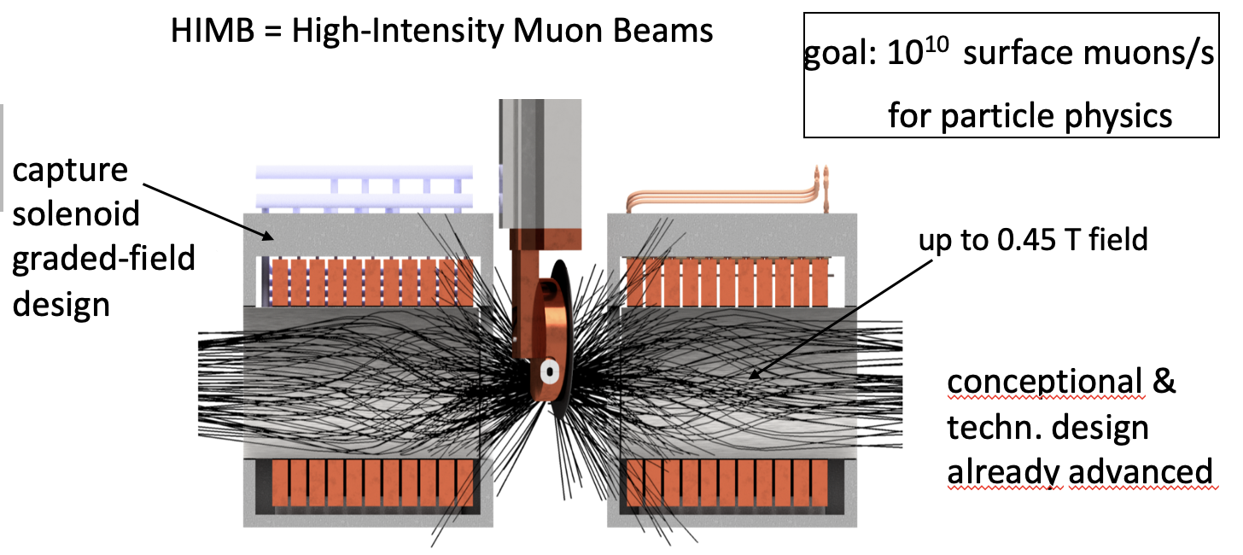
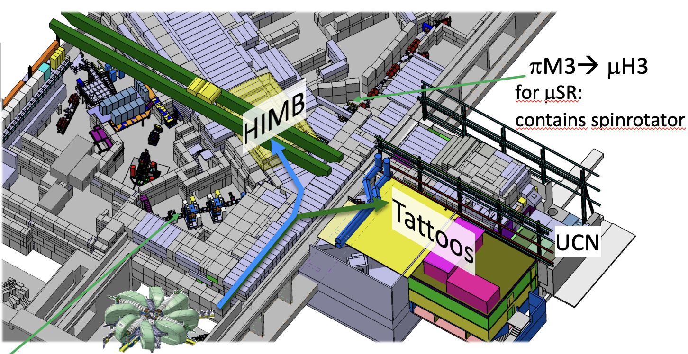
MOB2-2: IMPACT: A Substantial Upgrade to the HIPA Infrastructure at Paul Scherrer Institute (we are biased of course) D. Kiselev
A very nice summary on the new foreseen project IMPACT at PSI. It nicely demonstrates that even 50 year old facilities still represents an attractive playground for scientists.
With the HIMB project the muon rates at the Meson production target M are predicted to be a factor of 100. A factor, the accelerator beam power can not compete with.
The Tattoos project is an impressive isotope production facility that will receive beam currents of up to 0.1mA at full beam energy of 590 MeV. It will be used for research on cancer treatment and diagnostics at the same time with the isotope ¹⁶¹Tb. First beam studies proofed that it is possible to split of 0.08mA from the main Megawatt beam.

Slide 26
FFA’s

Slide 27
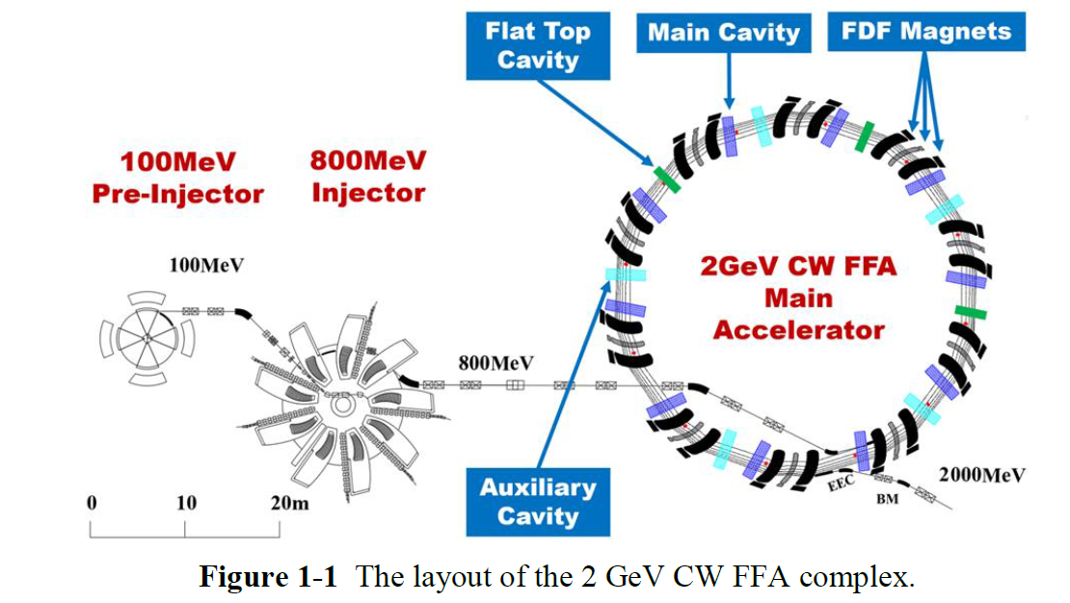
CIAE:
High Energy and High Current Isochronous Proton Accelerator

Slide 28
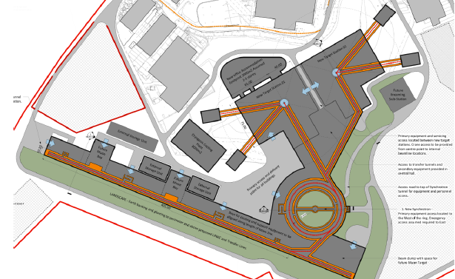

Slide 29
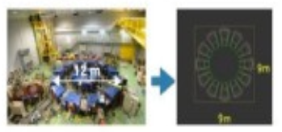
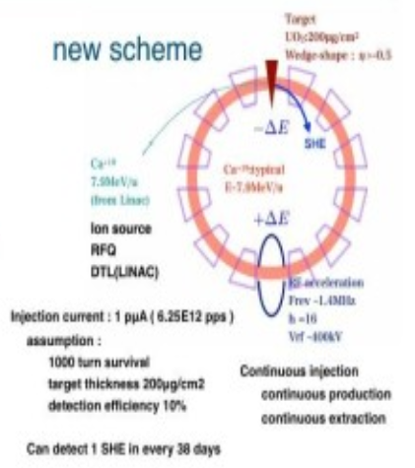

Slide 30
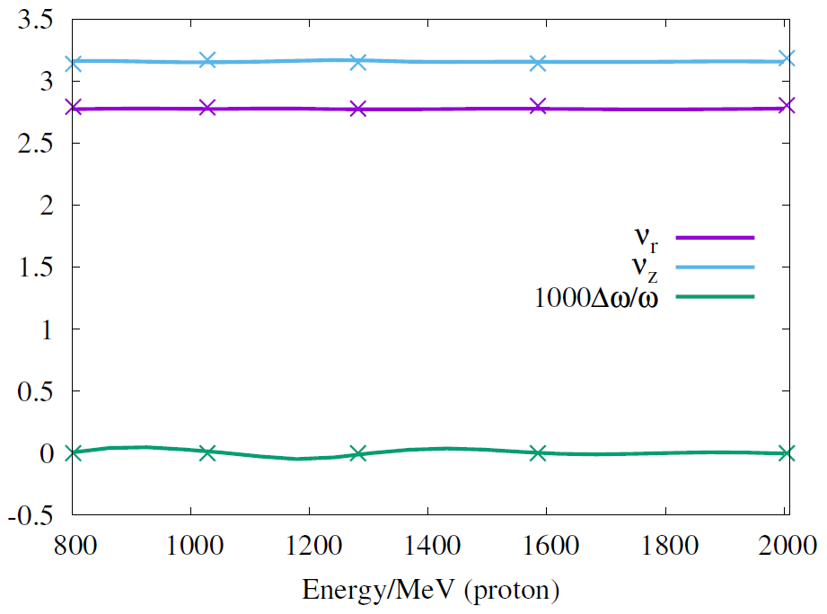
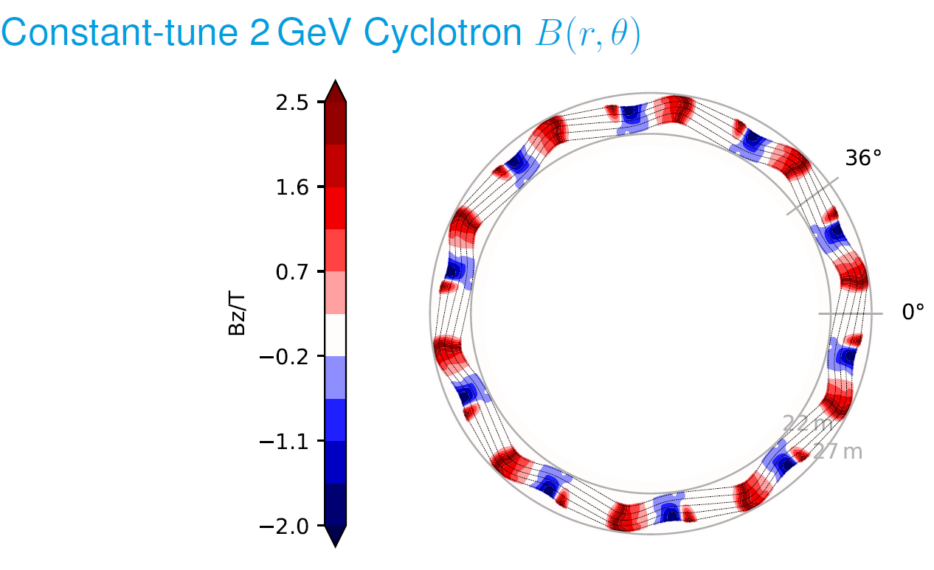
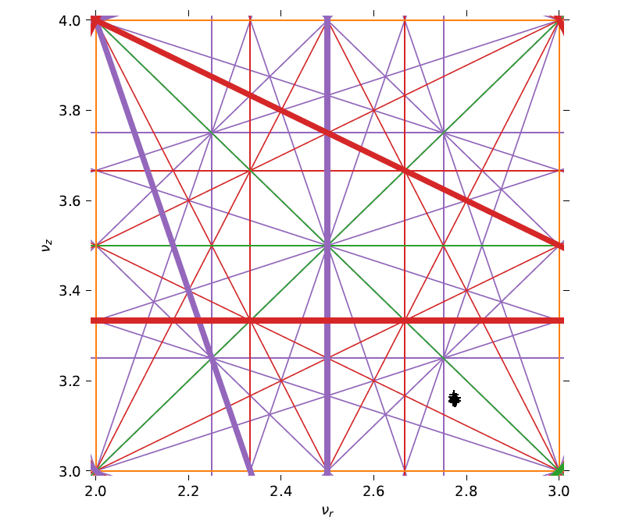
Constant Tune Cyclotrons
Richard Baartman

Slide 31
Beam Physics

Slide 32
Cyclotron stability region
On the Energy Limit of Compact Isochronous Cyclotrons
Wiel Kleeven
Vertical focusing limit (ν_{z}=0, dashed curve) and resonance limit (γ₁, solid curve) as function of flutter F (logaritmic scale) for a number of the sector spiral angles ξ
Focusing limit monotonically increases with F and ξ
2ν_{r}=N limit monotonically decreases with F and ξ
Stable area is area below both limits (green area in N=4, ξ=80° plot)
The intersections between focusing and resonance limits represents the energy limit for a given symmetry number N and a given spiral angle ξ
These are the solid dots in the plot.

Slide 33
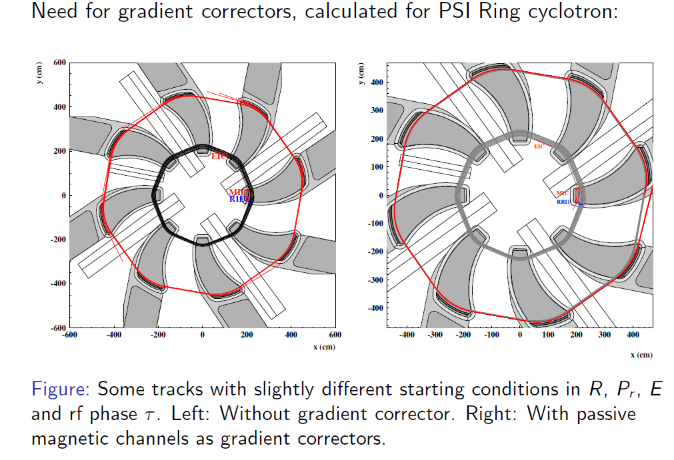
Cyclotron Beam Extraction by Acceleration

Slide 34
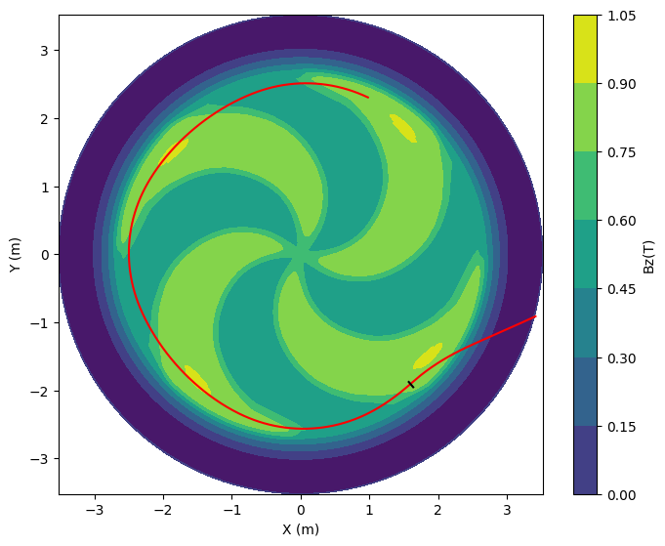
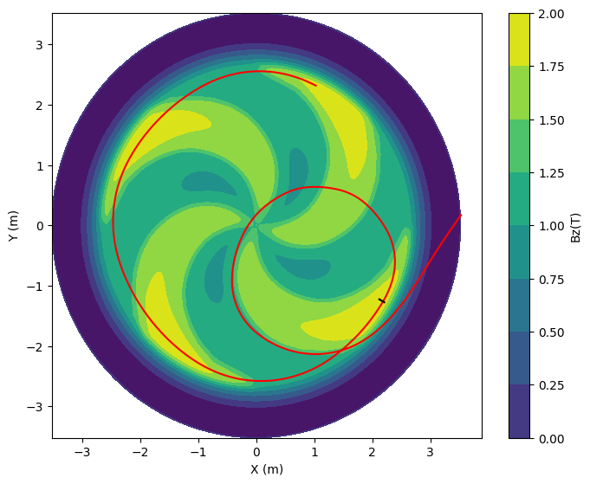
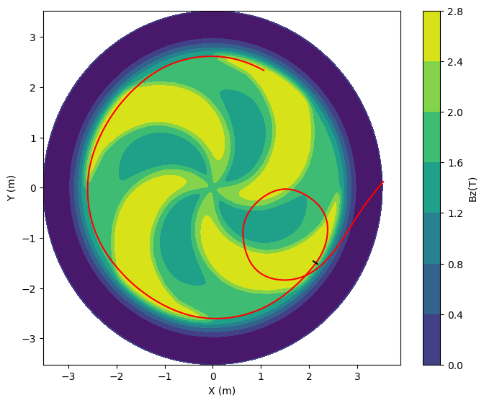
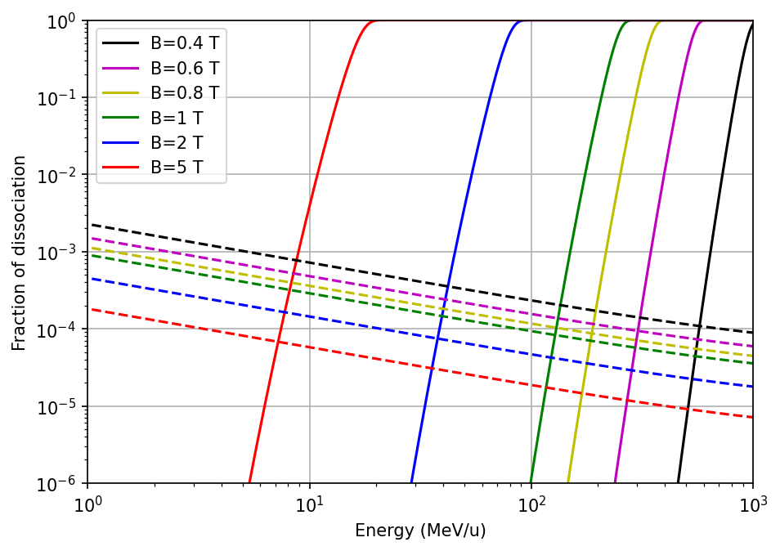
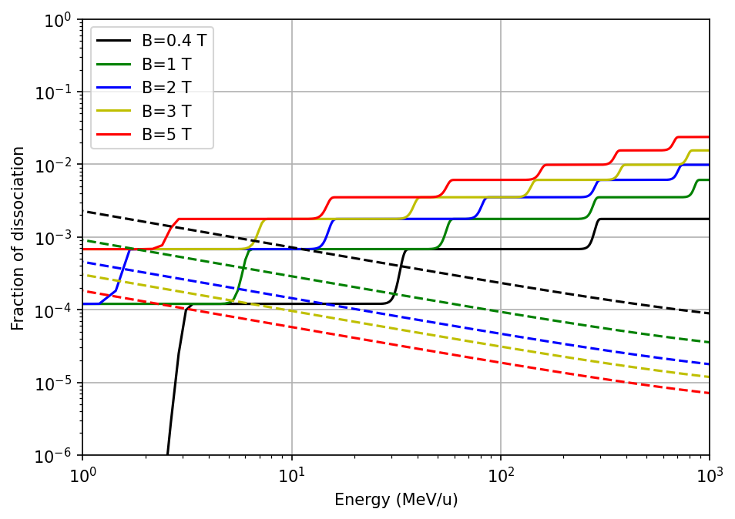
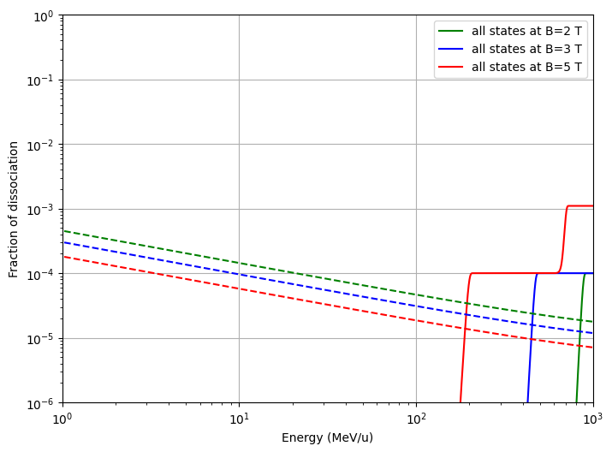
Stripping Extraction and Lorentz Dissociation
Hui Wen Koay
$$H^{−}$$
$$H_{2}^{+}$$
$$H_{3}^{+}$$

Slide 35
Self-consistent simulation of the plasma meniscus and the space charge dominated beam
G. D’Agostino and W. Kleeven

Slide 36
Subsystems

Slide 37
High performance ECR ion sources development at RIKEN and their impact to heavy ion accelerators. Takahide Nakagawa RIKEN

Slide 38
A novel multi-harmonic buncher
1st & 3rd harmonics
2nd harmonics
Fig. 7: Calculated electrostatic potential contour by using the code COMSOL
Fig. 6: A concept layout of the multi-harmonic buncher cavity *
Aperture radius | 1.27 cm
1st harmonic | 23.06 MHz
2nd harmonic | 46.12 MHz
3rd harmonic | 69.18 MHz
Re-buncher | 23.06 MHz
Table:3 New multi-buncher
Fig. 8: Calculated electric field along the axis of the buncher with an applied potential of 1 V.
Courtesy: * proposed by V. Zvyangintsev

Slide 39
Evaluation of PLC-Based EtherNet/IP Communication for Upgrade of Electromagnet Power Supply Control at RIBF
Akito Uchiyama RIKEN Nishina Center
great way to modernize control system parts

Slide 40
Industrial Cyclotrons

Slide 41
High Intensity Cyclotrons for Production of Medical Radioisotopes

Slide 43
A Compact 10 Tesla Superconducting 250 MeV Synchrocylotron for Cancer Therapy

Slide 44
THB1-1: Carbon cyclotron for particle therapy
Jerome Mandrillon
Very professional talk about the NHa C400 Cyclotron for Hadrontherapy. The design of the C400 of 2009 was not changed but all subsystems were reviewed. The machine has three ion source for H₂⁺, ⁴He²⁺, and ¹²C⁶⁺
The dual extraction system is used to extract H2+ via stripping and ⁴He²⁺, and ¹²C⁶⁺ with an electrostatic deflector.
The medical advantage of treating cancer with heavier ions to justify such a large cyclotron needs more studies.

Slide 45
Cyclotron Applications

Slide 46
The most “sexy” medical research: FLASH!

Slide 47
WEBO5: Upgrade of a Clinical Facility to Achieve a High Transmission and Gantry Angle-Independent Flash Tune
PSI succesfully upgraded their clinical facility to achieve a high transmission and gantry angle-independent FLASH tune on the Gantry 2
The 90° dipole was upgraded for energies up to MeV 250 MeV
The desired beam quality with small, symmetric and gantry angle independent beam size, as required for FLASH PBS, was achieved
The clinical Gantry 2, will provide a unique setting for researching FLASH-PT and demonstrating FLASH's adaptability in the clinic.

Slide 48
MOB1-1: Summary of Snowmass’21
D. Winklehner
A very informative summary of Snowmass’21 once again shows the importance of cyclotron technology in research, industry, and human health. The talk also pointed out the challenges the cyclotron community will be facing in the future. There is an ever increasing demand for higher beam power, reliability, and nowadays also for energy efficiency. This not least due to the current energy crisis but also for the idea to use cyclotrons for energy production. Therefore, cyclotrons play an important role in Nuclear and Particle Physics. The talk also pointed out new ideas e.g. for the injection and extraction of
particles from a cyclotron. A notorious
problem in cyclotrons. (Slide 18/Injection
and Slide 19/Extraction).

Slide 49
MOB2-4: : Experimental study on proton irradiation effect of gallium nitride high electron mobility transistor
Zheng Zhang
Very interesting results on GaN-based transistor. Radiation hardness of semiconductor based electronic devices has always be a notorious problem for the accelerator community. Radiation defects in conventional Silicon based devices do not allow the use of such devices in radiation environment. Slow, »analogue» device still need to be used. The wide-band gap Semiconductor GaN, with it’s superior electric properties, e.g. electron mobility and high breakdown voltage, has the potential to be used as the material of choice in the future for radiation hard electronic devices. It has been proven that the material can withstand high radiation doses as present close to accelerator and it exhibits a certain self-annealing effect. After 10 days at room temperature the electrical paramaters of the device were restored.
There should be more of such special contributions in CYC. Solid State Physics, especially semiconductors, had the greatest impact on society in the past century.

Slide 50
Real time determination of the range and Bragg peak of protons with a depth profile camera at HZB
Alina Dittwald Helmholtz-Zentrum Berlin für Materialien und Energie
inexpensive and rapid measurement of depth profiles

Slide 51
Measurement of Detector Response Functions for Fast Neutron Spectroscopy With Organic Scintillators Tanya Hutton Department of Physics, University of Cape Town
Making detectors independent from time signals

Slide 52
Li Huo from Beijing hospital reported that series translational nuclear medicine research on somatostatin receptor, which has demonstrated quite good diagnostic level and treatment effect.
T.Leadbeater from University of Cape Town
presented a BGO positron cameras (UCT and
iThemba LABS) with quite good performance.

Slide 53
WEBI2: Compact accelerator based epithermal neutron source and its application for cancer therapy
We received an excellent overview of the principle and the history of BNCT and the specific features, (dis-)advantages and optimization requirements of accelerator based BNCT systems.
The Kansai BNCT medical center founded at the Osaka Medical and Pharmaceutical University (OMPU) was opened in 2018. Their NeuCure® system is the world’s first BNCT system as a medical device that has now treated over 100 patients
Couch system for brain treatment
Chair system for head and neck treatment

Slide 54
WEBO6: Accelerator and detector developments for the production of theranostic radioisotopes with solid targets at the Bern medical cyclotron
The team of Saverio Braccini successfully develops, tests, qualifies, and improves existing and new methods for production of theragnostic radioisotopes, such as Ga-68, Sc-44 and others, with the Bern medical cyclotron.
Their work on precise measurements of cross-sections, production yields and radioisotope purity, for a wide range of nuclear reactions, stimulates further use of such isotopes for cancer diagnostics and treatment
⁶⁸Ga

Slide 55
IOC and LOC remind the authors to submit their full papers by Dec 31, 2022

Slide 56
Thank you for participation!

